Slide 1
LCGen Meeting
16 March 2016
Akiya Miyamoto

Slide 2
Beamstrahlung
New entries in https://svnweb.cern.ch/trac/lcgentools/trunk/ILC/gptools
lumidata/ ee-lumi data for ILC, 250, 350, 500, and 1000 GeV incl. initial beam energy spreads 20BXs ( text files, 40 ~ 165 MB )
mklumidata.py A python script to create lumi data from a GuineaPig file, randomizing the order and picking up beam energy only.
eγ and γγ lumi data
Got gp-1.4.4 (c version) and guinea-pig-1.2.1(c++ version) from https://clicsw.web.cern.ch/clicsw/ and confirmed that they could output eγ and γγ lumi data
( with a help by Moritz (DESY) )

Slide 3
BHWIDE
A version of BHWIDE-1.01, used by Andre Sailer, was obtained.
It was modified to
read lumi data for Whizard2
output a stdhep file
read job parameters from an input file, instead of hard coding
It was committed to lcgentools SVN,
https://svnweb.cern.ch/trac/lcgentools/browser/trunk/bhwide_lc

Slide 4
Whizard2 and tauola
A version, given to the Whizard author in January, committed to https://svnweb.cern.ch/trac/lcgentools/browser/trunk/Whizard2_tools/tauola_test
This does not include Whizard2.2.8 it self, but includes
tauola, interface to tauola and patches to Whizard2.2.8.
A bug fix for the longitudinal tau polarization in Higgs decay
Examples to run whizard2 for the test ( Sindarin files, etc)
A script to creates plots
Tranverse correlation in tau pair decay from Higgs.
A both tau+ and tau- have to be decayed, when PYTAUD is called for a single tau from Higgs.
FSR photon from tau should be created after tau decay by tauola using PHOTOS and
MSTJ(39)=15 to dis-allow Pythia to generate photon from tau, or
In PYTAUD, neglect FSR photons adding them to tau to recover tau momentum before FSR.

Slide 5
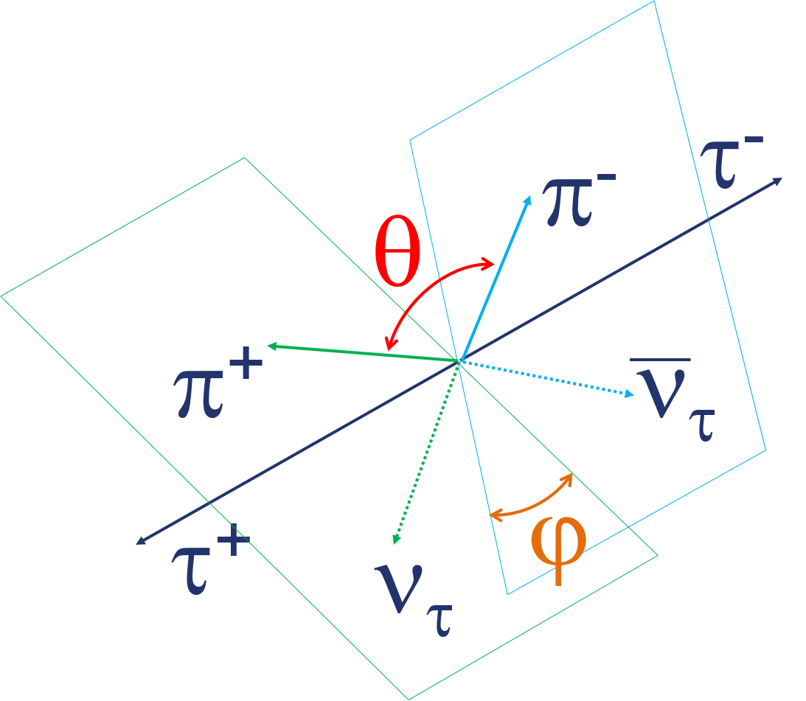
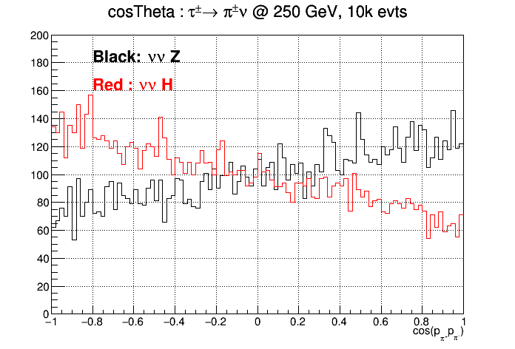
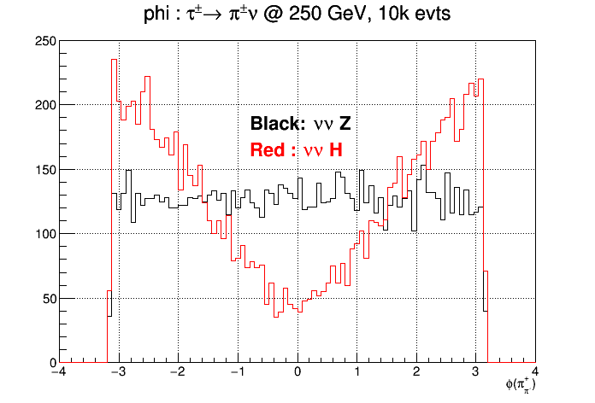
Red(ZH): e⁺e⁻ → ν_{μ}ν_{μ} Η, Η◊τ+τ− Black(ZZ): e⁺e⁻ → ν_{μ}ν_{μ} τ⁺τ⁻ ( m_{H}=2TeV)
τ ◊ πν decay only
(Latest version, not committed yet)
Cosθ between π⁺ and π⁻
Angle between π⁻ν_{τ} and π⁺ν_{τ} plains
ϕ
cosθ

Slide 6
Remaining issues
Complete tauola for Whizard2
Prepare eg and gg lumi data and
compare with the lumi-linker spectrum
compare with DBD samples
4f@500 GeV problem ( # of particles are different from DBD samples )
A possible solution: use a proper ( consistent ) pt cuts for jet
ISR γ ( γ has not Pt )
Which switch gives γ ? Do you know ?
CIRCE2 parameters for spectrum including initial beam energy spreads. Any info from Whizard2 team ?
Test shower matching

