Slide 1
Whizard2 test at KEK report of work in progress
Contents:
Comparison with DBD sample
  Recoil mass distribution of e⁺e⁻ → μ⁺μ⁻h at 250 GeV
  Visible mass distribution of e⁺e⁻ → μ⁺μ⁻ and τ⁺τ⁻ at 500 GeV
Multi-thread performance using LEP_HIggs.sin
Lists of to-do and wishes
Akiya Miyamoto
27 October 2015

Slide 2
Whizard2 validation
Whizard2 version: 2.2.7, compiled by GCC4.8.1
Installed at KEKCC, /group/ilc/soft/gcc481/whizard2
Compared with DBD samples

Slide 3
Beamstrahlung
Sample e+e- → μ μ h, Ecm=250 GeV, eL.eR
Compared with DBD sample,
E250-TDR_ws.Pe2e2h.Gwhizard-1_95.eL.pR.I106479.001.stdhep
Whizard2 sample.
  Beamstrahlung on.
    beam_events option: e+e- energy file was created from GunieaPig file
    created by Anthony for DBD study.
    Files are in http://www-jlc.kek.jp/~miyamoto/Whizard2/beamdata
    1 bunch of GunieaPig file was used for Whizard2 integration and event
    generation.
    Circe2 option did not include initial beam spread
  Other settings: Same as DBD
    model = SM_CKM
    Pythia hadronization parameter = same as DBD, except tau decay ( tauola was not used.)
    ISR only ( no Whizard2 FSR as Pythia does mu+mu- FSR ? )
    Output LCIO file

Slide 4
Whizard2 vs DBD : μμh
Job results
  http://www-jlc.kek.jp/~miyamoto/Whizard2/test/e2e2h/jobs
Total cross section
  DBD(Whizard1.95) = 17.143214 +- 0.0132 fb
  Whizard2(2.2.7) = 17.155336 +- 0.0426 fb
  ➔ result consistent

Slide 5
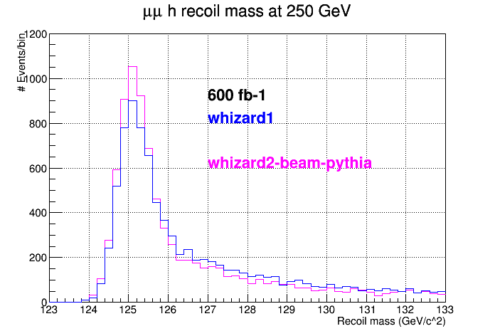
μμh – recoil mass
First μ+ and first μ-, regardless of their GeneratorStatus value, were used to
calculate the recoil mass. They are presumably m+m- before FSR(?)
The same analysis code was used for both samples (pyroot and pylcio)
In DBD sample, FSR effect was generated by Pythia. I suppose it is true
for Whizard2. This needs to be checked.

Slide 6
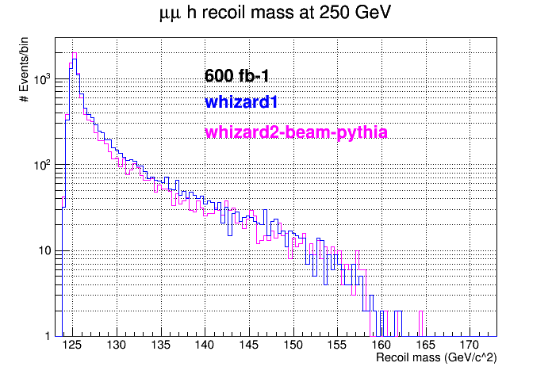
μμh – recoil mass

Slide 7
DBD vs Whizard2: e⁺e⁻ → l⁺l⁻ 500 GeV
Compared with DBD sample,
E500-TDR_ws.P2f_z_l.Gwhizard-1_95.eL.pR.I250106
Whizard2
  Process definition
  process P2f_z_l = e1, E1 => ( e2, E2 ) + (e3, E3 )
  Beams
  beams = e1, E1 => beam_events => isr
  $beam_events_file = “ ….lumiee500/lumiee500-run1.dat"
  beams_pol_density = @(-1), @(+1)
  ?ps_fsr_active = true
  ?hadronization_active = true
  $shower_method = "PYTHIA6“

Slide 8
e⁺e⁻ → l⁺l⁻ 500 GeV : Total Cross section
Total cross section
  DBD
  Whizard2
Total cross section is consistent
Whizard2 job result is at
http://www-jlc.kek.jp/~miyamoto/Whizard2/test/z_ll_500/

Slide 9
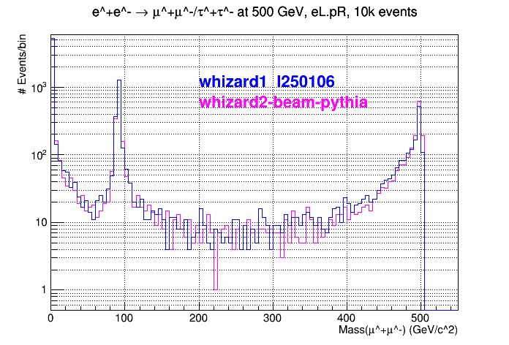
e⁺e⁻ → l⁺l⁻ 500 GeV: Mass(μ⁺μ⁻) distr.
Select first μ⁺ and first μ⁻ in the generated file and plots their invariant mass.
Similar to 250 GeV
μ⁺μ⁻ recoil mass
distribution,
whizard2 spectrum is
sharper than whizard1

Slide 10
Whizard2 Multi-threads
Quick test of whizard2 multi-threads
How to
  Whizard2 2.2.7, gcc4.8.1 on jlclogin3 (SL6.7, kernel 2.6.32-573.el6.x86_64 )
  Intel Xeon X5675@3.07GHz, max 24 threads, Memory 99Gbytes
  Whizard2 sindrin file: LEP_higgs.sin ( found in whizard2 example directory)
  Number of threads for calculation is set by OMP_NUM_THREADS environment parameter

Slide 11
Multi-threads result
Elapsed time reduced from 6.50 min to 4.46 min (~ 2/3), if 10 threads were used. But user time increases linearly with # of threads.
Overheads for multi-thread calculation is large.

Slide 12
To be tested
Pythia hadronization in Whizard2
Effects of setting alpha_s value. (alpha_s was set to 0 in DBD )
Spectrum for γγ and γe collisions
Do we prepare CIRCE2 parameter including initial beam spreads
or generate Gunipig files for γγ or γe lumi
lcio output file works fine. Should be fed to simulator ( Mokka ) and do comparison.
Try 6f processes. CPU time with multi-threads ? Results consistent ?
…. ( more will be filled. )

Slide 13
Whizard2 wish list
Tauola
PYGIVE parameter is very long and can not fit into one terminal line.
Can we use a continuation line or adding strings.
Functions for string-to-float and float-to-string conversion will be useful.
In addition to integral( process_name), are there function to get integral_error, error_in_fraction, accumulated_error, efficiency,
number of iteration before converge
… may be more

