Slide 1
LC Workshops
1

Slide 2
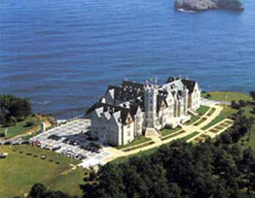
ECFA 2016
May 30 – Jun 5, 2016
Santander, Spain
‘Omnibus format’
Collection of individual meetings (ILD, SiD, CALICE, Physics, Accelerator…) with a central plenary day (a la ALCW 2015, KEK/Tokyo)
Industries session? ( Jun 1)

Slide 3
ECFA 2016: timeline
30-May afternoon | 31-May morning | 31 -May Afternoon | 1-June morning | 1-June Afternoon | 2-June All Day | 3-June Morning | 3-June Afternoon | 4-June Morning | 4-June Afternoon | 5-June Morning
 | CLIC Review of the Spanish Activity
Registration | ILC | ILC | ILC | ILC | PLENARIES | (ILC) | (ILC) | SID | ILD | ILD
 | Physics (Theor. Oriented) | Physics (Theor. Oriented) | Physics ( most experim. Oriented) | Physics ( most experim. Oriented) |  | (Physics) | ILD: MDI/Soft | ILD Optimization | ILD General Management (1 h). ILD subdetector status | ILD subdetector status
 | Vtx and Si Track | LCTPC/Si Track joint session | Vtx and Si Track | Vtx and Si Track |  | ILD,SID,CLICdp Joint session on physics benchmark analysis | ILD Optimization | ILD Optimization | ILD subdetector status | ILD Strategy Discussion. ILD Conclusion
E-JADE | FCAL | CALICE | CALICE | CALICE
 | LCTPC | (FCAL) | LCTPC | LCTPC
Reception | MDI | MDI | (MDI) | (MDI) |  |  | Dinner ILD, SID (evening)
 | Software | Software | Software | Software
 |  |  | CLICdp meeting (2 hours)
 |  |  |  | Industrial Session (afternoon, TBD)
Preliminary!

Slide 4
ECFA 2016: plenary
June 2 (Wed)
Morning
Afternoon
Preliminary!
4

Slide 5
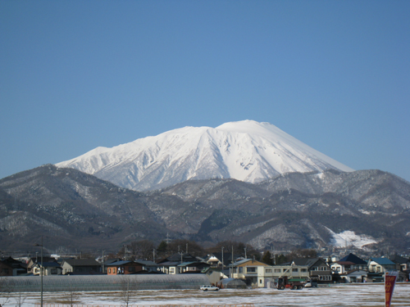
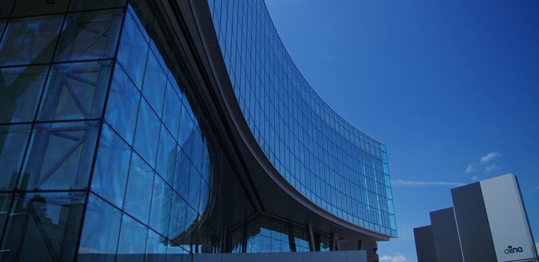
LCWS 2016
Dec 5(Mon) - 9(Fri), 2016
Morioka, Japan
Venues near the Morioka station
Strong supports by
Local governments
Local media
Near the Kitakami candidate site

