Slide 2
インフォーマルミーティング
テーマ： ILC SRF Cavity の電界性能
日時： 12/5 14:00 ~ 15:30
場所： ４号館 127号室
趣旨：
  TDR 検証部会において、SRF 電界性能余裕への懸念を指摘されている。 （CM 組み立て後の電界性能低下克服が国際的な大きな課題にもなっている）。
  TTC に、各国からのエキスパートが、来訪されている機会に意見交換を行った。

Slide 3
An Informal Meeting on
SRF CM Assembly and Gradient Performance
Akira Yamamoto
KEK, 5 December, 2014

Slide 4
SRF Cavity-CM Assembly and
Operational Gradient
Date and Time: December 5, 14:00 - 15:30,
Place: Room 127, Building 4.
Objective to;
discuss cryomodule assembly, and the reliable operational gradient,
overcoming the gradient degradation in long term operation
Agenda;
- Introductory talks:
"E-XFEL experience and future prospects"
by H. Weise and O. Napoly
“Status in Japan, and what is being asked"
by A. Yamamoto
- Comments and Discussions:
“Scope for future: 5 and 10 years, and further”
by all

Slide 5
E-XFEL Cavity Vertical vs. Module Test Statistics
Nick Walker (DESY)
for the XFEL cavity analysis team
Notes:
How to edit the title slide
Upper area: Title of your talk, max. 2 rows of the defined size (55 pt)
Lower area (subtitle): Conference/meeting/workshop, location, date,
your name and affiliation, max. 4 rows of the defined size (32 pt)
Change the partner logos or add others in the last row.

Slide 6
LCWS14, Belgrade
XFEL cavities
XFEL Vertical Test Results and extrapolation to ILC, N. Walker(DESY)

Slide 7

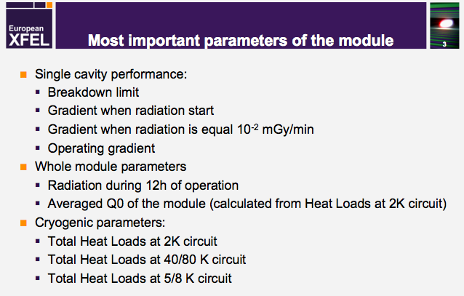
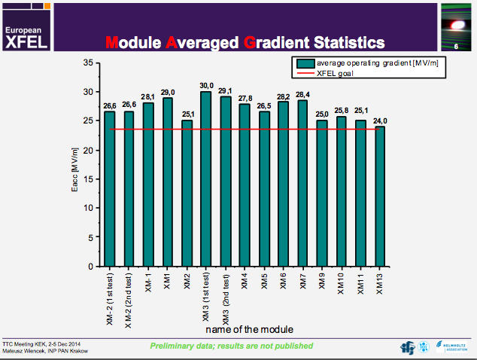
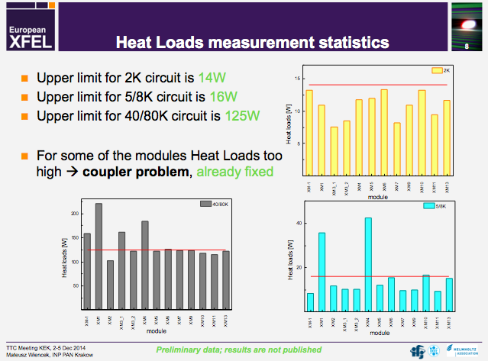

Slide 8
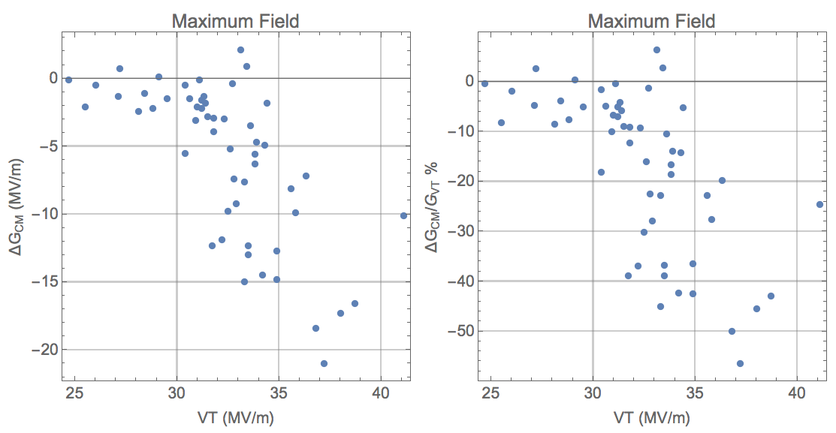
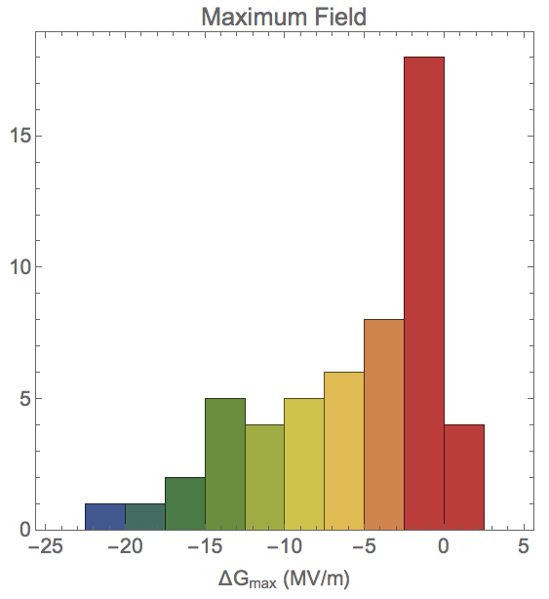
VT-CM comparison: MAX GRADIENT
not including power-limited CM results (quench limit)
Stats (mean ± rms):
54/88 cavities
Average reduction: -6±6 MV/m
  -17% ±16%
Below ~30 MV/m, no degradation
Above ~30 MV/m, correlated to VT performance

Slide 9

Summary stats
not including power-limited CM results
average ± rms
All results
Notes:
diff value for last row are wrt BD+FE CM test = banana.

Slide 10
MEXT’s Organization for Studying ILC based on SCJ’s Recommendation
140913
SCJ
Recommendation in 2013
MEXT
ILC Taskforce
formed in 2013
Academic Experts Committee
formed in 2014
Particle & Nuclear Phys.
Working Group
formed in 2014
TDR Validation
Working Group
formed in 2014

Slide 11
Status Report from TDR validation WGS
14 Nov. 2014
Title: Progress in the ILC TDR Evaluation Working-Group Report submitted - to the 2nd meeting of “MEXT, ILC Academic Expert Committee (ILC-AEC)” - from “MEXT, ILC TDR Evaluation Working Group (TDR-WG)” Date: 2014/11/14
Summary of the Study Subjects General scope of the ILC cost given in TDR Overall scope of the ILC total project cost including the cost missing in TDR Technical feasibility of the ILC to be built Human resource required for the ILC construction ILC Project Cost Estimate Discussions on Possible Risk Origins and Technical Issues

Slide 12
Status Report from TDR validation WGS
Discussions on Possible Risk Origins and Technical Issues - Assumptions during discussions in the TDR-WG meetings International cost sharing Preparation time of 4 years required for technical and human-resource preparation - Progress in discussions: cost risk origins and technical issues, Cost Risk Origin … Tehchnical and management issues Concerns identified in the current baseline design in TDR in-sufficient operational margin in SRF performance concerns of the gradient degradation seen in EXFEL, and it’s still existing gap to the ILC gradient requirement. It is concerned the ILC gradient specification not to be achieved, and it will cause the cost increase. Concerns to demonstrate and verify the performance achievement goal, to establish the production technology, and to realize the technical transfer to industry, during the preparation stage.

Slide 13
Questions
Shall we keep the ILC accelerator design gradient of 31.5 MV/m, also keeping VT-gradient of 35 MV/m?
If yes,
  How we may response to the expression of concern (by TDR-WG)?
If no,
  How we may re-optimize the design gradient?

Slide 14
Discussion and Advices
We shall consider the degradation sources,
  Particle already existing inside cavity and it would move,
  Particle coming from bellows and …
  Particle coming from vacuum venting
The EXFEL XM-3 has reached ~ 100 % performance without degradation, and we should be able to reach this technical level,
We shall watch the EXFEL progress in coming 1~2 years,

Slide 15
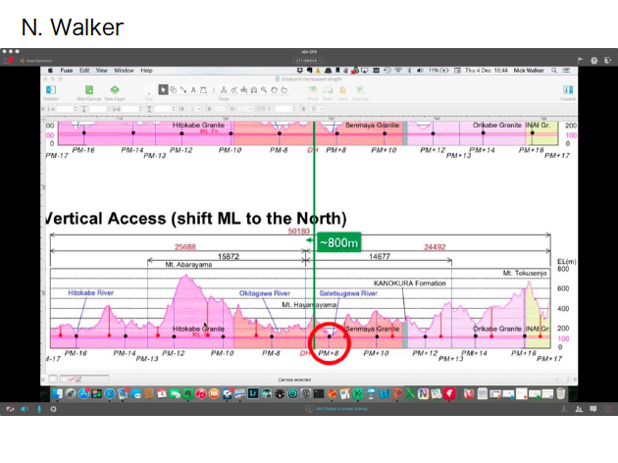

Slide 16
