Slide 1
2014.4.8-10 於東京大学
ADI-CFS Joint Meeting 報告
榎本收志／宮原正信

Slide 2
(ADI)
Conventional Facility & Siting (CFS)

Slide 3
（KEK-LC定例 山本室長報告スライドより）

Slide 4
（KEK-LC定例 山本室長報告スライドより）

Slide 5
Session 1, April 8, 9.00; Meeting Kick-off
Goals – Mike Harrison,
CFS Status – Atsushi Enomoto
ADI Status – Nick Walker

Slide 6
Session 2, 11.00; CFS pre-project activities
Pre-project scope of work (long & medium term plan), Timeline, Required resources, Profile – Masanobu Miyahara
Need to understand the elements of the work scope and their individual schedules.
Can any items be delayed? Can the 5-year estimate be shortened?
Before the anticipated GO-NOGO decision in 2016, how much money is needed and when.
宮原さんがご報告されます。

Slide 7
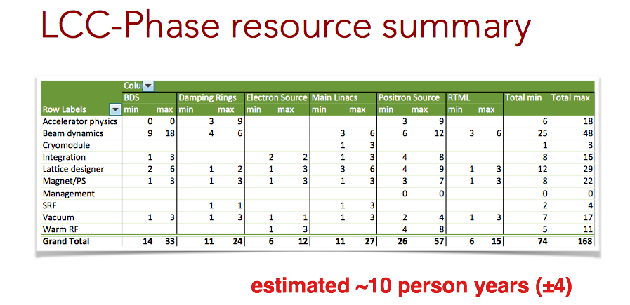
Session 3, 14.00; ADI Support of CFS
Issues pertaining to CFS for each system – Nick Walker
There remains” loose ends” in several systems in regard to CFS requirements. Ascertaining these issues will help determine the systems groups work scope and remaining CFS uncertainty.
１年以内に、ローカルには±100m程度、全長で±300m程度に。

Slide 8
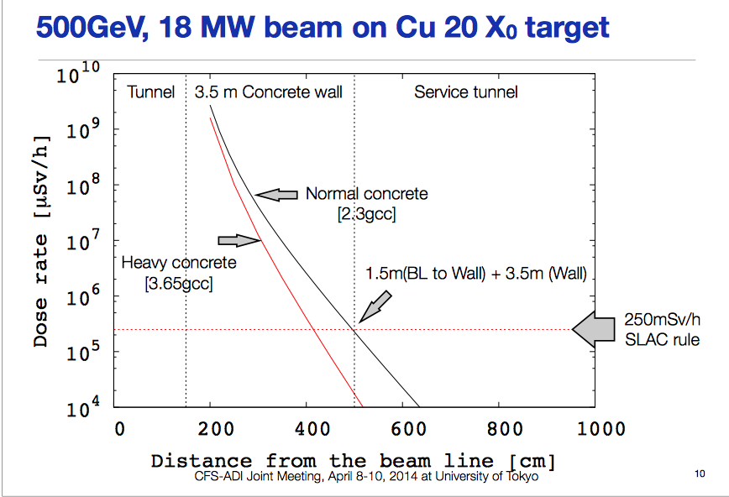
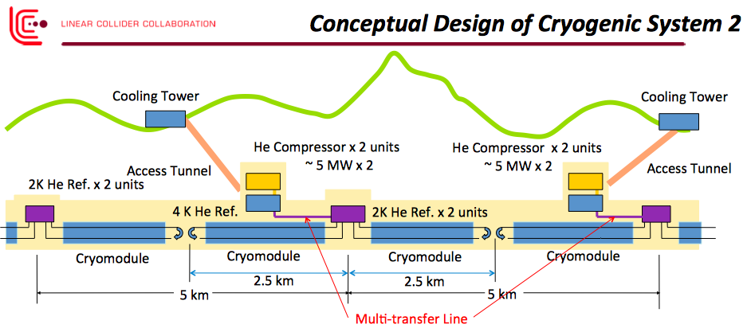
Session 4, 16.00; Technology Support & CFS Impact
Radiation shielding and related issues – Toshiya Sanami
Cryogenic Cavern in Mountainous Region – Hirotaka Nakai
Local PDS and Installation Model – Shigeki Fukuda
Tunnel layout issues, accessibility, construction, operation, safety – Tomoyuki Sanuki
tunnel and access-tunnel X-sections
Is the generic tunnel layout including accessibility and safety now stable ?

Slide 9
Session 5, April 9, 9.00; MD(1)
Detector Requirements both SiD and ILD minimum needs – Karsten Buesser
Do we understand the Detector design well enough to determine the CFS Detector Hall requirements ? Is there risk that significant Detector changes could still remain ? Can we identify the major technical cost drivers arising from the Detectors in terms of the CFS, including comparisons of effects with vertical shaft and horizontal access?

Slide 10
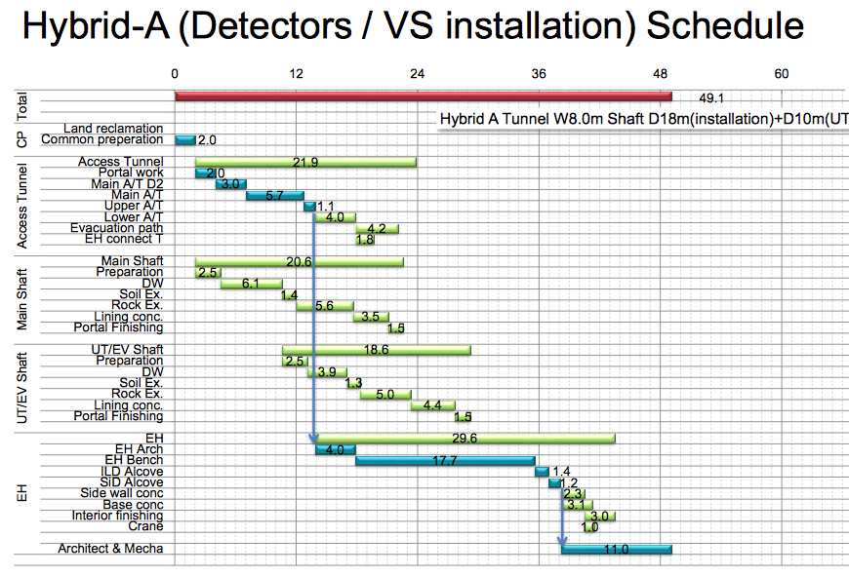
Session 6, 11.00; MDI (2)
Interaction Region Solutions including Hybrid, Detector Hall impact on Overall Construction schedule – Yoshinobu Nishimoto
ARUP Study Status – John Osborne
Can we conclude the horizontal – vertical access debate ( at least conceptually) ?

Slide 11
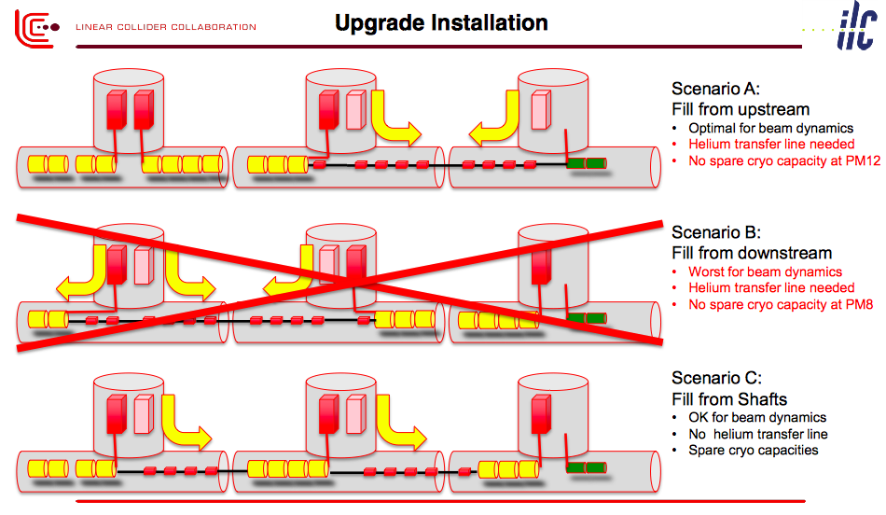
Session 7, 14.00; Energy Phasing
General Scheme, parameters, CFS impact – Benno List
What are these features (transfer lines, cryogenics, installation, storage, test facilities ……) ?

Slide 12
Session 8, 16.00; Site Infrastructure
Power Usage, Site requirements (water etc..) Vic Kuchler & Atsuchi Enomoto
Energy Issues – Marc Ross (Alt., Ewan Paterson)
Further information will be required soon on the outside-the-TDR site needs (power, water, roads etc….). How well do we know these requirements ? Are there any significant energy efficiency opportunities ? Power reduction on demand ?
山本室長ご報告

Slide 13
Session 9, April 10, 9.00;
CFS near term & Required ADI input
6-12 month activities, required ADI information - Masanobu Miyahara
The CFS pre-project work scope will need to have aspects of the accelerator design to be finalised at certain points in the timeline. We need to define when this ADI input is needed and what aspects needed to be defined. What near-term aspects of the CFS work will need to be addressed and what resources will be available.
宮原さんご報告

Slide 14
Accelerator Length within one year
Scenario C / Scenario A
Baseline / Hybrid Case A
Safety (Radiation shielding, Liq. He Storage, ..), Installation, ..

Slide 15
CFS Homework
Develop a final comparison of the two alternatives currently being considered for access into the detector hall.
5 year pre-construction effort. This breakdown should focus on the first couple of years. This analysis should include what work we are planning for the first year or two. This information will be included into a formal budget request to be generated by the Linear Collider Board at their meeting in July, 2014 and then forwarded to MEXT for consideration.
The LCC should work with the Radiation Safety Group to determine a Maximum Credible Accident for ILC Machine Operation. The CFS group should evaluate the cost and schedule impact for the tunnel shielding wall thickness.
Each region should develop a list of “functional requirements” that describe all of the functions required for both the ILC Project and the ILC Laboratory based on the existing experience at the KEK, Fermilab and CERN laboratories respectively. These can then be compared to develop a comprehensive list for discussion of the ILC Project/Laboratory Requirement
The Asian Team needs to examine the energy phasing alternatives presented at the CFS ADI meeting for the impact on the current schedule, focusing on the extent of support utilities that would be need (or not needed) for an phased machine installation approach

