Slide 1
超伝導RF試験施設KEK-STFの開発状況
H. Hayano 07122010

Slide 2
目次
1．‘S1-Global’ cryomodule 試験
2．STF phase-2の計画
3．空洞製造設備
4. その他のインフラ整備

Slide 3
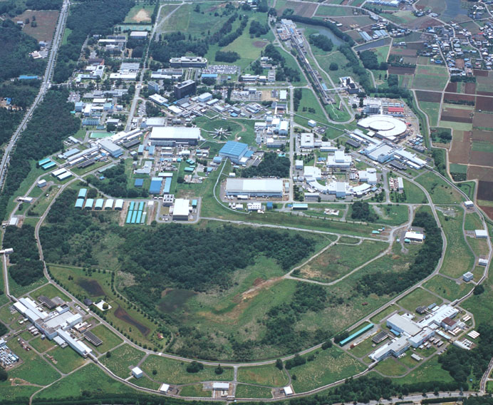
ILC試験設備の場所
空洞製造設備
ATF/ATF2
STF
KEK つくばキャンパス（北側上空より）

Slide 4
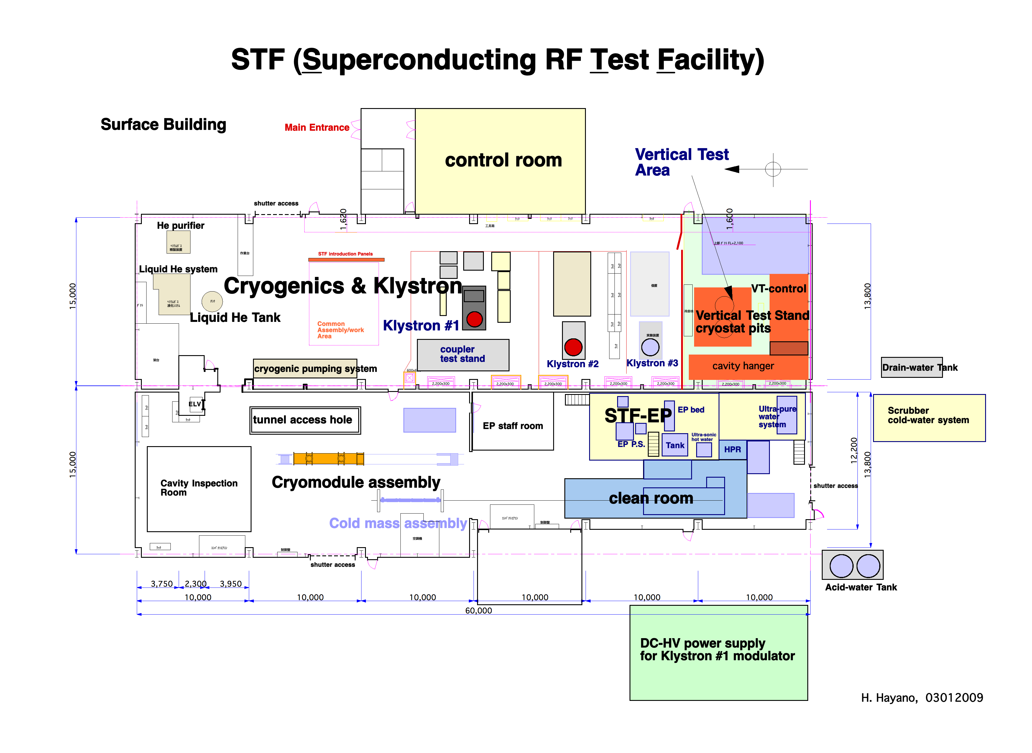
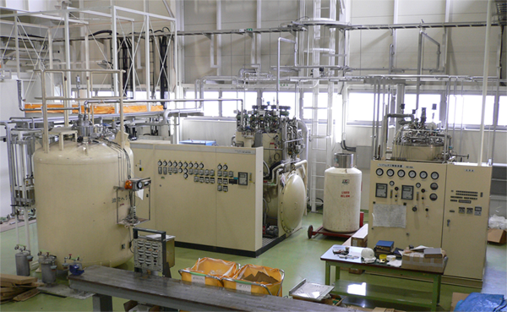
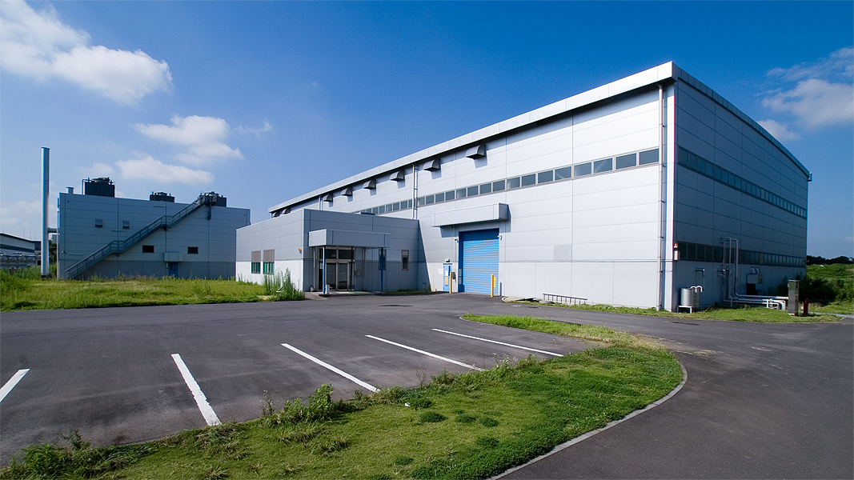
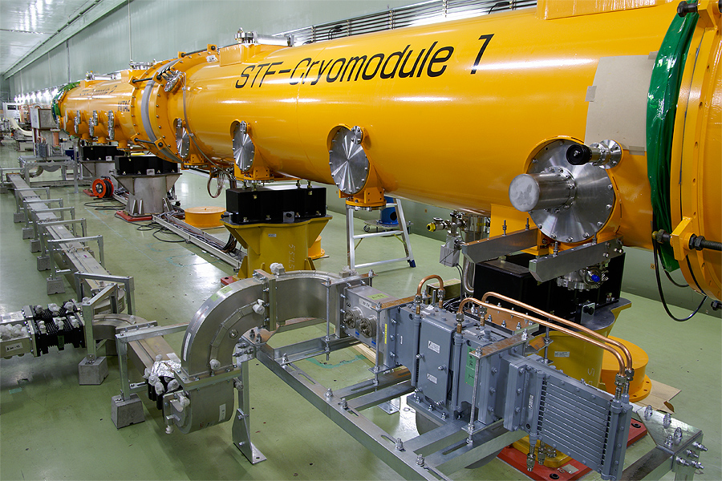
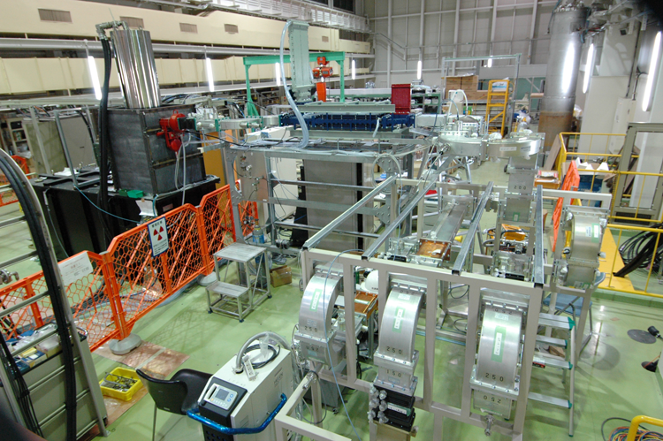
Cryogenic liquefier
STF building
EP No.2
tunnel underground
RF Power Source

Slide 5
1. ‘S1 Global’ cryomodule 試験
KEK-STFがホストし、
国際協力で平均31.5MV/m運転の加速モジュールを実証、
４つのタイプのチューナーを比較試験、
２つのタイプの入力カップラーを比較試験、
DRFSドライブシステムの始めての実証試験

Slide 6
S1-Global cryomodule test
Demonstration of average gradient 31.5MV/m cryomodule by international collaboration
Realization of ILC Plug-compatibility concept
Module-C : INFN Cryostat + 2 FNAL cavities + 2 DESY cavities
Module-A : STF short cryostat + 4 KEK TESLA-style cavities
power distribution : 2 SLAC VTO + STF waveguides
1 AES004 27MV/m(VT) 25?MV/m(HT)
2 ACC011 33MV/m
3 Z-108 31.3MV/m
4 Z-109 30.7MV/m
5 MHI-05 27.1MV/m
6 MHI-06 27.7MV/m
7 MHI-07 33.6MV/m
8 MHI-09 27.0MV/m
Assembly: Jan 2010 - May 2010
Operation: June 2010 – December 2010
FNAL
DESY
KEK-new
FNAL
DESY
KEK type1
KEK type2
Connection to 2K Cold Box
End Cap

Slide 8
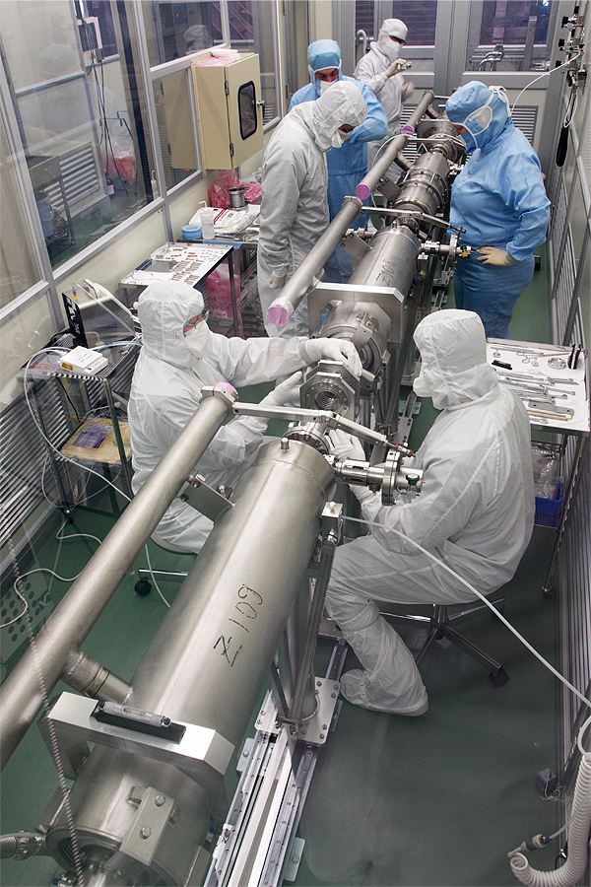
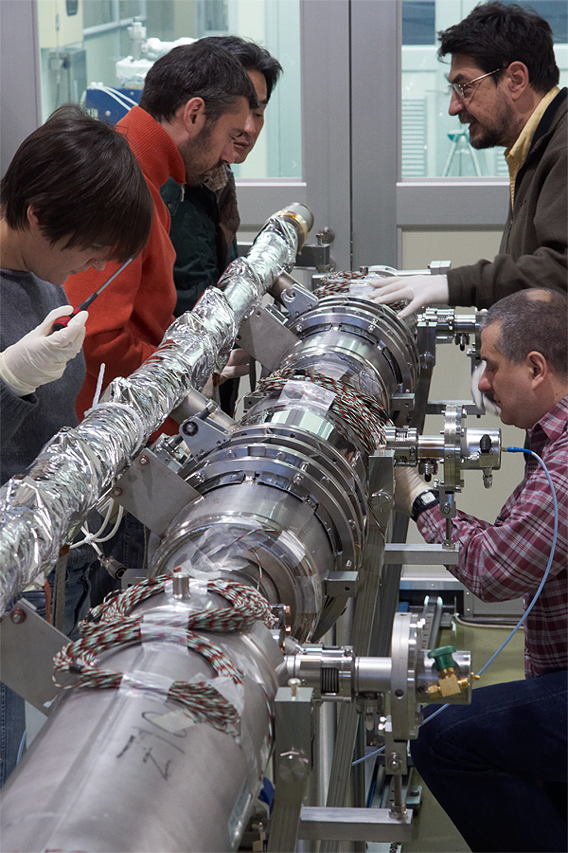
Cavities assembly for Cryomodule C
Two cavities from FNAL, two cavities from DESY,
FNAL, DESY team assembled 4 cavities, INFN, FNAL team installed blade tuners and Saclay tuners.
Tug Arkan
Brian Smith
Marco Battistoni
Manuela Schmoekel
Patrick Schilling
Carlo Pagani
Angelo Bosoti
Rocco Pararella
Serena Barbanotti
FNAL, DESY team
INFN, FNAL team
cavity connection in clean room
for module installation
Tuner installation for FNAL, DESY cavities
at outside of clean room

Slide 9
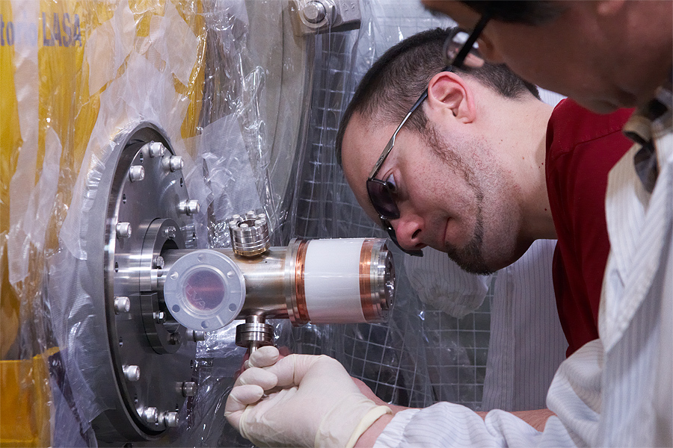
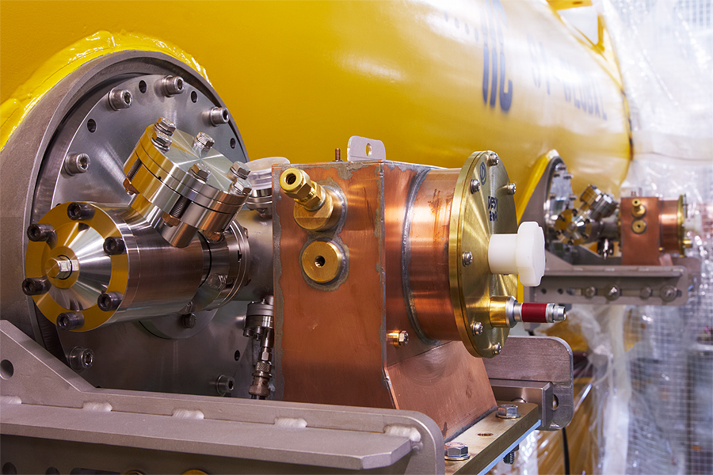
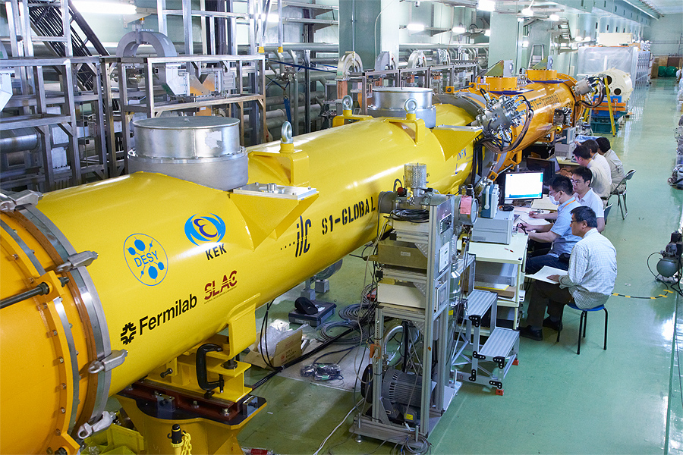
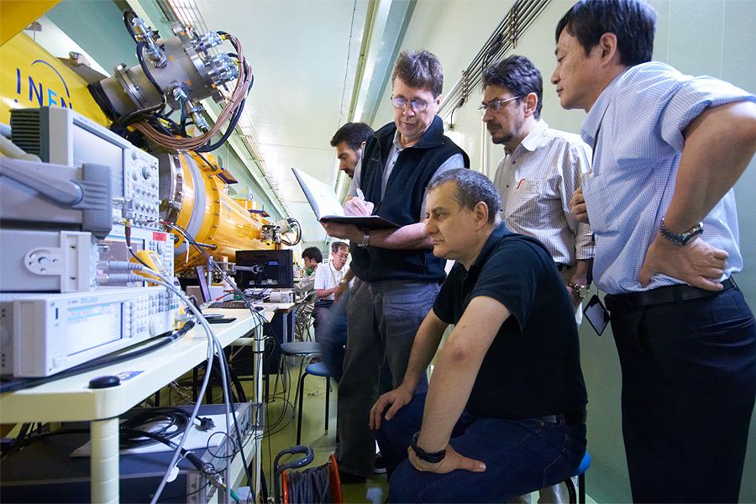
Finish Cryomodule assembly, start cryomodule cool-down
Denis Kostin from DESY attached warm couplers
Waveguides were installed into warm couplers
Cavity low-power measurement
collaboration measurement with INFN/FNAL researcher

Slide 10
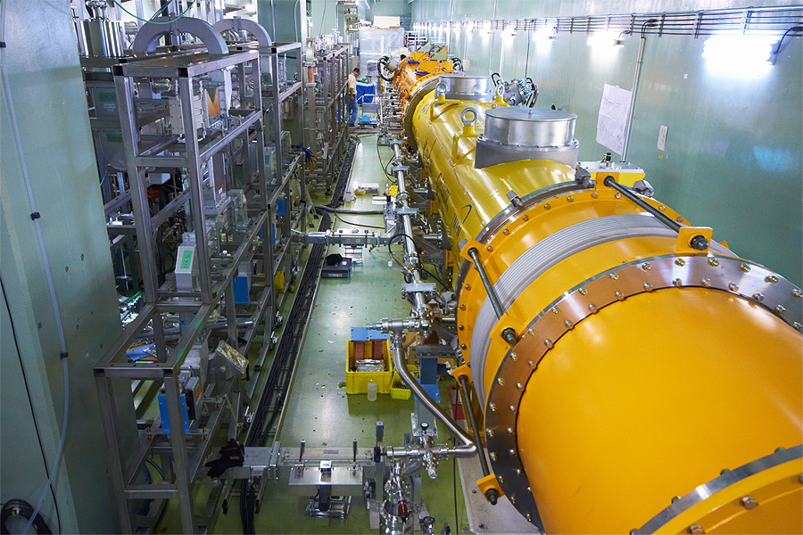
WG Layout for S1 Global Cryomodule
module-A
(KEK cavities)
module-C
(DESY,FNAL cavities & couplers)
SLAC VTO
導波管組立が進行中

Slide 11
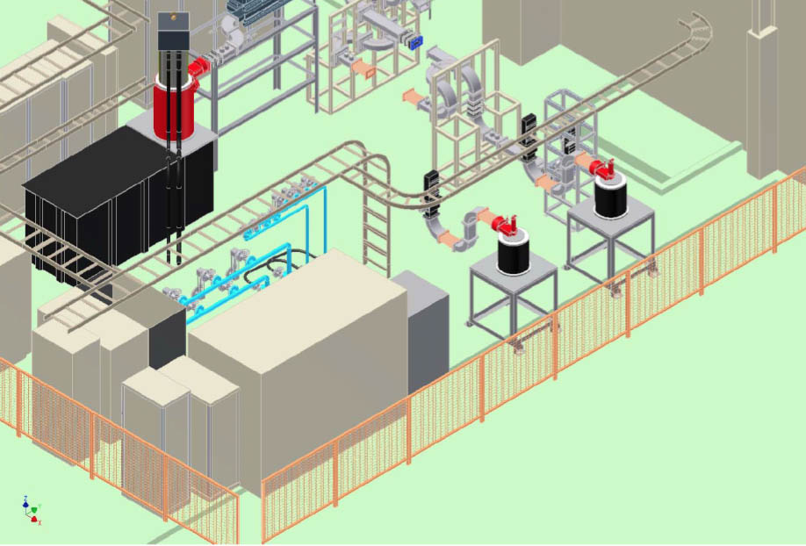
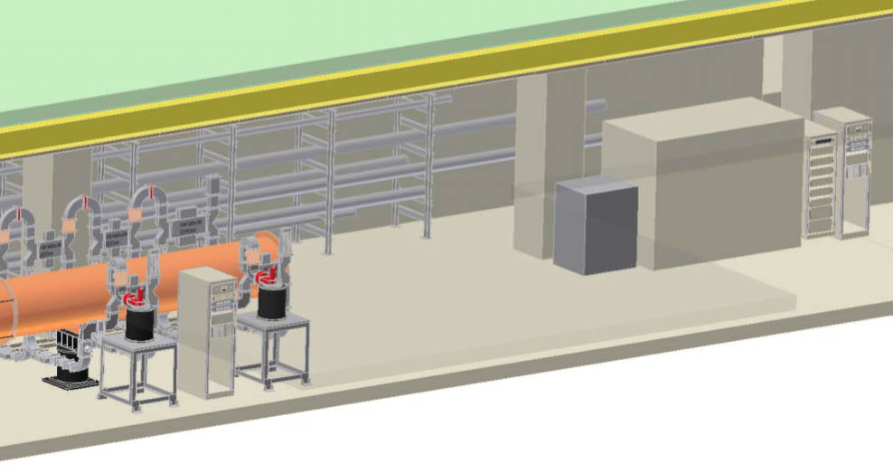
DRFS Demonstration at S1 Global Cryomodule test
地上部クライストロンギャラリーでの
クライストロン試験運転（１０−１１月）
高圧電源は地上部に置く事になった。
トンネル内は変調アノード電源、ソレノイド電源、LLRFなど。
地下トンネルでの
クライオモジュール試験運転（１１−１２月）

Slide 12
S1G overall schedule
2010
2011
6
7
8
9
10
11
12
1
cryomodule connection
Cryogenics
regular maintenance
cool down
S1G experiment term1
setting of power
distribution
cavities:
low-power check
(6weeks)
warm-up
coupler RF
process
coupler&
cavity
process
cool
down
heat load meas.
(1week)
Module-A
coupler RF process
（one-by-one）
S1G experiment term2
Module-A
coupler+
cavity process
（one-by-one）
cavity setup
(4weeks)
heat load meas.
(2weeks)
Module-C
coupler RF process
(one-by-one)
vector-sum
(2weeks)
warm-up
Module-C
coupler + cavity process
(one-by-one)
DRFS test.
(3weeks)
cryomodule
disassemble
6 weeks
4 weeks
3 weeks
11 weeks S1G main experiment
Parallel operation of RF power
station #1 and #2
Low power check
RF process
S1G Main experiment
IPAC2010
May23-28, Kyoto
ICHEP2010
July21-28,Paris
LINAC2010
Sep12-17, Tsukuba
Only LN2 will be Continuous full day operation.
LHe operation will be daytime only.
Monday : 2K cool-down,
Tuesday – Friday : 12:00 – 19:00
7hours for S1G experiment at 2K.
Domestic Accelerator Meeting
Aug 2010

Slide 13
2. STF phase-2の計画
Phase-2: ILC加速ユニットの建設担当能力実証と性能実証。
ILC型クライオモジュールを製作、運転。
ILC型ビームを空洞に通し、ビーム負荷空洞を高精度制御、
HOMダンピングを確認。
SC-QUADの製作、運転。
ML-BPMの組込み、運転。
など。

Slide 14
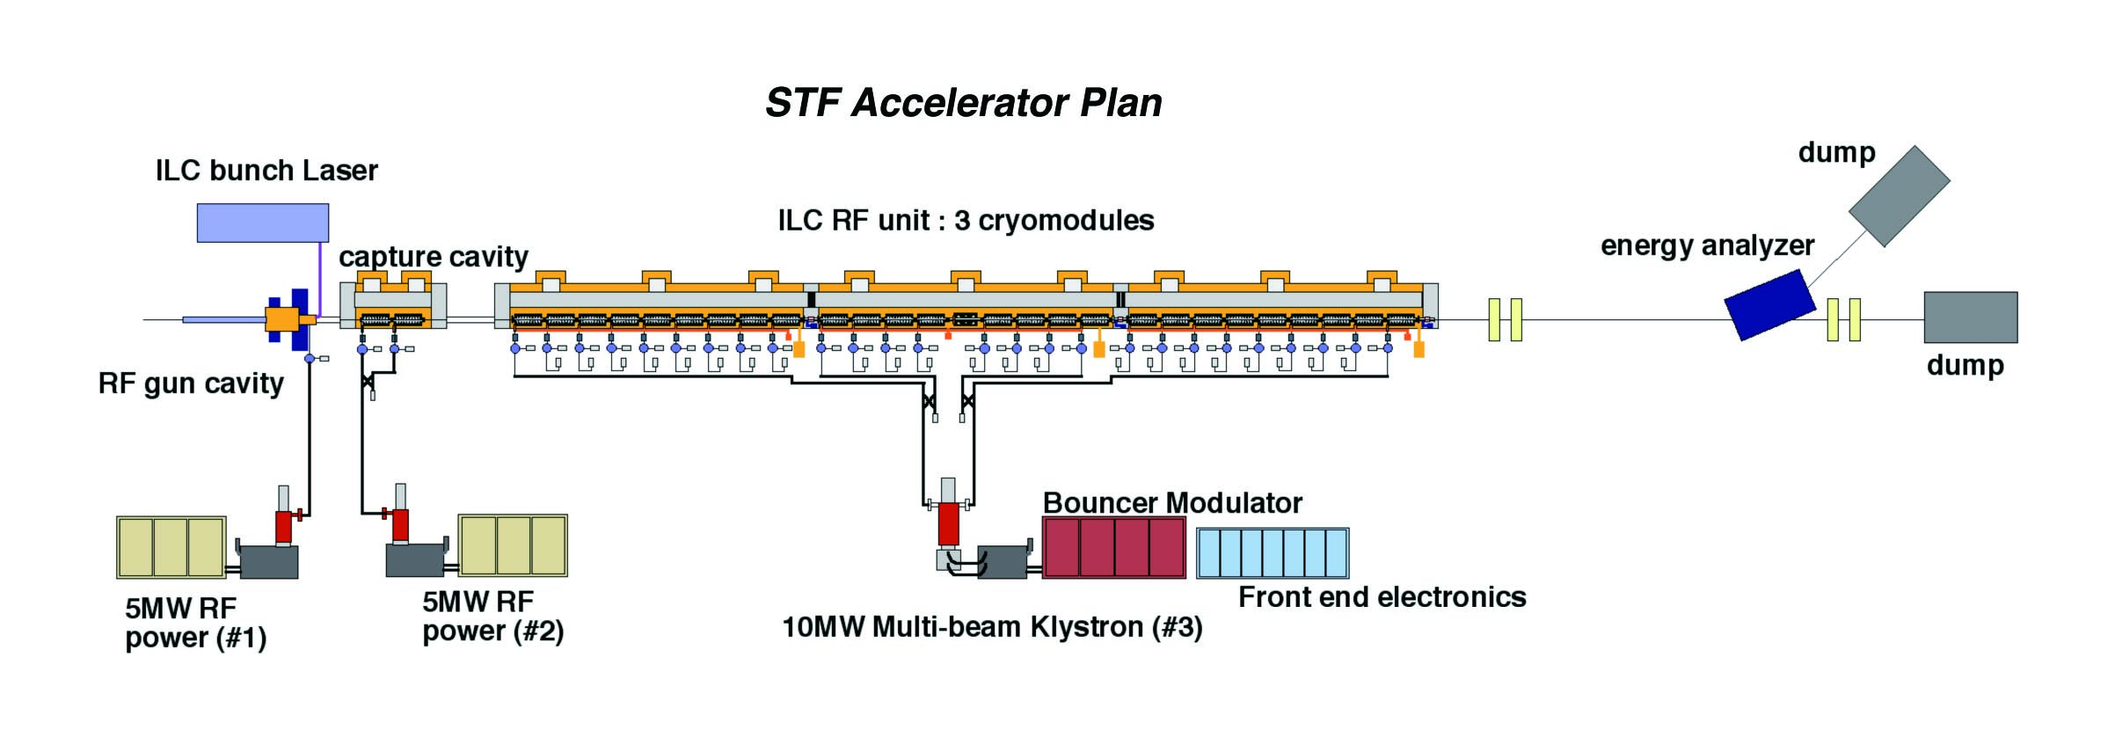
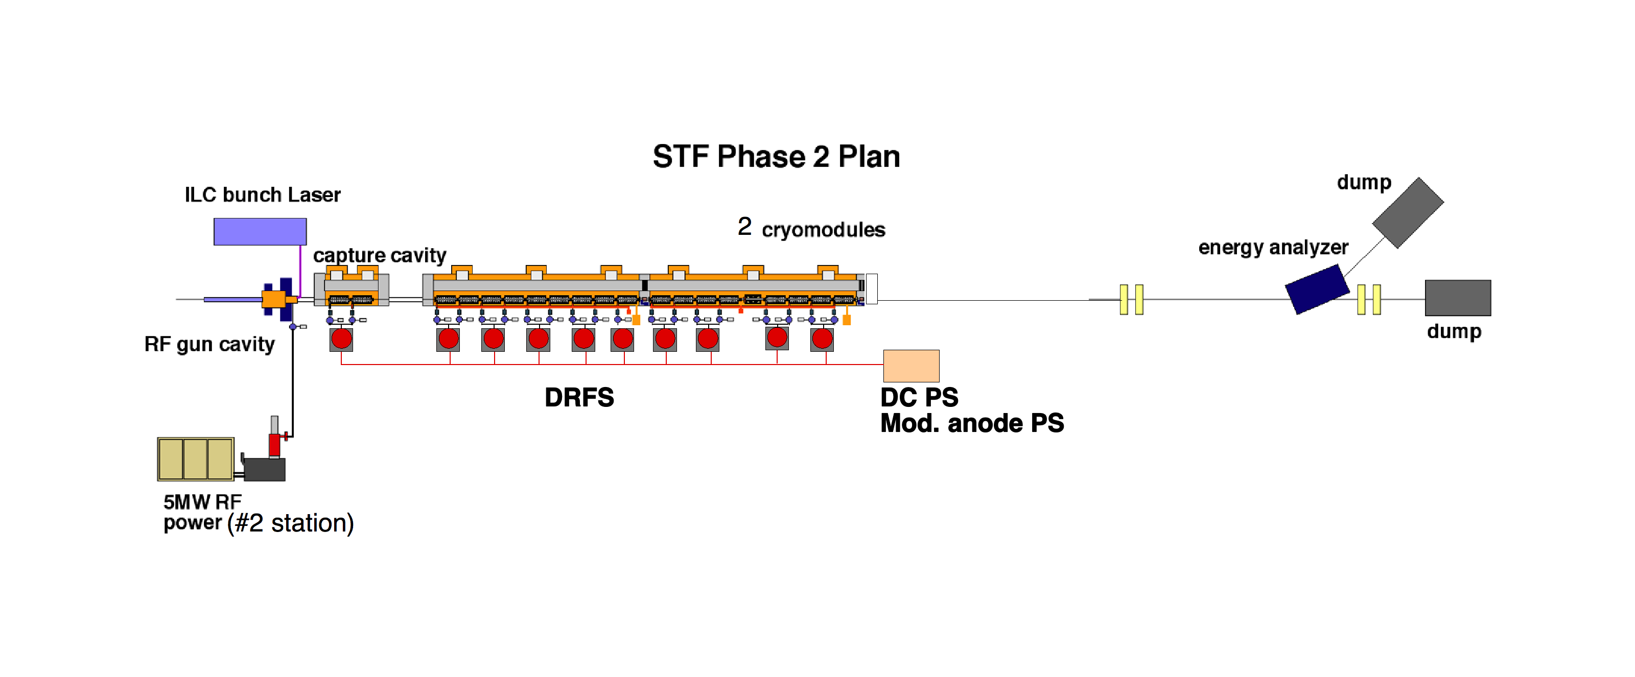
STF phase2.0 accelerator
Cavities : 2+26
Klystrons : 5MW + 5MW + 10MW
Beam : 850MeV, 1ms train、9mA、 5Hz
RDR-RFユニット実証 ー＞DRFS-RFユニット実証へ変更

Slide 15
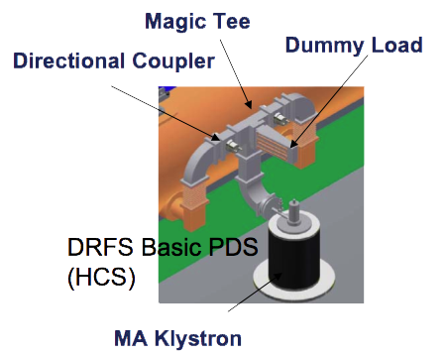
DRFS proposal
For single tunnel configuration,
1 klystron(750kW) is connected to two cavities,
13 klystrons are powered by 1 DC-HV
and 1 modulation anode PS.

Slide 16
STF phase 2 Accelerator Layout
空洞: Capture Module(2台）+
CM1(8台）
+CM2(8台）
ビーム: , 9mA, 5Hz
RF-gun出口:4.7MeV
Capture Module出口:21MeV,
CM1出口：273MeV
CM2出口：525MeV
RF-gun運転電圧： 41.4MV/m (3.5MW入力パワー）
空洞運転電圧: Capture Module(2台）:15.2MV/m
CM1(8台）:31.5MV/m
CM2(8台）:31.5MV/m

Slide 17
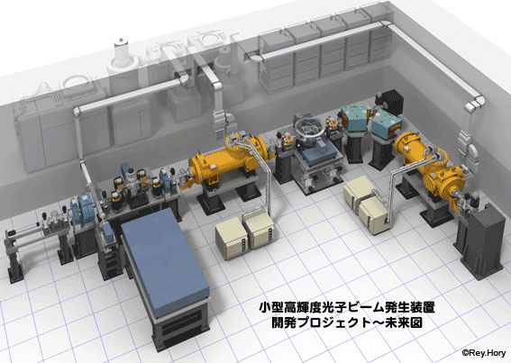
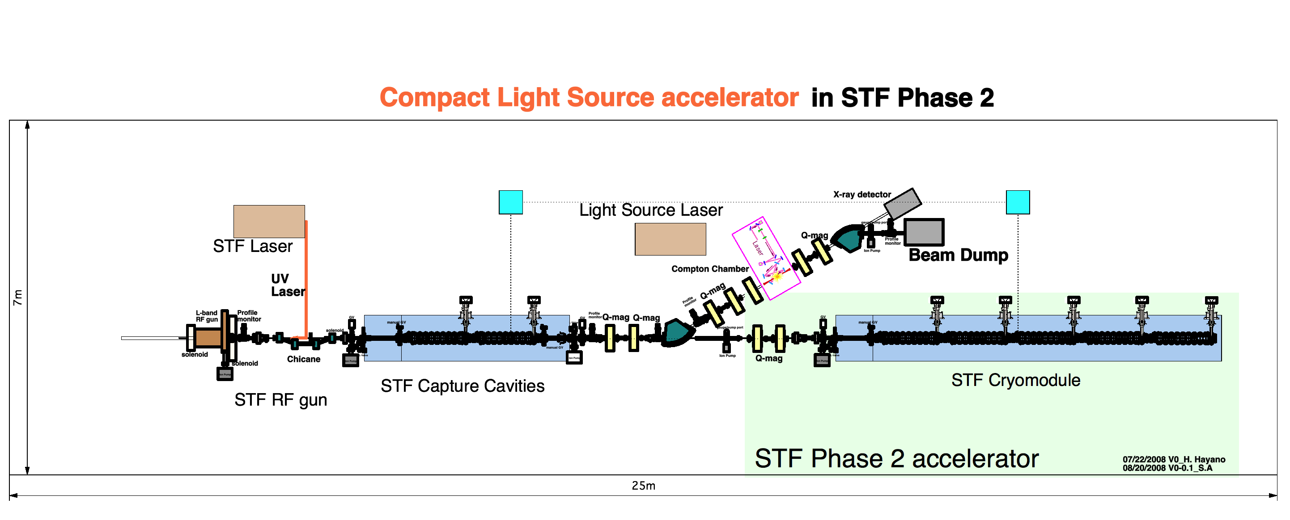
Compact X-ray source experiment using STF2 injector
STF phase-2加速器の建設の途上て、「量子ビーム」
課題研究を実証する。
Use of STF RF gun generated
multi-bunch beam,
Collide to laser in a laser
storage cavity,
Generate Compton
scattered X-ray
beam
Laser
Experiment :Oct. 2011 – July 2012
generated X-ray
Laser accumulation
electron beams
superconducting cavities
Photo-cathode RF-gun

Slide 18
STF phase2.0 accelerator :Capture Module
キャプチャーモジュール
9セル空洞２台：15.2MV/m 運転

Slide 19
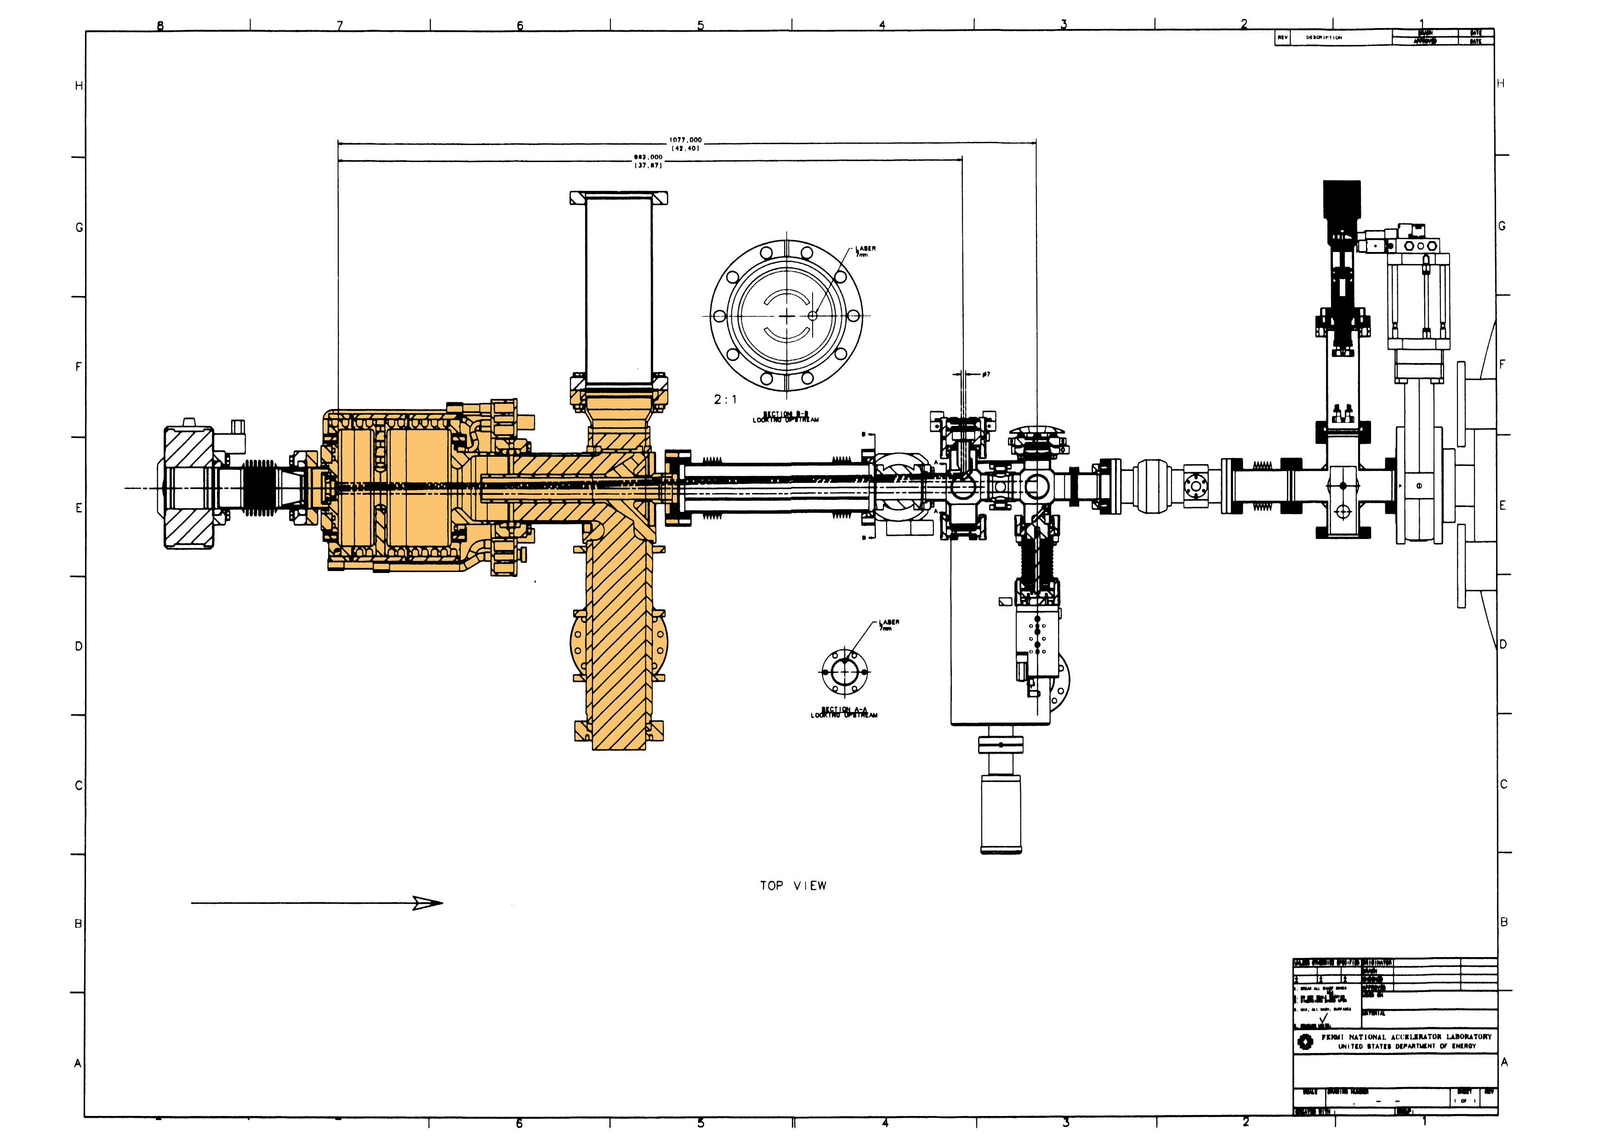
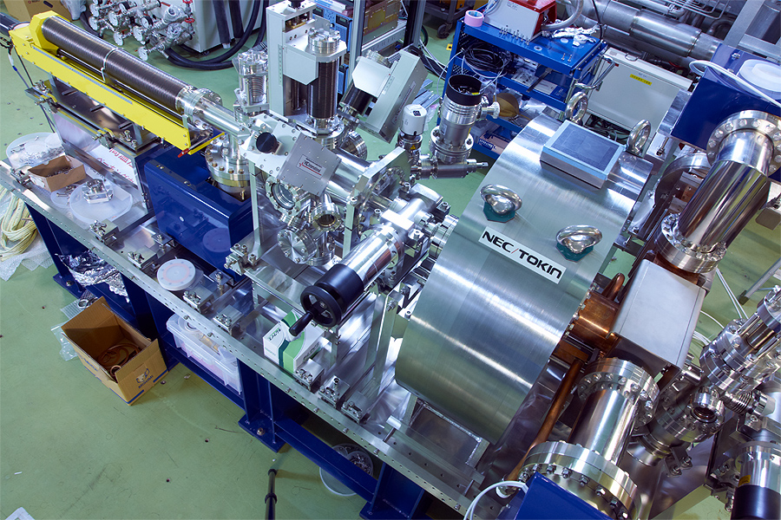
  Photocathode RF gun will supply beam into Cryomodules
  RF gun cavity and input coupler were fabricated by FNAL. (DESY-FNAL-KEK collaboration)
  FNAL delivered gun cavity and input coupler in November 2009.
  KEK started the gun assembly in STF tunnel.
  RF process in 2010, beam extraction in 2011.
Photocathode RF-gun under assembly in STF
Photocathode insertion
Solenoid magnet
photocathode chamber
gun cavity
input coupler
cavity
input coupler
DESY-FNAL design RF gun,
FNAL fabrication.

Slide 20
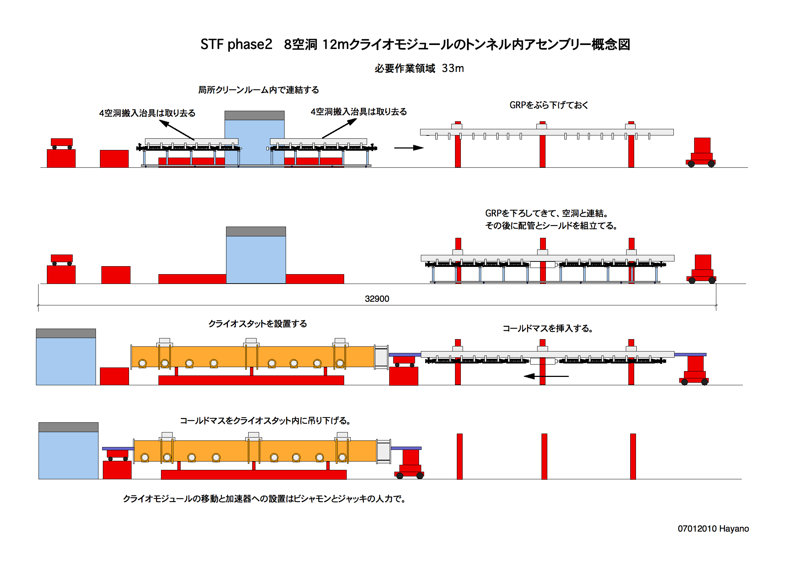
STF phase2.0 Cryomodule assembly in tunnel

Slide 21
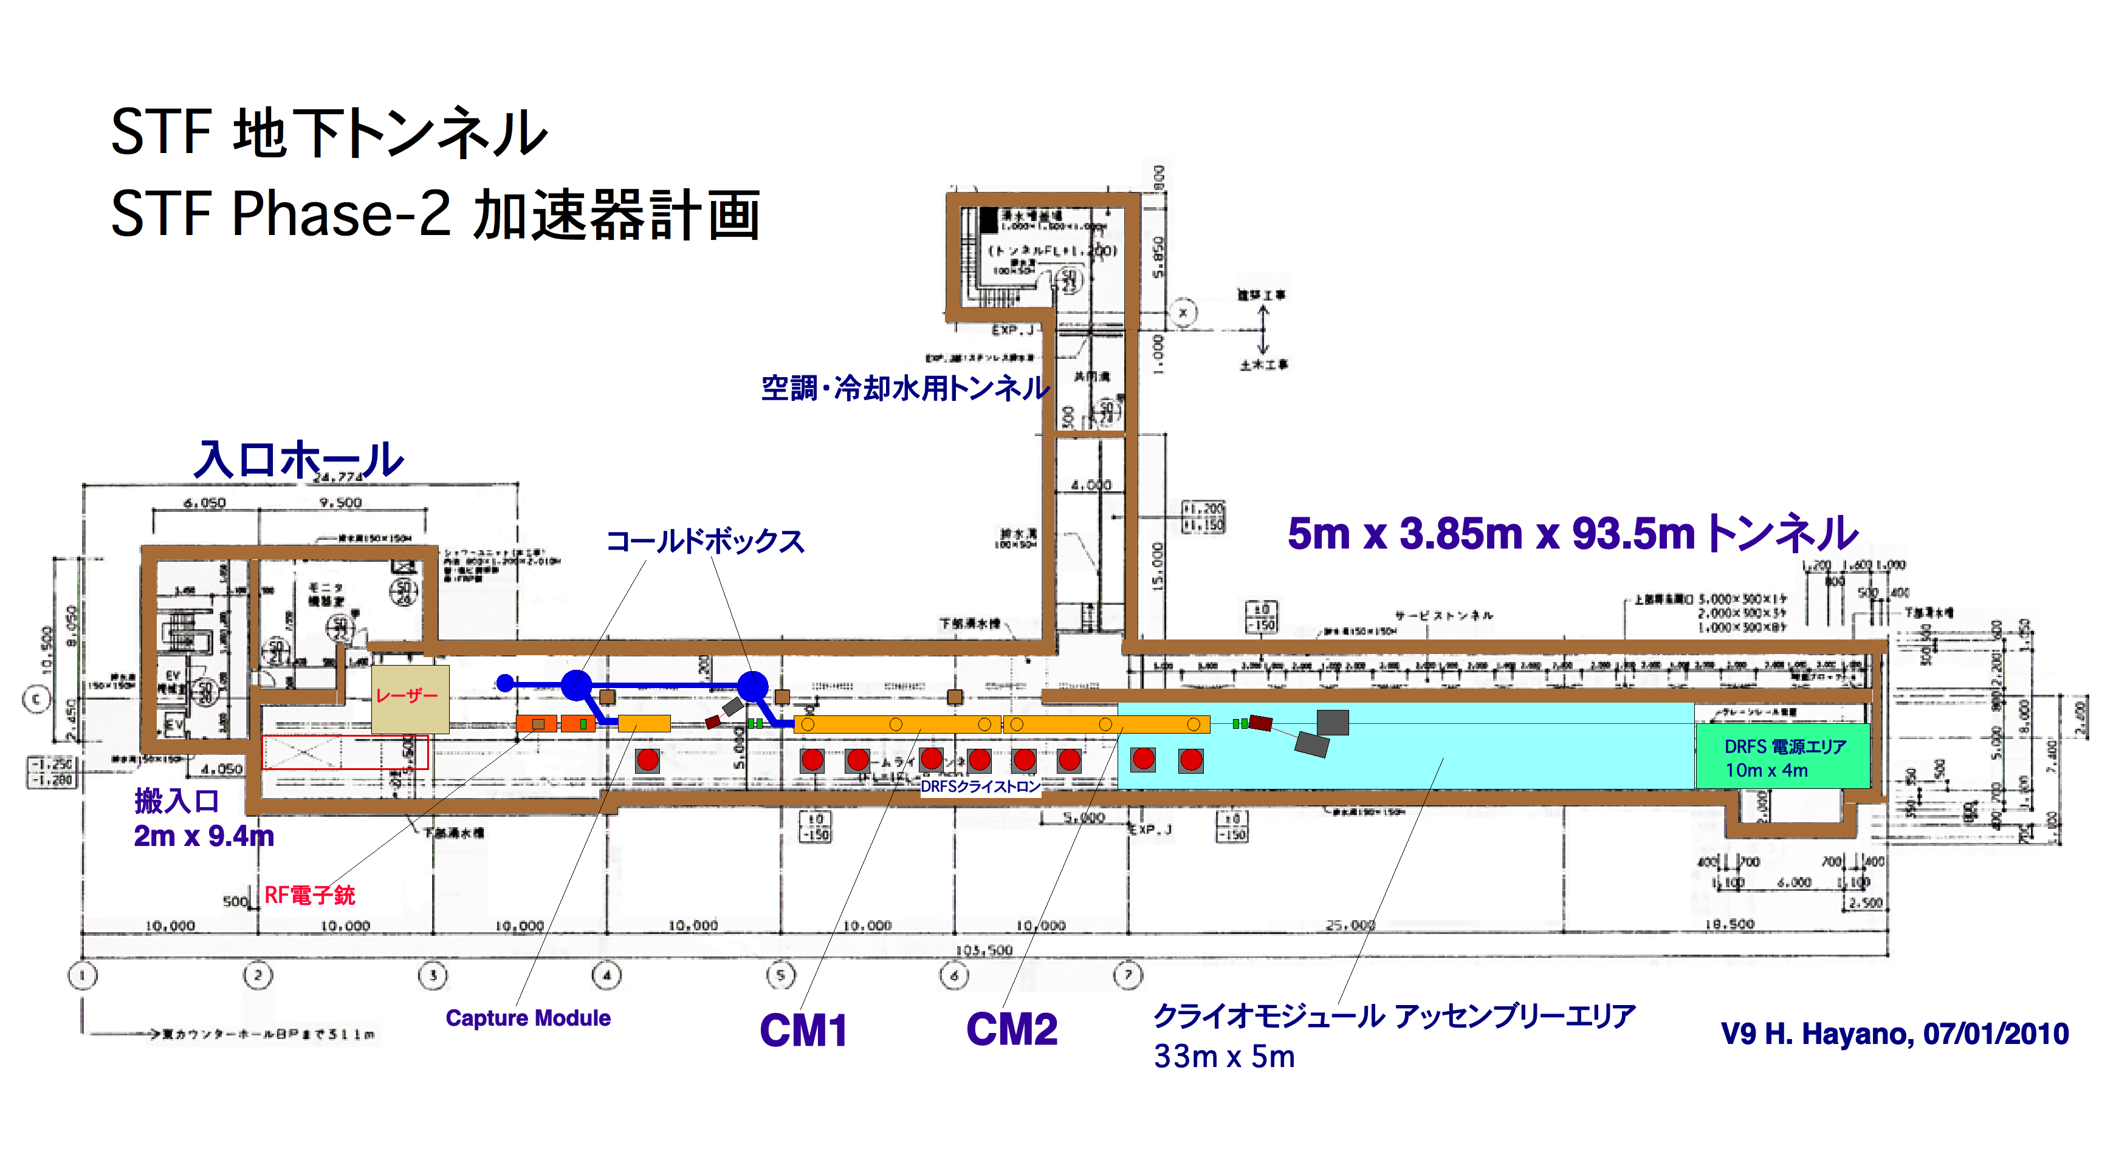
STF phase2.0 accelerator :Tunnel Layout
CM2設置時にはアッセンブリーエリアは解体となる。

Slide 22
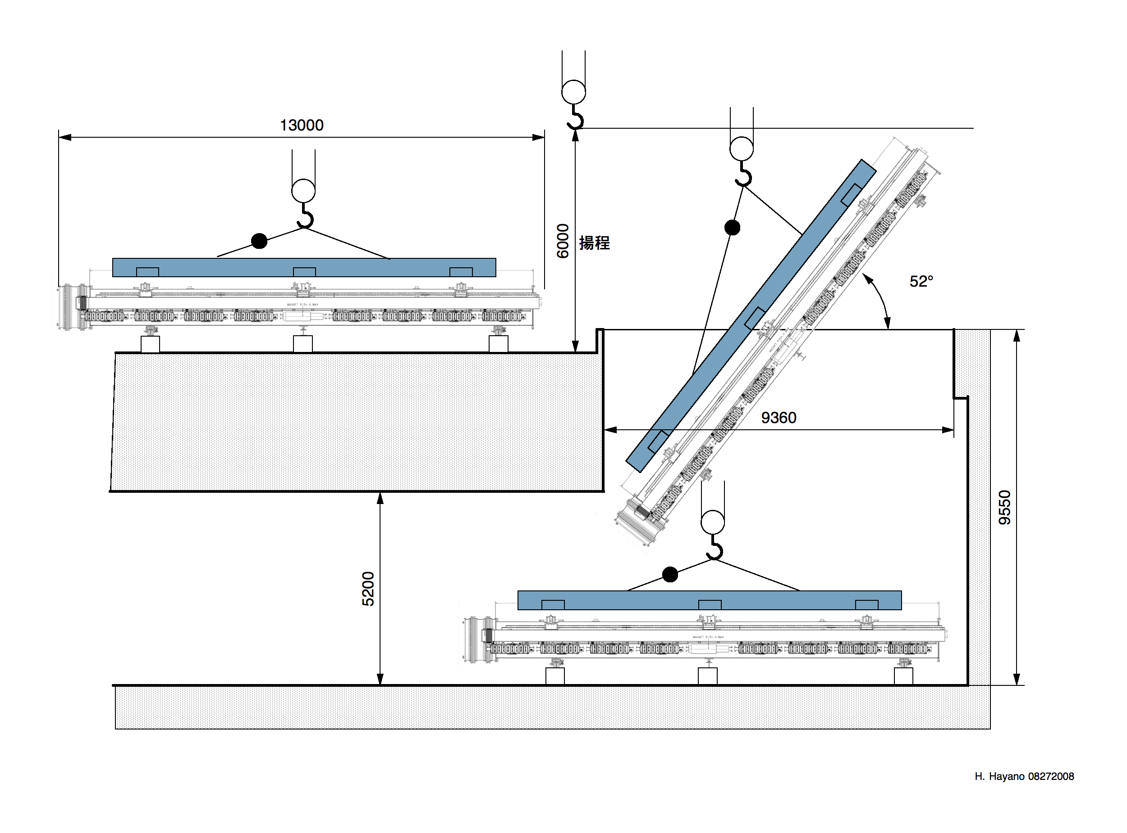
Carry-in of Cryostat and cold-mass
現在の搬入口を使って12mクライオスタット、コールドマスを出し入れする場合、52° 傾けなくてはならない。

Slide 23
STF Plans for 5 years (still under discussion)
CY2009
CY2010
CY2011
CY2012
CY2013
CY2014
クライオモジュール建設
運転
S1-Global cryomodule
phase2 ビーム入射部建設
運転
Phase2 Injector part
(量子ビーム課題研究)
STF phase-2
Phase2 第１クライオモジュール建設
運転
1st Cryomodule
Phase2 第２クライオモジュール建設？？
運転
空洞製造設備
設備建設と空洞製造立ち上げ
設備稼動
KEK EBW 稼働
1st cavity
2nd cavity, …………..

Slide 24
3．空洞製造設備
[低コスト、マスプロダクションのための計画]
メーカーを指導できる空洞製造技術の獲得、技術継承
と大量生産技術の開発

Slide 25
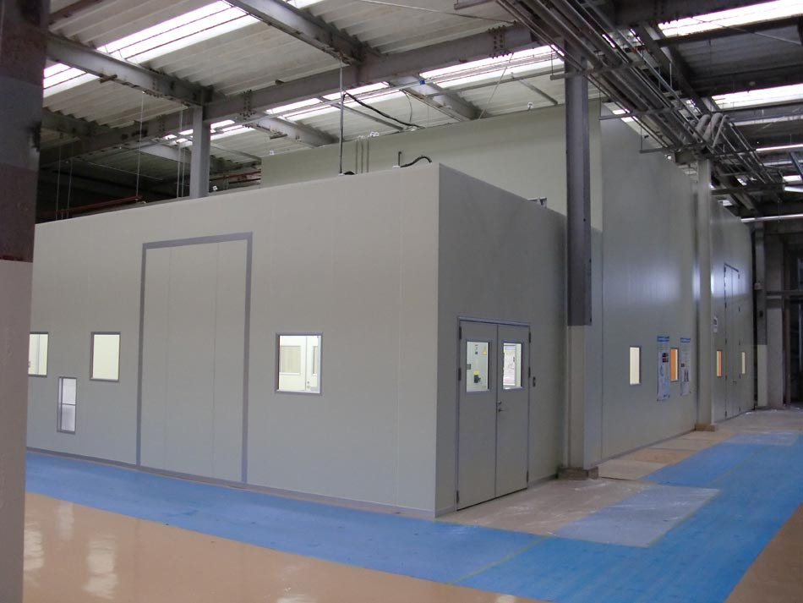
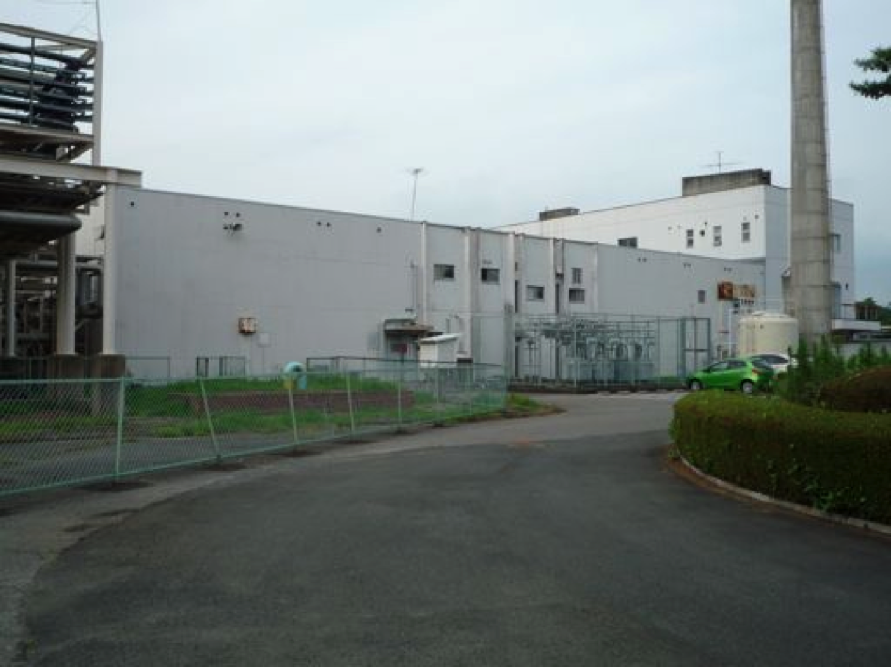
R&D Place in KEK
Refurbishment of ‘P.S. energy center’ building was completed.
Building 52m x 30m
Clean room 19m x 14m
clean room construction is completed
Pilot plant area

Slide 26
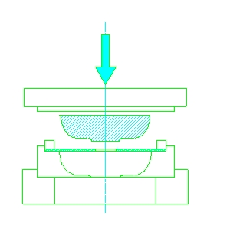
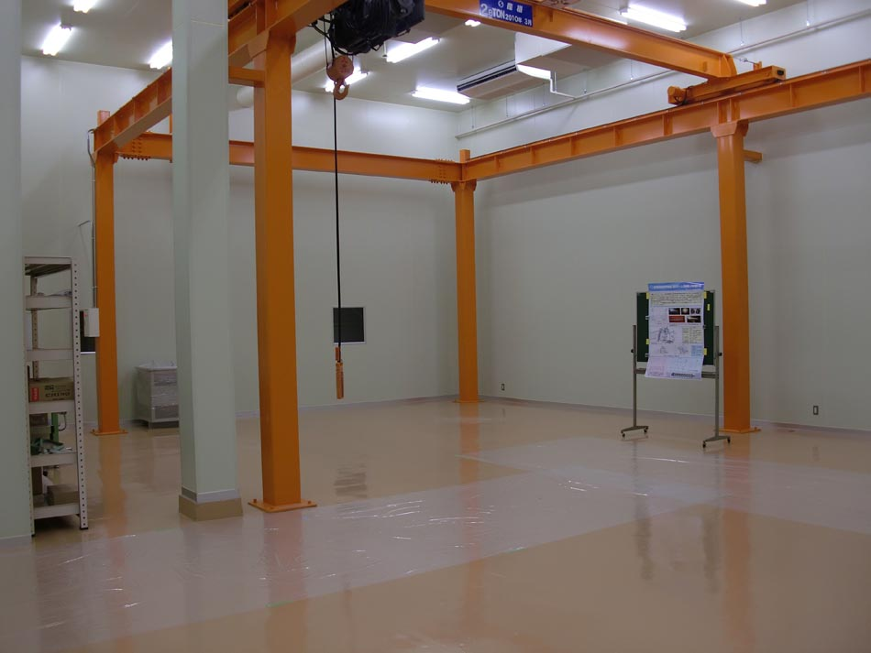
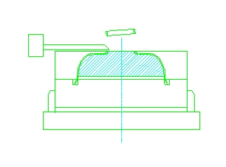
Pilot plant clean room
Chemical Polish room
19m x 14m ISO class-5 clean room
Electron Beam Welder
crane 2.8t
Press machine
Triming machine
EBW place and crane girder

Slide 27
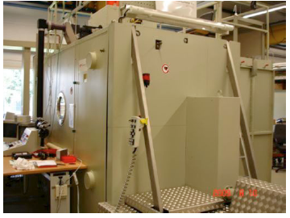
Main facility: Electron Beam Welder
we spent one year for survey of cavity EBW machine.
After bidding, one EBW machine was ordered.
electron gun
electron gun in horizontal place. (vertically movable)
DESY EBW; the same company
Steigerwald 150kV 15kW machine will be delivered in March 2011.

Slide 28
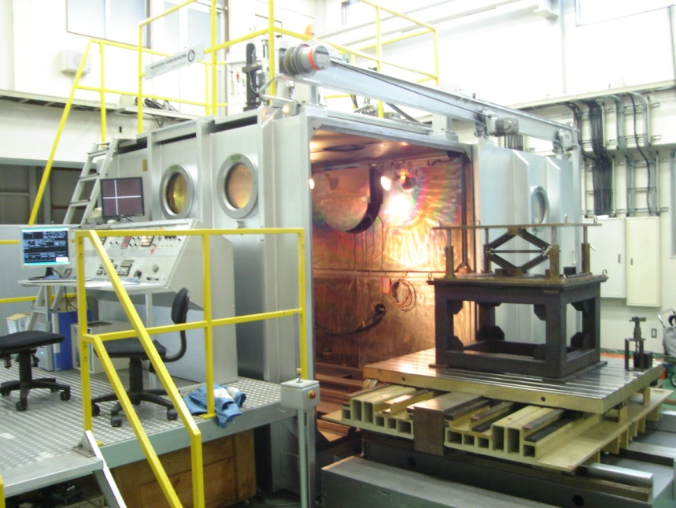
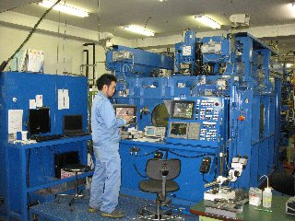
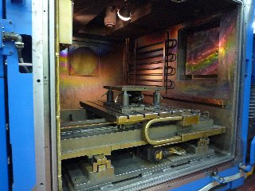
EBW R&D & Press R&D was started
Tosei-electrobeam co.
Mitsubishi-EBW
Tosei-electrobeam co. SST EBW
using EBW Job-shop
Nov. 2009 SST-EBW V=150 kV / 60 kV
EBW test on Nb plate（t=2mm）, EBW test on two-plate join（t=2mm）
Dec. 2009 Mitsubishi-EBW V=60 kV
EBW test on Nb plate（t=2mm）, EBW test on two-plate join（t=2mm）
Jan. 2010 Mitsubishi-EBW V=60 kV
EBW test on Nb plate（t=2mm）, EBW test on two-plate join（t=2mm）
two-plate hook-edge join（t=2mm）

Slide 29
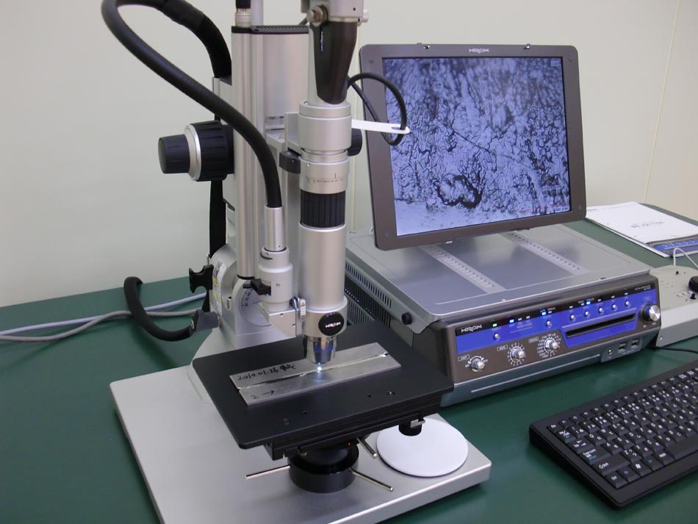
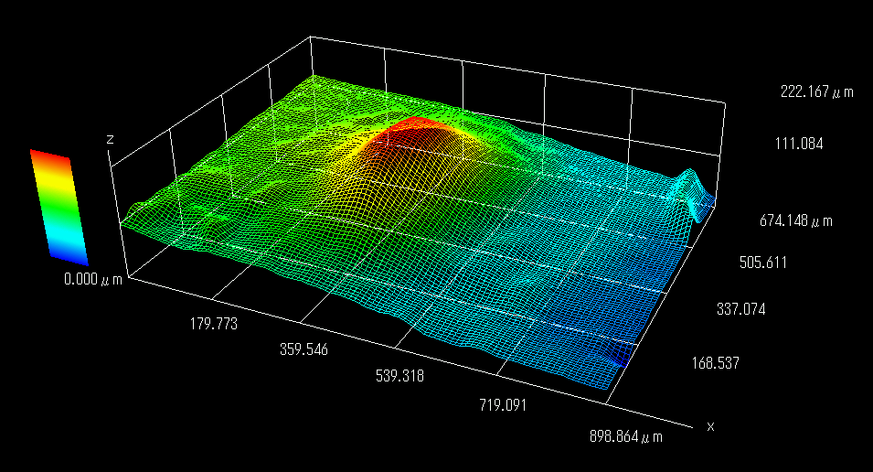
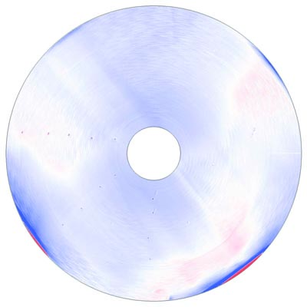
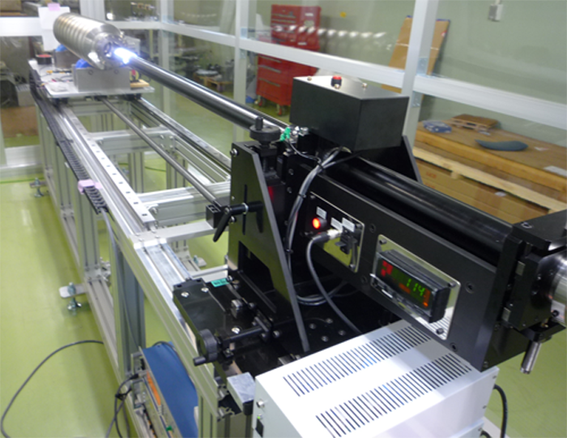
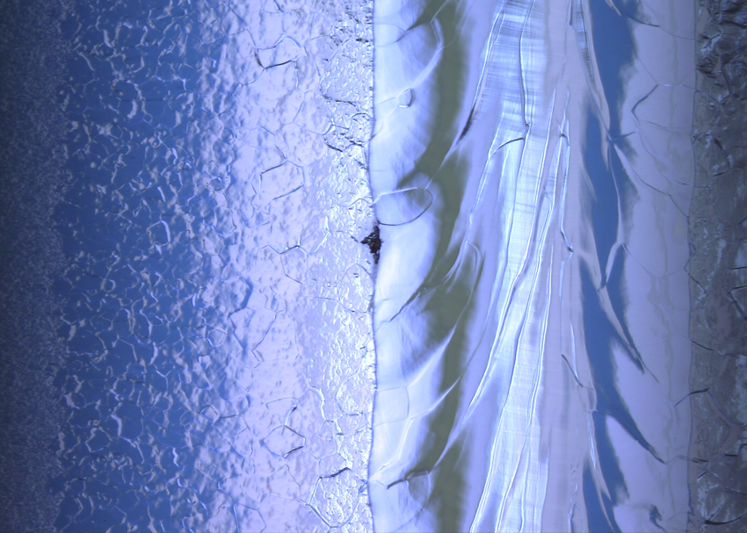
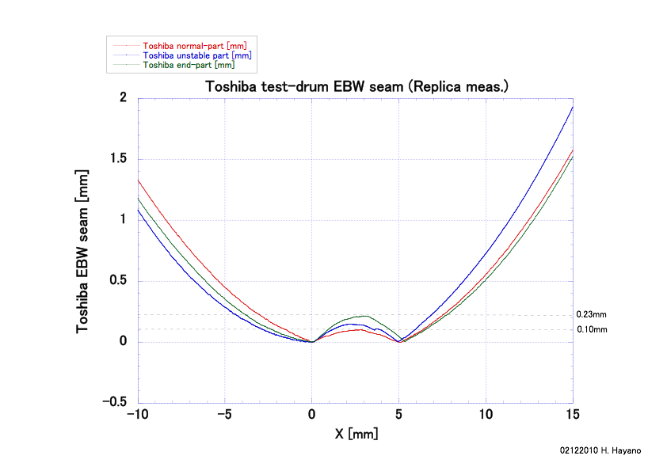
inspection instruments for fabrication support
optical 3D profiler
AES001 bump analysis
eddy current scanner
equator seam evaluation
molding & form-tracer
inner surface inspection
MHI008

Slide 30
４．その他のインフラ整備

Slide 31
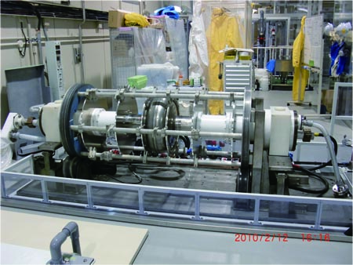
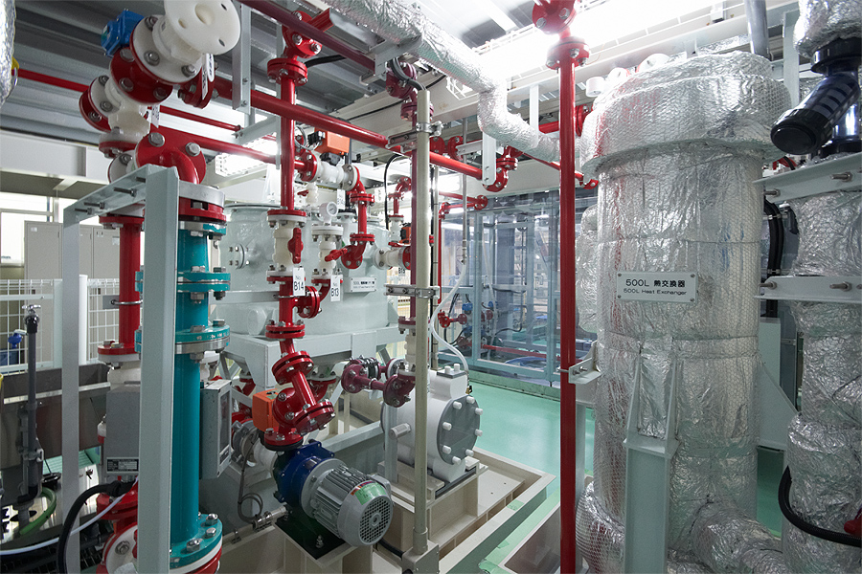
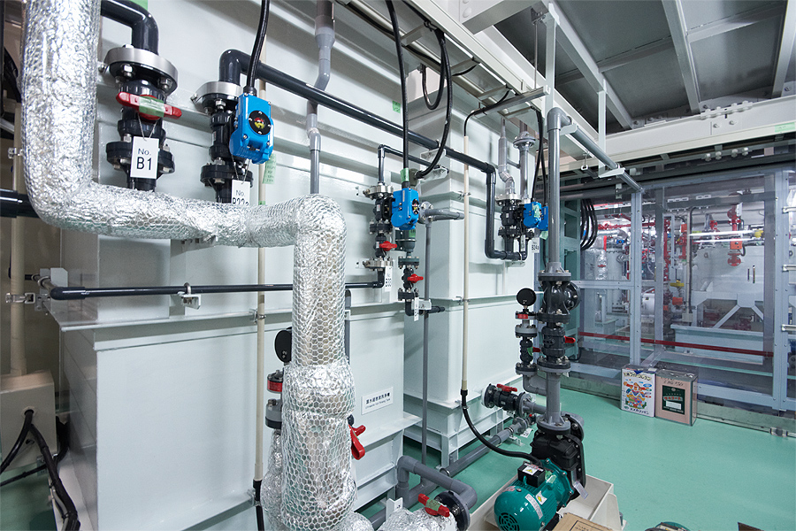
Surface treatment : EP system No.2
Electro-chemical polish for 500MHz cavity, ILC cavity, ERL cavity, etc
EP acid tank, pumps, acid heat exchanger
500MHz single cell test cavity mounted on the 2nd EP bed
Moved from Nomura co. in 2009,
rebuild in STF with some parts renewal.
Ultra-sonic (left), water spray rinse (right)

Slide 32
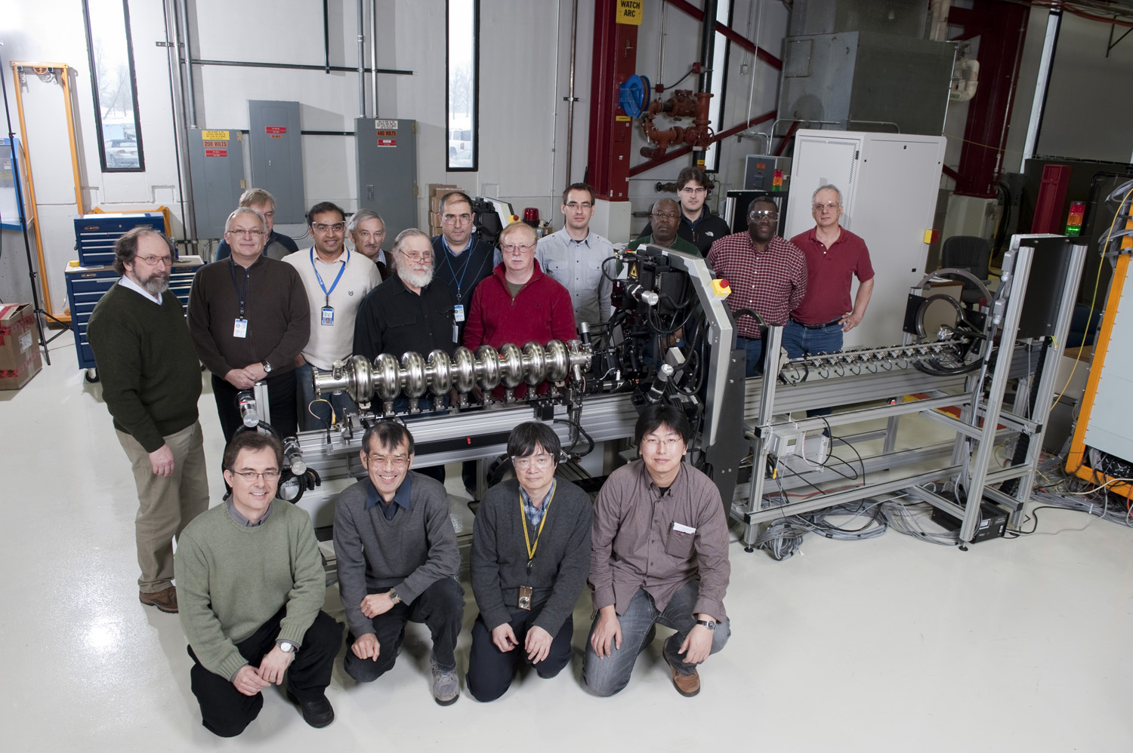
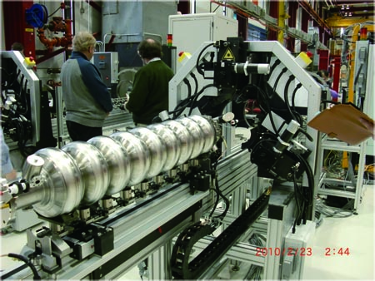
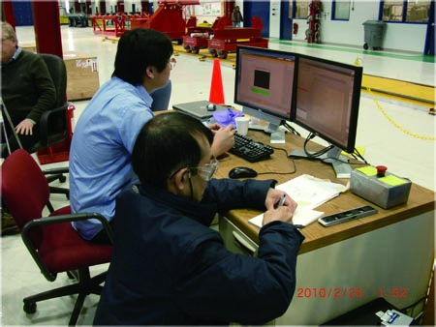
Automated Pre-tuning machine
DESY-FNAL-KEK collaboration
Eccentrisity measurement and correction,
Beam pipe tilt correction,
Frequency and field flatness corrections
KEK-STF will receive 1 pre-tuning machine
on July 2010.
training at FNAL, Feb. 23, 2010

Slide 33
まとめ
STFのR&D状況
(a) S1-Global Cryomodule試験 ：
国際協力によるクライオモジュールを実装し、試験を開始した。
(b) STF phase-2の策定：
2012年度までのクライオモジュール開発を策定した。
DRFSシステム実証に向け開発を開始した。
(c) メーカーを指導できる空洞製造技術の獲得と大量生産技術の開発：
EBWの導入を決定、各種製造装置を設備し、空洞製造技術開発を開始した。
(d) インフラ整備
第２EP設備を運転開始、プリチューニングマシーンを導入中。
終わり

Slide 35
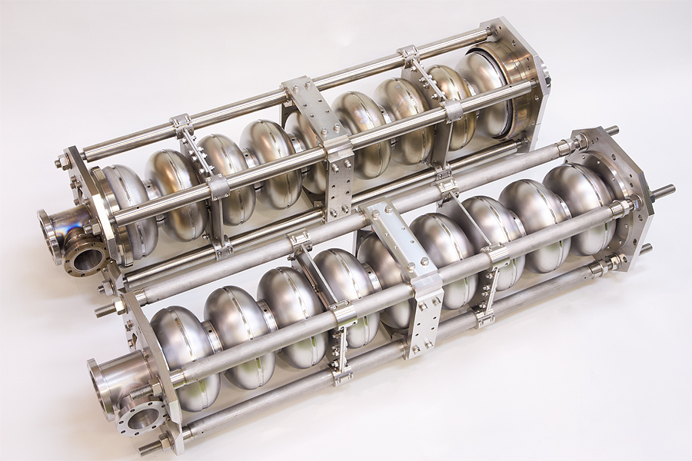
KEK-industry collaboration
2009-2010 two years program
Toshiba 9-cell cavity
8MV/m
Hitachi 9-cell cavity
35MV/m
Press; in the company, EBW; other job-shop company
KEK: inspection, vertical test and technical advice

Slide 36
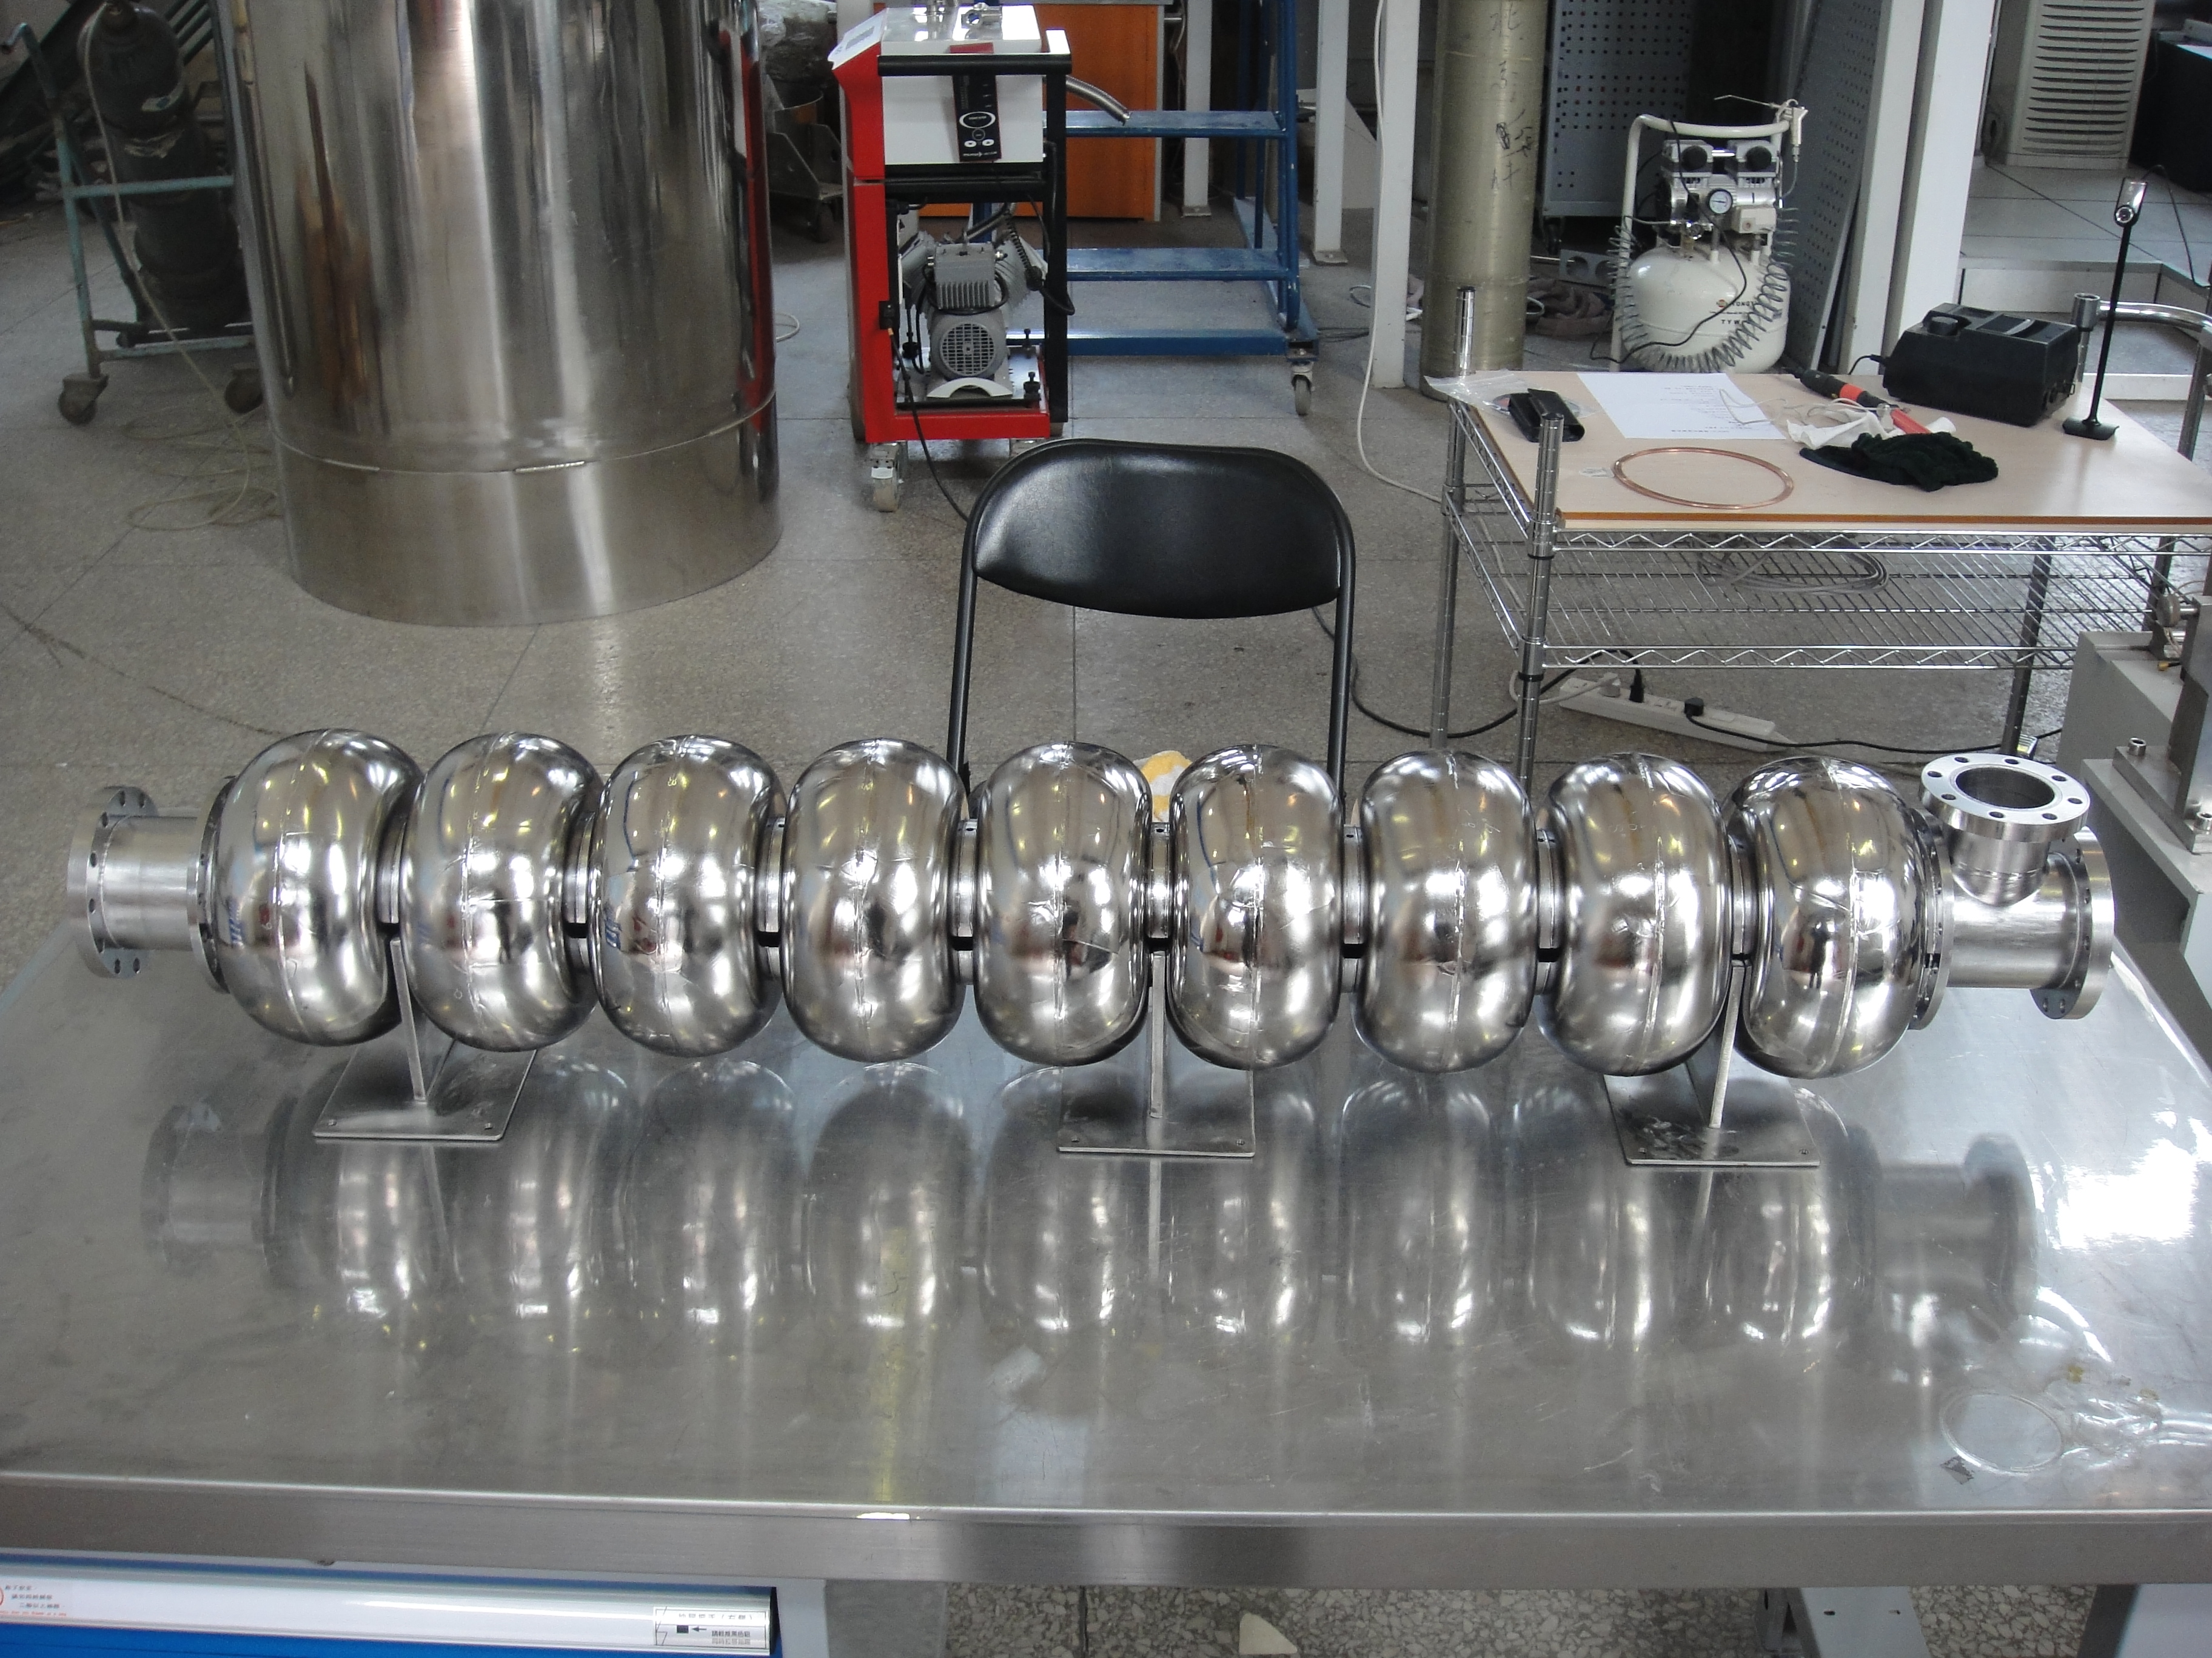
KEK-IHEP collaboration
IHEP cavity fabrication; EBW by Chinese company
KEK: vertical test collaboration and technical advice
IHEP facility
CBP,
BCP,
tuning machine,
clean room,
VT(He suppy issue)
20MV/m
LL-shape 9 cell without HOM,
CBP and BCP process, then VT. VT is scheduled on June

