Slide 1
Toward the Final Design of a TPC for the ILD Detector
Keisuke Fujii, KEK
on behalf of the D_RD_9 team

Slide 2
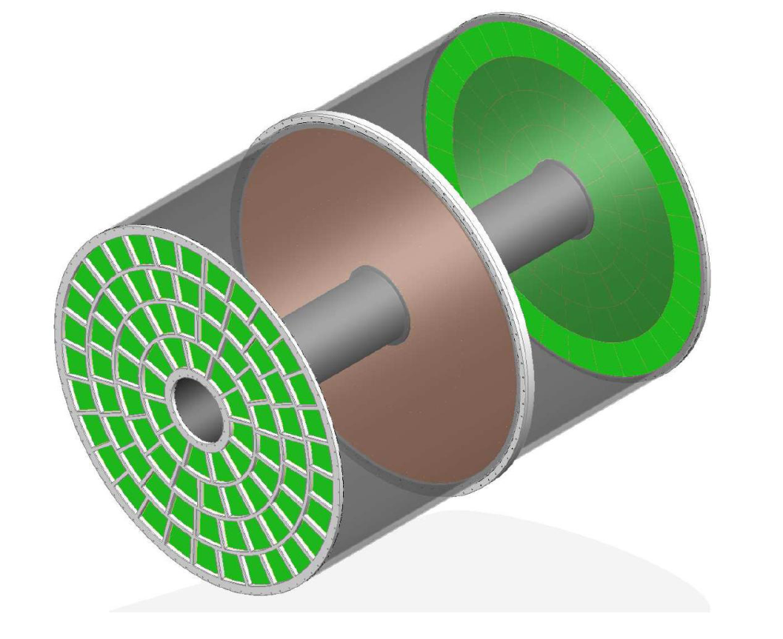
LC-TPC
Performance Goals as compared to LHC detectors
ILD DBD Completed on March, 2013
Vertex resolution 2-7 times better
Momentum resolution 10 times better
Jet energy resolution 2 times better
TPC
LC-TPC (ILD)
4.7m
International Large Detector
ILD : optimized for
Particle Flow Analysis
3.6m
LP1
Micro Pattern Gas Detector readout TPC provides pictorial 3D tracking by ~200 space points with σrφ~100 μm and two-hit separation of ~2mm
Highly efficient tracking in a jetty environment is an essential ingredient for PFA
Large Prototype being tested at DESY

Slide 3
LC-TPC
Performance Goals as compared to LHC detectors
ILD DBD Completed on March, 2013
Vertex resolution 2-7 times better
Momentum resolution 10 times better
Jet energy resolution 2 times better
TPC
LC-TPC (ILD)
4.7m
International Large Detector
ILD : optimized for
Particle Flow Analysis
3.6m
LP1
Micro Pattern Gas Detector readout TPC provides pictorial 3D tracking by ~200 space points with σrφ~100 μm and two-hit separation of ~2mm
Highly efficient tracking in a jetty environment is an essential ingredient for PFA
Large Prototype being tested at DESY

Slide 4
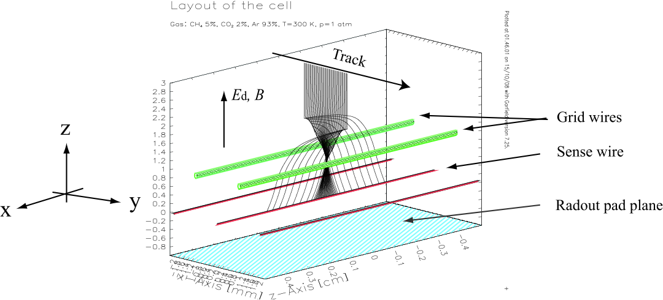
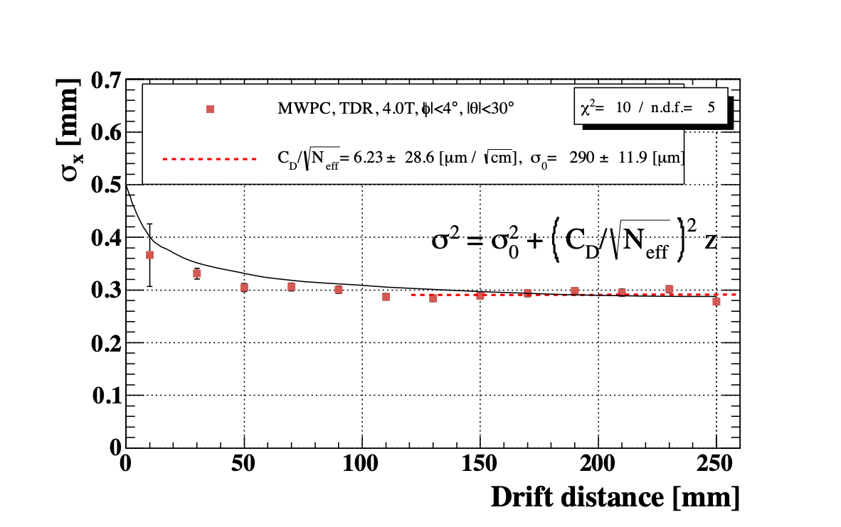
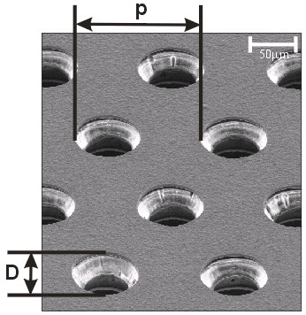
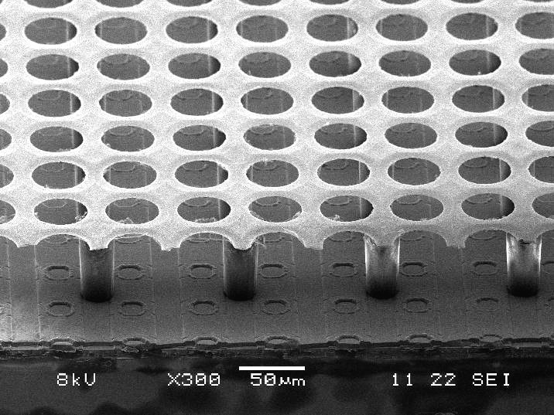
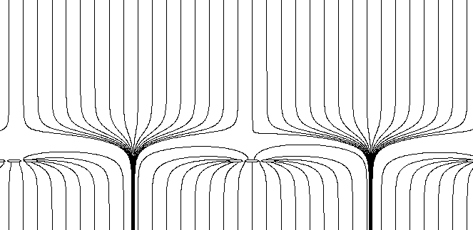
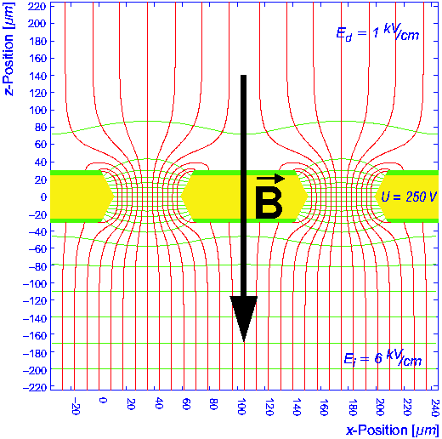
Why MPGD Readout?
We need high (>3 T) B field to confine e⁺e⁻ pair BG from beam-beam interactions, then ExB is too big for conventional MWPC readout
2mm 2-track separation is difficult with MWPC readout
Thick frames are unavoidable for MWPC readout
ExB spreads seed electrons along the sense wires, then avalanche fluctuation limits the spatial resolution!
Micro-Pattern Gas Detectors
Micromegas
GEM
InGrid TimePix
De-clustering
Pre-LCTPC group incl. the FJ team, together, excluded MWPC option with a small protoypte TPC!

Slide 5
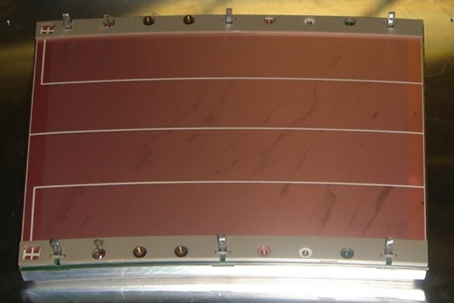
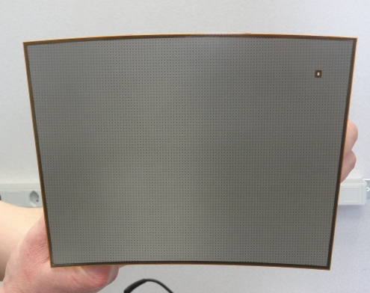
MPGD Options
After the initial stage of R&D with many small TPC prototypes, we are left with three options of MPGD TPC readout technologies for ILC, being tested at the Large prototype (LP) TPC at DESY.
I. Analog (Pad) TPC: Subject to the gas gain fluctuation in the gas amplification. Need to spread the avalanche charge for charge centroid.
(1) Multi layer GEM with the standard pad (~1x5mm²) readout : (charge spread by diffusion)
Asian (KEK-Saga-Tsinghua) Module, DESY module
(2) Micromrgas with the resistive-anode (pad: ~3x7mm²) readout :
Saclay-Carleton Module
II. Digital (Pixel) TPC: Free from the gas gain fluctuation. Expect 20-30% improvement of position resolution in the case of digital readout. No angular pad effect.
Theoretically the best but not yet ready for full implementation of a module.
(3) InGrid Micromegas mesh on Timepix chips (pixel: ~50x50μm²)
NIKHEF-Saclay Module, Bonn-module
Asian GEM module
MM (resistive anode)
InGrid+Timepix
→ being tested in Large Prototype at DESY
4

Slide 6
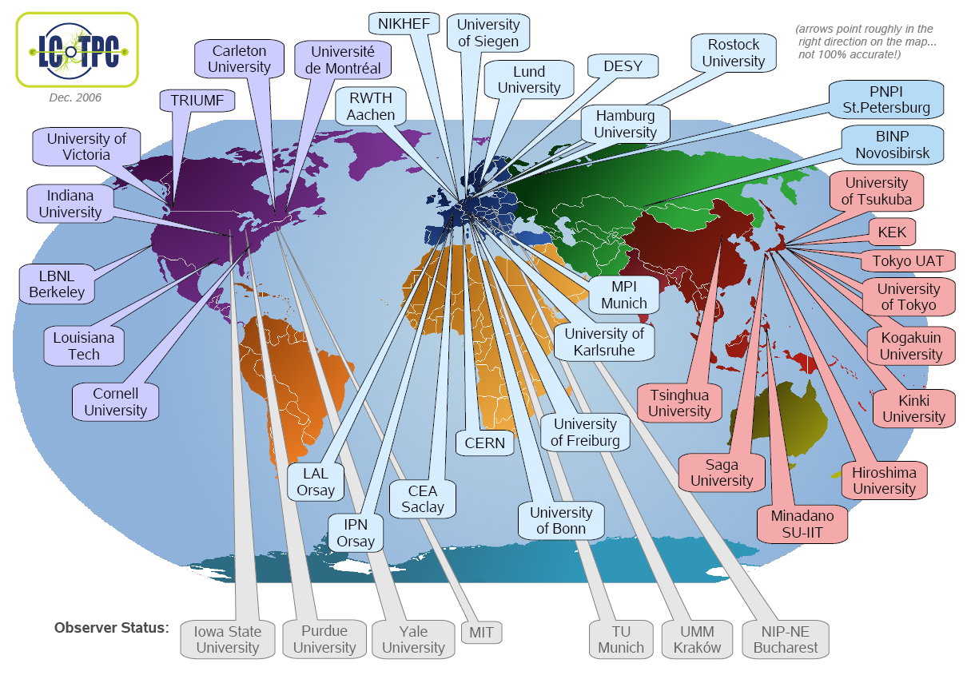

Slide 7
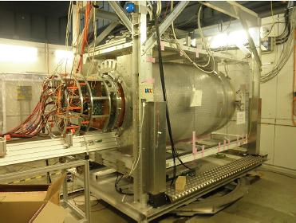
Large Prototype Test Beam Facility at DESY LC TPC Collaboration
Si strip detector
(EUDET/SiLC/DESY)
Magnet: PCMAG and its upgrade
(KEK, EUDET/AIDA/DESY, CERN)
Field cage &
Mechanics, Gas system
(EUDET/DESY)
Endplate
(Cornell)
Cathode Laser Calib.
(Victoria)
DAQ & Monitoring
(EUDET/DESY)
Beam Trigger
(NIKEFH)
2PCO2 cooling system
(KEK, DESY)
Test beam & Facility
(@DESY-T24-1 since 2008)
Cosmic trigger
(Saclay,KEK )
MPGD Detector Modules
(DESY, KEK/Tsinghua,
Saclay/NIKHEF, Bonn)
Two types of Readout Electronics
(EUDET/AIDA /Lund/DESY, KEK, Saclay)
Common Software Tools
(EUDET/AIDA , DESY, KEK, etc)

Slide 8
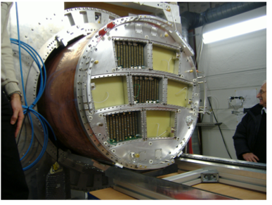
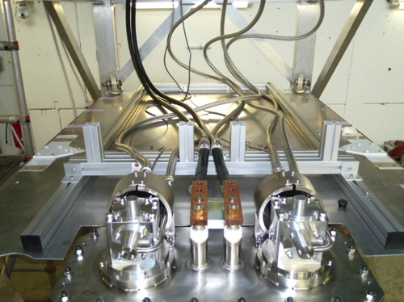
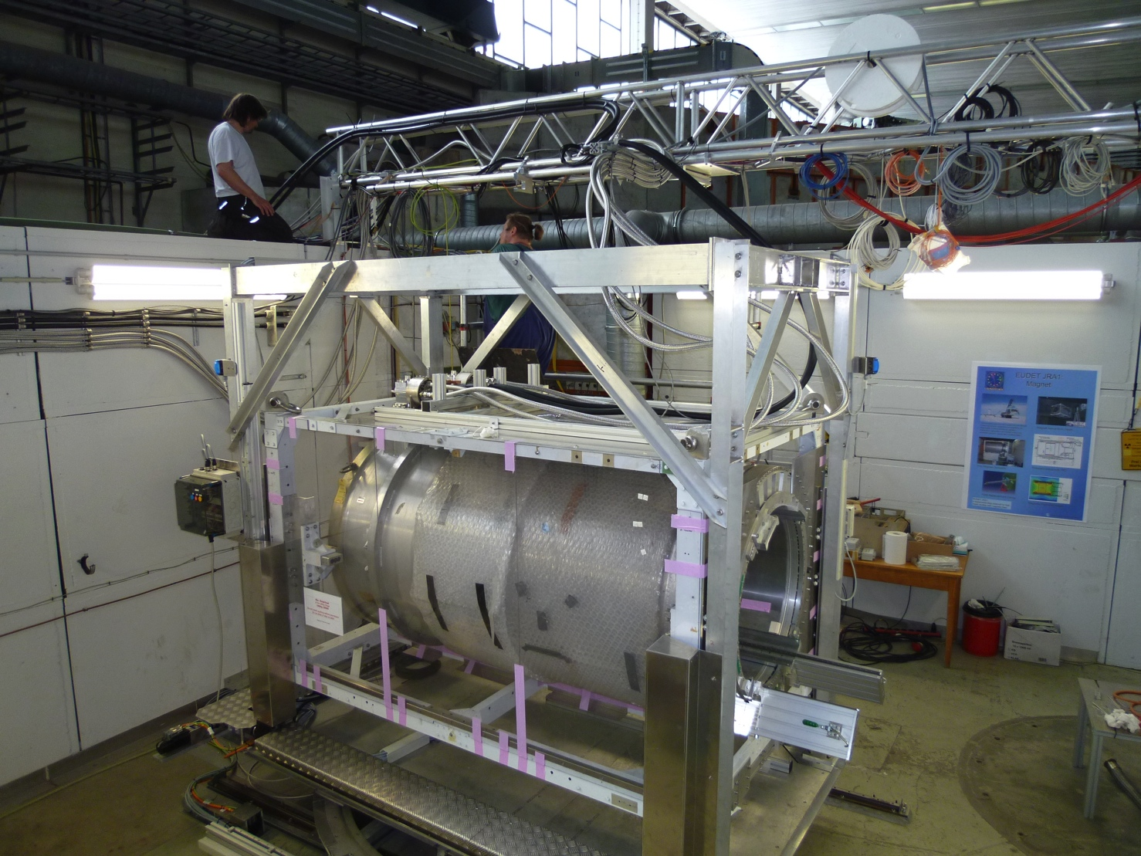
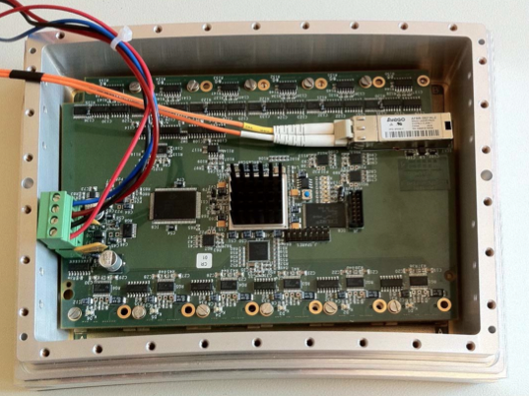
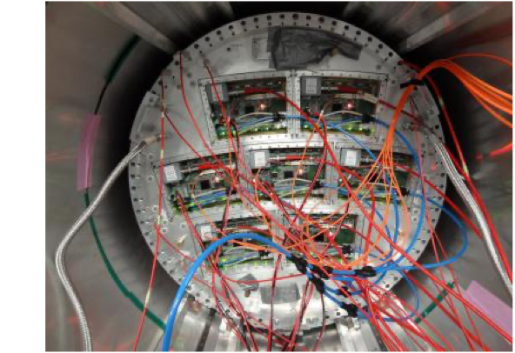
Large Prototype
Asian GEM
Modules
GM cryo-coolers
Can house up-to 7 modules
PCMAG from KEK modified by Toshiba under the framework of DESY-KEK collaboration in JFY2011 to allow Liq.He-less operation
Asian GEM
Module
Pad plane PCB from China
Being used for test beam experiments since June 2012
5GeV electron beam
Saclay Micromegas module with 1st prototype
of compact electronics
Large Prototype test beam
Saclay-Carleton MM modules
Notes:
中央飛跡検出器：Time Projection Chamber (TPC) の大型プロトタイプ（DESY のビーム試験エリアに設置）：国際共同研究グループ（LCTPC Collaboration）のもとに研究開発中。アジアグループは、TPC の心臓部である GEM 読み出し端部検出器（Asian GEM Module）の開発研究を担当。IPNS では、モジュールの設計、組み立て、試験を行っている。 読み出し Pad plane は、中国（清華大学）が製作した。前々回ビーム試験には清華大学からも学生が参加した。ビーム試験用の超伝導ソレノイド（B=1T）は、KEK が提供。H２３年度にKEK低温センター／低温グループのサポートをえて東芝により無冷媒化。H24 ３月末に DESY に返送。2012年６月に励磁試験、以降、ビーム試験のために運用中。2012年12月には、改良型 Asian GEM のビーム試験を DESY、Lund 大学行った。B=3.5T に外挿した位置分解能は、すでに要求性能（2m ドリフトで 100um 以下）を達成した。非一様磁場での運動量分解能の実証、読み出しエレキをモジュール背面へ組み込んだ次世代モジュールの開発が開発課題。日独仏協力で解析ソフト（MarlinTPC）開発も行っている。読み出しエレクトロニクスについては、CERN、Saclay、LUND 大学などとの国際協力で開発を進めている。

Slide 9
Spatial Resolution
Asian GEM Module
Saclay-Carleton MM Module
B=1T
B=1T
T2K gas
T2K gas
σrφ=100 μm
Extrapolation to B=3.5T
Extrapolation to B=3.5T
Both options seem to satisfy the σrφ=100μm requirement!

Slide 10
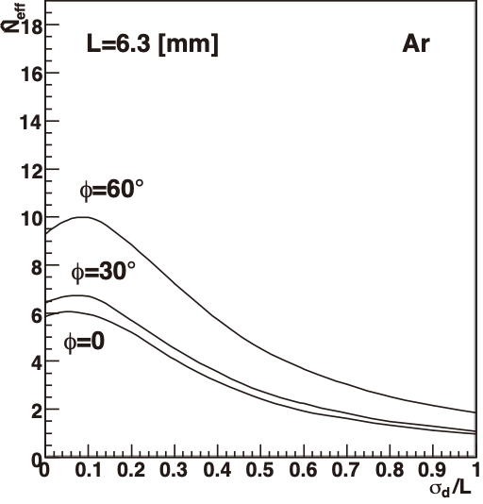
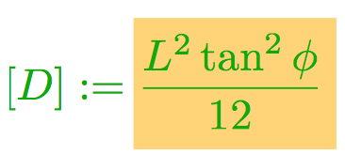
Resolution Formula
Since TPC operates on the nice and old “gas physics”; ionization, diffusion, gas amplification and fluctuation, etc., it is possible for the GEM TPC (option (1)) to formulate a fully analytic expression of its spatial resolution to understand the LP TPC results, to optimize parameters of the GEM TPC, and to extrapolate them to the ILD TPC (R. Yonamine / KF)
[A]: Hodoscope effect/S-shape at the short drift distances
The constant term also scales as 1/Neff!
[B]: Diffusion + finite pad size term
[C]: Electronics noise
: effective # electrons
[D]: Angular pad effect
: effective # clusters
σrφ quickly deteriorates with φ!

Slide 11
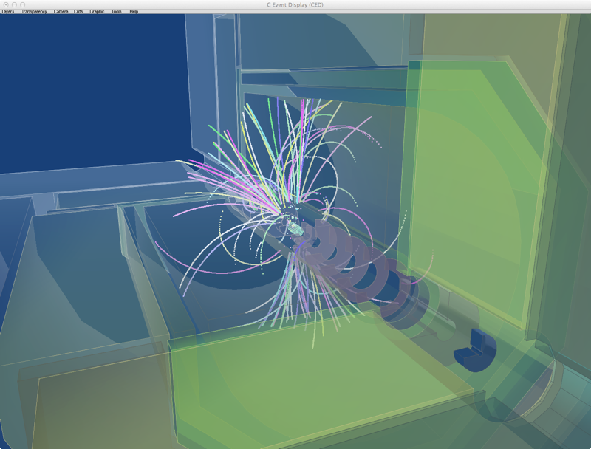
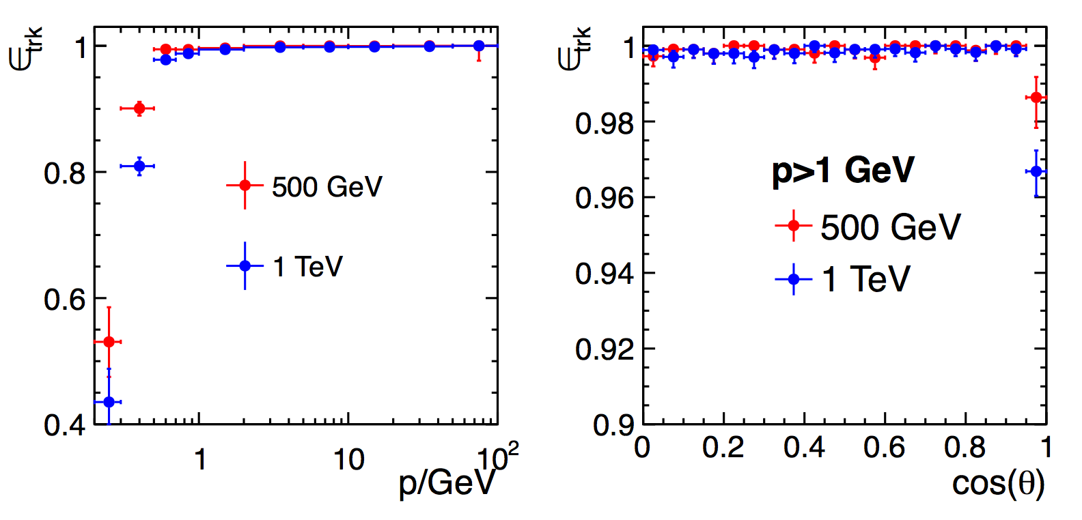
Tracking Code for LP TPC and ILD TPC
Tracking Code (MarlinTrk):
now fully C++
e⁺e⁻ → t tbar @1TeV
KEK developed Kalman Filter Package (KalTest)
Reconstructed Tracks
The continuous tracking in TPC is very robust against the backgrounds (including the micro curlers) at ILC reaching 100% tracking efficiency (> 1GeV/c) except the forward region
A Kalman filter based tracking code for TPC at ILC has been developed (Li Bo/ KF), and implemented in the MarlinTPC code for the beam test data analysis as well as to the new MarlinReco for the ILD physics simulation
~100% tracking efficiency
Despite the more realism (cracks, support structures, and service materials) brought in to the simulator,
PFA performance is now better than that of LoI!
9

Slide 12
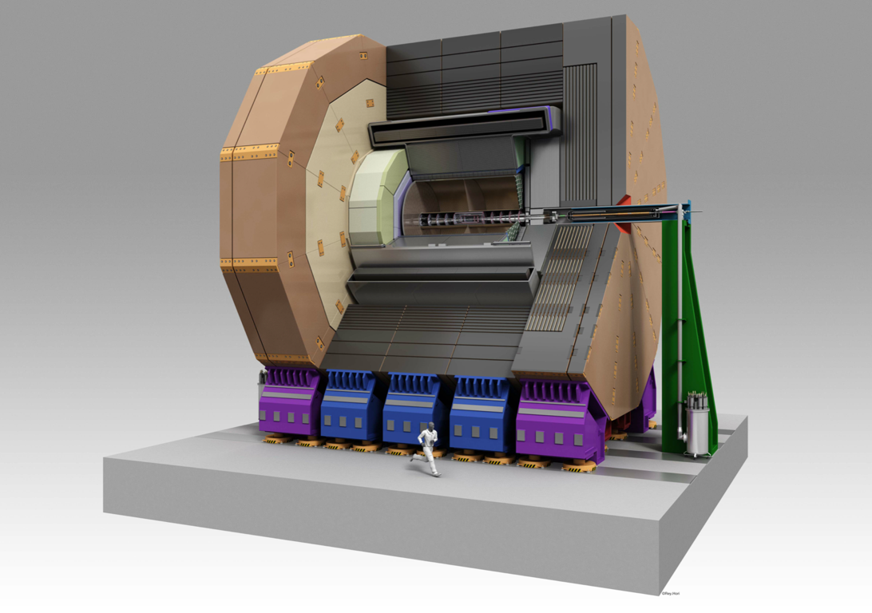
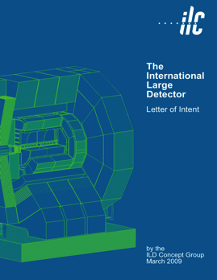
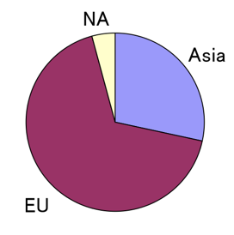
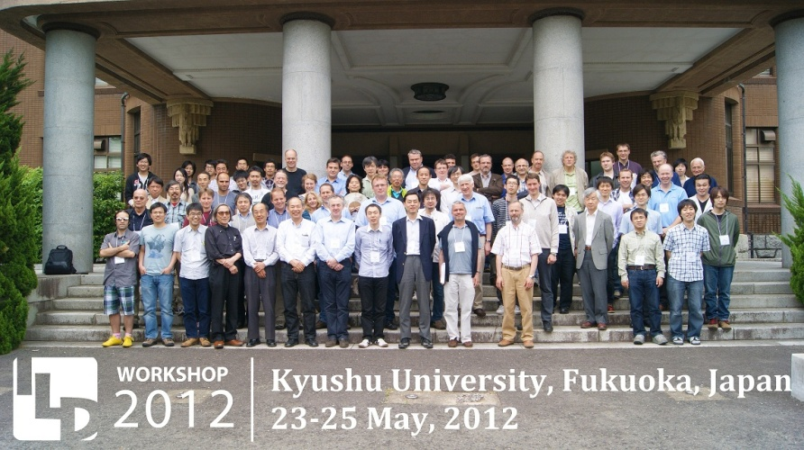
ILD Detailed Baseline Design
Letter of Intent (2009)
~700 signatories
~120 from Japan
ILD DBD now completed in March 2013!
We are now entering the phase for
the Final Engineering Design!
Notes:
ILD 測定器コンセプトは、Particle Flow Analysis (PFA) に最適化された高精細測定器で、All Silicon の SiD に比して、TPC を中央飛跡検出器に採用した点に特長がある。バーテックス検出器、中央飛跡検出器（TPC）、カロリメターとも、LHC測定器に比べて高精細、低物質で、LHC の一桁上の性能を目指す。200ページを超える DBD は、つい先日完成した。現在、レビュー中。（右下の写真）2012、5月の九州大学での ILD ミーティングの集合写真。

Slide 13
Entering New Phase
D_RD_9
ILD Detailed Baseline Design now completed!
We are now entering the phase for
the Final Engineering Design!
In addition to further R&D towards engineering design of the GEM or MM module on each side, we need to work together on the following:
Common tracking and analysis software R&D
Gating Device
2-Phase CO2 Cooling
Readout Electronics: Analog-Digital mixed chip for (semi-)surface mounting

Slide 14
Common Tracking
and Analysis Software
to compare different technologies
on the equal footing
for eventual technology choice

Slide 15
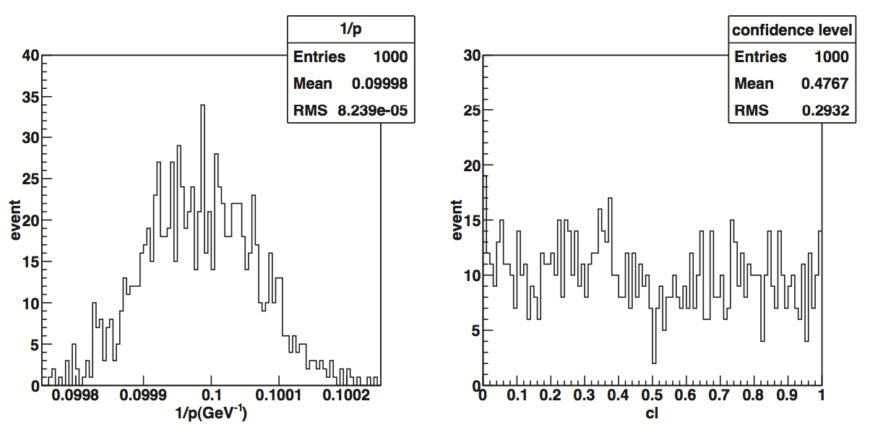
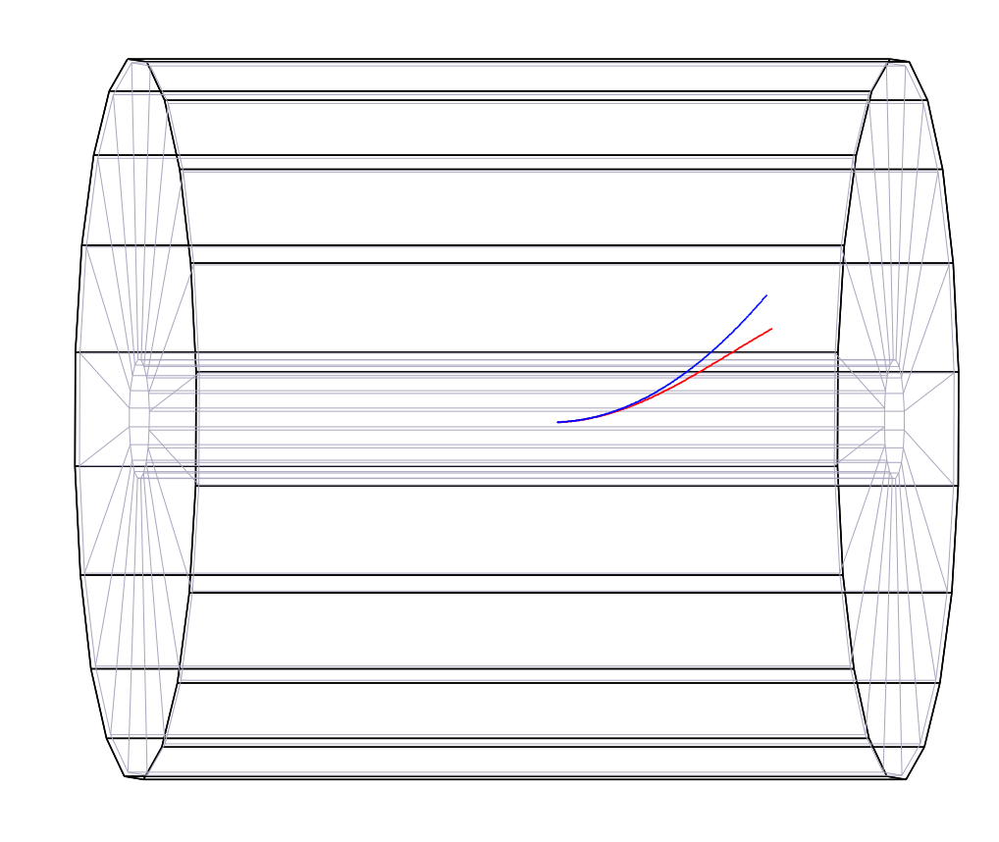
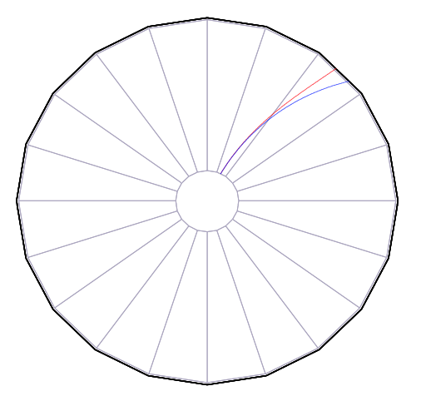
Kalman Filter Based Track Fitting in Non-uniform B Field
arXiv: physics.ins-det/1305.7300
p=1GeV
Confidence Level
Works in B field with >40% non-uniformity !

Slide 16
Ion Gate

Slide 17
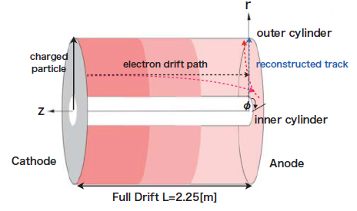
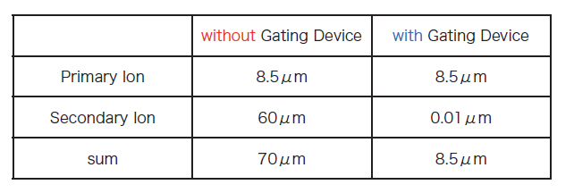
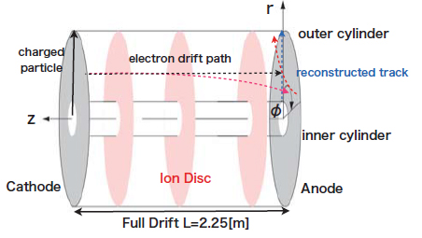
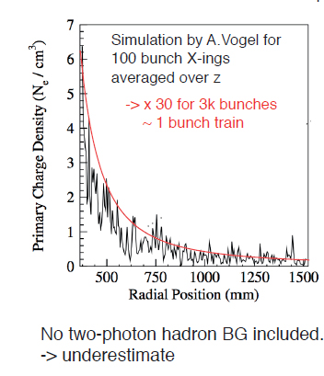
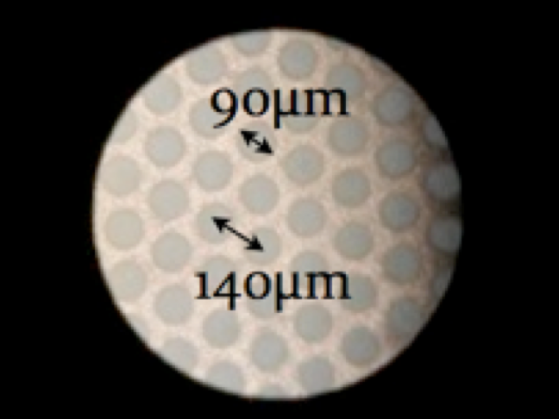
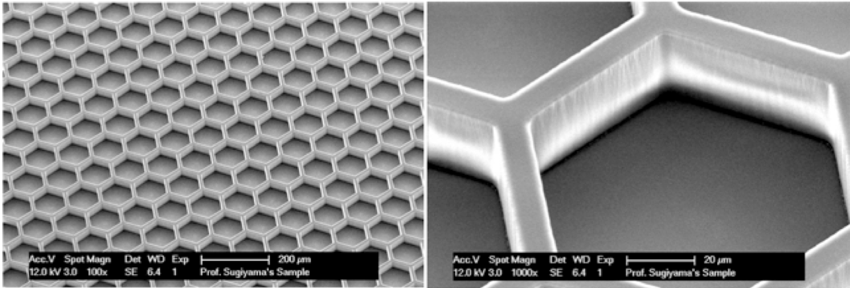
Effects of Positive Ions and Ion Gating at ILC
Solved the Poisson equation for the simulated ion density distribution with proper boundary conditions and then estimated the distortion of drift electron trajectory by the Langevin equation (D. Arai and KF)
Primary Ions
OK
Not OK
Secondary Ion disks
For the secondary ions from the amplification, we need an ion gate device for the ion feed back ratio of >10⁻³ (measured both for the triple GEM and Micromegas) at the gas gain of 1,000.
The current options of the ion gate are limited:
The traditional wire gate is expected to work, but introduces mechanical complications to the MPGD modules. We also need to check ExB effect.
Thin GEM gate offers the electron transmission of only 50%@ 1T → 30% loss in the point resolution (Japanese LC TPC group).
Try a larger geometric aperture with new fabrication method?
wire gate
GEM gate
New way?

Slide 18
2P CO2 Cooling

Slide 19
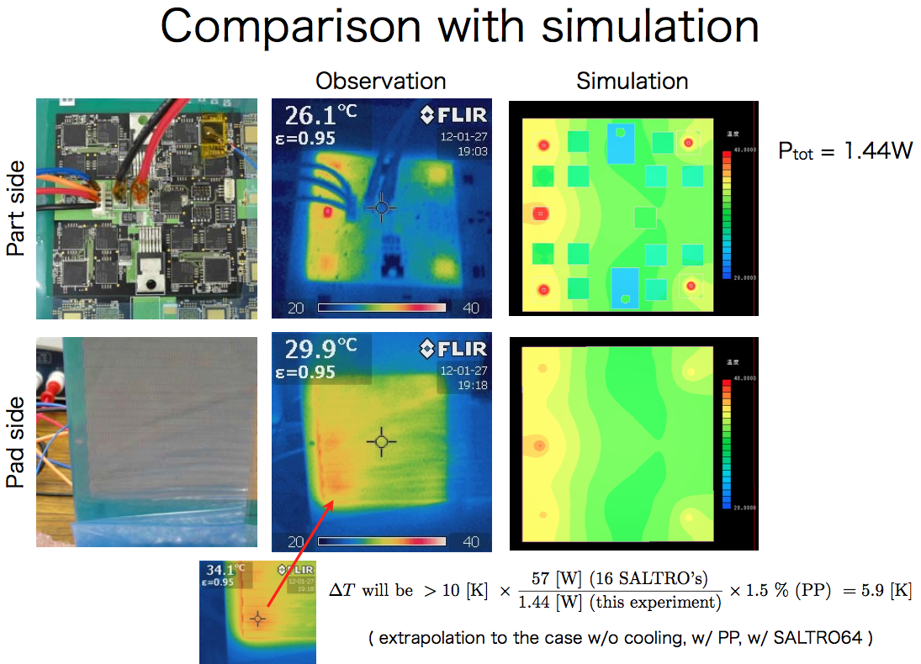
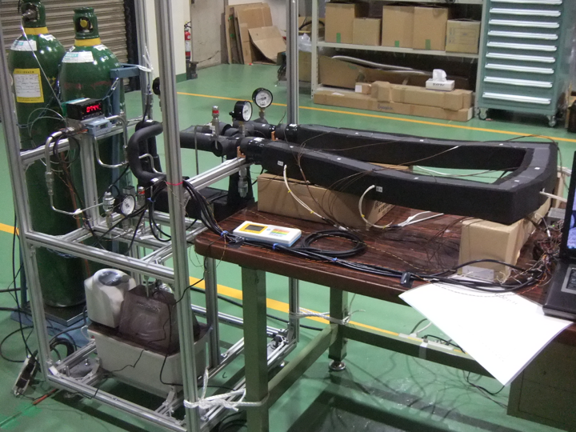
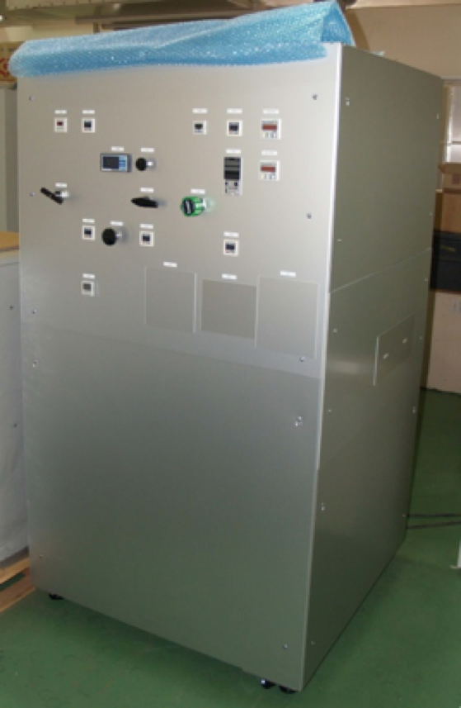
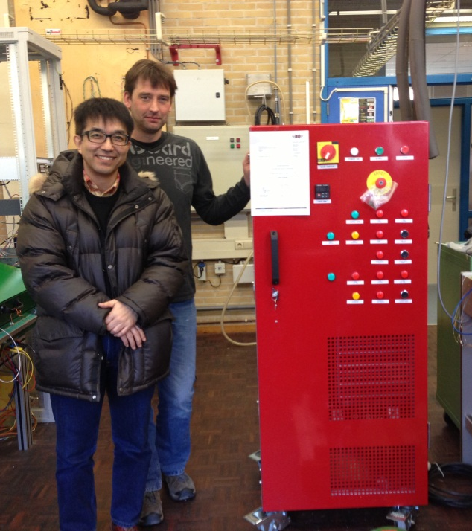
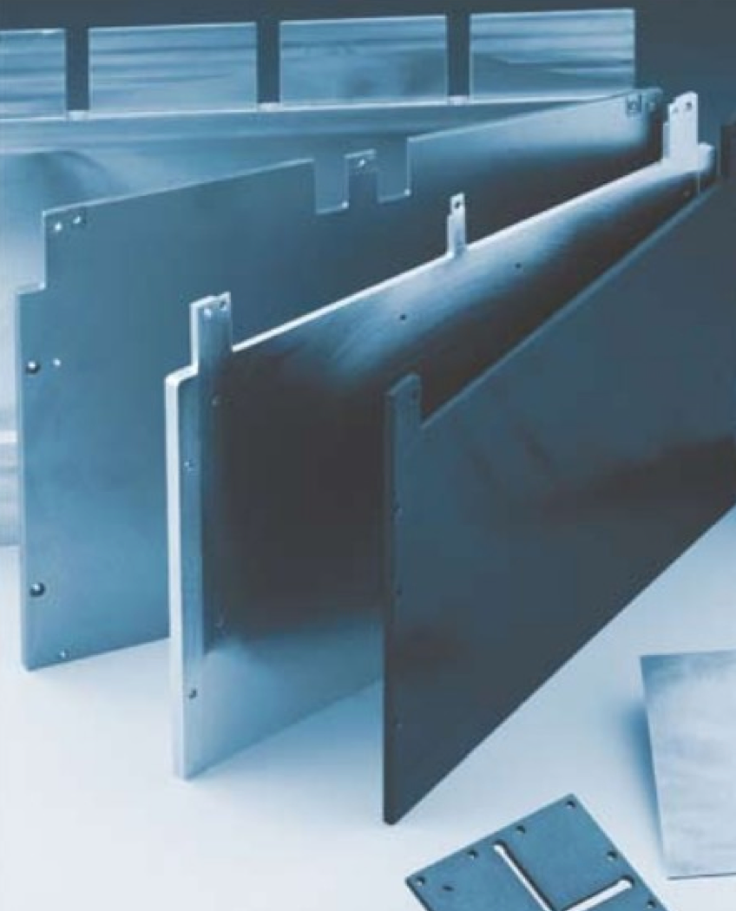
R&D on Power Pulsing and Cooling
Test with Dummy Module
Open 2-Phase CO2 Cooing System for detector cooling tests at KEK
2-PCO2 Cooing Circulation System at KEK
Cooling Channel R&D
cooling pipes
TPG: Carbon
(Momentive)
Thermal conductivity ~3 x that of Cu
The two phase CO2 cooling
system for the LC TPC R&D
(Delivered at NIKHEF)
Thermal simulation

Slide 20
Readout Electronics

Slide 21
S-ALTRO 16 Development
as a Pre-advanced Stage
done

Slide 22
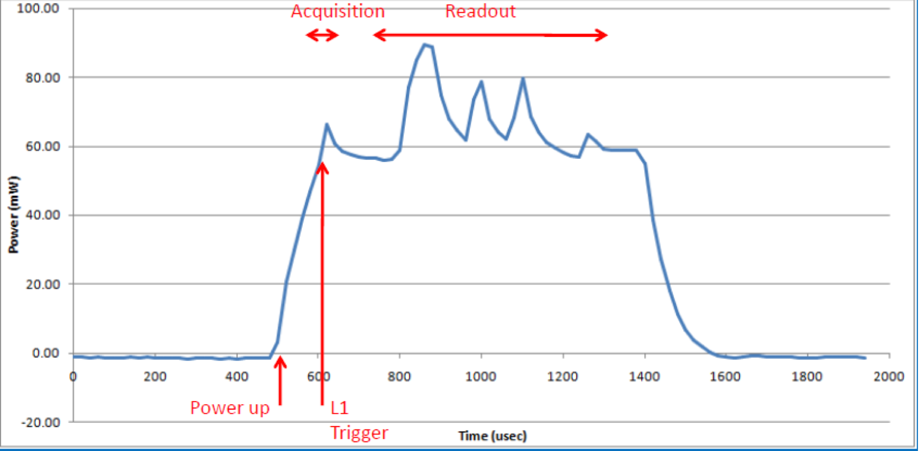
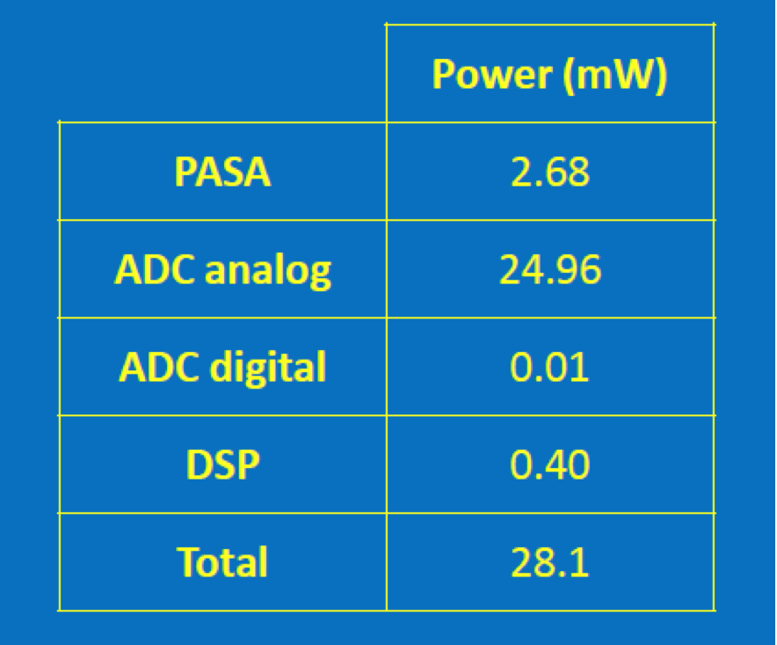
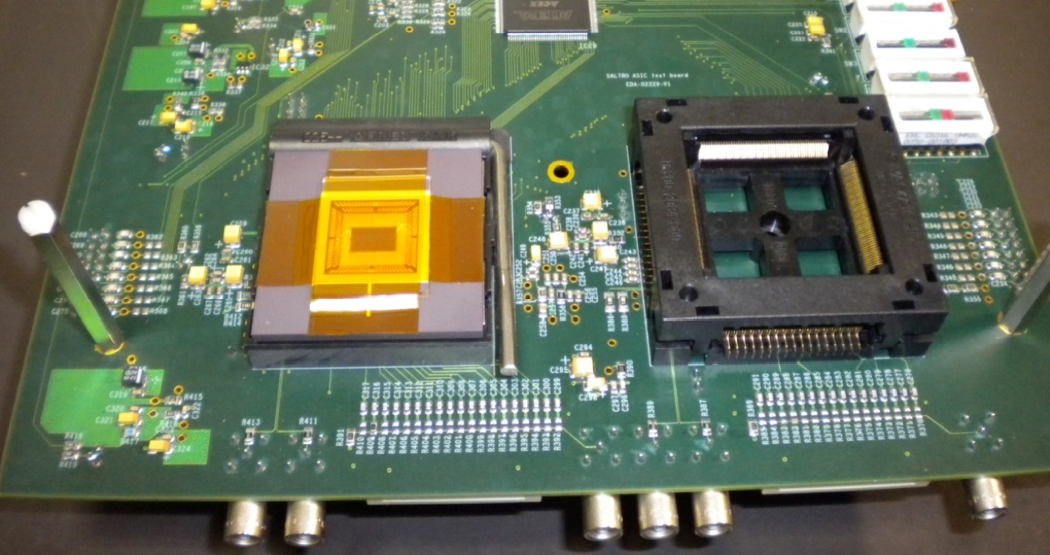
Gas detector Signal Processor ?
Our path not yet totally clear (definitely need collaboration)
S-ALTRO 16 Power Pulsing Test
S-ALTRO
756mW / chip if no power pulsing
28mW / chip if 5Hz power pulsing
Next Step
Still too high!
Natural successor of S-ALTRO chip
Very low power ADC: 4mW/ch, complete revision of other sections, too, for low power consumption.
S-ALTRO → GdSP 64 → 128ch / chip ?
Optimized DSP
Fully accommodates power pulsing
Section-by-section power management
Applications: CMS high-η, ILD-TPC, ...?

Slide 23
Summary

Slide 24
Now and Future
The France-Japan collaboration on the LCTPC R&D has
clarified the basic principles to determine the spatial resolution through series of test beam experiments using a Large Prototype TPC and through development of an analytic resolution formula to understand their results, and
demonstrated that both the GEM and the restive anode readout Micromegas modules meet the ILC’s σrφ requirement.
In addition to further R&D for solving remaining issues towards the engineering design of the GEM or MM module on each side, we need to work together on the following common issues:
Tracking and analysis software R&D,
Gating Device,
2-Phase CO2 Cooling, and
Readout Electronics: Analog-Digital mixed chip for (semi-)surface mounting.
The France-Japan team has been the driving force of the LC-TPC collaboration. This tradition should continue towards the final design of the Linear Collider TPC.

Slide 25
Backup

Slide 26
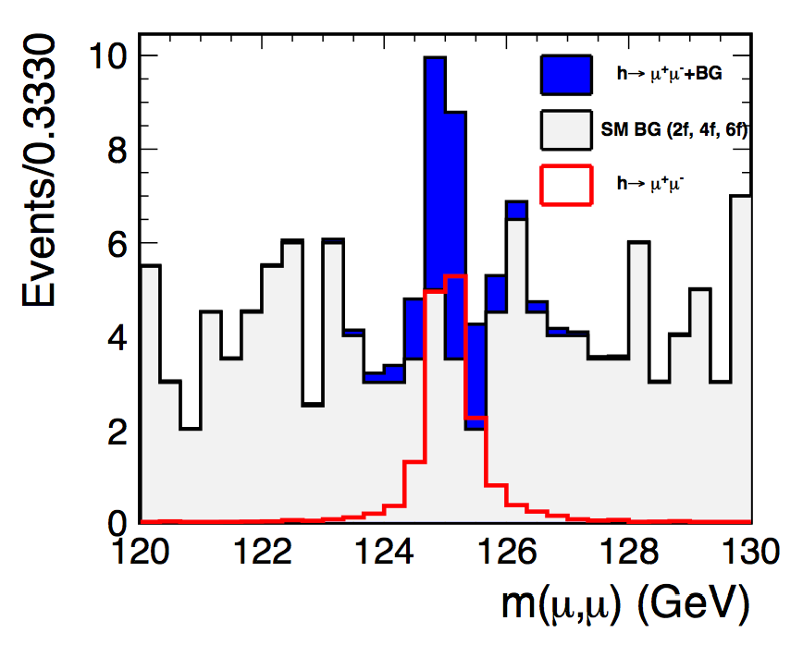
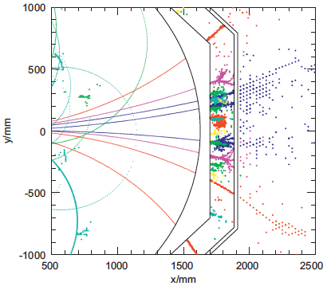
Performance Goals
Momentum Resolution: σ(1/pt) = 2x10⁻⁵ (GeV⁻¹) >200 sampling points along a track with a spatial resolution better than σrφ~100 μm over the full drift length of >2m in B=3.5T (recoil mass, H→μ⁺μ⁻).
High Efficiency: 2-track separation better than ~2mm to assure essentially 100% tracking efficiency for PFA in jetty events. High tracking efficiency also requires minimization of dead spaces near the boundaries of readout modules.
Minimum material: for PFA calorimeters behind, also to facilitate extrapolation to the inner Si tracker and the vertex detector
1-to-1 track- cluster matching for exact Ech subtraction
Recoil Mass Measurement
H→μ⁺μ⁻
Particle Flow Analysis

