Slide 1
LC計画推進室からの報告
山本 明
LC計画推進委員会・2016-1-7

Slide 2
KEK-LC： FY2015 Plan
M | Date | LC・ Comm. | KEK-LC / Domestic | LCC / International | AY @ KEK/JP
9 | 7, 14, 21, 28 |  | 1-4: OHO-2015 at KEK 6: KEK つくば一般公開 14: ILC測定器月例会 25-28: 物理学会（大阪市大・杉本C) 26: 物理学会.ILC シンポジウム | 2-4: PosiPol Meeting at Daresbury 7-11: LFC15 at Trento (横谷） 14-18, SRF2015 at Vancouver | 1-6 26-30
10 | 5, 12, 19, 26 | 15: LC計画推進委 | 7: ILD Detector Int.WS in Paris 29 : KEK つくば防火訓練 30:東北・超伝導低温工学会講演（山本） | 13-14: L. Evans in Japan 19-23, MT-24 at Soul 26-30: LH-LHC/LARP at CERN | 13-15, 31 (30:仙台）
11 | 2, 9, 16, 23, 30 |  | 17: 野村総研・KEKヒアリング 18：文科省・ILC 人材検証 WG 20: STF今後の取組・意見交換 | 2-6: LCWS-2015 in Whistler 24: EuroCirCol at CERN | 1, 16-20
12 | 7, 14, 21 28 |  | 8-10: 測定器・年会 -- 11: STF 運転 -- 18: ATF運転, 18: 忘年会 (笹の家） 21: 文科省・ILC 人材検証WG | 1-4: TTC at SLAC 4: CBMM Collab. Mtg. at JLab 4: TRIUMF-KEK 会議（横谷） | 14-21
1 | 6, 11, 18. 25 | 7: LC計画推進委 | 6: LC(新年）打ち合わせ 6: 機構長・年頭挨拶 | 13-15 : ATF TB at LAL 18-19 ; IAS (横谷、山本） | 6-8, 20-21
2 |  |  | XX, 文科省・ILC 人材検証WG | 25-26: LCB-ICFA mtg at KEK
3 |  | ? LC 計画推進委 | XX 日本物理学会

Slide 3
Status in Japan
Akira Yamamoto
Report for the TB meeting,
5 January, 2016

Slide 4
SRF Progress in ‘15, and Prospect in ‘16
STF: CM1+CM2a Gradient Performance
  G-average = 30. 3 MV/m
  CM1-upstream : 39, 37, 35, 36 MV/m
    not degraded
  CM1-downstream: 26, 16, 26, 32 MV/m
    Clearly degraded
  CM2a: 18, 34, 33, 32 MV/m
    partly degraded
New Input-coupler (Tesla compatible) to be tested soon
RF wave-guides delivered and to be assembled
  8-cavity string to be connected to Klystron
  8-cavity string RF test to be realized in May through July

Slide 5
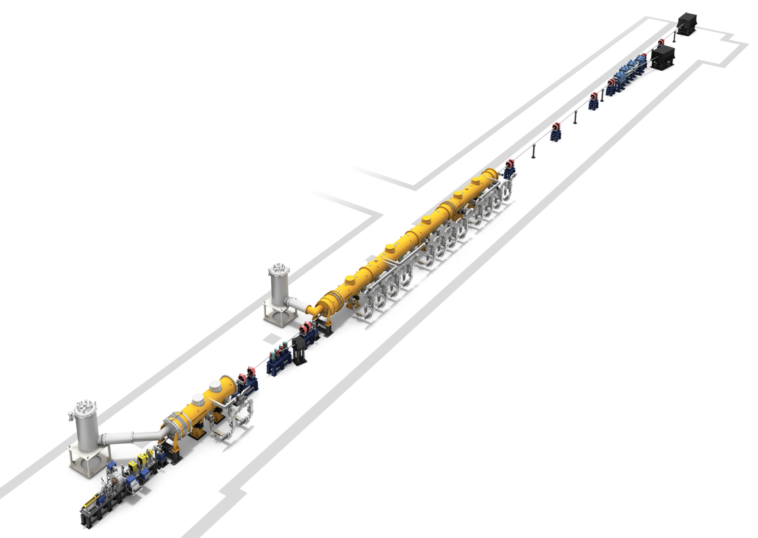
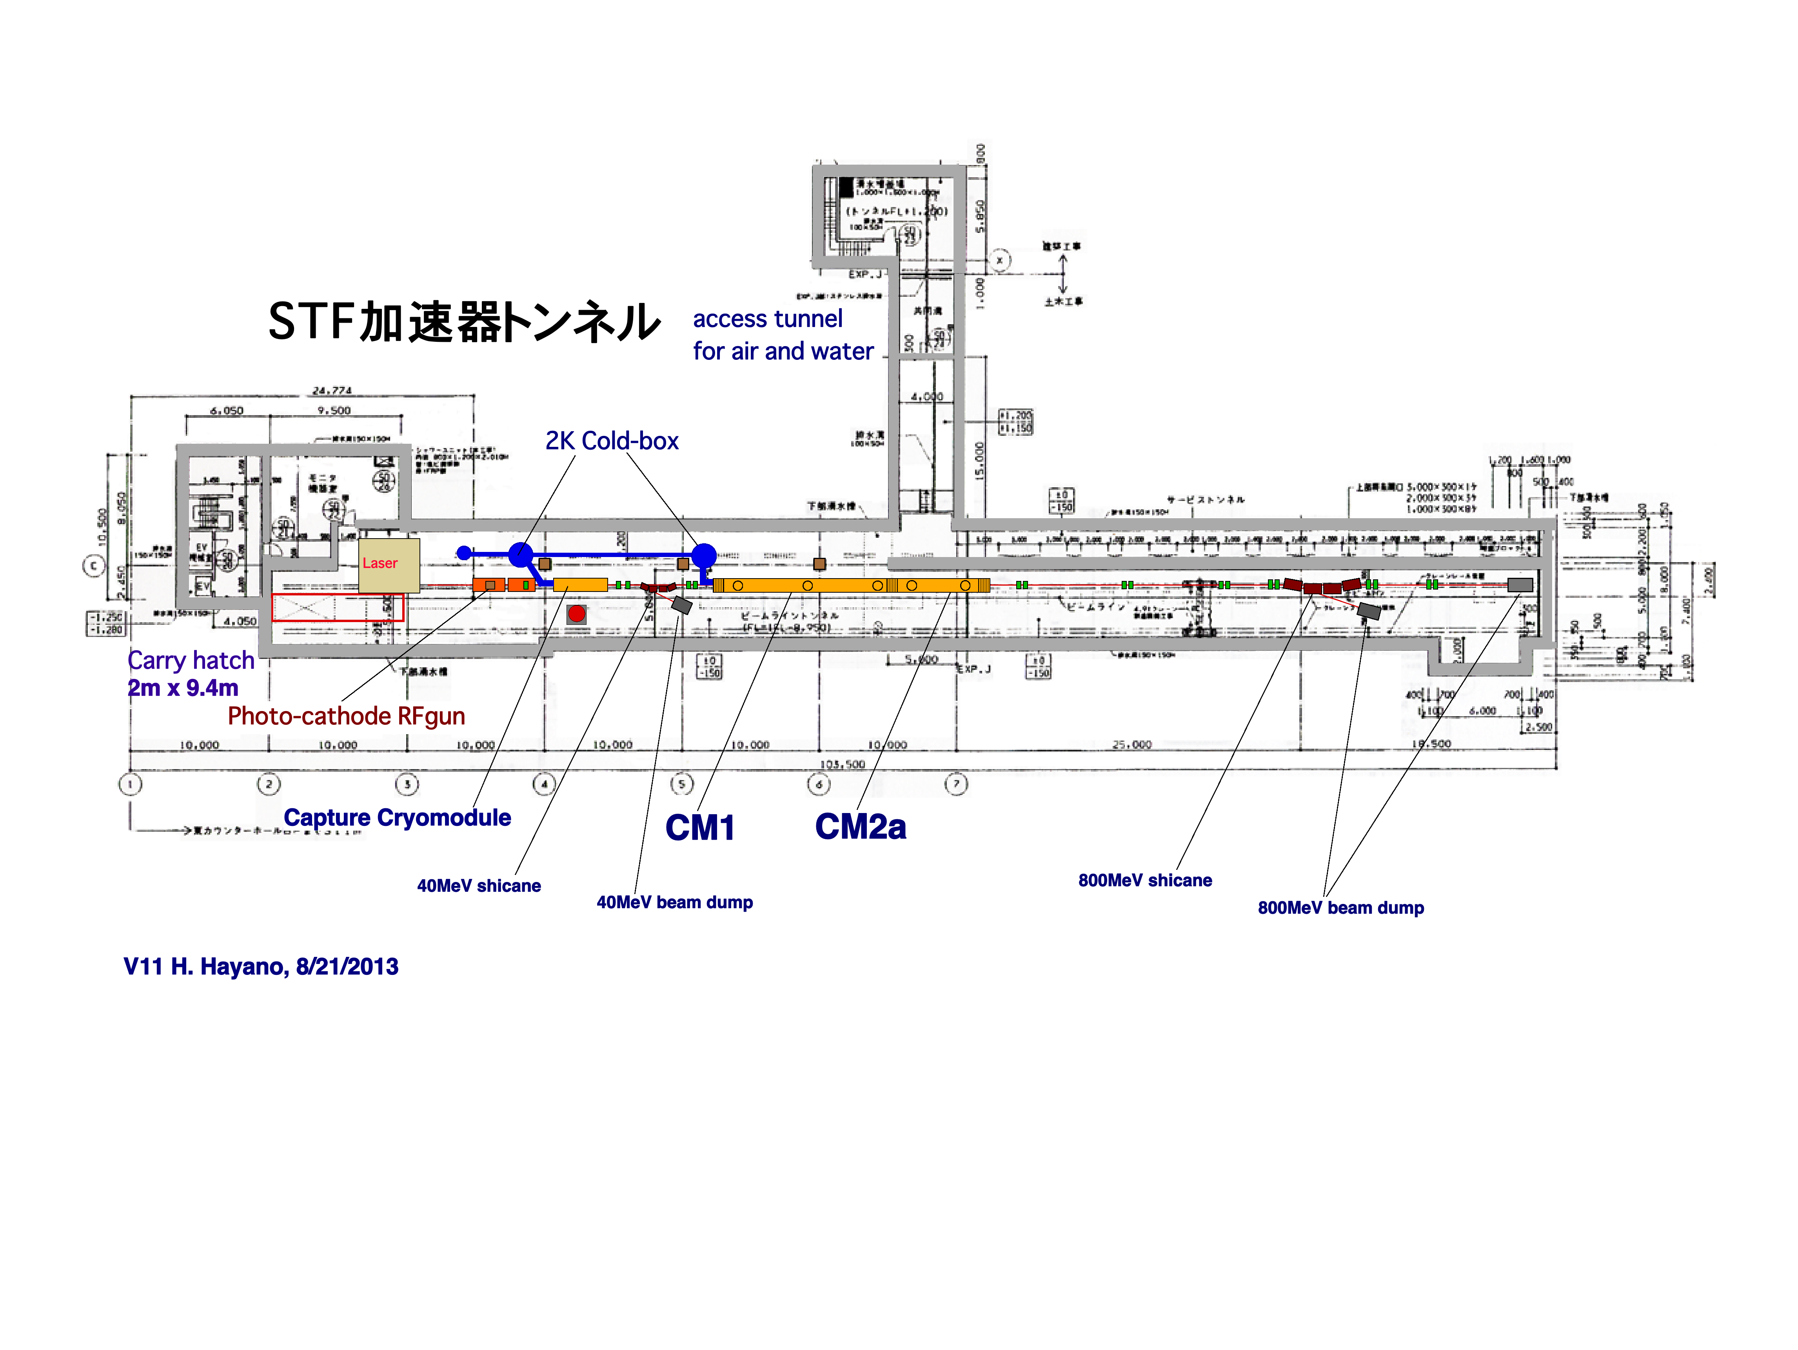
CM Test and Beam Acceleration
Design
Beam Energy：418MeV (40MeV + 31.5MeVx12cavities)
Beam Charge： 2.15nC/bunch, 2437bunch, 0.9ms, 5Hz
Beam current: 5.8mA in train
Bunch train: 369ns spacing
ILC-TDR、2E10/bunch, 1312bunch/train
554ns spacing, 0.72ms train length
5.8mA peak current

Slide 6
2016年時のSTF加速器の計画
CM1とCM2aが連結設置。 ビームラインは将来のクライオモジュール追加を想定
してマグネットやビームダンプを後方に配置する。
CM2b,CM3a,CM3bの予定の場所にはQマグネットダブレットを３組配置するが、
CMを組み込むときには順時外していく。
上流に40MeVダンプ１台、下流に800MeVダンプ２台（１台はエネルギー
アナライザー後のダンプ）

Slide 7
Cryogenics Layout Study
CR-008 ready to be submitted to the CMB
  Main compressor and He storage on surface
New Actions:
  4K cold-box location to be further studied
    An industrial study contracted with Taiyo-Nissan (Linde) for cold-box optimization study and thermal balance. A clear view expected by the next LCWS-Spain
    A technical study contracted also with J-Power, for CFS cost difference.

Slide 8
CFS Progress
ILC TOT program delivered to KEK
  Study for access-hall direction and and access tunnel approach to surface being started
  A special action needed to establish a consensus
    ML orientation (CM and RF utility sides)
    Access hall direction,
      Still some confusion existing
  A mini-workshop in March, to boost layout/access study by using TOT
    An small/additional contract made with ARUP.

Slide 9
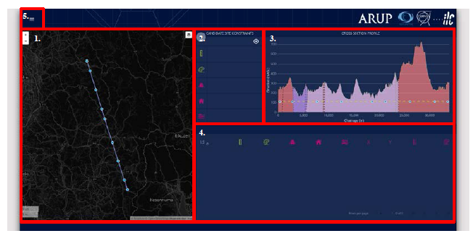
Overview of the ILC-TOT Development
Panel-1:
Map Plan View
Panel-2: Decision Making Constraints
Panel-3: Section View
Panel-4: Decision Output

Slide 10
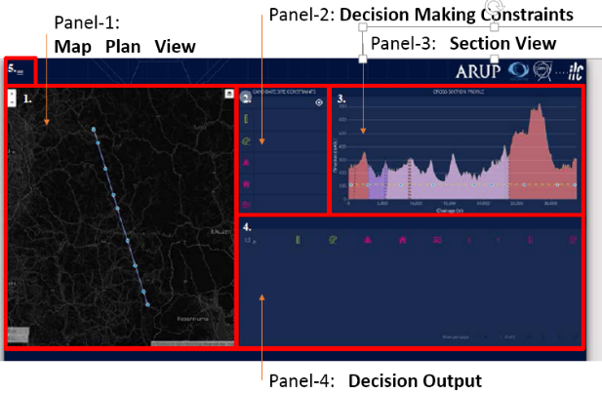
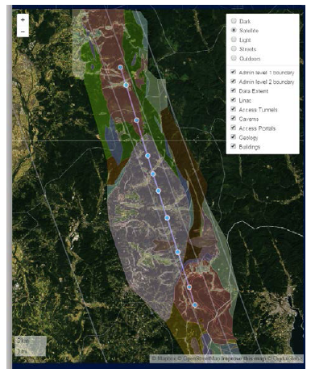
Panel-1:
Map Plan View
Layers:
Dark (enhancement)
Satellite (orthophotography)
Light (enhancement)
Streets (street map)
Choose data layers:
a. Admin Level 1 boundary (Prefecture)
b. Admin Level 2 boundary (Region)
c. Data
d. Linac (Displays chosen Linac option)
Access Tunnels
Caverns
Access Portals
h. Geology
i. Buildings (Displays building locations)

Slide 11

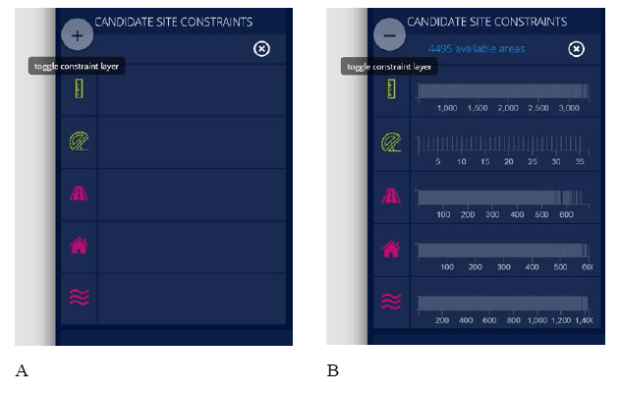
Panel-2: Decision Making Constraints
Decision Making Constraints
Tunnel Length (m)
Terrain Slope ( °)
Distance to Roads (m)
Distance to Build. (m)
Distance to River (m)

Slide 12
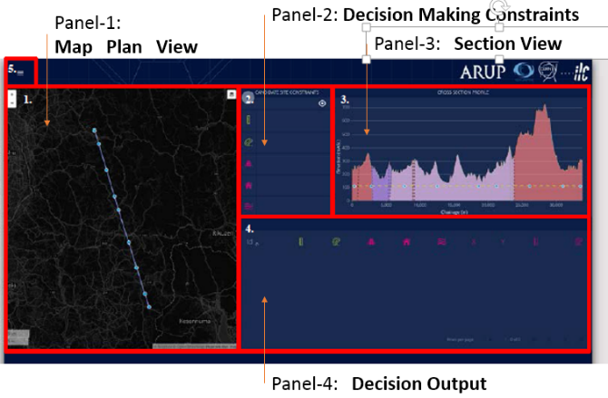
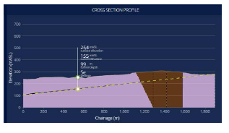
Panel-3: Section View
Profile:
Surface elevation:
Tunnel elevation:
Tunnel Depth:
Geology:

Slide 13
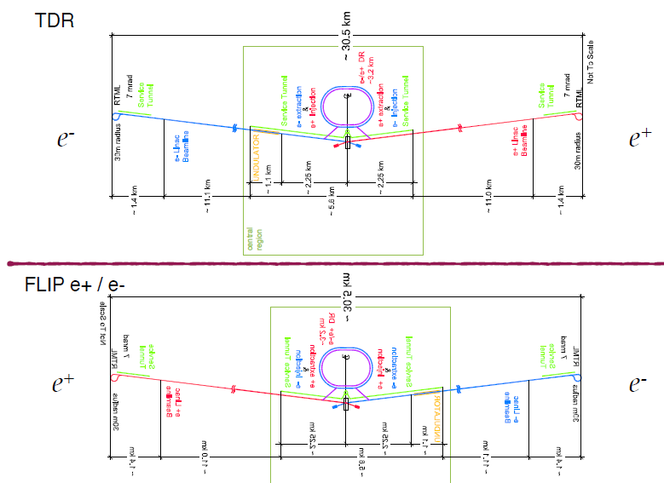
北上サイトにおける施設レイアウト (3)
Sanuki Report: 2014.11 @ADI-WS

Slide 14
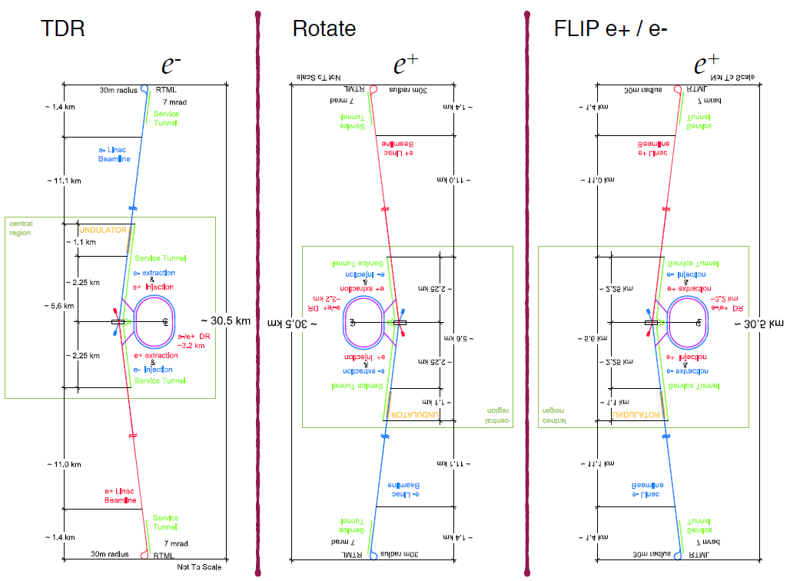
ILC Accelerator Layout
Some confusion and alternate options

Slide 15
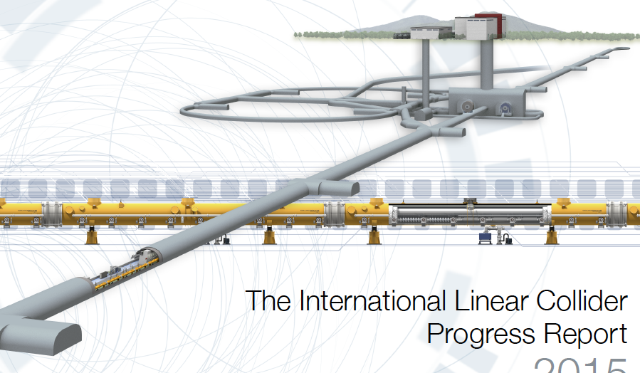
Tunnel Access Consideration
北 e-
Access Hall
南から北を見たＭＬ断面
Good for installation
南 e+
Good for maintenance

Slide 16
本日の報告内容 まとめ
現状の理解
ML本体、DHに比べアクセス・インストール問題に関する
技術検討・議論；不十分。
インストール方法と施設計画の擦り合わせ；未済
取り組むべき課題
CFS：TOTツール活用によるアクセス施設の最適化
加速器サイドとCFSの協議による合意形成：
- インストール方法の詳細についての共通理解
- アクセス施設の計画案（新モデル）策定
DR,BDSを含めた全体のアクセス計画コンセプト策定

