Slide 1
第25回・LC計画推進委員会
日時： 4月17日（木）13:00 ~ 17:00
場所： 3号館1階 セミナーホール
議 事
１．日本学術会議での審議状況 （相原委員：リモート）
２．リニアコライダー計画推進に関する状況 （鈴木機構長）
３．LCBおよび高エネルギー研究者会議報告 （駒宮委員）
４．リニアコライダー戦略会議からの報告 （山下委員）
５．KEK-LC推進室からの報告 （山本)
６．ILC CFS-ADI joint Meeting からの報告 （榎本委員・宮原氏）
７．ILC 準備段階における技術的準備課題・方策 （山本）
６．ディスカッション （全員）
次回： 6月１３日（金）
次次回： 9月16 日（火） （にて調整）

Slide 2
ILC加速器
『設計から実現』への取り組み
山本 明
技術的取り組み
Global/CERN-Europe-KEK の協力推進
LCC とKEK の連携・協力分担

Slide 3
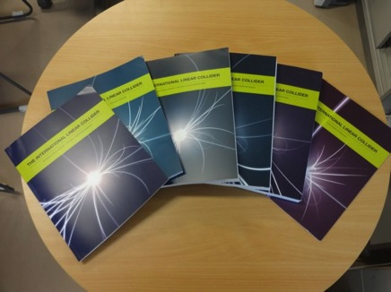
ILC Technical Design Report: 2013-6-12 公開

Slide 4
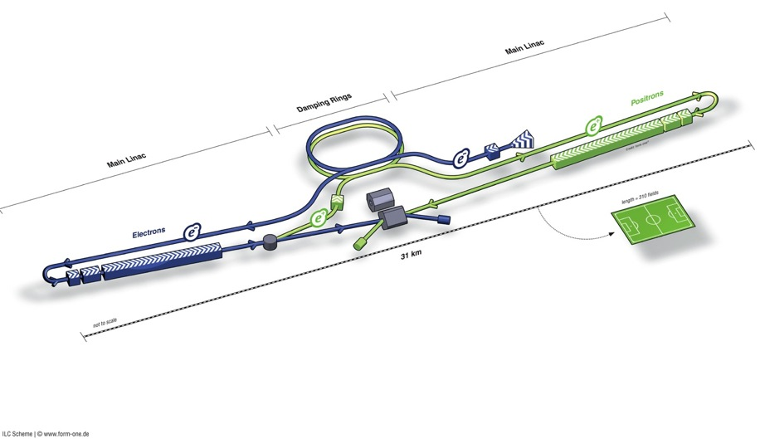
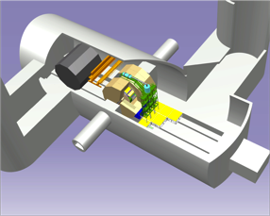
ILC TDR Design
Damping Rings
Polarised electron source
Ring to Main Linac (RTML)
(including
bunch compressors)
e+ Main Linac
e- Main Linac
Parameters | Value
C.M. Energy | 500 GeV
Peak luminosity | 1.8 x10³⁴ cm⁻²s⁻¹
Beam Rep. rate | 5 Hz
Pulse duration | 0.73 ms
Average current | 5.8 mA (in pulse)
E gradient in SCRF acc. cavity | 31.5 MV/m +/-20% Q₀ = 1E10
E+ source

Slide 5
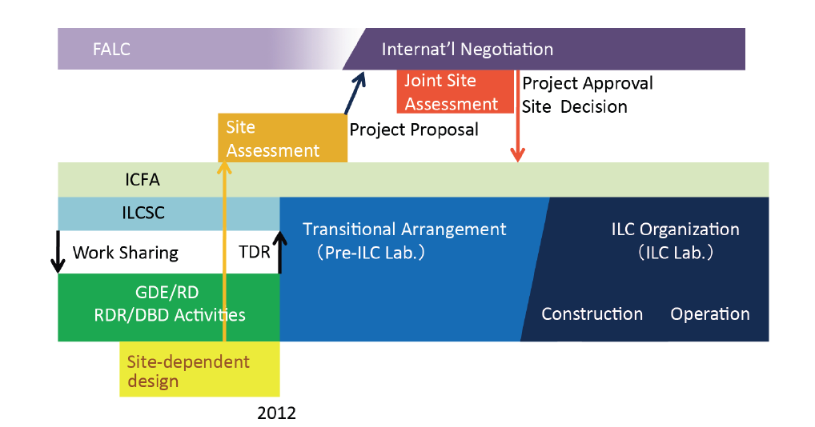
ILC Time Line: Progress and Prospect
Expecting: 3+2 year

Slide 6
ILC Time Scale required
 | 12 | 13 | 14 | 15 | 16 | 17 | 18 | 19 | 20 | 21 | 22 | 23 | 24 | 25
ILC TDP/TDR
ATF-II | Beam test
ATF-future |  |  | Extended program
STF
QB | Beam test
STF2- CM1+CM2a |  |  | Beam test
STF-Future |  |  |  | Extended program
CFS
Civil eng.
Site-survey
 |  |  | 14 19 |  | 16 21 |  |  | 19 24 |  |  |  |  |  | 25 30
ILC constr. |  |  |  |  |  |  |  |  |  |  |  |  |  | Commissioning
Fabrication |  |  | Preparation for the project |  | Preparation for industrialization |  | Fabrication and tests, preparation for installation
Inst/commission. |  |  |  |  |  |  |  |  |  |  | Installation
After getting Green Sign、
・Preparation for contract： ~ 2 years
・Construction period： ~ 10 years
・If the green sign given in 5 years、
ILC to be realized by 2030

Slide 7
Further Works in Preparation Phase
Accelerator Engineering Design
Positron Source: Conventional source development as backup
Damping Ring: Ultra low emmittance beam, and the stability, Undulators, 650 MHz SCRF
RTML: residual magnetic field effect in long beam transport-line
ML: Cavity integration, CM engineering for cost-effective industrialization, Cryogenic Eng.
BDS: Final focusing with nano-beam, alignment w/ tighter tolerance, and design update
Beam Dynamics: Accurate lattice design based on the specific site
CFS: Site specific work including Detector hall and Central Campus design and others
EDMS: engineering based on the EDMS

Slide 8
LCC-ILC準備段階・包括的技術課題
加速器の設計最適化（詳細技術設計）
  加速器設計パラメータの最適化
  250 GeV から500 GeV へのStaging 具体案
  信頼性の高い陽電子源（バックアップ）の設計、実証。それに伴う加速器全体設計
  陽電子／電子衝突タイミング調整の為のラティス詳細設計最適化（DR, RTML, ML 長さのマッチング
  衝突点における衝突角度の確定
ILC 土木・建築設計（建設サイトを特定した設計）の最適化
  地質調査（更なるボーリング、）精細化、加速器レイアウトの固定
  中央キャンパス、（リモートキャンパスアクセスポイントの選定・固定 （これに伴う、地域と連携した調整）
  環境アセスメント：
加速器要素設計・量産技術（性能／コスト）の最適化、システム技術実証
  超伝導加速空洞技術
  ナノビーム技術
  陽電子源技術の確立、技術（耐久性）実証試験
  衝突点ビームコミッショニング技術
  要素・安全アセスメント（放射線、高圧ガス等）
コスト、人員、スケジュールの精度向上
  サイト候補地が一本化された段階での、詳細、具体的な検討に基づく、コスト再評価
  国際協力によるコスト、人員の配分の具体的な検討、国際協力交渉
広範な学術、技術への貢献、展開
  エネルギーフロンティアとしての展開、より広範な加速器応用展開等

Slide 9
ILC建設にむけた土木・建築設計準備
FY-H26
P1 |  | P2 |  | P3 |  | P4 |  | P5
Planning
Basic Design
Detailed Design
Tendering
Cost Estimate
Geological Survey
Basic Survey
Detailed Survey
Additional.
Topographical Survey
Basic
Detailed
Construction
Land Acquisition
Compensation
Site Decision
Land Negotiation
Acquisition
Environmental Impact Study
Preparation
Environmental Impact Survey
Permission

Slide 10
Linear Collider
R & D Status in Cooperation between CERN and KEK, focusing on ILC
Akira Yamamoto (KEK/LCC)
CERN-KEK Committee, 30 December, 2013

Slide 11
Cooperation Anticipated between
KEK-CERN-European Laboratories
Nano-beam handling technology
  Nano-beam and the stability as a common subject for both ILC and CLIC, through ATF collaboration
  Final focusing including magnet and the mechanical stability, as well as commissioning technology, still to be investigated
SCRF cavity integration technology,
  Specially on input-power couplers and tuners, as a common subject for both ILC and SPL for LHC injector upgrade,
Cryogenic engineering
  Specially on handling of large amount of helium inventory, as a specially crucial issue in mountain region,
Civil engineering study
  specially for the detector-hall design,

Slide 12

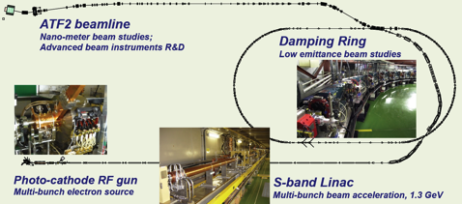
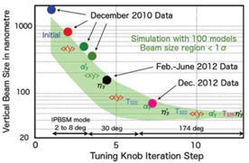
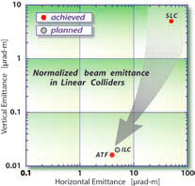
KEK-ATF：Progress
Ultra-small beam
Low emittance : KEK-ATF
  Achieved the ILC goal (2004).
Small vertical beam size : KEK ATF2
  Goal = 37 nm,
    160 nm (spring?, 2012)
    ~65 nm (April. 2013) at low beam current

Slide 13
ATF Future Plan
ATF長期計画(案)
GDE
Next KEK Roadmap
CY
2011
2012
2013
2014
2015
2016
2017
2018
ILC
others
Delay by fire and earthquake
Nano beam orbit control
Develop.(2nmBPM, Fast FB)
Nano beam orbit control (FONT extension)
Beam study
2nm stab. R&D
2nm steady op.
Beam study
37nm
Steady op.
Challenging R&D of the Very high chromaticity optics
Ultra small beam ~ 20 nm
Small beam
Gamma-gamma collider R&D
Develop. / beam study
4-mirror optical cavity (LAL/KEK)
Gamma-gamma laser system R&D
Application
High Field Physics
General R&D
Ex) for KEKB; CSR, RF gun,
Instrument develop.,
Low emittance,…
Test beamline for detector?

Slide 14
Cooperation Anticipated between
KEK-CERN-European Laboratories
Nano-beam handling technology
  Nano-beam and the stability as a common subject for both ILC and CLIC, through ATF collaboration
  Final focusing including magnet and the mechanical stability, as well as commissioning technology, still to be investigated
SCRF cavity integration technology,
  Specially on input-power couplers and tuners, as a common subject for both ILC and SPL for LHC injector upgrade,
Cryogenic engineering
  Specially on handling of large amount of helium inventory, as a specially crucial issue in mountain region,
Civil engineering study
  specially for the detector-hall design,

Slide 15
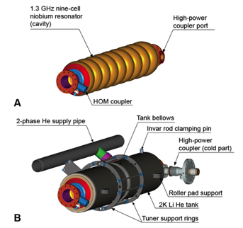
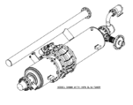
Cavity Integration：工業化への取り組み
9-cell resonator
Input-coupler
  TTF-III coupler
Frequency tuners
  Blade tuner
He tank
Magnetic shield
  Inside He tank

Slide 16
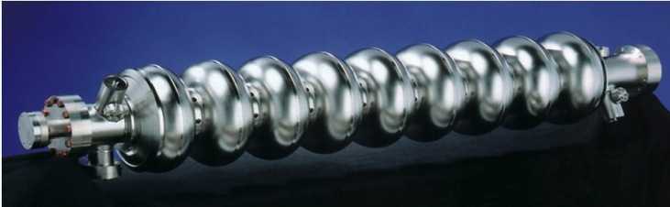
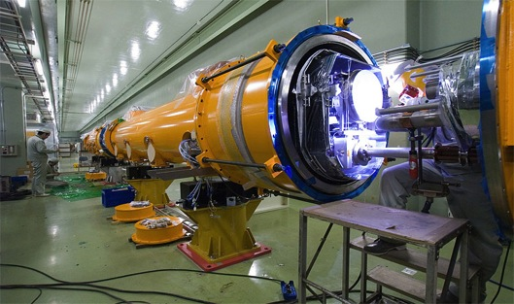
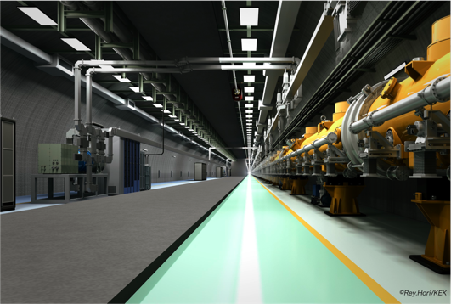
SCRF Linac Technology
1.3 GHz Nb 9-cellCavities | 16,024
Cryomodules | 1,855
SC quadrupole pkg | 673
10 MW MB Klystrons & modulators | 436 / 471 *
* site dependent
Approximately 20 years of R&D worldwide
→ Mature technology, overall design and cost

Slide 17
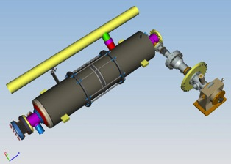
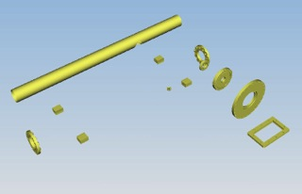
Plug-compatible Conditions
Item | Varieties | Baseline
Cavity shape | TESLA / LL | TESLA
Length |  | Fixed
Beam pipe flange |  | Fixed
Suspension pitch |  | Fixed
Tuner | Blade/ Slide-Jack | Blade
Coupler flange (cold end) | 40 or 60 | 40 mm
Coupler pitch |  | Fixed
He –in-line joint |  | Fixed
Plug-compatible interface established

Slide 18
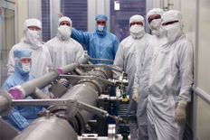
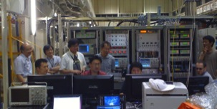
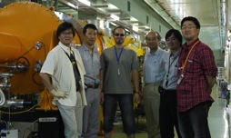
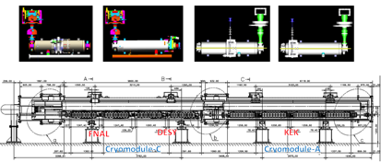
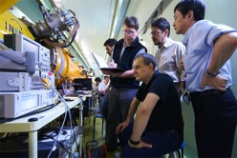
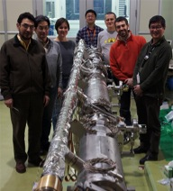
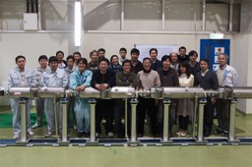
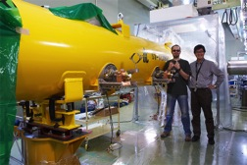
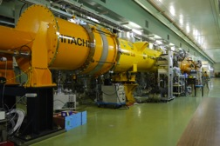
S1-Global hosted at KEK:
Global cooperation to demonstrate SCRF system
DESY, FNAL, Jan., 2010
DESY, Sept. 2010
FNAL & INFN, July, 2010
INFN
and
FNAL
Feb.
2010
March, 2010
DESY, May, 2010
June, 2010 ~

Slide 19


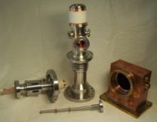
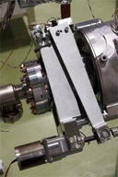
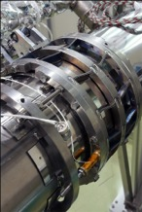
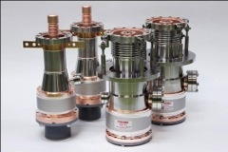
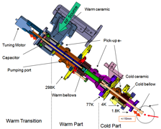
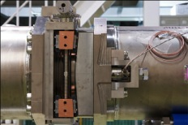
Demonstrations and Evaluation of Various Couplers and Tuners in S1-Global
Every coupler and tuner demonstrated, as expected, and be applicable for ILC cavities
Finding various subjects to be further investigated and settled

Slide 20
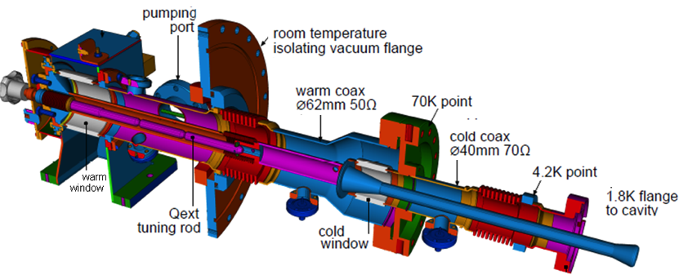
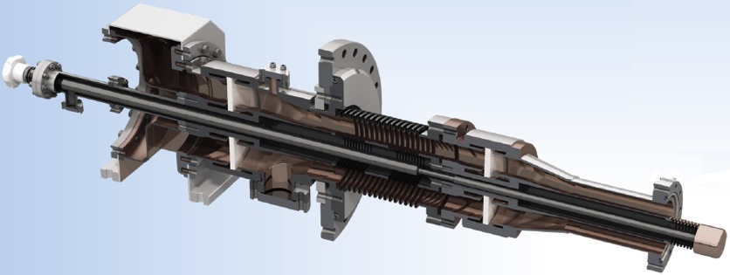
(1) Deep Technical Review of Input Couplers
TTF3/XFEL coupler
TDR coupler
STF-2 coupler
Cu-plating is a key-issue

Slide 21
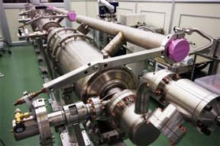
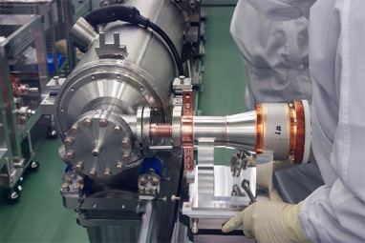
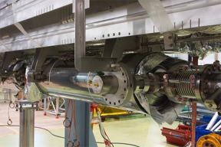
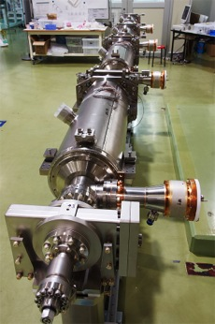
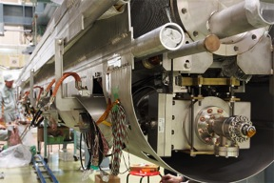
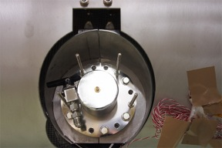
coupler assembly
TTF-III Coupler: various support jigs are required.
KEK STF Coupler:self standing

Slide 22
Actions Agreed at LCWS-2013 AWG7-SCRF Session, toward broadening industrialization (as an example for
STF2 coupler has to demonstrate stable long time (>6 month) beam operation in a CM (TTF3 coupler has a long history in FLASH)
The ILC management recommend an adapted STF2 design with 40mm cavity flange. In this case more development steps have to follow in order to realize the compatible design. The new design has to be proven with beam operation.
The concept of plug compatibility has to be further developed in view of a spare part concept. We recommend spare modules, not individual parts.
An industrial study of mass production for both designs is recommended
Industrial study of STF2 for design optimization and cost reduction is recommended.

Slide 23
Cooperation of ILC host- and hub-laboratories with worldwide industry (proposed)
ILC Host-Lab
Technical Coordination
for Lab-Consortium
Regional Hub-Lab:
A
Regional Hub-Lab:
E, & …
World-wide
Industry responsible to
‘Build-to-Print’ manufacturing
Regional Hub-Lab:
B
Regional Hub-Lab:
D
Regional Hub-Lab:
C: responsible to
Hosting System Test and Gradient Performance
Regional hub-laboratories responsible to regional procurements to be open for any world-wide industry participation
: Technical
coordination link
: Procurement link

Slide 24
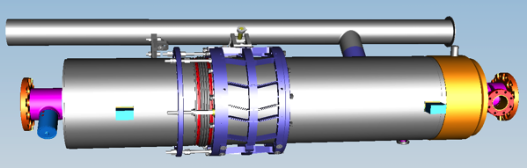
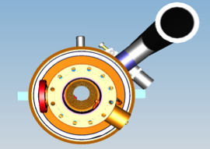
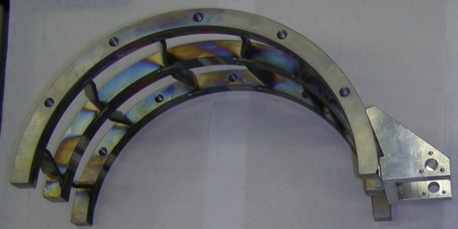
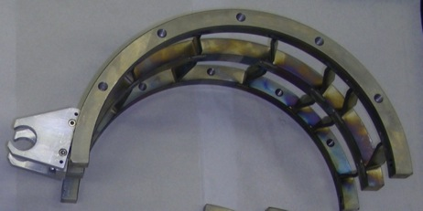
Legend
top
bottom
Toward pick-up side
Toward coupler side
coupler side
motor side
Preassembled parts
Driving unit support elements are already installed on the tuner halves.

Slide 25
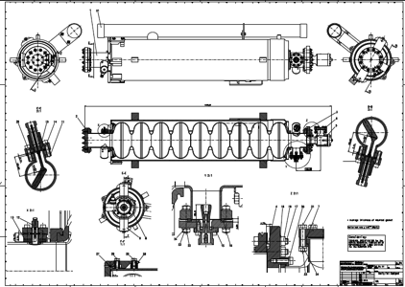
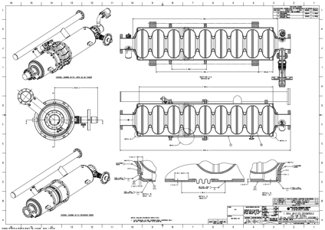
He Tank Design Comparison
EXFEL/FLASH/TESLA LHe tank w/ Saclay/Desy tuner at the axial end
ILC LHe tank design with ‘Blade Tuner’ at the axial center
Note:
Re-visiting overall design of tuner and LHe tank may be required

Slide 26
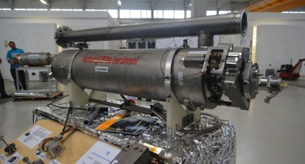
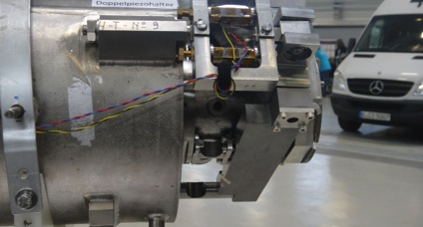
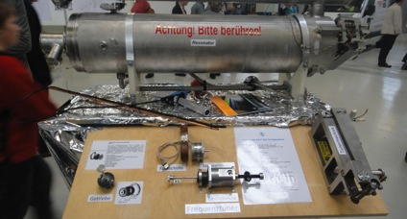
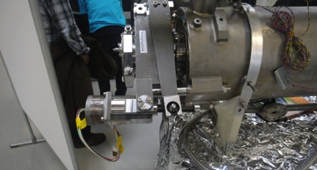
EXFEL Cavity and Tuner

Slide 27
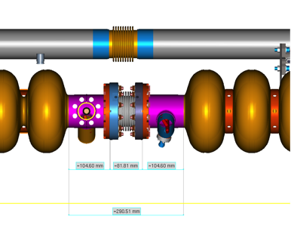
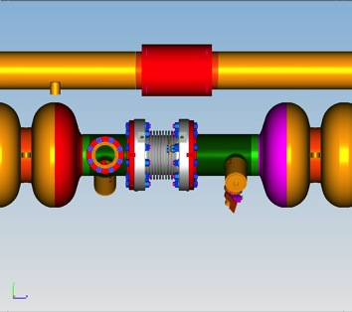
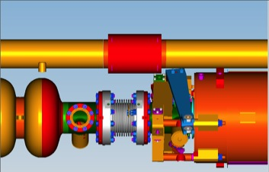
Inter-Cavity Spacing
ILC Type-IV
XFEL
105
82
105
105
108
140
292
353
Reduction in inter-cavity spacing = 61 mm
Bellows: = 108→82 = 26 mm
“Long” cavity end = 140→105 = 35 mm

Slide 28
Cooperation Anticipated between
KEK-CERN-European Laboratories
Nano-beam handling technology
  Nano-beam and the stability as a common subject for both ILC and CLIC, through ATF collaboration
  Final focusing including magnet and the mechanical stability, as well as commissioning technology, still to be investigated
SCRF cavity integration technology,
  Specially on input-power couplers and tuners, as a common subject for both ILC and SPL for LHC injector upgrade,
Cryogenic engineering
  Specially on handling of large amount of helium inventory, as a specially crucial issue in mountain region,
Civil engineering study
  specially for the detector-hall design,

Slide 29


CERN’s Experience for He/N2 Storage to be reflected to the ILC Cryogenics design

Slide 30
Cryogenics Safety
Coordination
  Global Leader: H. Nakai,
    Global coordination should be important for establishing the safety design guidelines
      Contact Persons agreed: T. Peterson (Fermilab) and D. Delicalis (CERN)
      Practical experience important from
        Fermilab (Tevatron and original design work) and CERN (LHC and specially for He inventry management work)
Plans and Opportunities
  4/25: A kick-off meeting at CERN with Fuze connection
    CERN, KEK, and further participation welcome to prepare for AWLC14
  6/18: A mini-review and/or workshop advised by M. Harrison
    A good opportunity to learn the CERN cryogenics safety management and to discuss more
Work during AWLC2014
  5/13: It is suggest to organize a joint parallel session with getting participation of H. Nakai, Peterson, Delicalis, and others to discuss how we may prepare for the major input for the CFS design.

Slide 31
Cooperation Anticipated between
KEK-CERN-European Laboratories
Nano-beam handling technology
  Nano-beam and the stability as a common subject for both ILC and CLIC, through ATF collaboration
  Final focusing including magnet and the mechanical stability, as well as commissioning technology, still to be investigated
SCRF cavity integration technology,
  Specially on input-power couplers and tuners, as a common subject for both ILC and SPL for LHC injector upgrade,
Cryogenic engineering
  Specially on handling of large amount of helium inventory, as a specially crucial issue in mountain region,
Civil engineering study
  specially for the detector-hall design,

Slide 32



Site Specific Design to be carried out
Kitakami
Candidate
Site
Kitakami-site cross section
Damping Ring
Ring To Main Linac (RTML)
Detector Hall
PM+10
PM+12
PM+13
PM-ab
PM+8
Surface Structures
e+ ML
PM-8
e- Source
Existing surface road
PM-10
PM-12
(Slope <7%)
PM-13
e+ Source
Access Tunnel
Access Hall
PX
(Slope <10%)
(Center Campus)
e- Main Linac (ML)
Existing road
RTML turn-around
(The background photo shows a similar site image, but not the real site.)
Need to establish the IP and linac orientation
Then. the access points and IR infrastructure
Then. linac length and timing

Slide 33

Engineering Data Management (EDMS)
Collaborative engineering:
Design integration, visualisation, traceability, configuration management
Design integration:
Geology, Civil engineering, accelerator design, experimental groups
Different user groups:
ILC Community, Planning team, local team, sub-contractors
Standardization:
Names, procedures, formats, conventions, design rules
Tunnel
RF Distribution
Lattice
Cryomodules

Slide 34
Radiation Safety
Coordination
  Global Leader: T. Sanami (KEK)
    Global coordination should be important for establishing the safety design guidelines
      Contact Persons anticipated from: AMs and EU
      Practical experience important from
        SLAC, DESY-FLASH experiences, and CERN experiences,
An opportunity
  “Task-Force on Shielding Aspects of Accelerators, Targets and Irradiation Facilities” – SATIF-12
    https://indico.fnal.gov/conferenceDisplay.py?confId=7469
    http://indico.fnal.gov/event/SATIF12-14
    T. Sanami to participate the meeting, and will try to contact world-wide experts.
Work during AWLC2014
  It will be hard for T.S. to visit twice the US in the same month,
    Some homework may be given, based on the task force meeting above.

Slide 35


Interaction Region design
Detector Requirements both SiD and ILD minimum needs – Karsten Buesser
Discussion
Do we understand the Detector design well enough to determine the CFS Detector Hall requirements ? Is there risk that significant Detector changes could still remain ? Can we identify the major technical cost drivers arising from the Detectors in terms of the CFS, including comparisons of effects with vertical shaft and horizontal access?
Detector assembly models are not finally determined – what is the role of the central lab complex
The various arguments are not cut and dried, surface preassembly helps to decouple CFS from the detector critical path.
In the end the site will dictate - Karsten
7% slope is a lot.
If required either detector can live with either approach. The detector design could/would reflect the access method.
Commissioning scenarios with and w/o the detectors in place are not well developed.
Heavy lifting device ~4M CHF from John Osbourne
Arup Detector anaiysis soon

Slide 36
Pre Construction Design Work
Design Phase Skeleton
1 annual |  | 2 annual |  | 3 annual |  | 4 annual |  | 5 annual
Predesign Phase
Design Phase
Contract Phase
Basic Planning
Basic Design
Detailed Design
Contract
基本計画
基本設計
実施設計
Construction Phase
Estimation
Basic Plan Document
Basic Design Document
Detailed Design Document
Contract Document
基本計画書
基本設計書
実施設計書
施設設計に備えて、 ﾌﾟﾛｼﾞｪｸﾄの基本構想や施設の全体計画、基本仕様等をまとめた文書(事業計画書)
実施設計のために、各計画施設の基本形状や基本寸法等の基本仕様を明示した設計図書
契約や施工のために計画施設の形状寸法や構造・材料・工法等の詳細仕様を明示した設計（契約）図書

Slide 37
まとめ
施設土木設計の積み上げ
  地質調査の補完
  施設・土木・建築設計（基礎検討ーー＞実施設計）
  サイトの具体化
加速器技術
  ATF: ナノビーム技術・システム実証
  STF: 超伝導加速空洞・工業化技術の確立
    欧州(EXFEL) 、米国（LCLS-II) 等との協力による実証
  STF-II 超伝導加速器のシステム実証（STF2)

Slide 38


STF2: 14-417

