Slide 1
Pre-Project Scope of Work
Long term & Medium term plan,
Timeline, Required sources, Profile
CFS-ADI Joint Meeting から
CFS near term & Required ADI input
6-12 month activities, required ADI information
17. Apr 2014
KEK リニアコライダー計画推進室
宮 原 正 信

Slide 2
Pre Construction Schedule
Long term & Medium term
1 annual |  | 2 annual |  | 3 annual |  | 4 annual |  | 5 annual
Predesign Phase
Design Phase
Contract Phase
Basic Planning
Basic Design
Detailed Design
Contract
Estimation
Construction Phase
LCC Review
LCC Review
LCC Review
Basic Plan Report
Basic Design Document
Detailed Design Document
Contract Document
Investigation in the Design Phase
地形測量
Topographical Survey
地質調査
Geological Survey
環境アセス
Environmental Assessment

Slide 3
Pre Construction Design Work
Design Phase Skeleton
1 annual |  | 2 annual |  | 3 annual |  | 4 annual |  | 5 annual
Predesign Phase
Design Phase
Contract Phase
Basic Planning
Basic Design
Detailed Design
Contract
基本計画
基本設計
実施設計
Construction Phase
Estimation
Basic Plan Document
Basic Design Document
Detailed Design Document
Contract Document
基本計画書
基本設計書
実施設計書
施設設計に備えて、 ﾌﾟﾛｼﾞｪｸﾄの基本構想や施設の全体計画、基本仕様等をまとめた文書(事業計画書)
実施設計のために、各計画施設の基本形状や基本寸法等の基本仕様を明示した設計図書
契約や施工のために計画施設の形状寸法や構造・材料・工法等の詳細仕様を明示した設計（契約）図書

Slide 4
PAn investigation plan in every phase
Investigation Plan
Investigation Required by each phase
 | Basic Planning | Basic Design | Detailed Design
Topographical Investigation | Preparation | Basic Survey | Additional Survey
 | Collection of the exiting Data & Materials - 1/10,000 map | Creating a topographical map in the ground site - 1/500~1/1,000 | Optional Survey: - Construction site - Temporary site
Geological Investigation | Preliminary Survey | Basic Survey | Additional Survey
 | Necessary Survey: - Boring: 1(near DH) - Seismic wave Survey (1 km, near DH ) | Necessary Survey: - Borehole investigation: 4(near DH) & 6 (near AH) - Seismic wave Survey: (1,000m×5, near A/P) | Optional Survey: - 10 Boreholes(?) - Unknown place of geological conditions Design problem part
Environment Impact Assessment | Preparation | Environmental assessment survey
 | - Draft plan for Field Investigation - Literature Research | - Field Investigation(1) - Making the Submitted document | - Field Investigation(2) - Creating an Evaluation document
地形測量
地質調査
環境ｱｾｽ

Slide 5
PAn investigation plan in every phase
Investigation Plan
Investigation Required by each phase
 | Basic Planning | Basic Design | Detailed Design
Topographical Investigation | Preparation | Basic Survey | Additional Survey
 | Collection of the exiting Data & Materials - 1/10,000 map | Creating a topographical map in the ground site - 1/500~1/1,000 | Optional Survey: - Construction site - Temporary site
Geological Investigation | Preliminary Survey | Basic Survey | Additional Survey
 | Necessary Survey: - Boring: 1(near DH) - Seismic wave Survey (1 km, near DH ) | Necessary Survey: - Borehole investigation: 4(near DH) & 6 (near AH) - Seismic wave Survey: (1,000m×5, near A/P) | Optional Survey: - 10 Boreholes(?) - Unknown place of geological conditions Design problem part
Environment Impact Assessment | Preparation | Environmental assessment survey
 | - Draft plan for Field Investigation - Literature Research | - Field Investigation(1) - Making the Submitted document | - Field Investigation(2) - Creating an Evaluation document
地形測量
地質調査
環境ｱｾｽ

Slide 6
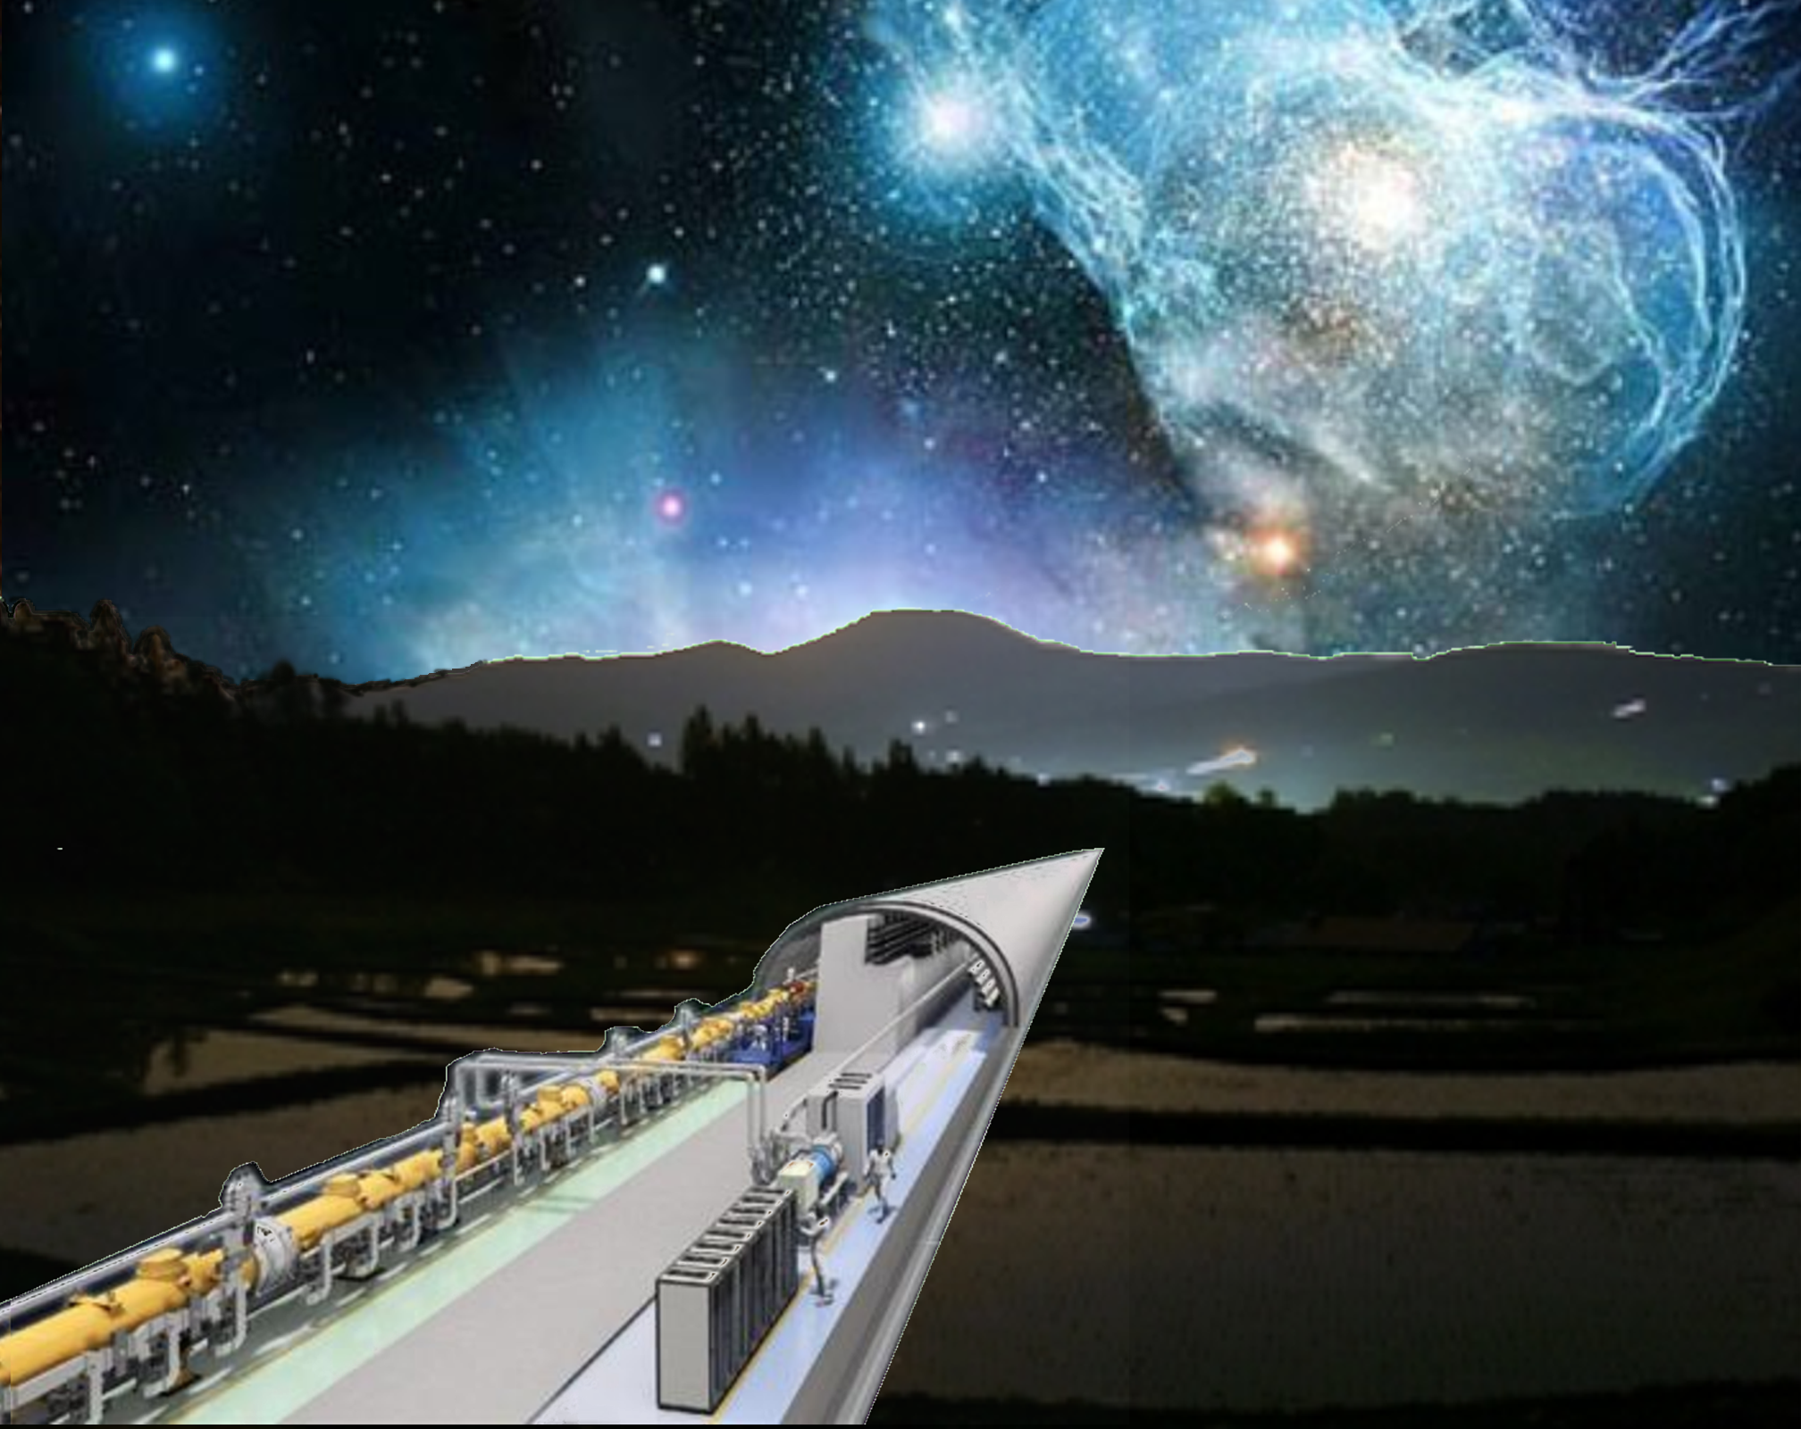
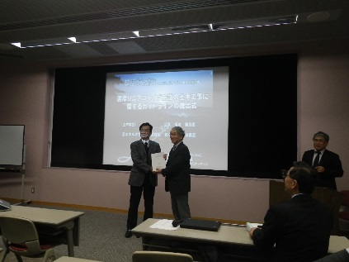
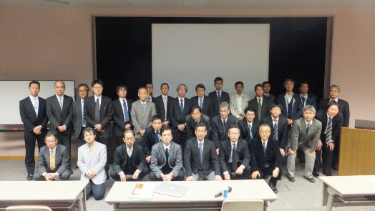
PAn investigation plan in every phase
Geological Investigation
Proposal from JSCE／ILC sub-committee
Guidlines for the Civil Engineering
Work of ILC Facilities
ＩＬＣ地下構造物の設計・施工ガイドライン
3. Apr 2014
5 Sectional Meetings
■ Project Investigation
■ Large Cavern
■ Horizontal Tunnel
■ Special Tunnel
■ Disaster Prevention

Slide 7
PAn investigation plan in every phase
Geological Investigation
Proposal from JSCE in the Guidline (3)
  Important place of Investigation
    Boundary zone with different rock kind (fracture zone, Weathering zone, etc.)
    Place of the Topography changes such as a Valley part and the river-bed part
    Important place for the performance and function of the accelerator facility
過不足なく！ 重要箇所を！
Hitokabe Granite
Senmaya Granite
Orikabe Granite
BDS, DR, DH

Slide 8
Riverbed part
PAn investigation plan in every phase
Geological Investigation
□ Profiles of Geological Surveys along the project
Borehole Survey
New IR point?
Hitokabe Granite
Senmaya Granite
Orikabe Granite
Seismic Exploration Survey
Survey area: @Bedrock boundary, Riverbed part
各フェーズ毎に ｽﾃｯﾌﾟ ﾊﾞｲ ｽﾃｯﾌﾟで！
Profile of Electromagnetic Survey
Geological Survey at pre-construction stage
 | Basic Planning | Schematic Design | Detailed Design
Borehole Survey | - 1 p DH area | - 5 p DH/DR area | - 10 p along the BL
Seismic Exploration | - 1 area /1,000m | - 5 area /5,000m | 0 (Additional)

Slide 9
Environmental Assessment -Ⅰ
System of Environmental assessment
    Environmental impact assessment by Law
    targeted to large-scale development projects.
    (Dam, Road, Railroad, etc.)
    Environmental Impact Assessment by Ordinace (Prefecture)
    targeted to projects not covered in the national system.
    An enterprise cannot be started until it submits an evaluation document.
  Application to the ILC project
    Environmental impact assessment law
    Environmental Impact Assessment Ordinance
    Not applicable (IWATE & MIYAGI pref.)
法ｱｾｽ
条例ｱｾｽ
The pilot survey of the Raptores
Field survey takes time most is on going.

Slide 10
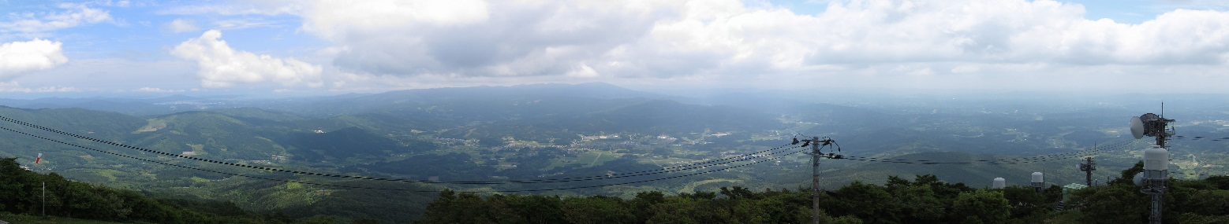

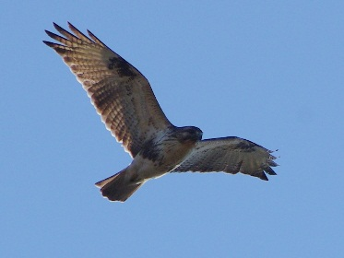
Environmental Assessment –Ⅱ
自主ｱｾｽ
戦略ｱｾｽ
  Voluntary Assessment
    We should do perform the Assessment strategically (SEA)
Strategic Environment impact assessment
Northern goshawk
Golden eagle
Main Survey Item in Environmental assessment
Air Environment | Air quality
 | Noise
 | Vibration
 | Stench
Water environment | Dirt of water
 | Water turbidity
 | Groundwater
Landscape
Other environmental | Geology
 | Noise
 | Foundation
 | Soil
Animal
plant
Waste
Greenhouse gas
猛禽類調査
Rare Creature:
Raptores Survey

Slide 11
Environmental assessment –Ⅴ
Standard schedule based on the local govinmment regulation
Scoping
 | 1 anual |  |  |  |  |  | 2 anual |  |  |  |  |  | 3 annual |  |  |  |  |  | Procedure | Work | Work
Making a Method Document |  |  |  |  |  |  |  |  |  |  |  |  |  |  |  |  |  |  |  | 3.0
Inspection Method Document |  |  |  |  |  |  |  |  |  |  |  |  |  |  |  |  |  |  | 1.0
Resident opinion submitting |  |  |  |  |  |  |  |  |  |  |  |  |  |  |  |  |  |  | 0.5
Create a opinion summary |  |  |  |  |  |  |  |  |  |  |  |  |  |  |  |  |  |  |  | 1.5
Governor opinion submitting |  |  |  |  |  |  |  |  |  |  |  |  |  |  |  |  |  |  | 3.0 |  | Max4.0
Field investigation |  |  |  |  |  |  |  |  |  |  |  |  |  |  |  |  |  |  |  | 12.0
Submission of preparations |  |  |  |  |  |  |  |  |  |  |  |  |  |  |  |  |  |  |  | 4.0
Inspection the preparations |  |  |  |  |  |  |  |  |  |  |  |  |  |  |  |  |  |  | 1.0
Resident opinion submitting |  |  |  |  |  |  |  |  |  |  |  |  |  |  |  |  |  |  | 0.5
Opinion summary submitting |  |  |  |  |  |  |  |  |  |  |  |  |  |  |  |  |  |  |  | 1.5
Governor opinion submitting |  |  |  |  |  |  |  |  |  |  |  |  |  |  |  |  |  |  | 4.0 |  | Max5.0
Creation of the Evaluation Doc |  |  |  |  |  |  |  |  |  |  |  |  |  |  |  |  |  |  |  | 3.0
Inspection the evaluation Doc. |  |  |  |  |  |  |  |  |  |  |  |  |  |  |  |  |  |  | 1.0
 |  |  |  |  |  |  |  |  |  |  |  |  |  |  |  |  |  |  | 11.0 | 25.0
 |  |  |  |  |  |  |  |  |  |  |  |  |  |  |  |  |  |  | 36.0
公告・縦覧
説明会
意見聴取
Field Survey
Key Factors :
Inspection,
Briefing,
Hearing the opinion
Case of Iwate Prefecture
■ Assessment process generally takes ３ years.
■ Pilot Survey is on going by local government !
The Raptores investigation which a field survey takes time most

Slide 12
Pre Construction Schedule
Long term & Medium term
1 annual |  | 2 annual |  | 3 annual |  | 4 annual |  | 5 annual
Predesign Phase
Design Phase
Contract Phase
Basic Planning
Basic Design
Detailed Design
Contract
Estimation
Construction Phase
LCC Review
LCC Review
LCC Review
Basic Plan Report
Basic Design Document
Detailed Design Document
Contract Document
Investigation in the Design Phase
Topographical Survey
Geological Survey
Environmental Impact Assessment

Slide 13
Pre Construction Work Scope
Current Status: Facility Planning Progress
 | Underground Facilities
Work | ML | AH | DR | BDS | DH
Facility Arrangement | B/C | B/C | C | C | B/C
Basic Shape, Dimension | B/C | B/C | B/C | C | B/C
Civil/Architectural Design | C | C | C | C/D | C
Electronic Design | C | C | C | C/D | C
Mechanical Design | C | C | C | C/D | C
Surface Facilities
AY | CS | CC
D | C | D
D | C | D
D | C | D
D | C | D
D | C | D
Legend: Progress degree
Legend: Facility
 | Requirement | Technical Study
A | Clear | Completed
B | Clear less | Under study
C | Unclear partially | Partially executed
D | Unclear | Not yet started
 | Technical Study
AH | Access Hall
AY | Access Yard
CS | Central Substation
CC | Central Campus

Slide 14
In Basic planning stage
Near Term Activities : 1
１ | Decision of Facility arrangement
■ Determination: IR Point & Access way
Revision the DH Configuration (TDR)
Access Facility to DH (VS or HT)
Underground Facilities Layout and configuration
■ Determination: Surface Facility Layout
Surface Facilities planning (Assembly hall)
Kick off some kind of Investigation
(Topographical survey, Environmental Assessment)
Consultation with regional society

Slide 15
In Basic planning stage
Near Term Activities : 2
2 | Decision of Facility arrangement
■ Determination: BL Route and Length
Revision the Access Point (AH & AT portal)
Access Facility to ML (AT length & location)
Consistency with surface environment
■ Determination: Beam line level (elevation)
Vibration Impact Evaluation
(Artificial, Separation from Riverbed)
Access Facility to ML (AT length & location
Groundwater treatment (Natural Drainage system)

Slide 16
In Basic planning term
Near Term Activities : 3
3 | Decision of the basic facilities plan
■ Specific study of Power equipment
(Central power receiving facility)
Location of the Central Power Station
Power voltage, power receiving system
Consultation of Power receiving line
Negotiation with local power company
Planning the emergency power system

Slide 17
Pre Construction Schedule
Long term & Medium term
1 annual |  | 2 annual |  | 3 annual |  | 4 annual |  | 5 annual
Predesign phase
Design phase
Contract phase
Planning
Basic Design
Detailed Design
Contract
Bidding
Review
Review
Review
Topographical Survey
  <Survey for land Acquisition>
Construction Phase
Topographic Document
Basic Survey
Detailed Survey
Environmental Impact Assessment
Assessment Statement
Preliminary
Survey
Environmental Impact Assessment Survey
Geological Survey
Preliminary
survey
Basic survey(1)
Basic survey(2)
Additional Survey
Geological Document

Slide 18
Summary：CFS-ADI Joint Meeting
□ 基本計画段階で決定すべき課題抽出（1年以内）
1. Ｄetector Hall：IP、アクセス方式の見直し
2. ビームライン：ルート、高さ（標高レベル）
3. トンネル長さ、レイアウト（ＢＤＳ/Positron Source）
□ 基本設計に向けた喫緊の課題（CFS）
1. 設計に必要な最小限の経費算定（調査・設計）
2. ＴＤＲ見直しに伴うスケジュール・コストの再検討
3. 基本計画確定のためのＡＤＩへのRequirement集約
4. 基本計画書（案）の策定→ＬＣＣへの提示、レビュー

