Slide 1
Roadmap Review Report
Yasuhiro Okada
LC計画推進委員会
June 11, 2013

Slide 2
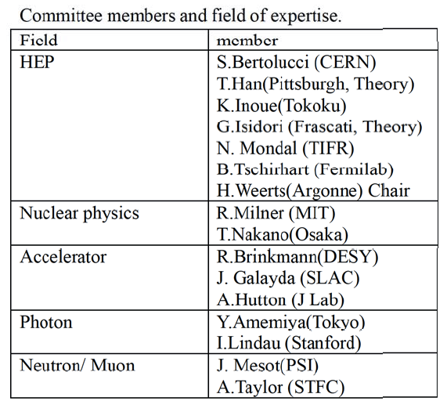
Roadmap review committee
The roadmap review committee was held on April 5-6, 2013 at KEK.

Slide 3
ILC in the Roadmap 2013

Slide 4
General remarks

Slide 5
Comments on ILC

Slide 7
