Slide 1
ILC Technical Status Report
Akira Yamamoto
June 11, 2013

Slide 2
Outline
Technical Status reached in TDR
  Design update from Reference Design Report (RDR’07) to Technical Design Report (TDR’12)
  Results from research & development
  Recommendations given by PAC
Further Plan beyond TDR
  Further work required for detailed engineering to prepare for realization of the ILC project,

Slide 3


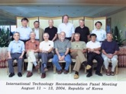
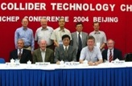

ILC Time Line
1980’ ~ Basic Study
2005
2006
2007
2008
2009
2010
2011
2012
2013
2004
ILC-GDE
LCC
Ref. Design (RDR)
TDR
Tech. Design：TDP1
TDP 2
LHC
Higgs particle
discovery
TDR completion
Selection of SC Technology
126 GeV

Slide 4
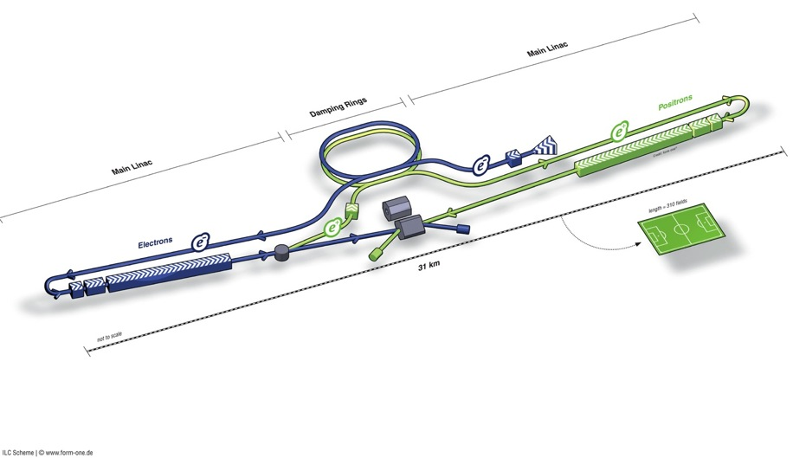
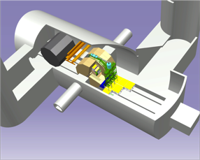
ILC TDR Layout
Damping Rings
Polarised electron source
Ring to Main Linac (RTML)
(including
bunch compressors)
e+ Main Linac
e- Main Linac
Parameters | Value
C.M. Energy | 500 GeV
Peak luminosity | 1.8 x10³⁴ cm⁻²s⁻¹
Beam Rep. rate | 5 Hz
Pulse duration | 0.73 ms
Average current | 5.8 mA (in pulse)
E gradient in SCRF acc. cavity | 31.5 MV/m +/-20% Q₀ = 1E10
E+ source

Slide 5
ILC-TDR: Baseline Parameters
Centre-of-mass dependent:
Focus of design (and cost!) effort
Centre-of-mass energy | GeV | 200 | 230 | 250 | 350 | 500
Electron RMS energy spread | % | 0.21 | 0.19 | 0.19 | 0.16 | 0.12
Positron RMS energy spread | % | 0.19 | 0.16 | 0.15 | 0.10 | 0.07
IP horizontal beta function | mm | 16 | 16 | 12 | 15 | 11
IP vertical beta function | mm | 0.48 | 0.48 | 0.48 | 0.48 | 0.48
IP RMS horizontal beam size | nm | 904 | 843 | 700 | 662 | 474
IP RMS veritcal beam size | nm | 9.3 | 8.6 | 8.3 | 7.0 | 5.9
Vertical disruption parameter |  | 20.4 | 20.4 | 23.5 | 21.1 | 24.6
Enhancement factor |  | 1.83 | 1.83 | 1.91 | 1.84 | 1.95
Geometric luminosity | ×10³⁴ cm⁻²s⁻¹ | 0.25 | 0.29 | 0.36 | 0.45 | 0.75
Luminosity | ×10³⁴ cm⁻²s⁻¹ | 0.50 | 0.59 | 0.75 | 0.93 | 1.8
% luminosity in top 1% DE/E |  | 92% | 90% | 84% | 79% | 63%
Average energy loss |  | 1% | 1% | 1% | 2% | 4%
Pairs / BX | ×10³ | 41 | 50 | 70 | 89 | 139
Total pair energy / BX | TeV | 24 | 34 | 51 | 108 | 344
http://ilc-edmsdirect.desy.de/ilc-edmsdirect/item.jsp?edmsid=D00000000925325

Slide 6
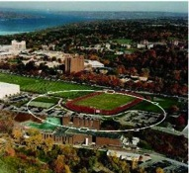
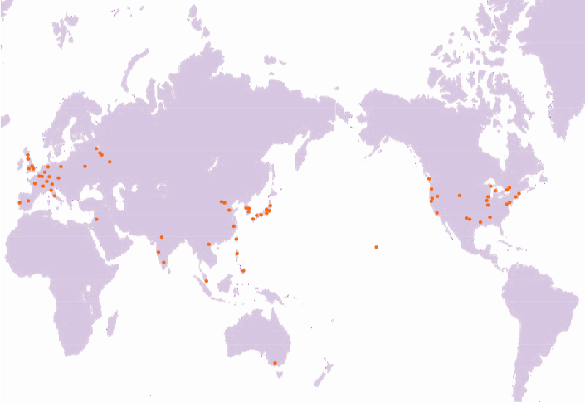
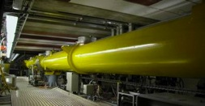
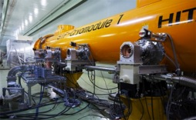
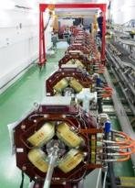
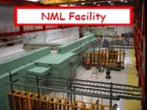
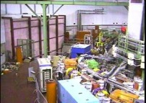
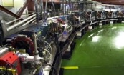
Global Cooperation for ILC Accelerator Beam Demonstration
TTF/FLASH (DESY) ~1 GeV
ILC-like beam ILC RF unit
(* lower gradient)
STF (KEK) operation/construction
ILC Cryomodule test： S1-Gloabal
Quantum Beam experiment
CesrTA (Cornell)
electron cloud
low emittance
DESY
◉
◉
INFN Frascati
KEK, Japan
FNAL
◉
◉
Cornell
◉
ATF & ATF2 (KEK)
ultra-low emittance
Final Focus optics
KEKB electron-cloud
NML facility ILC RF unit test
Under construction
DA^{f}NE (INFN Frascati)
kicker development
electron cloud

Slide 7
Major R&D Efforts in TD Phase
SCRF technology and beam acceleration：
  Cavity Gradient required：31.5 MV/m
    ILC SCRF cavity R&D
      Effort for ~ 7 x Gradient (KEK-TRISTAN, CERN-LEP)
      Gradient Progress ： < 37 MV/m> （Record：46 MV/m at DESY)
      System engineering： S1-Global program with global effort
Electron Cloud Mitigation
Nano-beam handling :
  ILC requiring a beam size ~ 6 nm (vertical) and stability ~2nm:
    Progress in KEK-ATF:
      achieving ~70 nm (at 1.3 GeV),
      corresponding to 10 nm (at 250 GeV, ILC)

Slide 8
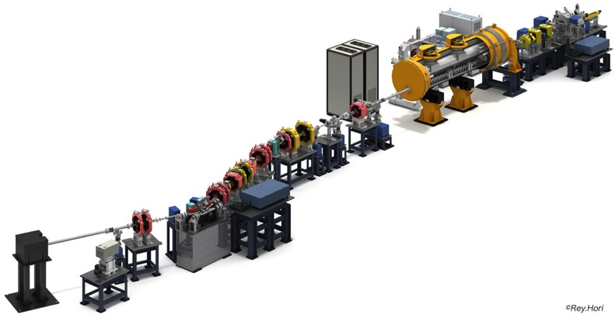
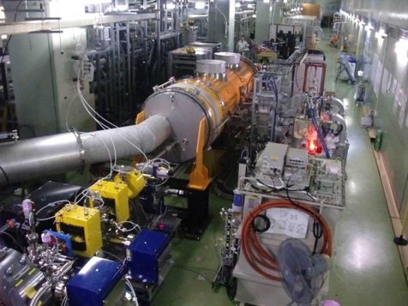
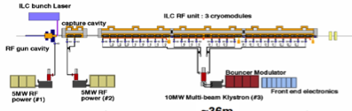
ILC beam condition demonstrated at QB
Quantum-Beam Accelerator
Starting as starting of KEK-STF-2
Beam acceleration (40 MV) and transport for 6.7 mA, 1 ms, succeeded in 2012
High-flux X-ray by Inverse-Comton scattering
10mA electron beam （40MeV, １ｍｓ, ５Ｈｚ）
4-mirror laser resonator cavity
head-on collision with beam
photocathode RFgun
Capture cryomodule ( 2 SC cavities )
collision point
(Laser, electron beam)

Slide 9

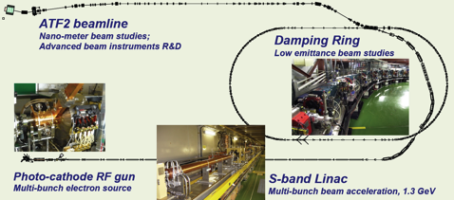
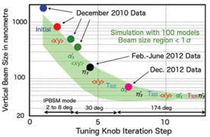
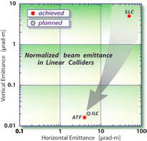
KEK-ATF：Progress
Ultra-small beam
Low emittance : KEK-ATF
  Achieved the ILC goal (2004).
Small vertical beam size : KEK ATF2
  Goal = 37 nm,
    160 nm (spring?, 2012)
    ~70 nm (Dec. 2012) at low beam current

Slide 10
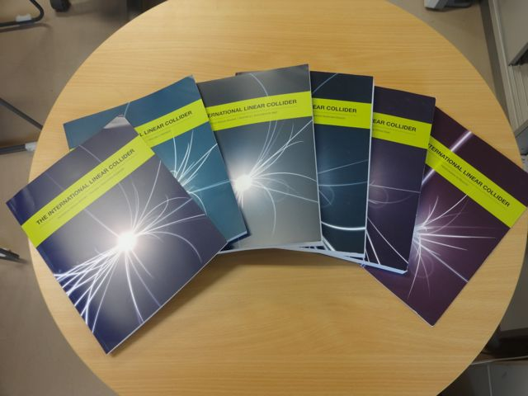
ILC Technical Design Report
Delivered, Yesterday, June 10, 2013

Slide 11
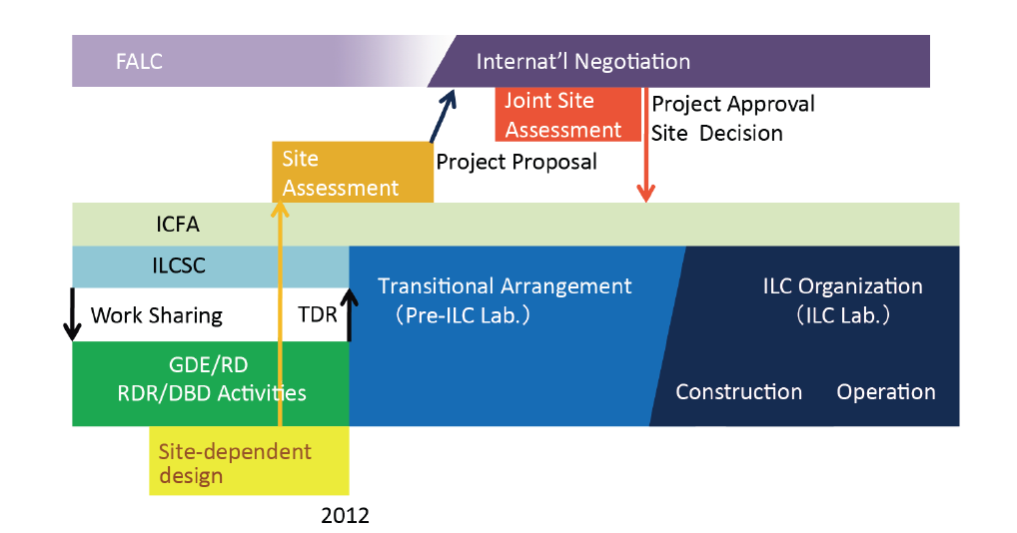
ILC Road Map
Preparation Period
Construction

Slide 12
Outline
Technical Status reached in TDR
  Design update from Reference Design Report (RDR’07) to Technical Design Report (TDR’12)
  Results from research & development
  Recommendations given by PAC
Further Plan beyond TDR
  Further work required for detailed engineering to prepare for realization of the ILC project,

Slide 13
“ILC Work Plan for the LCC Phase” under discussion in ILC-TB
Summarized by M. Harrison
June 7, 2013

Slide 14
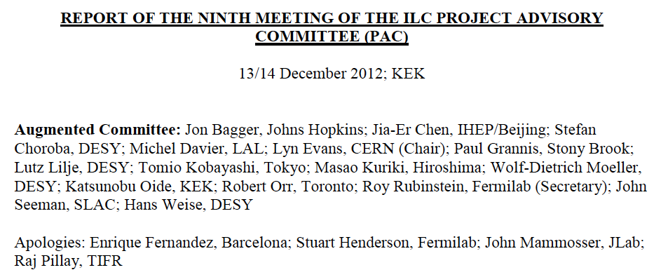
Report given by PAC

Slide 15
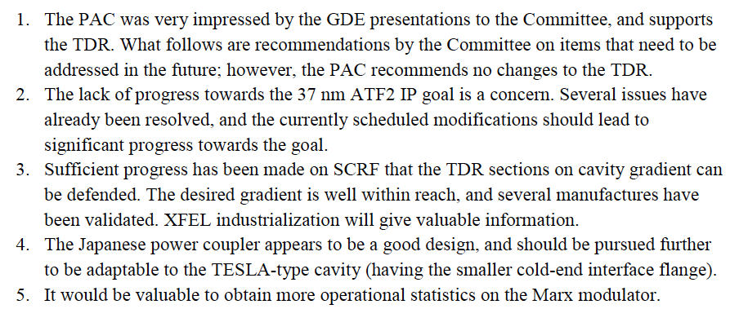
PAC Summary and Recommendations (1/3)

Slide 16
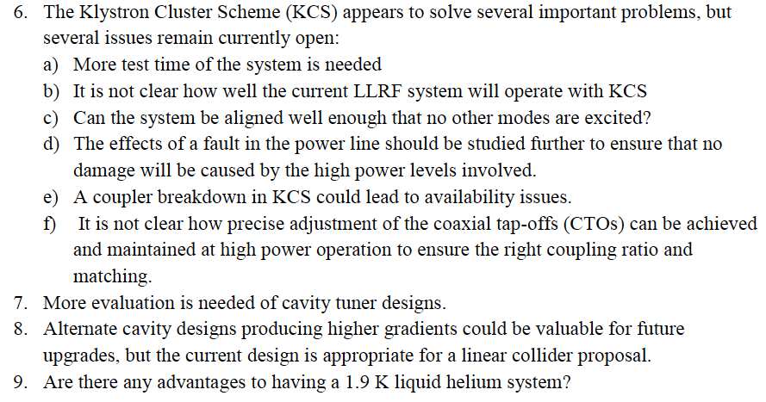
PAC Summary and Recommendations (2/3)

Slide 17
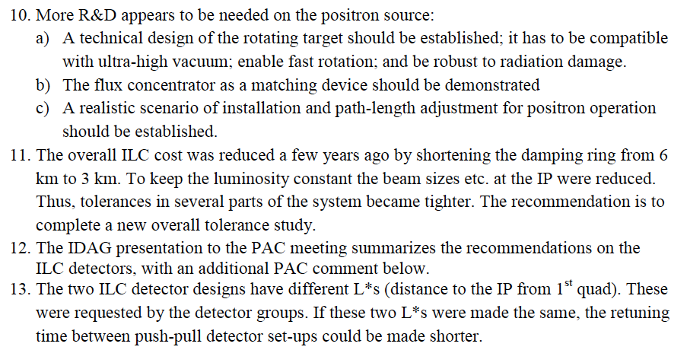
PAC Summary and Recommendations (3/3)

Slide 18
Further R&D/Engineering Study required
Summary
Positron source: Rotating target, alternate solution/backup
Damping ring: Undulators, 650 MHz SCRF
RTML: Quadrupole magnet with HTS?
ML: Cavity integration, CM eng. design, HLRF demonstration…
BDS: Final focusing, alignment w/ tighter tolerance
Beam Dynamics: Accurate lattice design based on the specific site
CFS: Site specific work including Central Campus design and others
General engineering: such as drawing coordination (rules)

Slide 19
SRF - 1
In terms of cryomodule design issues there was a general consensus that we should continue to develop the alternative KEK coupler which should prove cheaper and more reliable than the current designs. This new design will be available for the cryomodule design review later this year. The coupler development will be done at KEK. It will be modified to have a “plug compatible” 40 mm iris aperture. We can expect a coupler to test in ~2 years. The XFEL startup experience re-inforces the couplers as a potential problem.

Slide 20
Comparisons of Input Couplers
- TTF-III and KEK design -
Akira Yamamoto / Eiji Kako (KEK)
To be presented at RI-GDE (WebEx) meeting
August 29, 2012

Slide 21
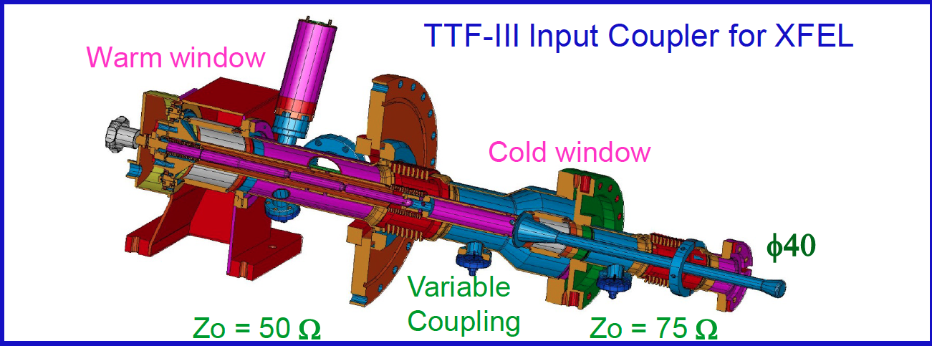
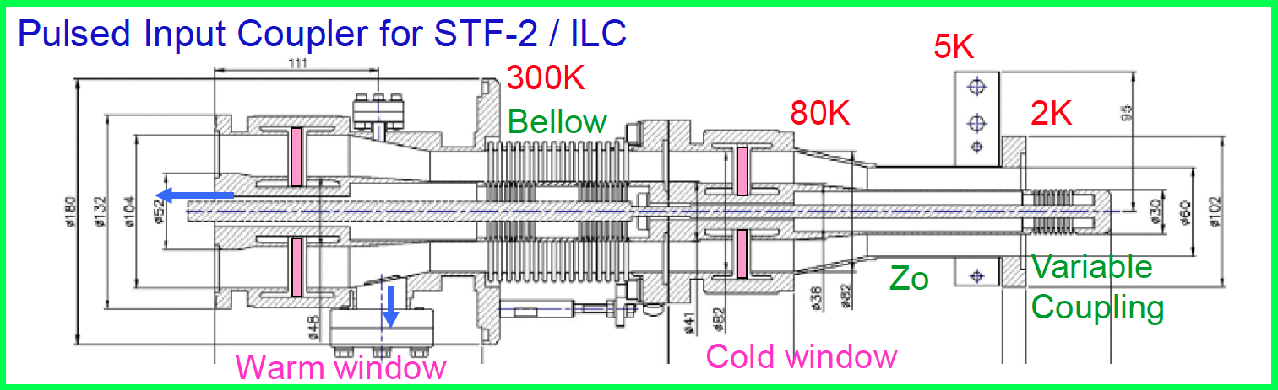
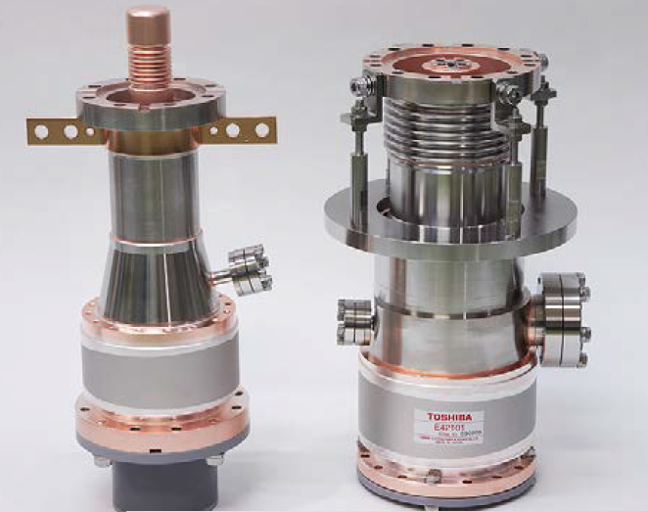
Comparison of Input Couplers
TTF-III
Two bellows
40 mm D.
125 kW
KEK-STF-II/QB
Single bellows
60 mm D
(40 mmD to be tried
350 kW

Slide 22
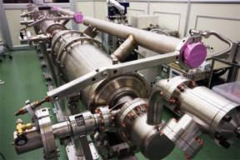
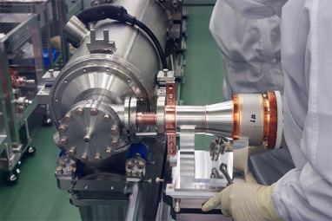
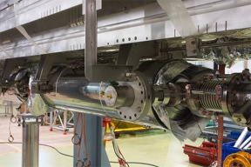
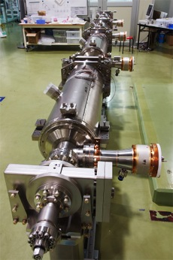
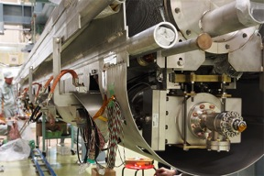
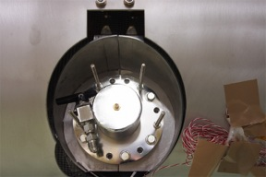
coupler assembly
TTF-III Coupler: various support jigs are required.
KEK STF Coupler:self standing

Slide 23
SRF - 4
Lyn wants to review the cryomodule design (tuners, couplers, etc..) How do we go about this. The suggestion was that we should try to schedule a cryomodule review around the Tokyo workshop. This has the benefit of minimizing travel but results in an extended trip. If we are going to have a cryomodule design review then we will need to have an official baseline design. We should try to resolve 5K shield finally one way or another.
Are hub labs the best way to proceed ? Yes

Slide 24
Implication of a Phased Proposal - 1
The proposal is to recommend the approach of leaving the “empty” tunnel closest to the IP.
Although it is the most expensive solution at 75% of the final project cost (the cheapest is ~68%) there are many advantages:
  adiabatic energy upgrade allows for more aggressive gradient goal,
  low rate CM/HLRF production over many years is attractive for vendors,
  beam dynamics better (high energy transport), tunnel utilities available.

Slide 25
250 GeV staged (scenario 1)
15.4 km
1.1 km
5.1 km
1.3 km
2.2 km
Main Linac
BDS
e+ src
IP
bunch comp.
central region
Half the linac
Full-length BDS tunnel & vacuum (TeV)
½ BDS magnets (instrumentation, CF etc)
½ RTML LTL
Extended tunnel/CFS already 500 GeV stage
10Hz mode e- linac

Slide 26
250 GeV staged (scenario 2)
15.4 km
1.1 km
5.1 km
1.3 km
2.2 km
Main Linac
BDS
e+ src
IP
bunch comp.
125 GeV transport
central region
Half the linac
Full-length BDS tunnel & vacuum (TeV)
½ BDS magnets (instrumentation, CF etc)
1 RTML LTL
5km 125 GeV transport line
Extended tunnel/CFS already 500 GeV stage
10Hz mode e- linac
quasi-adiabatic energy upgrade?

Slide 27
Implication of a Phased Proposal - 2
The 10Hz scheme required for low energy operation is “unattractive and expensive”. This suggests we revisit the conventional (non-polarised) alternative. We should also see if the shorter pitch undulator R&D can be started somehow in the UK or the US without any money.
Some recent work at DESY hints that the 10Hz operation may not be necessary with the existing baseline hardware. We should review this anecdote.

Slide 28
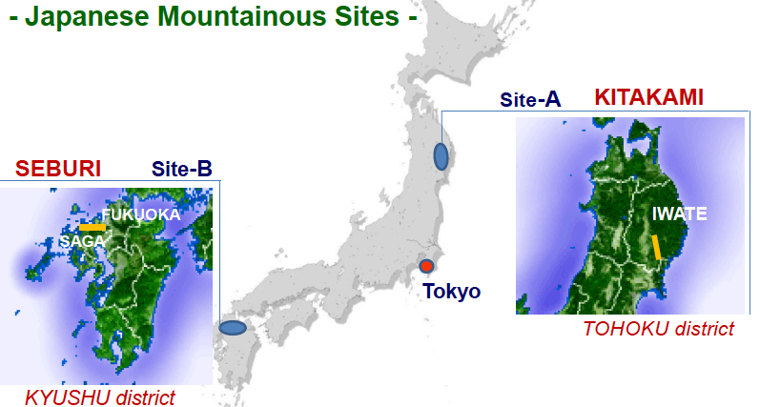
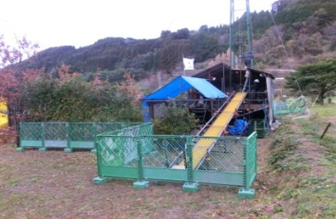

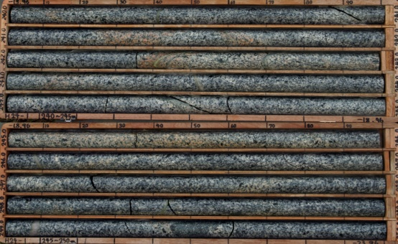
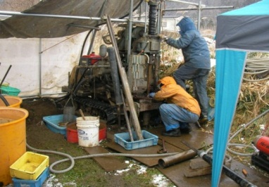
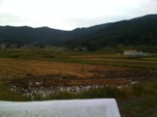
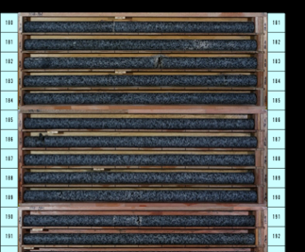
Geological Survey and
Common-Subject Study, going on, in japan
KEK
Tohoku U. G. Survey
Nomura Research Common Subject: Central Campus
Kyushu U. G. Survey.
Kitakami
Sefuri
-150m
Reports to be available in July, 2013
-300m

Slide 29
まとめ
ILC Technical Design Report が完成
    TDR における基本設計・技術によってILC の建設が可能
『設計から実現』にむけた準備への取り組みへ
    技術詳細設計
    建設に対応する工業化技術の準備、詰め
    加速器・研究所施設、環境設計の準備
  国際協力の枠組み準備
    国際準備チームの形成・立ち上げ

Slide 30
Backup

