Slide 1
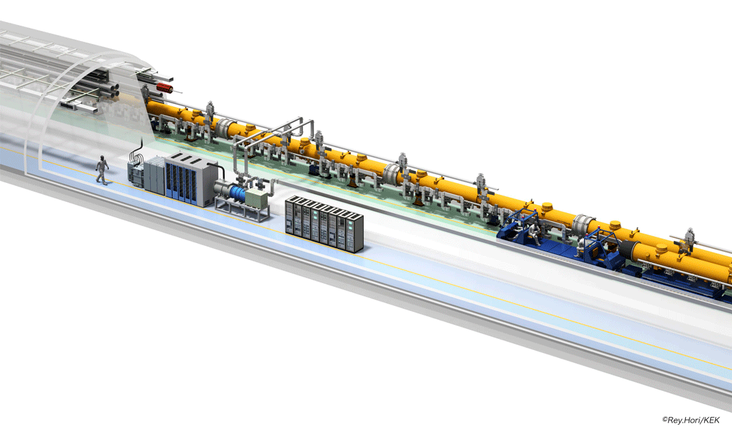
Japanese Bid-to-Host Activities
for ILC
Atsuto Suzuki
IHEP-KEK Annual Cooperation Meeting
Feb. 4, 2013

Slide 2
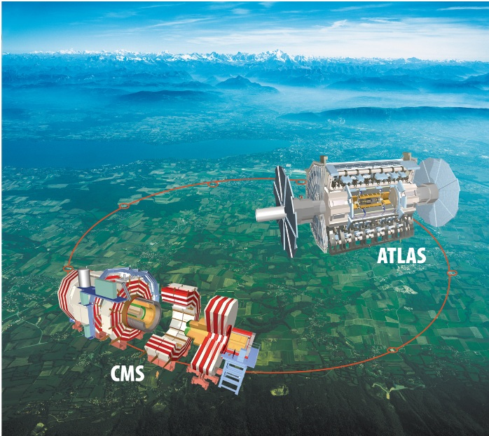
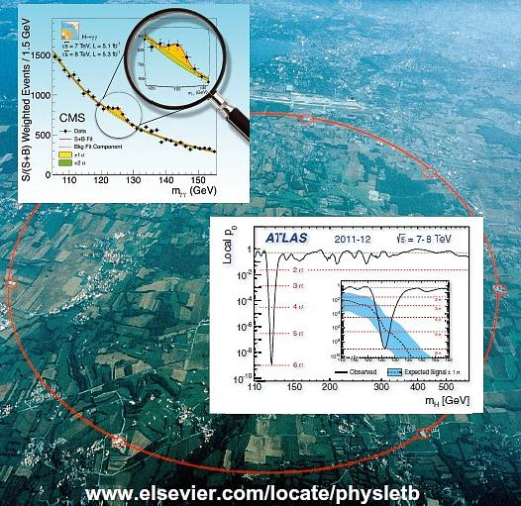
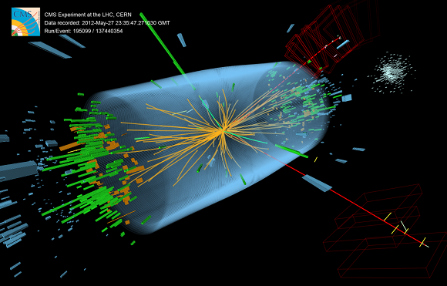
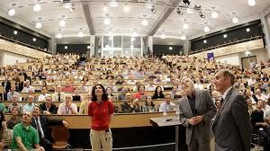
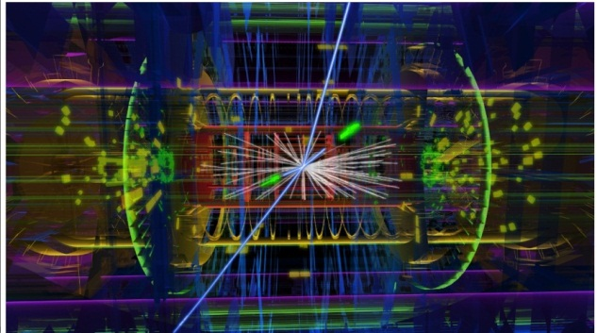
July 4 2012

Slide 3
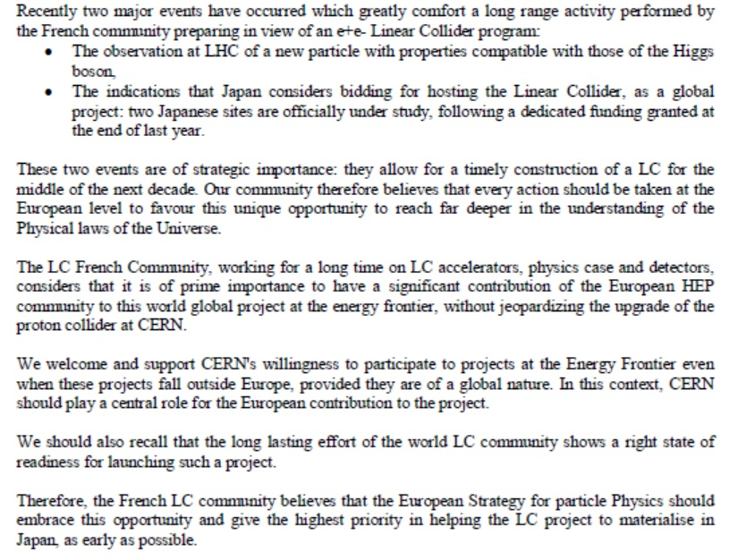

Slide 4
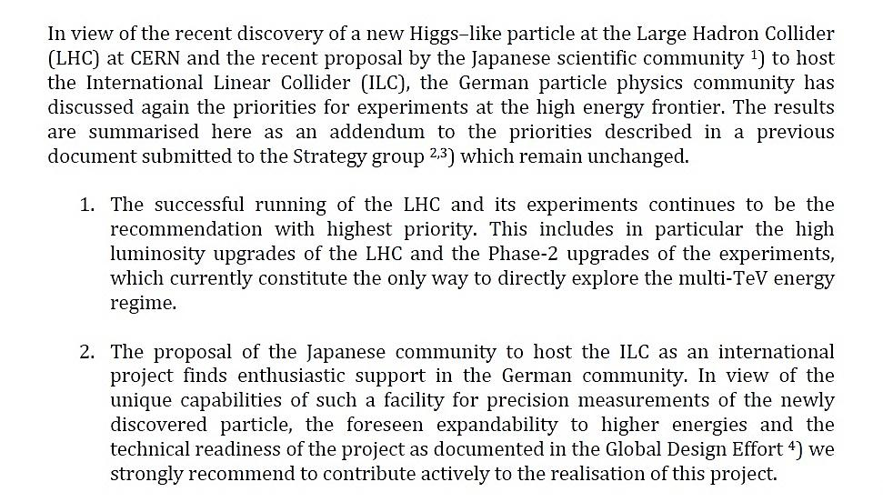

Slide 5
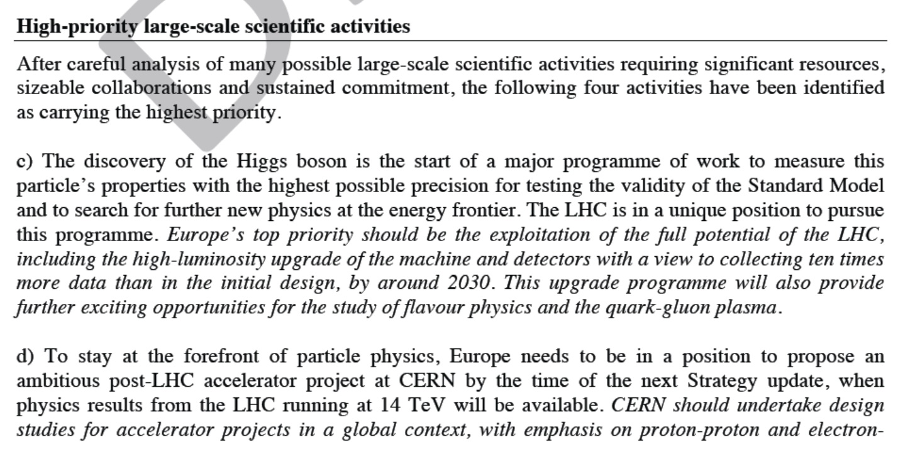
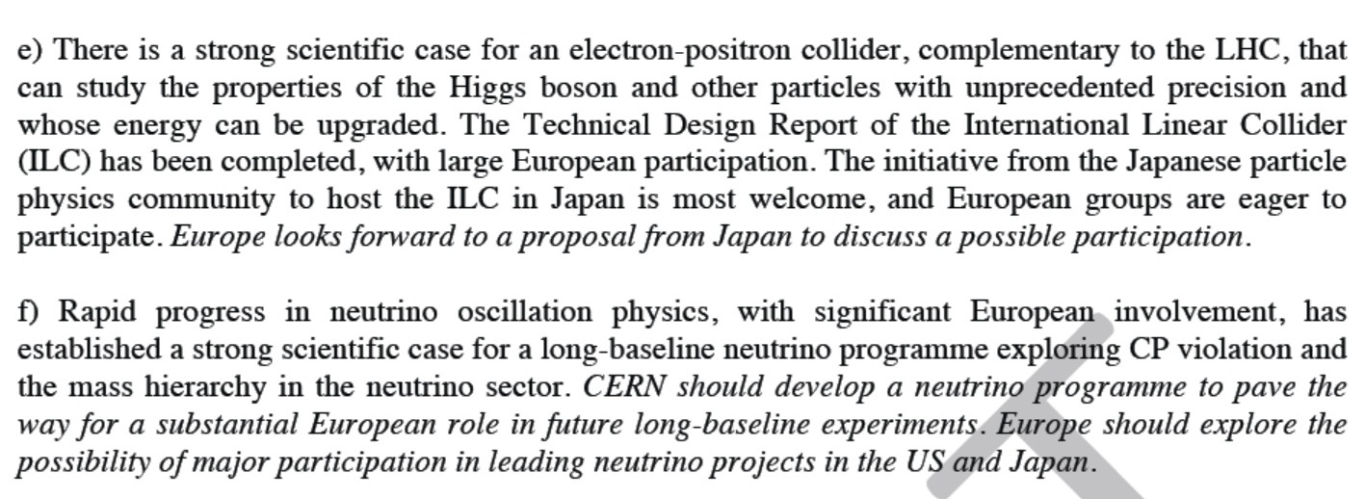

Slide 6
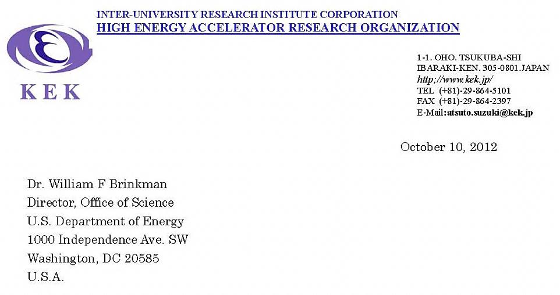
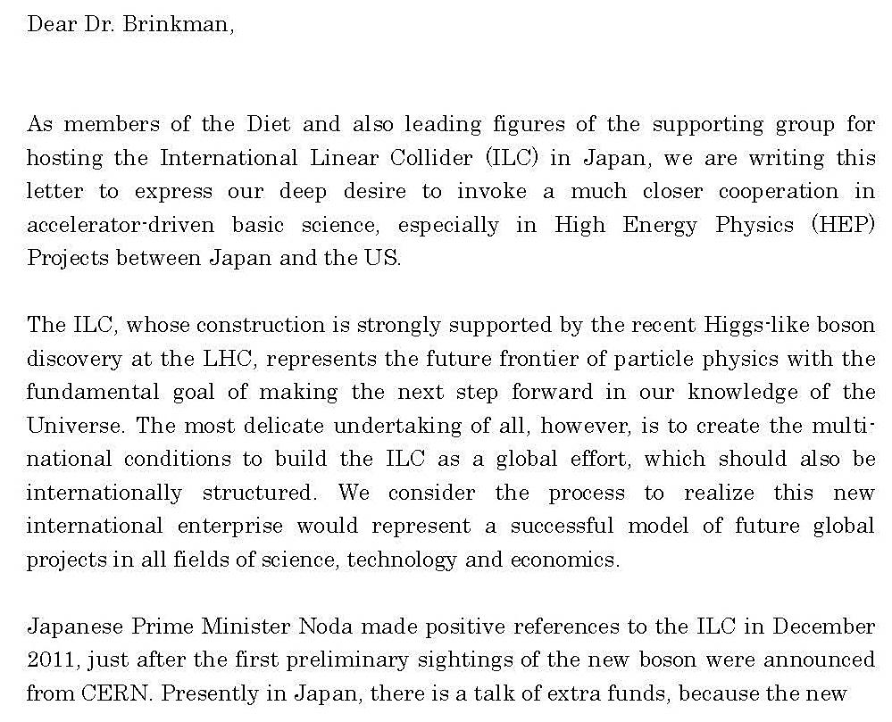

Slide 7
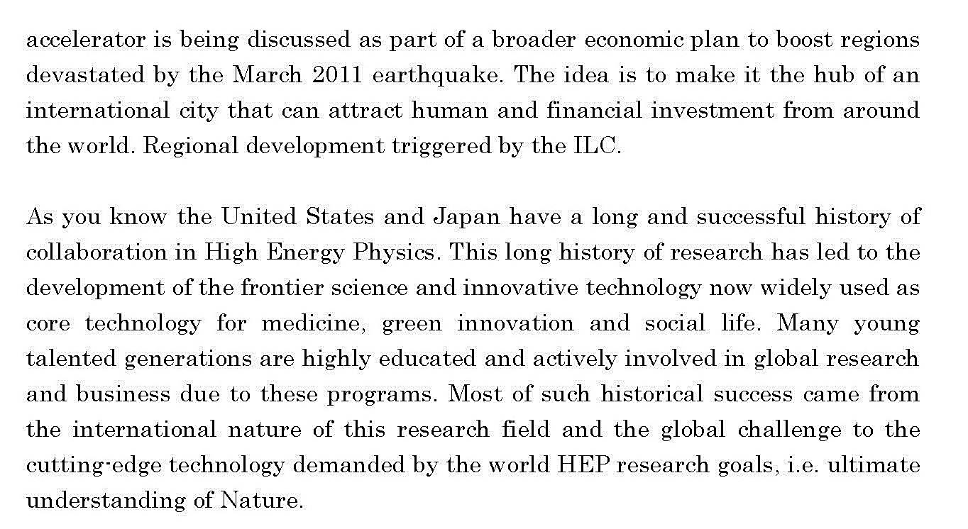
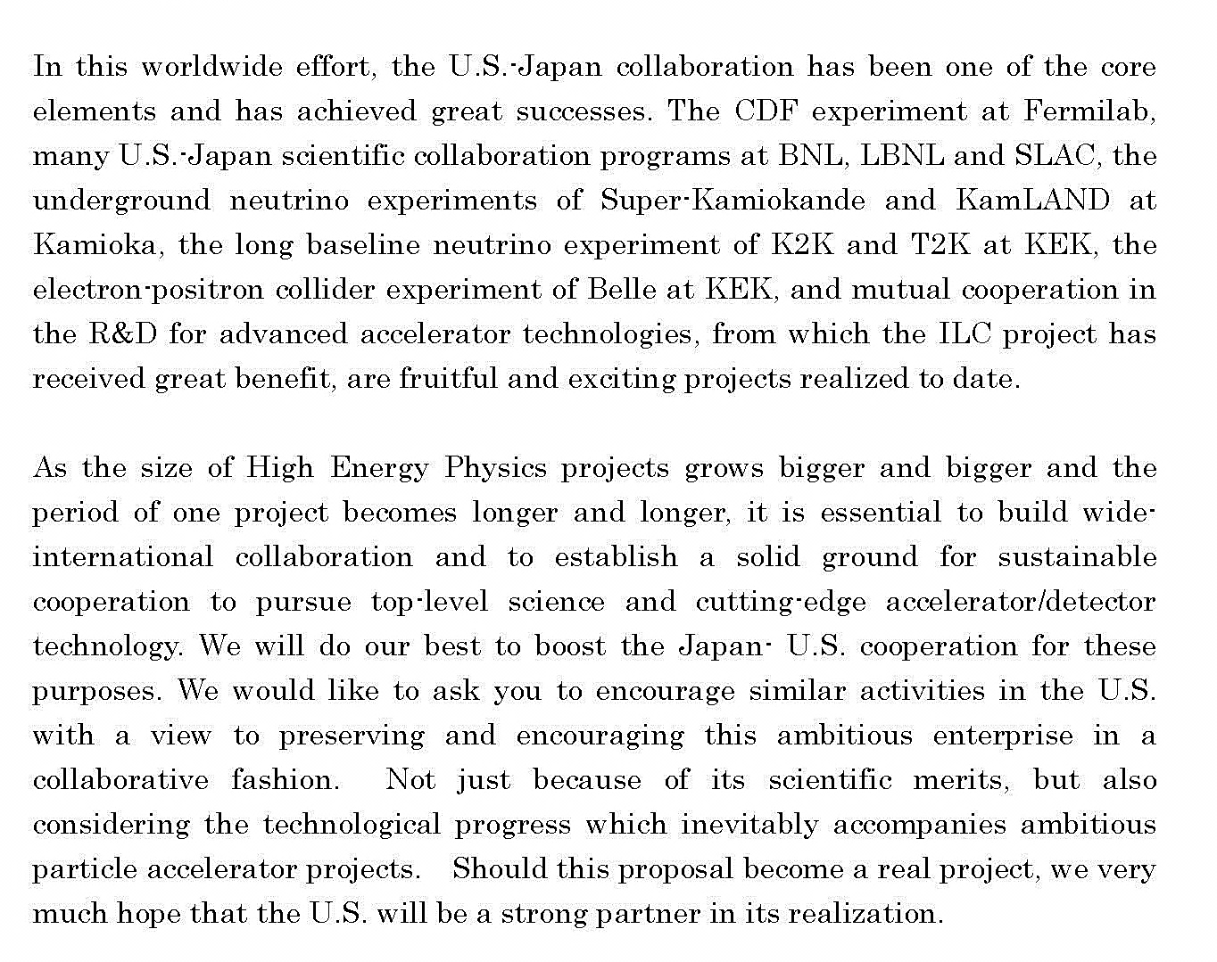

Slide 8
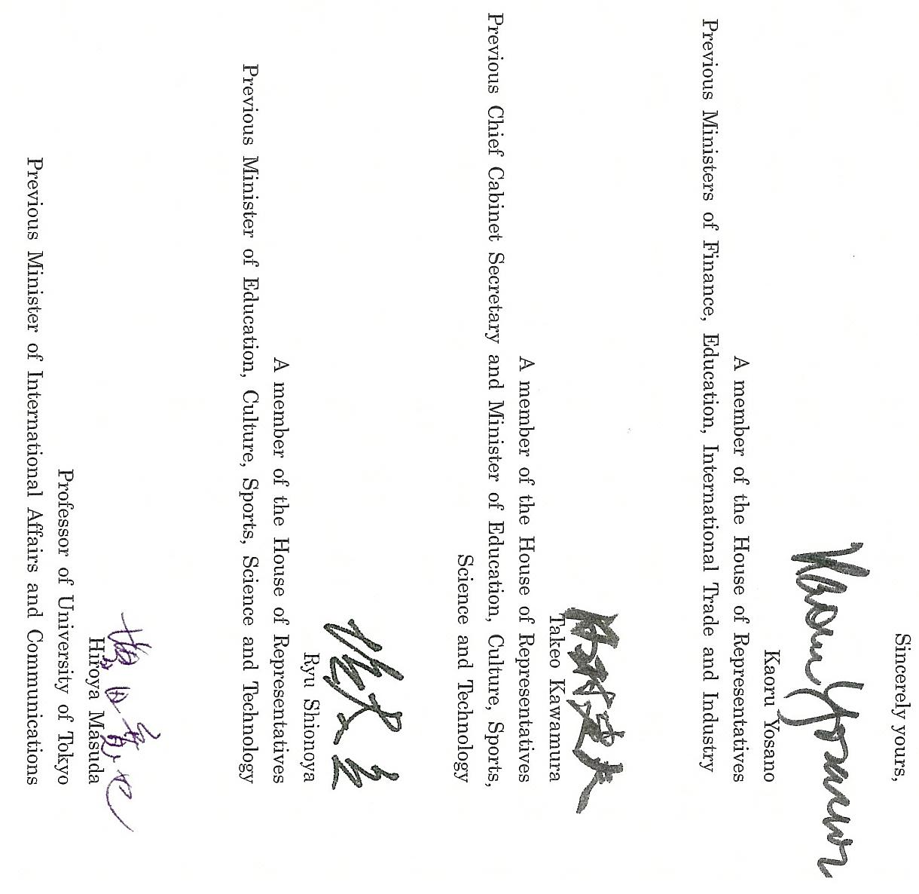

Slide 10
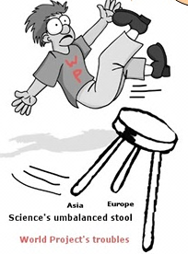

Slide 11
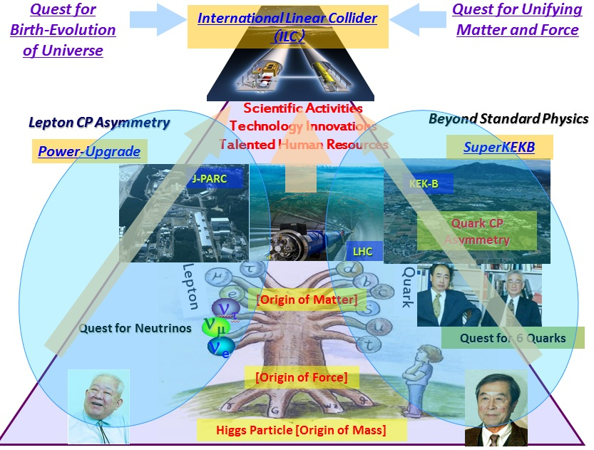
Why ILC in Japan ? : 1
In 2008

Slide 12
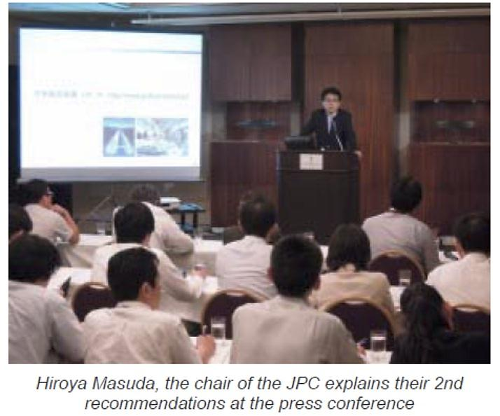
Creation of Global Country inside Japan

Slide 13
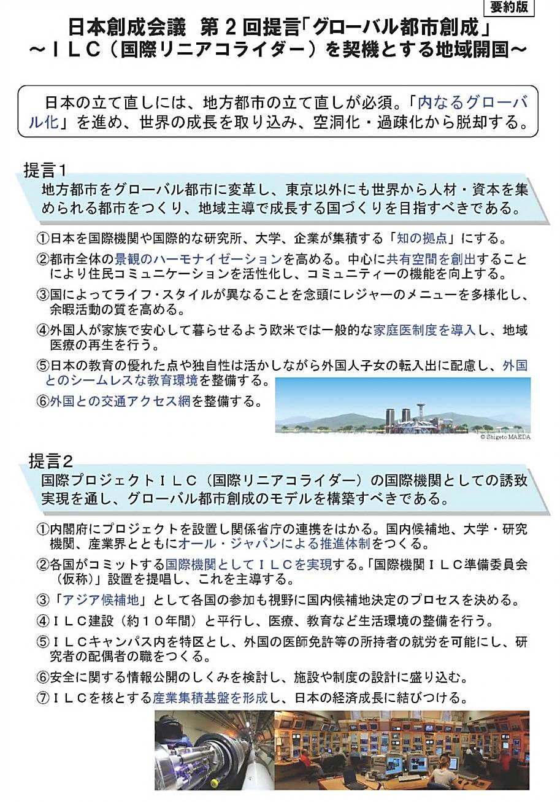
Why ILC in Japan ? : 2
July 12, 2012
Japan Policy Council
Second Recommendations:
Regional Development through Creation of Global Country inside Japan
Realizing a global city that can attract human and financial resources from around the world: Regional development triggered by the International Linear Collider (ILC)
Realizing an international organization for the International Linear Collider (ILC), to push towards reforming regional cities as a role model for the creation of a global country.

Slide 14
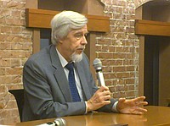
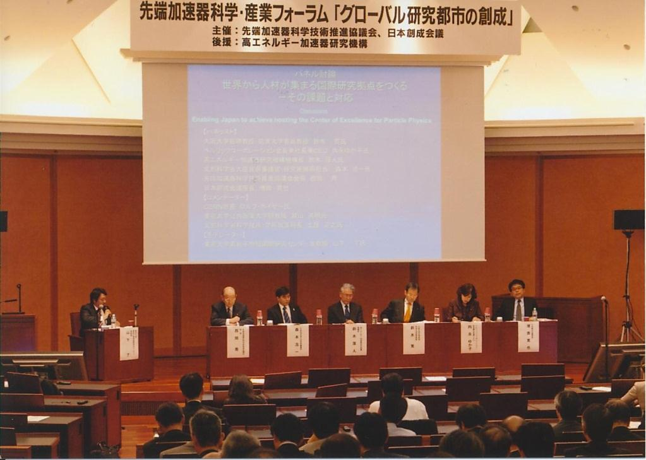
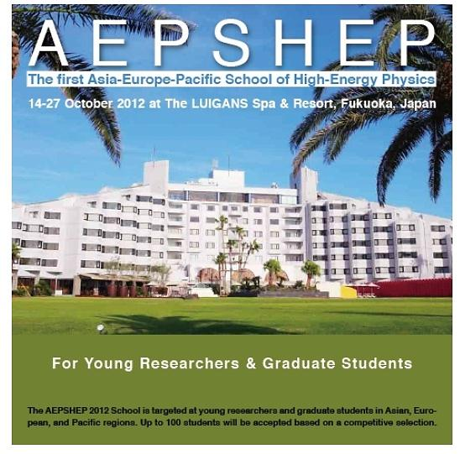

Slide 15
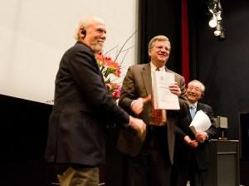
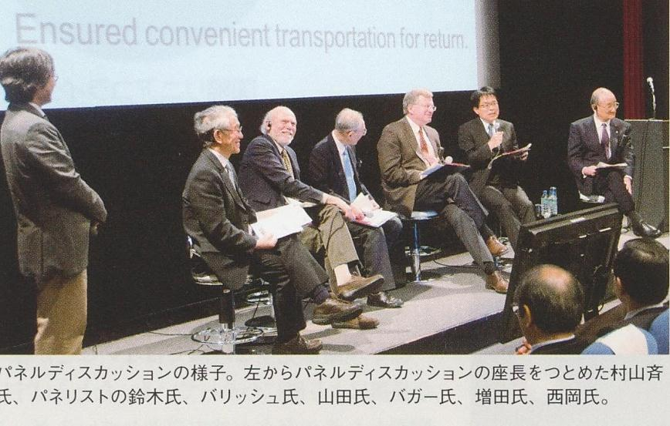
Barry Barish and Sakue Yamada handing over the TDR to ILCSC chair Jon Bagger. Image: Nobuko Kobayashi
The handover was followed by a panel discussion.

Slide 16
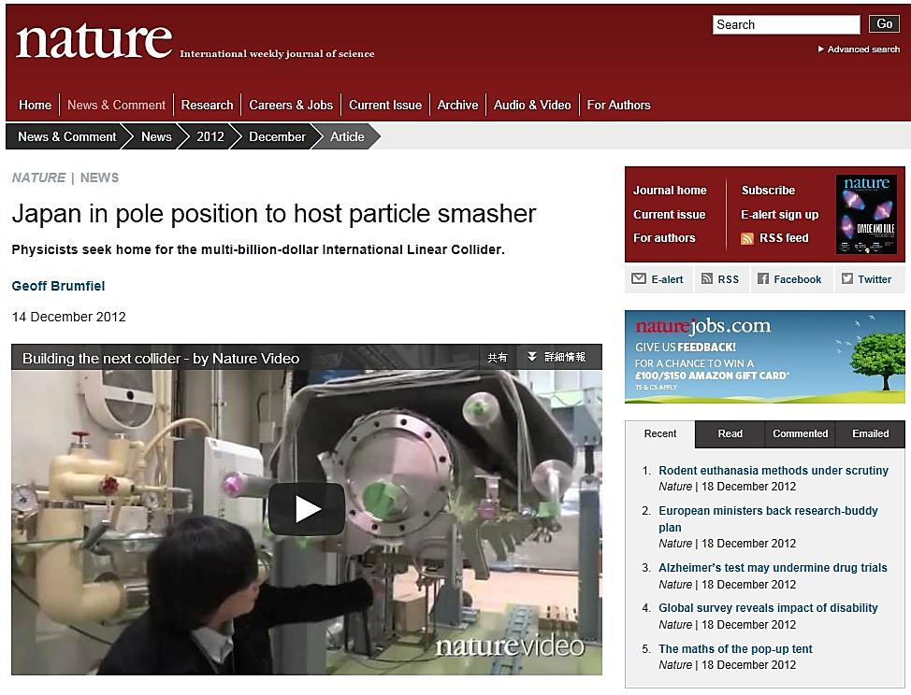

Slide 17
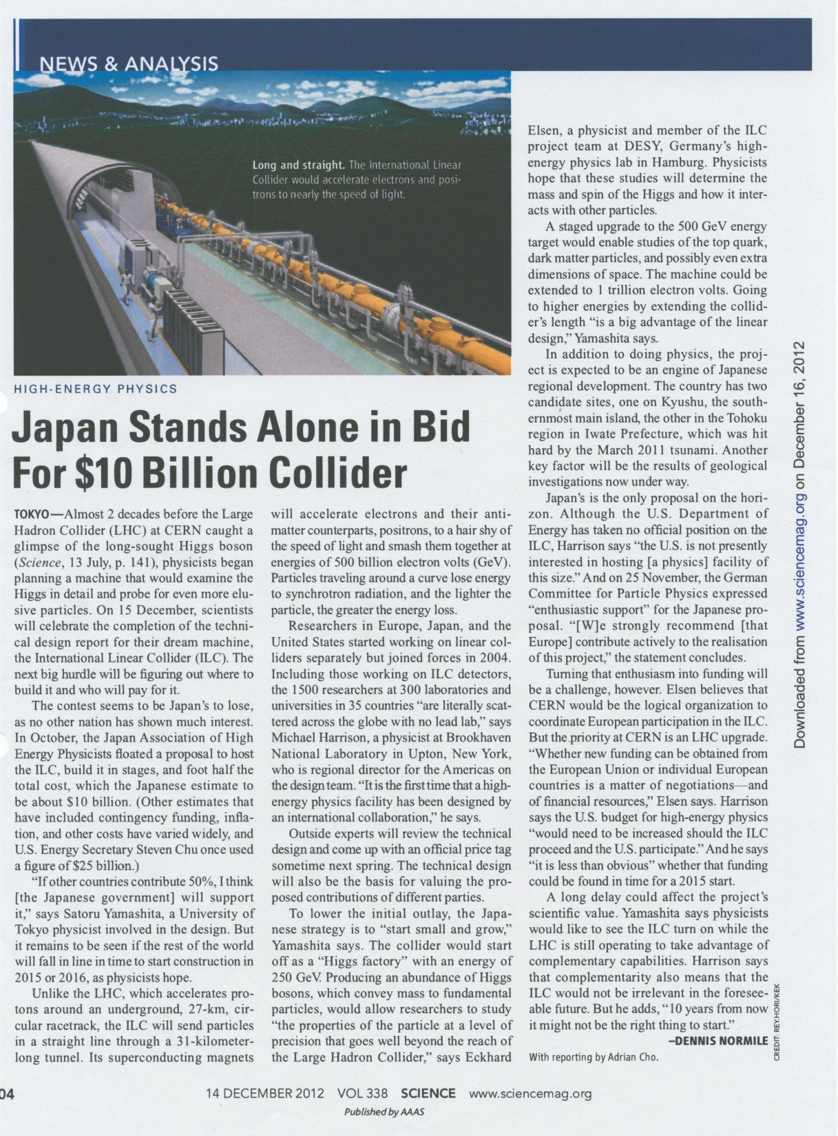

Slide 18
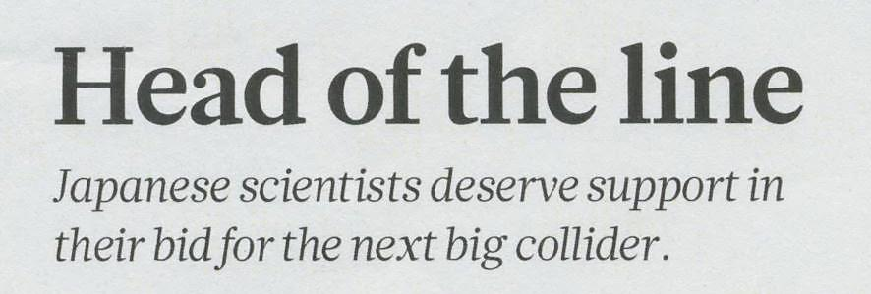
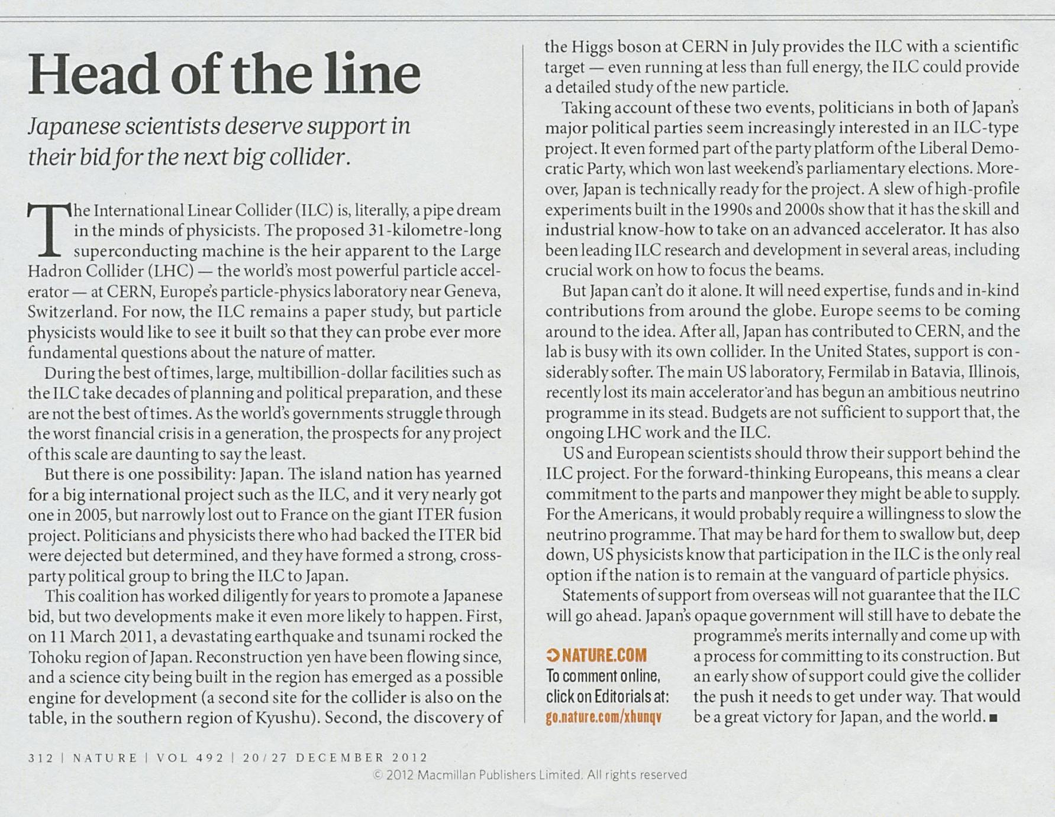

Slide 19
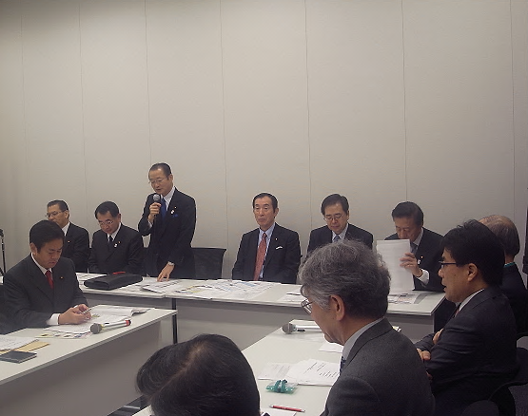
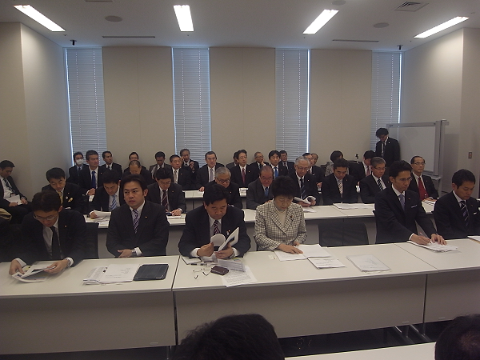
Feb. 1, 2013

Slide 20
Toward ILC Construction : Japan Activities
2012
2013
2014
2015~6
Positive Reference
from New Prime Minister
Establish ILC Pre-
J-Lab.
Establish ILC -Lab.
Set-up JLCB and JLCD
HEP
Researchers
Cite Decision
Design ILC Lab.
Cite/Host
Establish
Fomal Message
on Hosting ILC in Japan
Project Proposal to Science Council of Japan
ILC Host Recommendation to Government
Detailed Design of International Country
Japan Policy Council

Slide 21
Japanese Government Body for

Slide 22
ILC J-PreLab.
Governance Board (J-ICFA)
()
ICFA
ILC Strategy Council (J-LCB)
()
Directorate (J-LCD)
Director Vice Directors
() ()
LCB
LCD
Accelerator Detector CFS
() () ()
()
KEK-Industry Consortium
()

