Slide 1
Physics at ILC

Slide 2
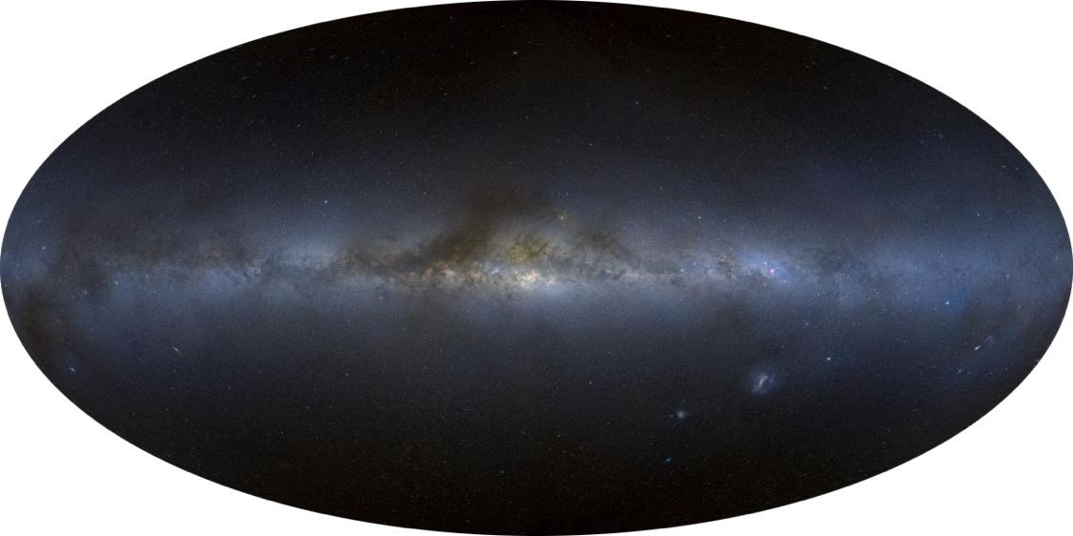
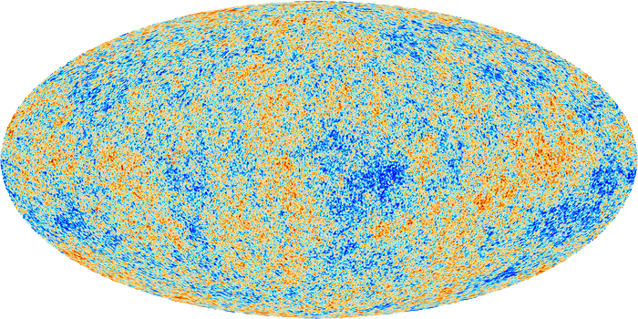
Quest for Ultimate Unification
Our goal is to go back in time to the moment of creation,
when everything, matter, force, and space-time, was conceived to be unified.
13.8 byr
Now
Gravity
Strong
Weak
EM
Formation of large-scale structure of the Universe consisting of galaxies and groups of galaxies, seeded by dark matter
380 kyr
Clear Up
of the Universe
Era can’t be seen with optical means
→ Accelerator
Age of Universe
EW Symmetry
Breaking
Standard Model world
10⁻¹⁰ s
Study with ILC
Our current
understanding
Higgs filled the Universe
Unification of
forces
Grand Desert？
BSM Physics
EW force
Unification of
matter
Dark Matter
Baryon Number Asymmetry
Neutrino mass/mixing
Dark Energy
…
10⁻³⁶ s
Unification of
matter and force
GUT?
10⁻⁴³ s
Birth of Universe
SUSY GUT？
Unification of
matter, force, and space-time
Quantum Gravity
(Superstring)?

Slide 3
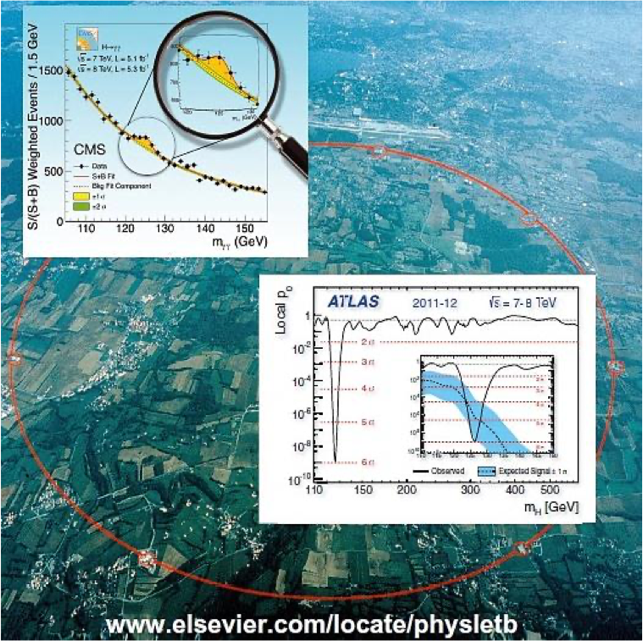
Towards Ultimate Unification
Our goal is to go back in time to the moment of creation (Planck Scale), when everything, matter, force, and space-time, was conceived to be unified.
Gravity
Strong
Weak
EM
13.8 byr
Standard Model (SM) =Summary of Our Current Understanding
380 kyr
EW symmetry breaking
= phase transition
Age of Universe
Unification of
forces
Gauge Symmetry = SU(3)xSU(2)xU(1)
10⁻¹⁰ s
Matter Fields = Quarks & Leptons (3 Gen.)
Unification of
matter
Grand Desert?
ILC
Electroweak Unification
10⁻³⁶ s
Unification of
matter and force
Grand Unification ?
1995 Top discovery @ FNAL Tevatron →3 generations of matter fields completed
10⁻⁴³ s
Quantum Gravity ?
Unification of
matter, force, and space-time
Force Fields = Gauge Fields (γ,W/Z, g)
1983 W/Z discovery @ CERN SPPS → Gauge bosons for the 3 forces found
July 4, 2012
Symmetry Breaking Field = Higgs Field (H)
The Higgs boson
found @ CERN LHC
→ 2012 found @ LHC: SM completed
Beyond the SM
The SM has been extremely successful.
→ Yet, there remain a lot of mysteries (Dark Matter, Baryon Number Asymmetry, Neutrino Mass/Mixing, Dark Energy, ..）
→ Start of new voyage to the Plank Scale: From the EW
scale, there seems to be still a long way to go.
Why is the EW scale so important?

Slide 4
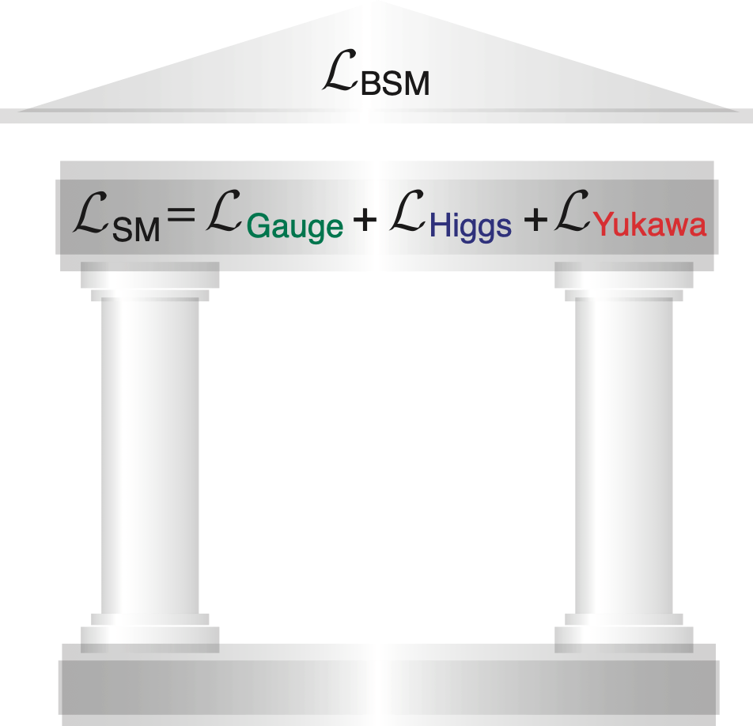
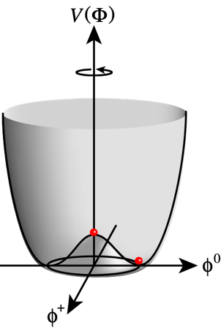
Why is the EW scale so important?
Mystery of the Higgs field filling the universe
2 Pillars of SM
Unknown
Vacuum filled with weak charge (evidence: H125)
The nature of the Higgs field - its multiplet structure & dynamics behind it - is all unknown!
Success of SM = success of gauge theory (left pillar)
Gauge
Principle
Electroweak Symmetry Breaking
Precisely tested!
Relativistic Quantum Field Theory
The SM does not explain why the Higgs field filled the universe:
Why μ² < 0?
The EW scale is the key to answer this question.

Slide 5
Higgs is the key to BSM
We have a very successful Standard Model (SM). However, all of its parameters are put in by hand to fit observations.
Except for the three gauge couplings, all of these parameters are of the Higgs field. The SM cannot predict any of these.
In particular, the SM cannot explain why the Higgs field filled the whole universe and why at the electroweak scale.
We need physics beyond the SM to answer this question.
Answers to other big questions like dark matter, baryon asymmetry, neutrino masses/mixings, dark energy, etc. would change, depending on the answer to this question.

Slide 6
Why did the Higgs field fill the universe and why at the EW scale?
Central Question
at the EW Scale
Notes:
なぜその時、ヒッグスが宇宙を満たしたのか？ 答えによって素粒子物理学の将来は大きく分岐します。

Slide 7
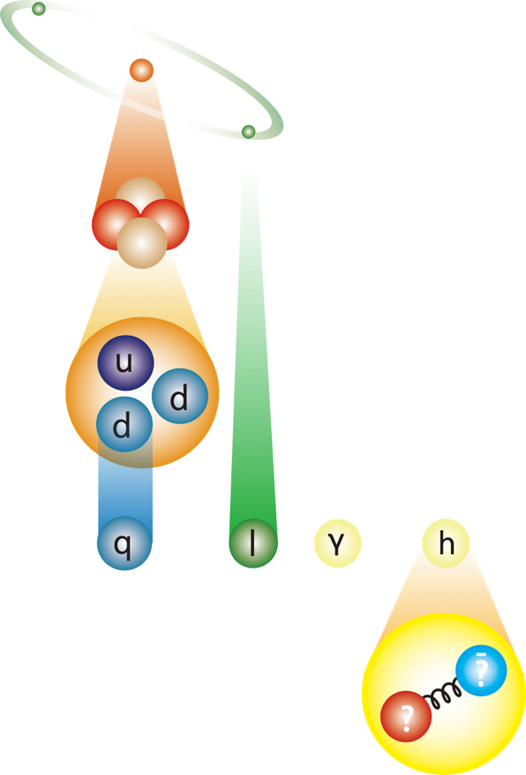
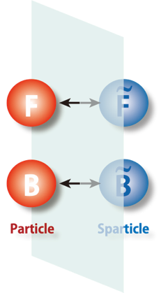
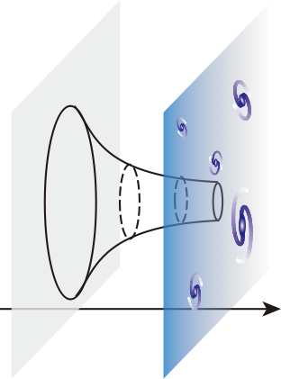
Our future forks in three ways
depending on the answer
Extension of Space-Time
SUSY / Extra-dimensions
Extension of Matter Structure
Composite Higgs
Completely New Principle Multiverse + Anthropic Principle？
Key = Precision Higgs and Top couplings SUSY particle discovery
Atom
Key = Precision Higgs
and Top couplings
Key = precision mt and mh
measurements
Fermionic Extra
-dim. = SUSY
Bosonic Extra
-dim. = RS (ADD)
electron
Nucleus
Nucleons
gauge bosons
quarks
leptons
Higgs boson
Jungle of new heavy composite particles in the TeV+ scale
Big step towards ultimate unification
New Strong Force
The 2nd Road: Existence of a new stratum of Nature
No deviation from SM
The 1st Road: Existence of another dimension
The 3rd Road: Existence of a myriad of universes ?
We are
here

Slide 8
Depending on which way to go, the answers to other big questions like dark matter, baryon asymmetry of the universe, neutrino masses/mixings, dark energy, … also change.
We need to know which way to go to answer these big questions!

Slide 9
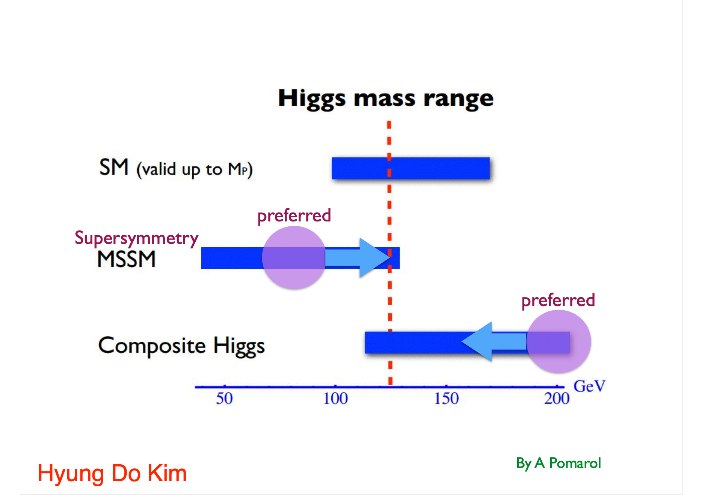
Before the Higgs discovery, we were hoping that the Higgs mass value would tell us the answer (SUSY or Composite H).
The Higgs mass turned out to be at a very subtle point.

Slide 10
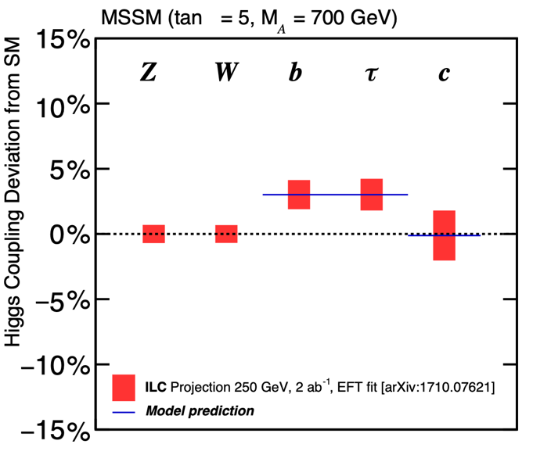
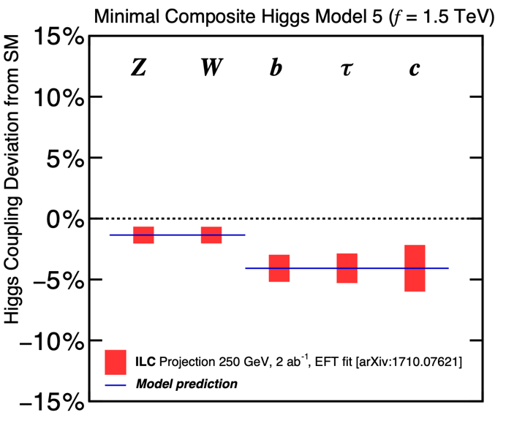
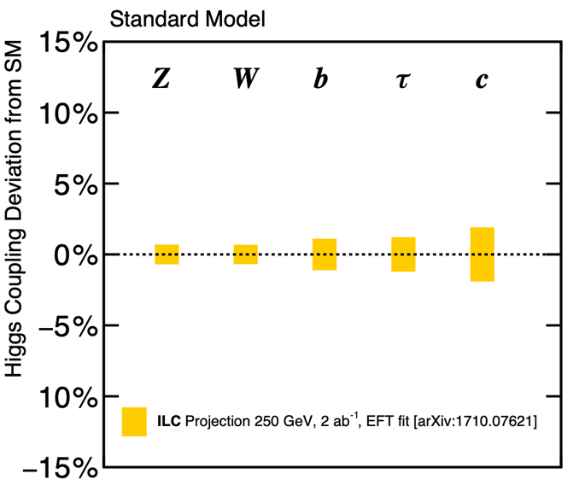
We need to study Higgs couplings
Supersymmetry
(MSSM)
Composite Higgs
(MCHM5)
Multi-verse?
(Standard Model)
Downward shift for all the couplings
Upward shift only for down-type fermions
No deviation at all
Different models predict different deviation patterns → Deviation pattern tells us which way to go.

Slide 11
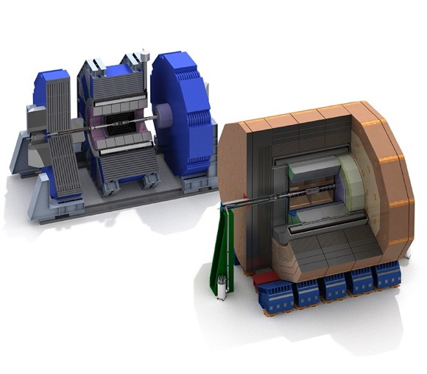
Higgs is the Key to decide the direction
Supersymmetry
(MSSM)
Composite Higgs
(MCHM5)
Multi-verse?
(Standard Model)
Downward shift for all the couplings
Upward shift only for down-type fermions
No deviation at all
example 1: Minimal SUSY (tanβ=5, radiative correction factor ≈ 1)
example 2: Minimal Composite Higgs Model
ILD
heavy Higgs mass
V=W/Z
composite scale
New physics at 1 TeV → deviation is at most ~10%
We need 1%-level precision
→ ILC Machine + ILD/SiD
SiD

Slide 12
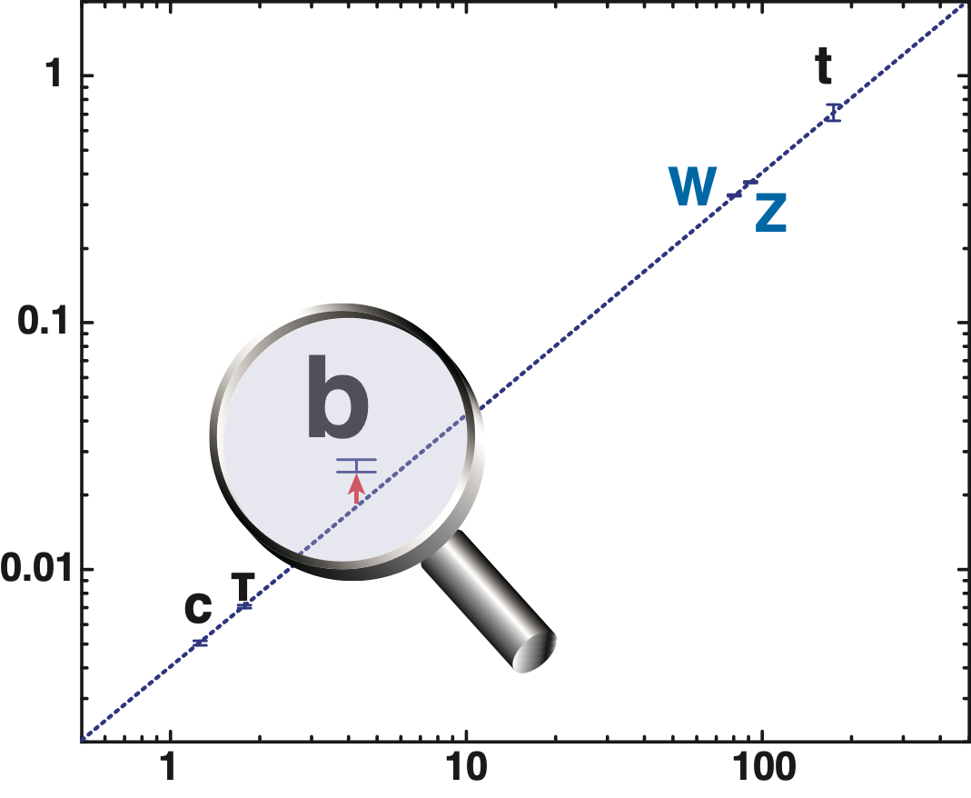
This, however, requires precisions
Mass-coupling relation
The size of the deviation depends on the new physics scale (Λ)!
ILC = magnifying glass
with sufficient magnification factor
Decoupling Theorem: Λ↑ → SM
SM
example 1: Minimal SUSY (MSSM : tanβ=5, radiative correction factor ≈ 1)
Coupling to Higgs
heavy Higgs mass
example 2: Minimal Composite Higgs Model
Mass (GeV)
V=W/Z
composite scale
New physics at 1 TeV → deviation is at most ~10%
We need 1%-level precision.

Slide 13
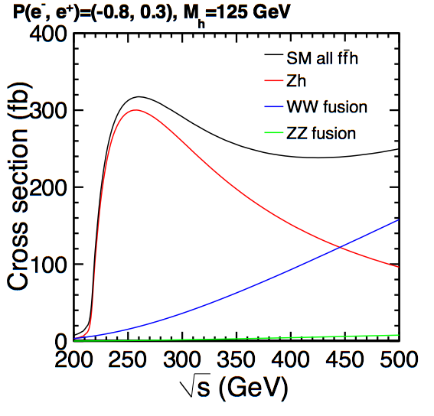
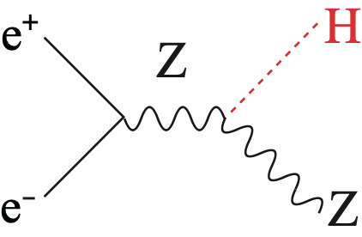
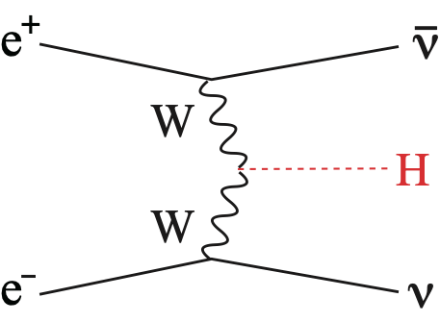
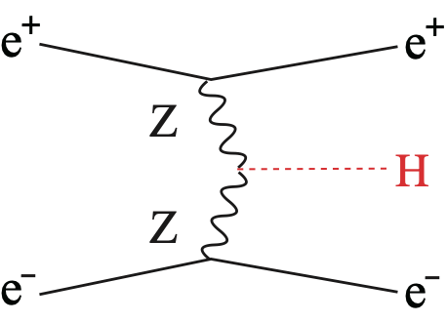
250 GeV ILC is a Higgs Factory where single Higgs production cross section attains its maximum
Production Cross Section as a fun. of Ecm
250 GeV: cross section maximum (~0.5 Million events for 2 ab⁻¹)
Mass-produce Higgs bosons and study them in detail.

Slide 14
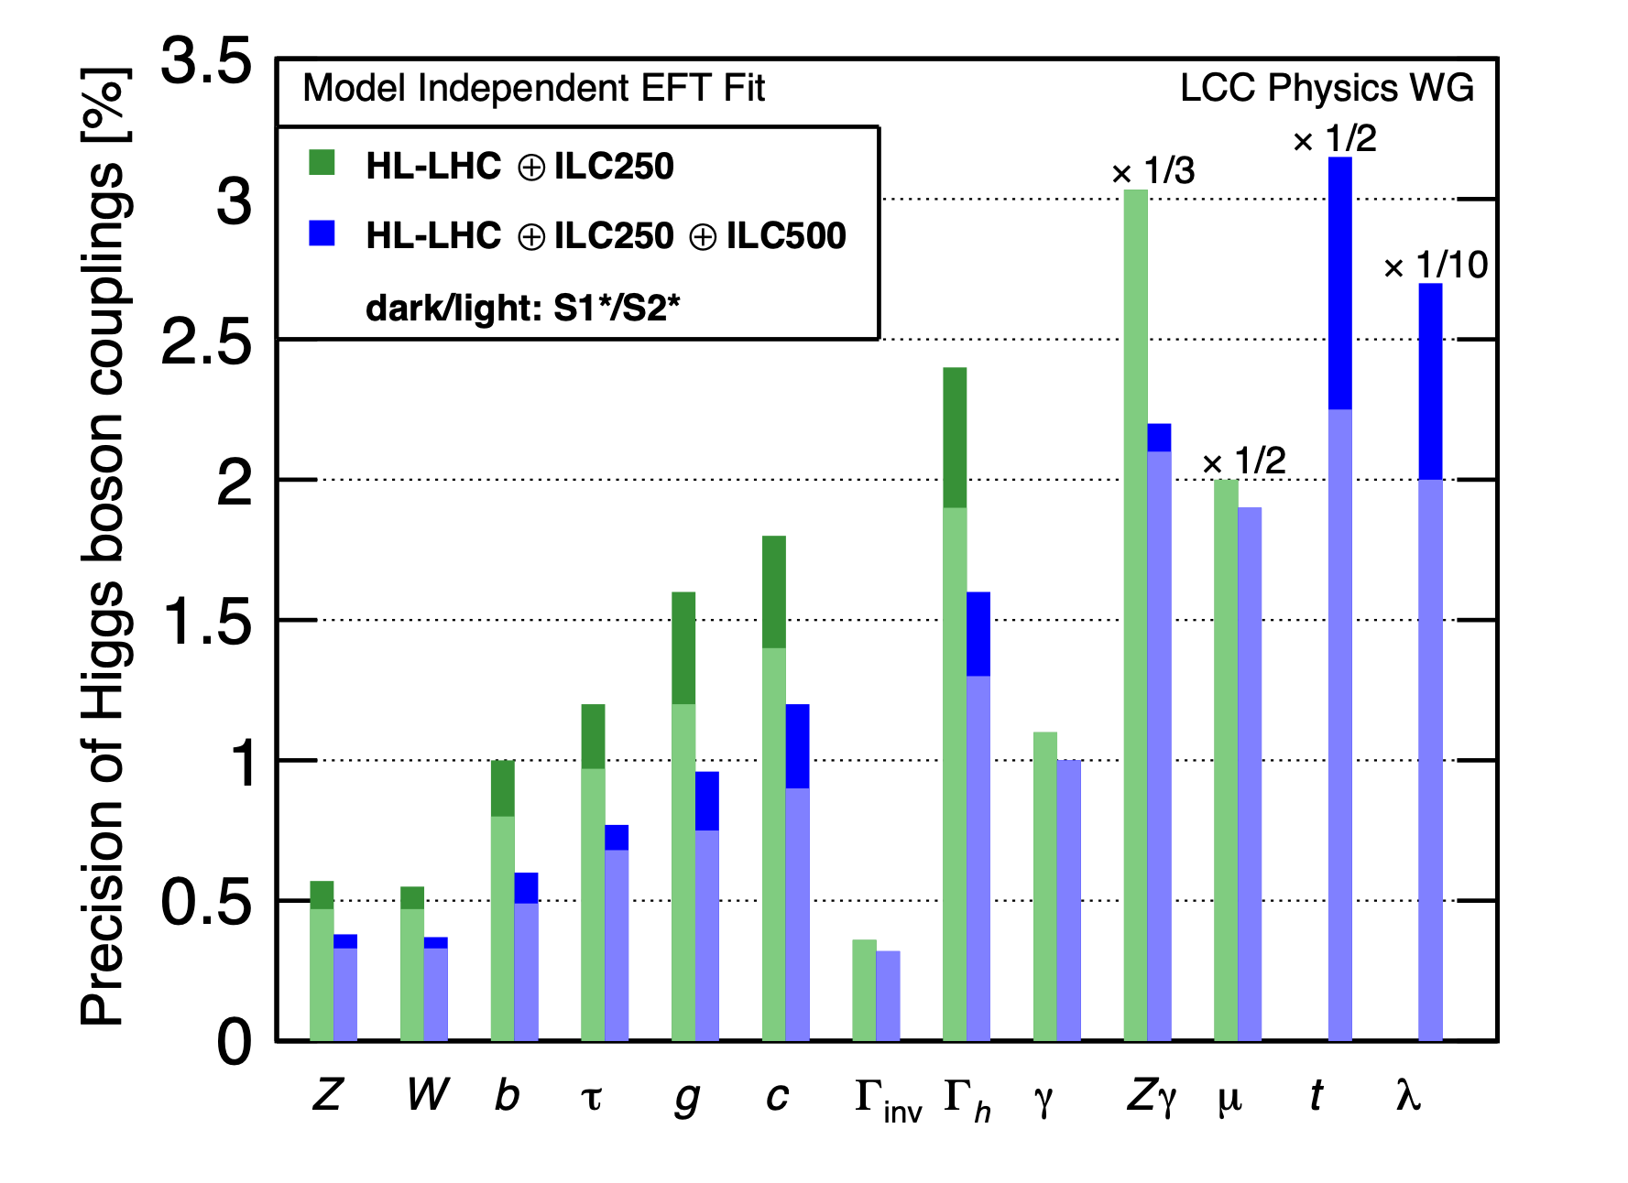
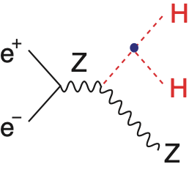
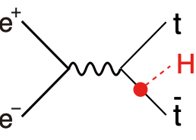
arXiv: 1901.09829
arXiv: 1903.01629
Self-coupling
Not accessible at 250 GeV.
Can reach 26% at 500 GeV.
Top Yukawa
Not accessible at 250 GeV.
Can reach 3% at 550 GeV.
FIG. 2. Projected Higgs boson coupling uncertainties for the ILC program at 250 GeV and an energy upgrade to 500 GeV, using the highly model-independent analysis presented in [3]. This analysis makes use of data on e⁺e⁻ → W⁺W⁻ in addition to Higgs boson observables and also incorporates projected LHC results, as described in the text. Results are obtained assuming integrated luminosities of 2 ab⁻¹ at 250 GeV and 4 ab⁻¹ at 500 GeV. All estimates of uncertainties are de- rived from full detector simulation. Note that the projected uncertainties in the Higgs couplings to Zγ, μμ, tt, and the self-coupling are divided by the indicated factors to fit on the scale of this plot. The scenario S1* refers to analyses with our current understanding; the scenario S2* refers to more optimistic assumptions in which experimental errors decrease with experience. A full explanation of the analysis and assumptions underlying these estimates is given in [6].
ILC allows model-independent fit to extract all the major Higgs couplings！

Slide 15
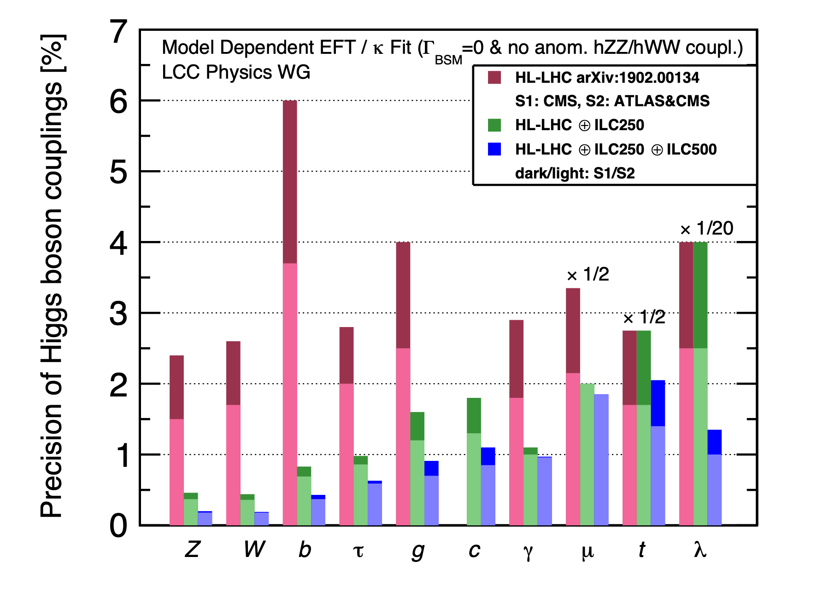
arXiv: 1901.09829
arXiv: 1903.01629
LHC-ILC Synergy
Self-coupling
Not accessible at 250 GeV.
Can reach 26% at 500 GeV.
Challenging @ LHC
Top Yukawa
Not accessible at 250 GeV.
Can reach 3% at 550 GeV.
FIG. 1. Projected Higgs boson coupling uncertainties for the LHC and ILC using the model-dependent assumptions appropriate to the LHC Higgs coupling fit. The dark- and light-red bars represent the projections in the scenarios S1 and S2 presented in [9, 10]. The scenario S1 refers to analyses with our current understanding; the scenario S2 refers to more optimistic assumptions in which experimental errors decrease with experience. The dark- and light-green bars represent the projections in the ILC scenarios in similar S1 and S2 scenarios defined in [6]. The dark- and light-blue bars show the projections for scenarios S1 and S2 when data from the 500 GeV run of the ILC is included. The same integrated luminosities are assumed as for Figure 2. The projected uncertainties in the Higgs couplings to μμ, tt, and the self-coupling are divided by the indicated factors to fit on the scale of this plot.
With ILC, we can reach our goal of 1%-level precisions for all the major couplings.

Slide 16
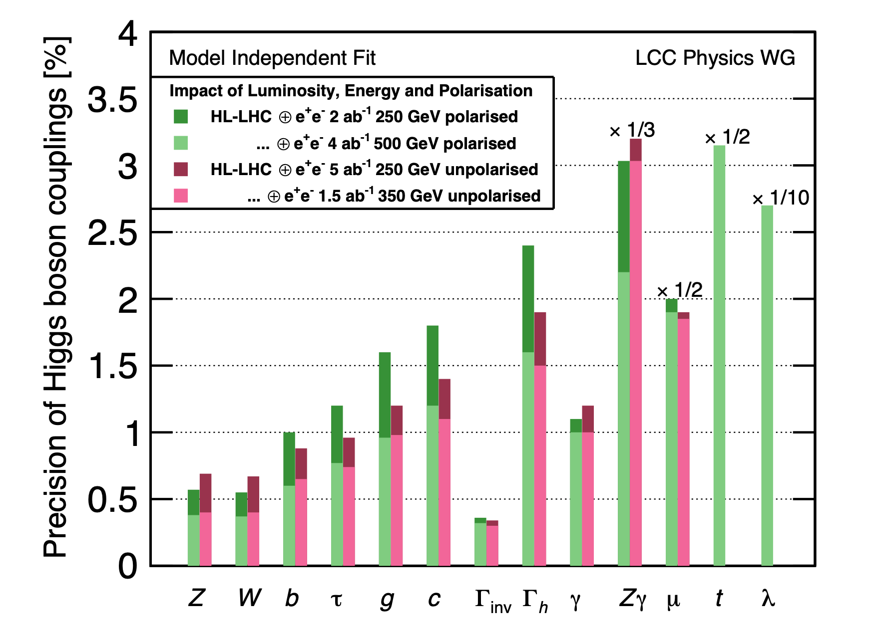
Power of Polarization
arXiv: 1903.01629
Polarized 2 ab⁻¹ is roughly equivalent to unpolarized 5 ab⁻¹!

Slide 17
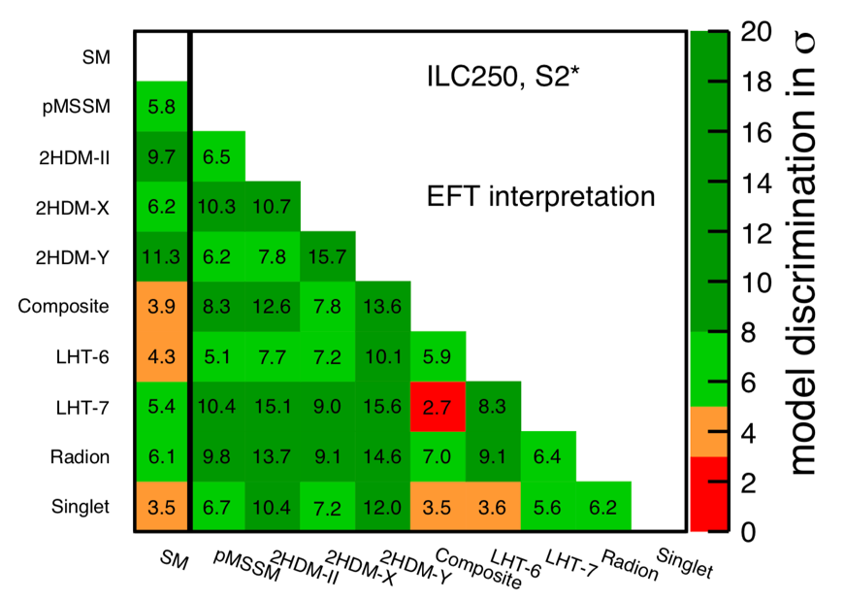
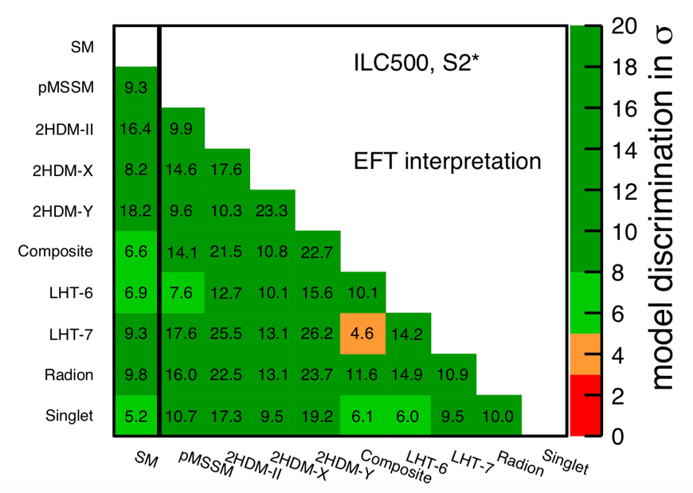
Sensitivity to BSM
ILC not only shows us the general direction but points to a specific direction
9 sample models and expected deviations (%)
arXiv: 1710.07621
arXiv: 1903.01629
All new particles unlikely to be within the reach of the HL-LHC
→ The only probe would be precision measurements of the Higgs couplings
Expected deviations are at most 10% or so Needs high precision to see the deviations
Different new physics models predict different deviation patterns
We can discriminate the models !
Discrimination power in σs
> 3σ sensitivities to most models @ 250 GeV
> 5σ sensitivities to almost all models @ 500 GeV

Slide 18
The 250 GeV ILC will enable us to do precision measurements of absolutely normalized Higgs couplings.
The 250 GeV ILC will show us the future direction of particle physics, by fingerprinting the deviation pattern of these precisely measured Higgs couplings.
By adding experiments at higher energies (not covered today) in future which allow precision top studies and a measurement of the cubic Higgs self-coupling, we will be able to further narrow down viable new physics models.

Slide 19
Backup

Slide 20
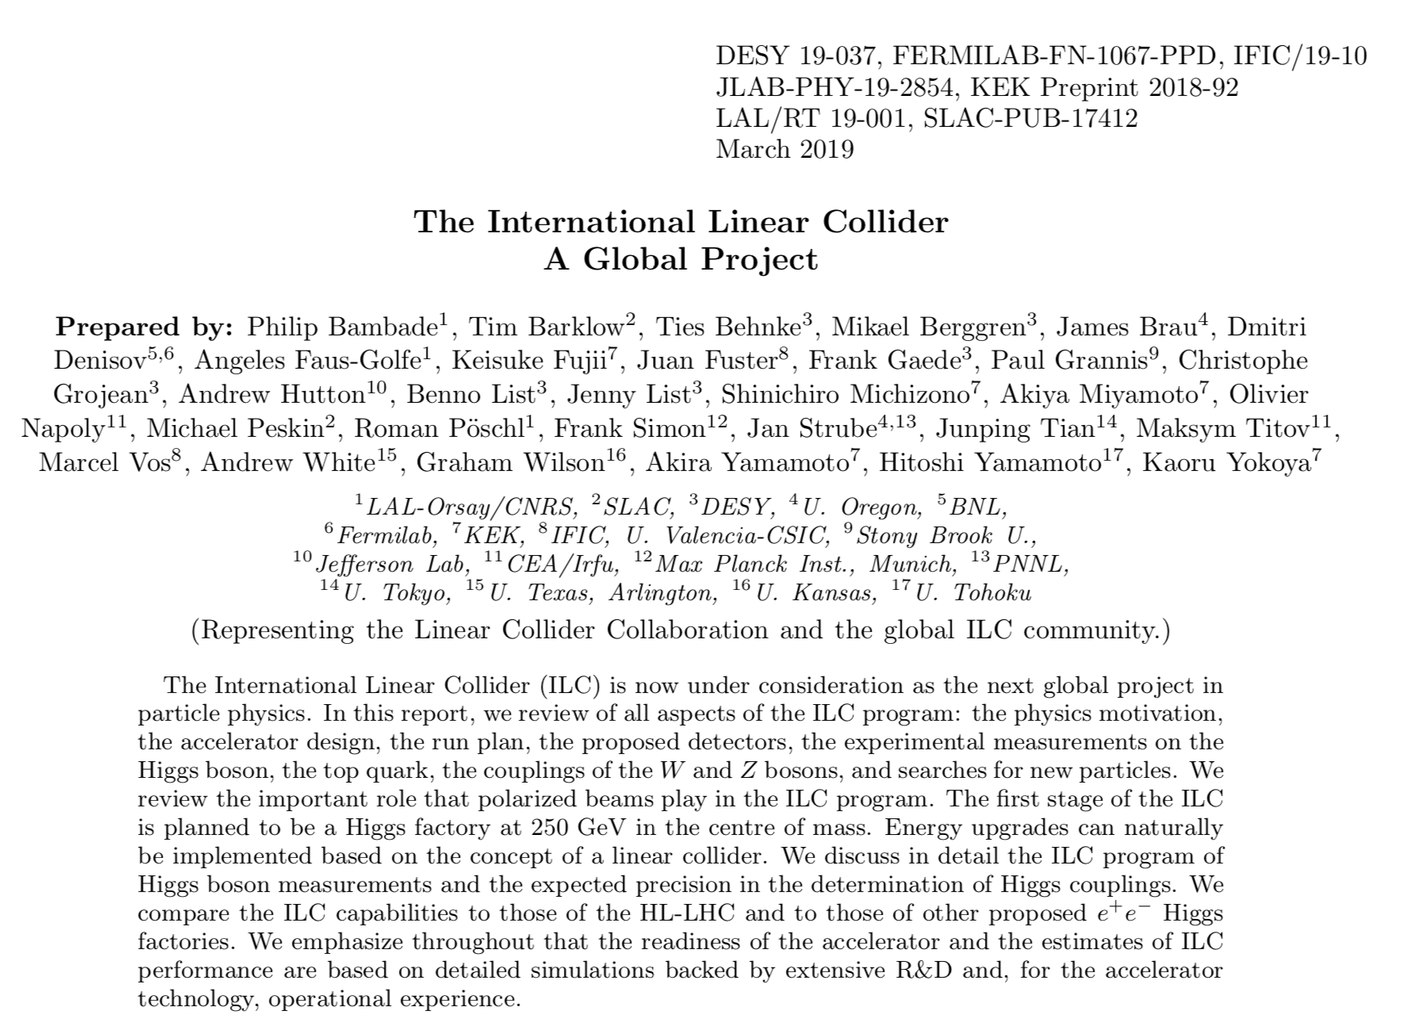
Details in the Support Documents
https://arxiv.org/abs/1903.01629

Slide 21
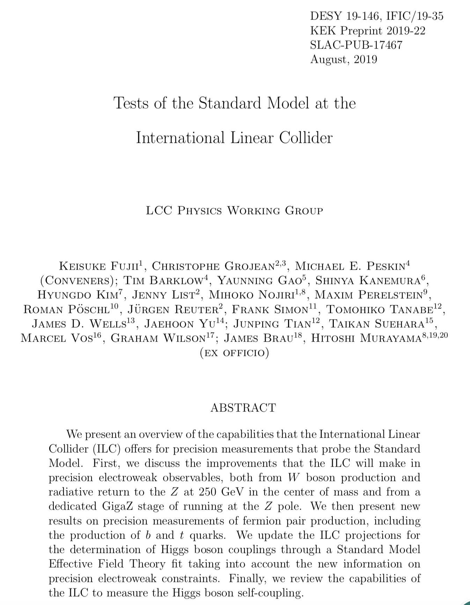
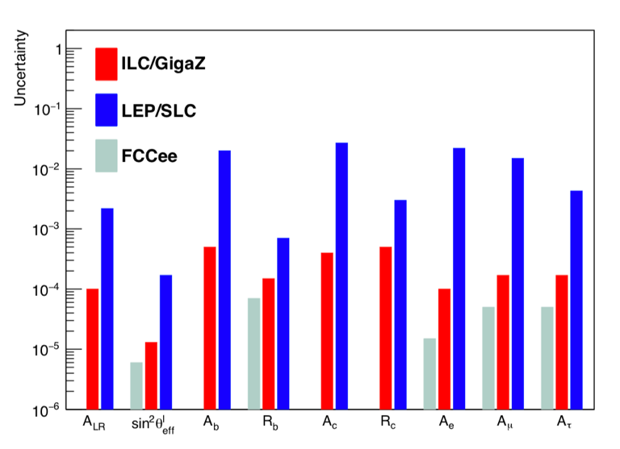
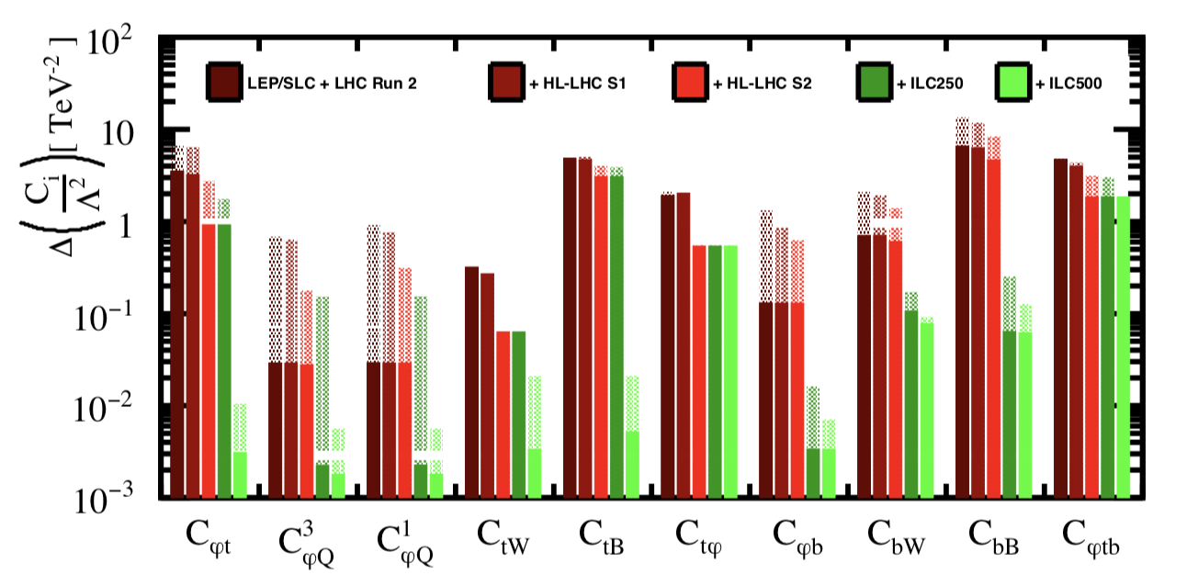
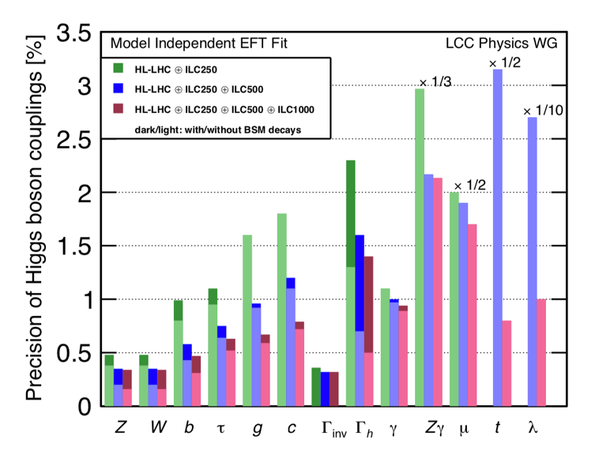
https://arxiv.org/abs/1908.11299
https://arxiv.org/abs/1907.10619

Slide 22
Direct New Particle Searches
>10³ higher luminosity than LEP2
beam polarizations
much better detectors
trigger-less data taking
enhance sensitivities to regions with small cross sections and compressed mass spectrum, which are challenging at LHC

Slide 23
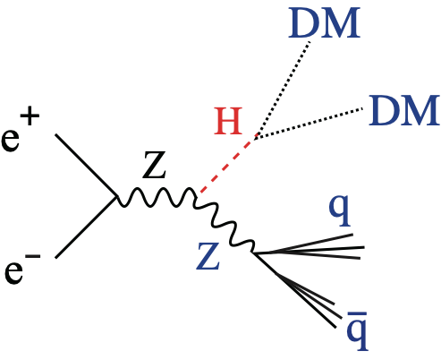
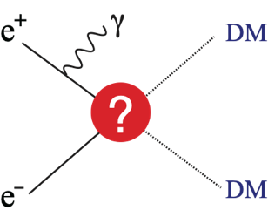
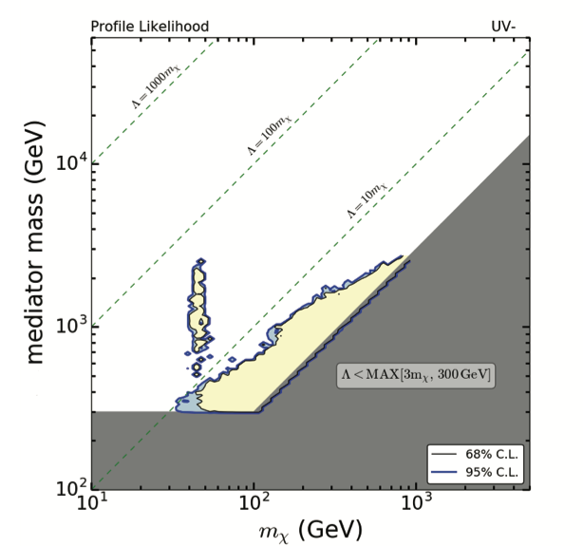
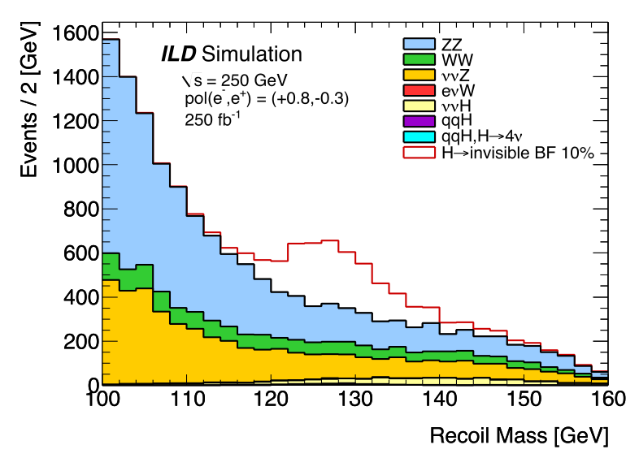
WIMP Dark Matter Search @ ILC
Weakly Interacting Massive Particle
1. Higgs Invisible Decay
2. Mono-photon Search
Sensitive to various types of Dark Matter particles
Effective when the Dark Matter particle interacts with the Higgs boson
Effective in particular for DM particles which couple mostly to EW gauge bosons and leptons and hence difficult to find at the LHC.
Light yellow region = to be left for ILC
(after future direct searches including HL-LHC)
ILC250
MDM < Mh /2
Mediator Mass [GeV]
# events
Recoil Mass [GeV]
DM Mass [GeV]
Possible to access BRinv to 0.3%!
Significant chunk of region remains for ILC250!
O(10) more sensitive than HL-LHC

Slide 24
Two ILC Detectors in the TDR
Design studies ongoing by international teams
Compared with LHC detectors, ILC detectors have ~10 times better momentum resolution and 100~1000 times finer granularity.
This performance can be achieved only in the clean environment of the ILC, and cannot be achieved in the LHC environment.
Large R with TPC tracker
LOI signatories: 32 countries, 151 institutions, ~700 members
ILD
Si Tracker
TPC tracker
SiD
High B with Si strip tracker
LOI signatories: 18 countries, 77 institutions, ~240 members
Notes:
ILD IA:
SiD IB:
実働率：~30%
学位取得者：年平均：M~10、D~1
ATLAS の場合：LoI: ~900、Proposal: ~1500、Now: ~3000
こうした加速器の違いに加え、測定器の違いもあります。ILC 測定器の性能は、LHCと比較して、運動量分解能で約10倍、細密度で100倍から1000倍程度高性能です。これは、ILC のクリーンな環境下でしか使えない技術が使えるためです。現在、ILD、SiD という二つの測定器が提案されており、国際的な研究チームによる全体設計と測定器要素の研究開発が進んでいます。

Slide 25
Higgs Studies

Slide 26
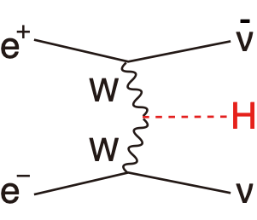
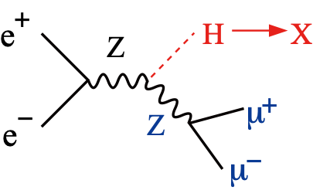
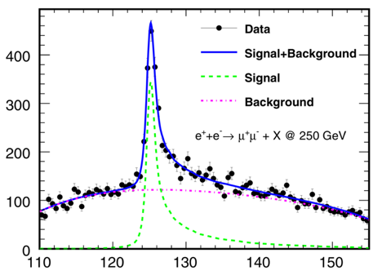
Recent Development: EFT Analysis
Potential drawback:
It has been said that Γh (Higgs total width) necessary for absolute coupling normalization requires >350GeV.
SU(2)xU(1) inv.
dim.6 operators
# EFT coefficients to decide: 17 ＠ ILC
This ILC number is quite tractable.
Beam polarization doubles the number of usable observables.
cross section: small@250GeV
The importance of the σZh measurement by recoil mass technique remains the same.
Solution: EFT (Effective Field Theory) to relate hZZ and hWW couplings
LHC Run II results suggest that 250 GeV is likely in the validity range of the EFT
WL and ZL are NGBs from the Higgs sector. can use all the SM processes with W and Z to constrain the EFT coefficients.
Absolute and model-independent Higgs coupling measurements possible with the 250 GeV data alone.

Slide 27
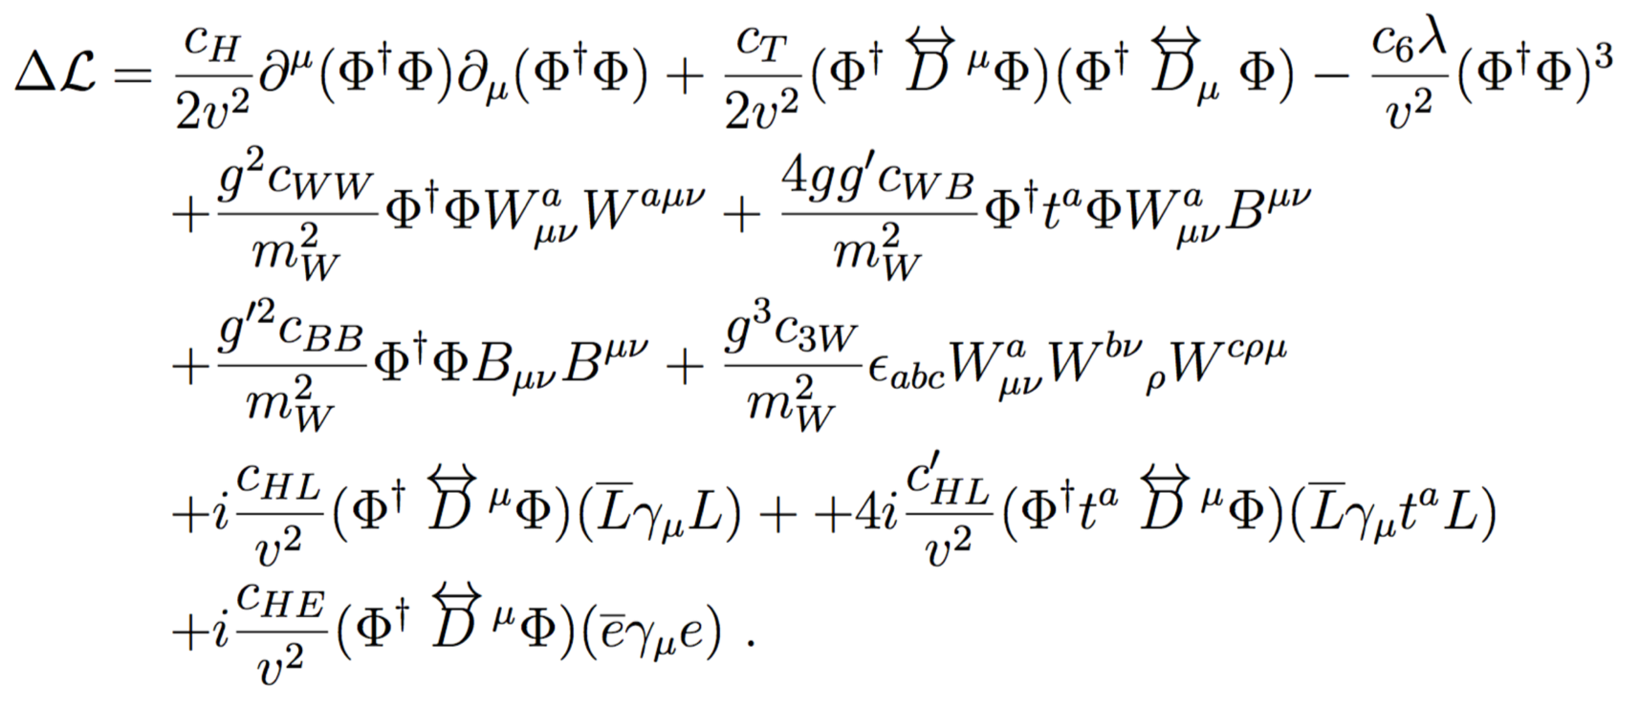
EFT Lagrangian Before EW Symmetry Breaking
Manifestly SU(2)xU(1) gauge invariant
10 parameters of which C6 only affects Higgs self-coupling analysis.
5 parameters to account for Higgs coupling to b, c, τ, μ, g.
2 parameters to account for invisible and exotic Higgs decays.
4 parameters to account for the shifts of g, g’, v, and λ
2 parameters (CHL-type) to shift W, Z widths.

Slide 28
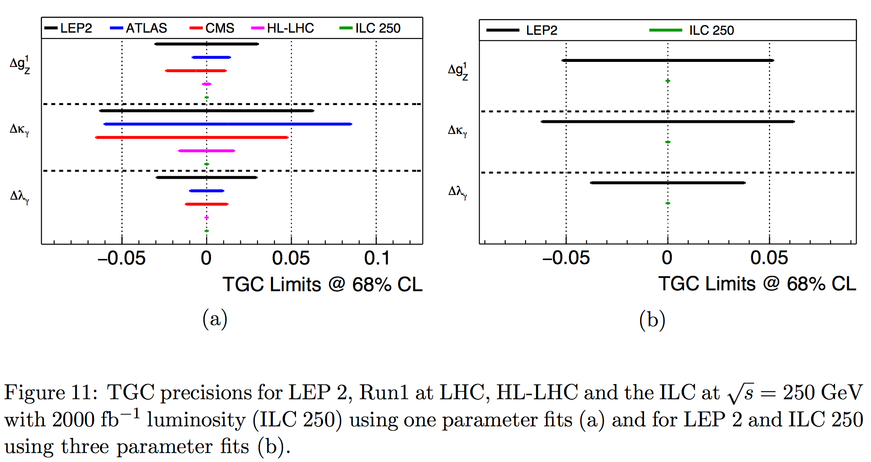
Example of Non-Higgs Process that plays an important role in the EFT fit
e⁺e⁻→W⁺W⁻ (Triple Gauge Couplings)
Significant improvements from HL-LHC and LEP2 !

Slide 29
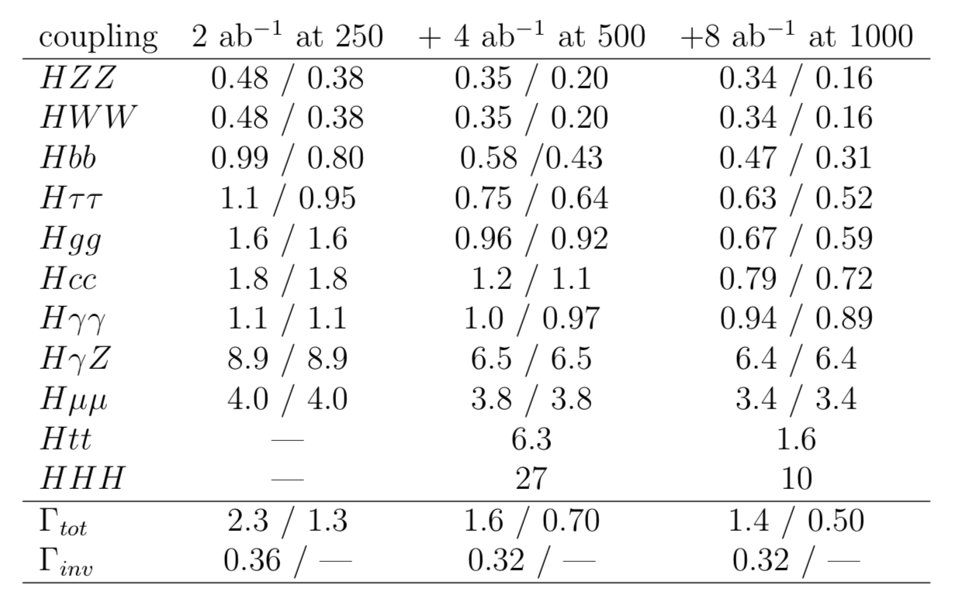
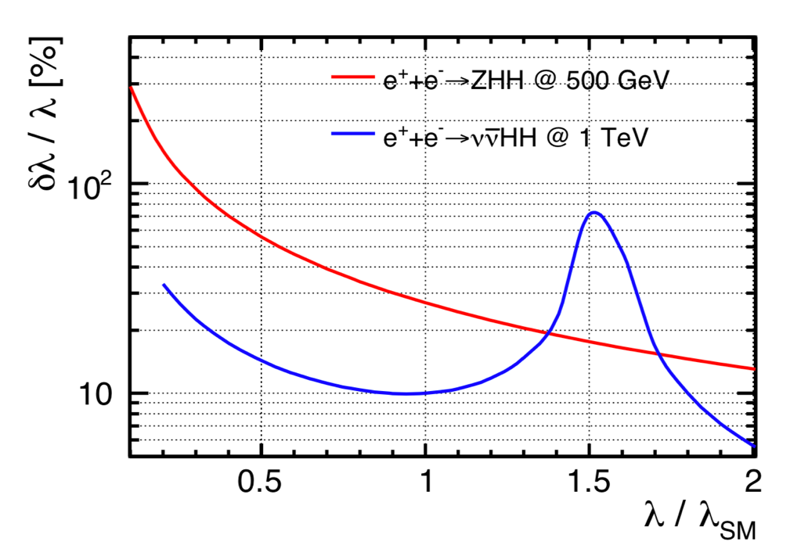
8ab-1 split into 4 pol. combinations: (-+, +-, ++, - -) = (40%,40%,10%,10%)
Significant improvements in single Higgs and WW productions
2nd number assumes Σ BR(SM)_i = 1
Significant improvements in Top Yukawa and Triple Higgs couplings

Slide 30
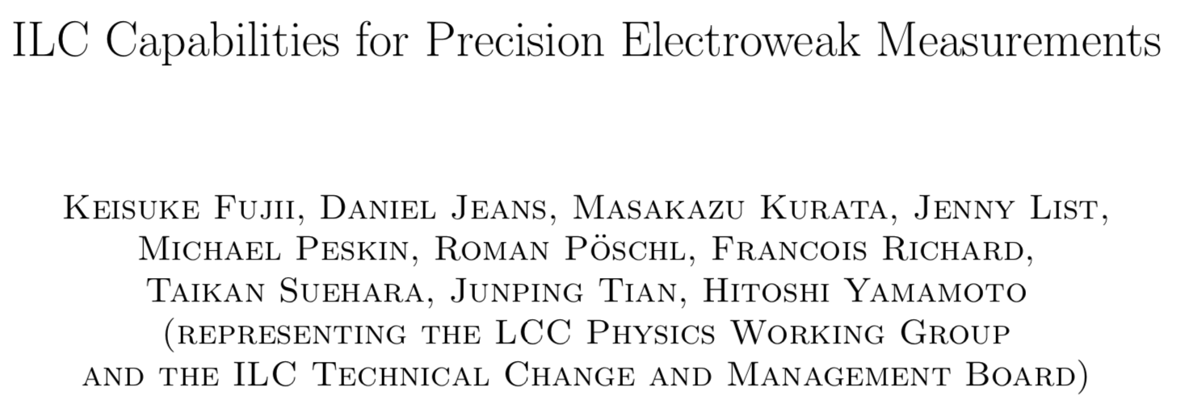
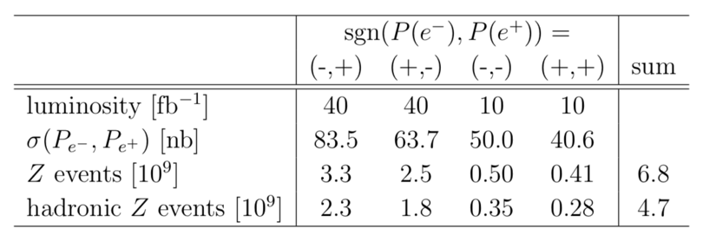
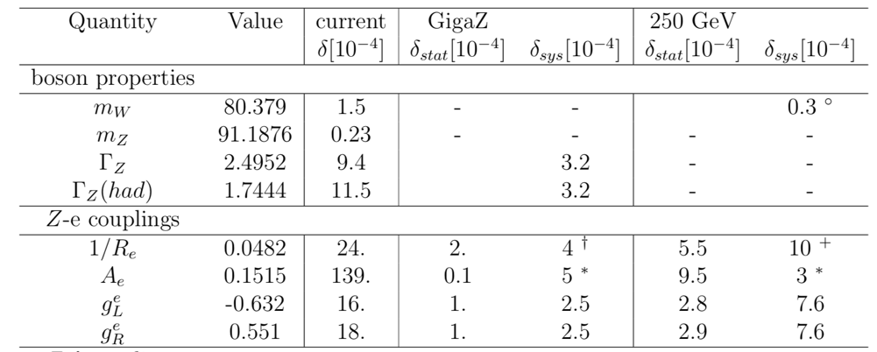
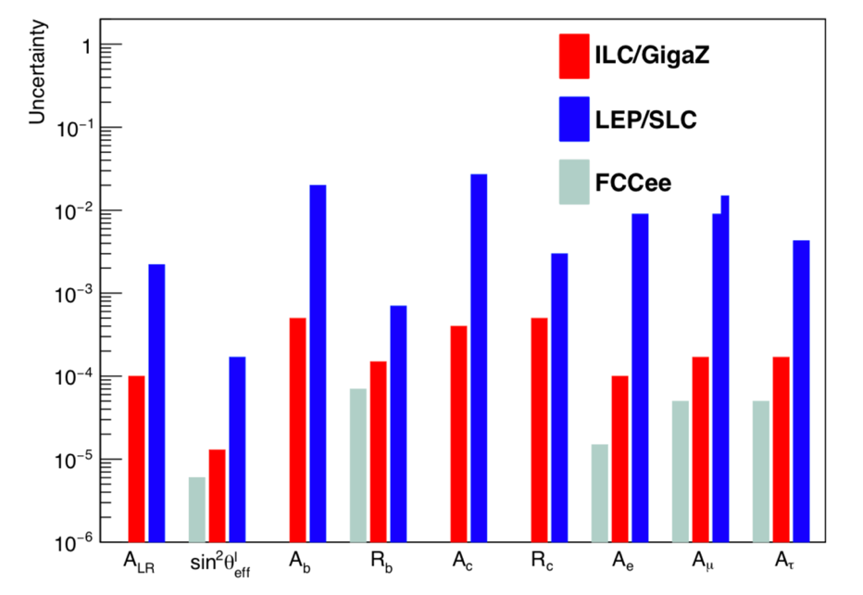
The source of the dominant systematic error: † acceptance; ◦ energy scale; ∗ beam polarization; # jet correlations; ⁺ flavor tag.
Radiative Return to Z @ 250 GeV
already gives a factor of 10 better Ae than LEP/SLC.
Giga-Z further improves precisions.

Slide 31
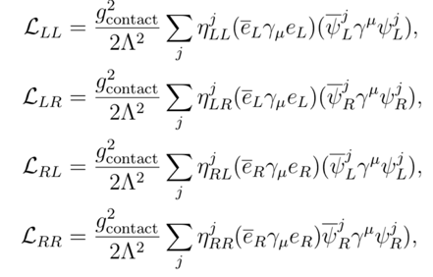
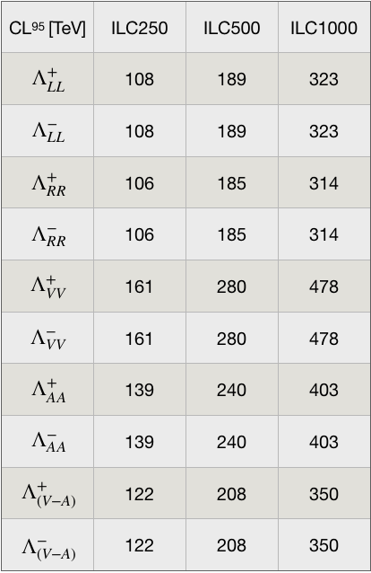
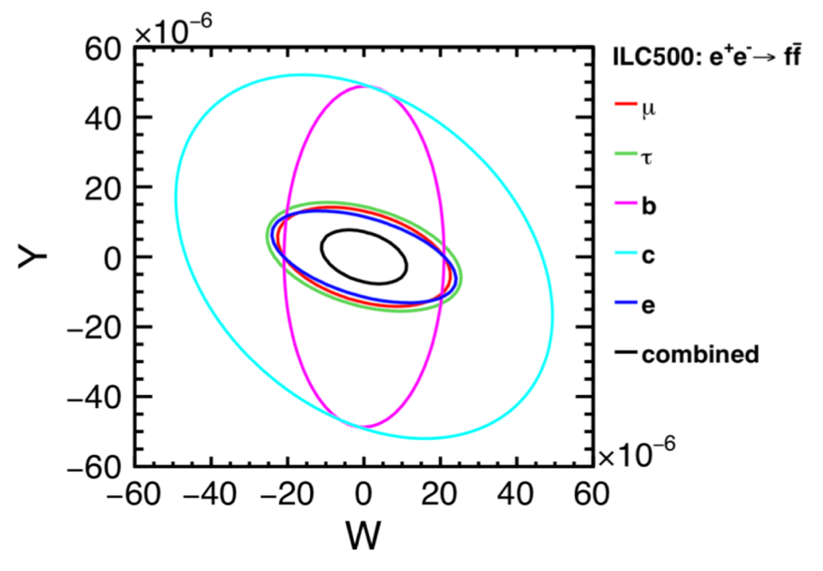
4-fermion contact int.
Z’ mass: 95% excl. lim. & 5-σ disc. reach in TeV
W/Y param. Higgs Compositeness Scale
Sensitivity comparable to FCC-ee & CLIC,
can separately measure different fermions
Λ >200 x Ecm

Slide 32
Linear vs Circular
Discussion

Slide 33
Political support: ILC has been considered in depth over a number of years by the government of Japan,
which, for the first time, officially showed its interest in the ILC.
Politicians, governments, and funding agencies in Japan have been discussing the ILC
with their counterparts in Europe and the US for a number of years, and have been
encouraged by these discussions.
Other large collider projects have not yet reached a similar stage.
Technical maturity:
The RDR (CDR equivalent) for the ILC was published in 2007 and the TDR in 2013.
Circular collider projects have only recently published their CDRs.
The ILC's quoted performance and costs are deeply understood and thus reliable.
Timeline: Given a go-ahead, the ILC will very soon be ready to start construction. First collisions can occur within around 15 years from now.
According to current run plans, the ILC will complete its 2 ab-1 250 GeV run at about the time
FCCee begins its ZH run.
Physics: Beam polarization is a powerful tool not available at high energy circular colliders.
When measuring Higgs couplings, polarization compensates for the lower integrated
luminosity at 250 GeV compared to FCCee (2 vs 5 ab-1) not just by the increased rates
but also by its power to remove some correlations among different EFT operators.
In the case that ILC observes new phenomena other than in the Higgs couplings, polarization
will play an essential role in determining their chiral properties.
Polarization will also allow systematic uncertainties on many measurements to be significantly
reduced.
Upgradeability: The ILC's collision energy can be readily upgraded to 500 GeV and above.
A technical design for a 500 GeV stage exists.
Likewise, a technical design exists for upgrading the luminosity:
- by a factor 2 by doubling the number of bunches per pulse,
- another factor 2 by doubling the repetition rate.
The ILC250 infrastructure is reusable. It provides long-term perspectives beyond current technologies (e.g. a plasma-based accelerator).

Slide 34
2018/10/21
Lumi-Up = # bunches x 2
Design Luminosity
E-Up = E-Up to 500 GeV
 | Base Line 1312 bunches (5 Hz) | Lumi-Up 2625 bunches (5 Hz) | (Lumi+E-Up) 2625 bunches (High Rep)
250 GeV (H20) | 0.82 x 10³⁴ (5 Hz) | 1.64 x 10³⁴ (5 Hz) | 3.28 x 10³⁴ (10 Hz)
350 GeV (H20) | 1.0 x 10³⁴ (5 Hz) | 2.0 x 10³⁴ (5 Hz) | 2.8 x 10³⁴ (7 Hz)
500 GeV (H20) | 1.8 x 10³⁴ (5 Hz) | 3.6 x 10³⁴ (5 Hz) | —
250 GeV (New) | 1.35 x 10³⁴ (5 Hz) | 2.7 x 10³⁴ (5 Hz) | 5.4 x 10³⁴ (10 Hz)
H20 numbers from arXiv: 1506.07830 with revision according to Change Request 5 (approved by Change Control Board in 2015)
250 GeV (New) numbers based on arXiv: 1711.00568
New Luminosity Upgrade Scenarios now in the long document.

Slide 35
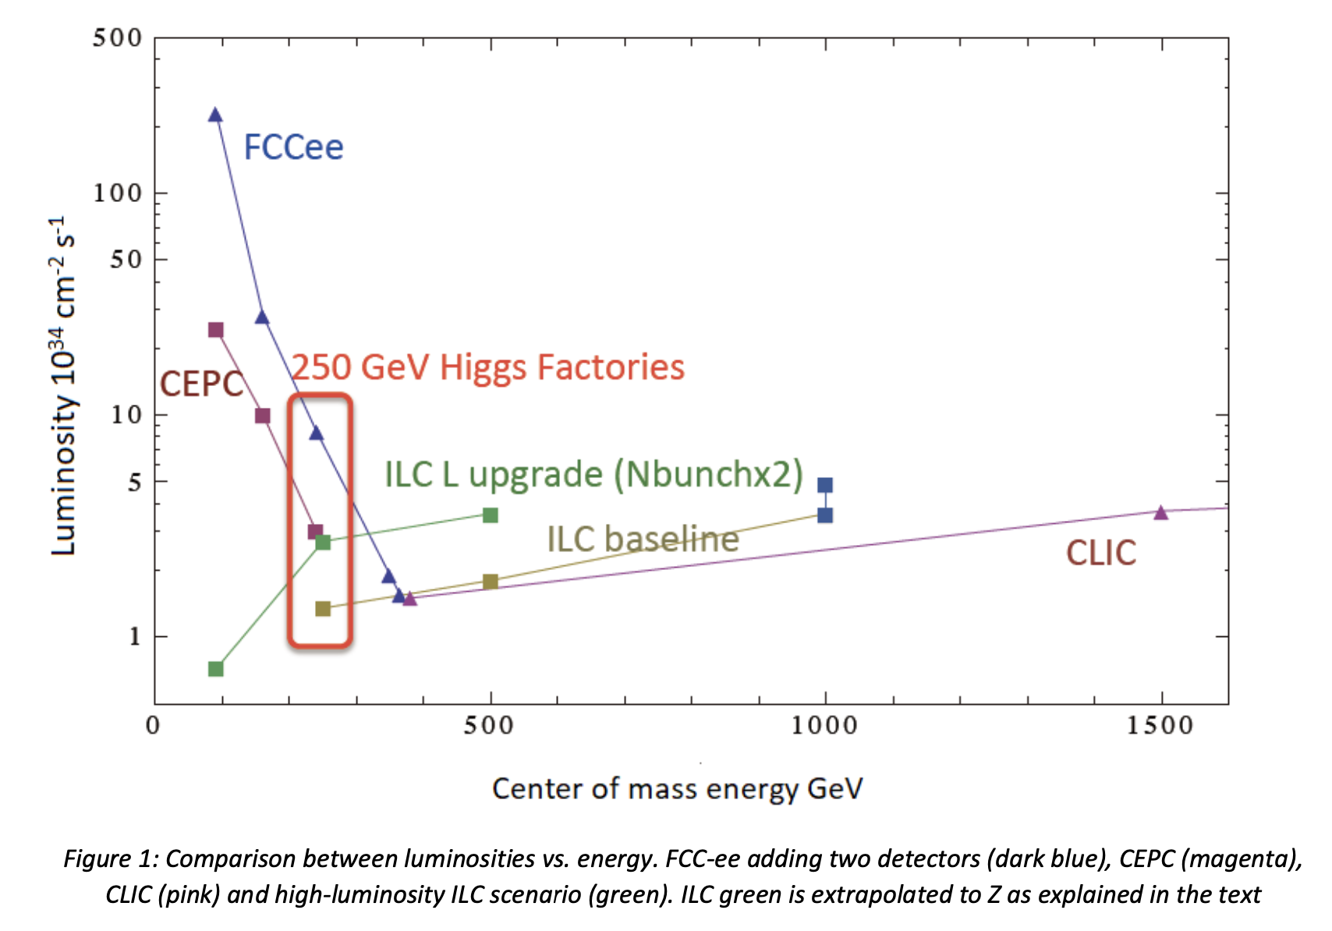
arXiv: 1905.00220

Slide 36
Beyond 250 GeV
What we can do at higher energies
Precision EW coupling measurement of Top
Precision Top mass measurement
Direct measurement of Top Yukawa coupling
Measurement of 3-point Higgs self-coupling
Expansion of search region of new particles

Slide 37
If no deviations at all would be seen?

Slide 38
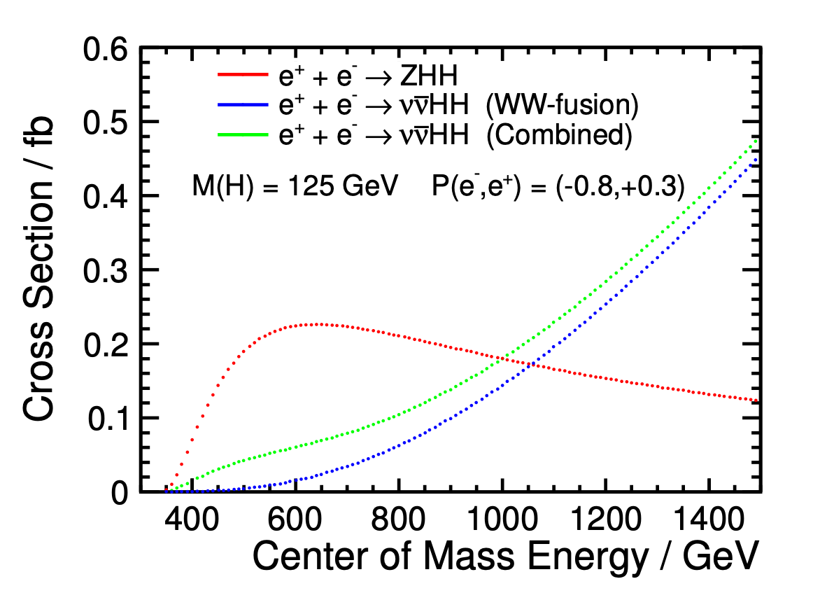
Higgs Self-Coupling
The Higgs cubic self-coupling is at the heart of EWSB, so should be measured in its own right!
There are two ways to measure it at ILC
ILC
CLIC
Challenging even at ILC because of
Small cross section
Presence of irreducible BG diagrams that dilute the self-coupling contribution!
Separation of BSM effects that appear other than in self-coupling (possible in EFT: same impossible at LHC)
 | 500 GeV | + 1 TeV
Snowmass | 46% | 13%
H20 | 26% | 10%
1.4 TeV (1.5 ab⁻¹) | +3 TeV (2 ab⁻¹)
21% | 10%
(arXiv: 1307.5288)
H20 arXiv: 1506.07870
Ongoing effort towards O(10)% measurement
J. Tian, LC-REP-2013-003
C. Dürig @ ALCW16
M. Kurata, LC-REP-2014-025
If +100% deviation as possible in EWBG scenario, Δλ/λ=14%!

Slide 39
Clarify the Range of Validity of SM Stability of SM Vacuum
V(φ)
Stable
Top Yukawa coupling drives the 4-point Higgs coupling (λ) to negative! → The true vacuum could be somewhere else at a high φ value.
The current values of mt and mh seem to be in subtle point of meta-stability!
mt↑
Does λ go to negative below ΛP? or λ(ΛPl) = 0 (suggesting new principle) ?
φ
Our vacuum
To answer this, we need precision mt measurement!
True vacuum?
At LHC, theory error limits the precision to ~500MeV.
TTbar Threshold Scan ＠ILC allows very clean measurement of theoretically well defined mt
ILC 3σ
ILC pinpoints the vacuum location
arXiv:1205.6497, Degrassi et al.
arXiv:hep-ph/1502.01030: Quark mass relation to 4-loop order
arXiv:hep-ph/1506.06864: NNNLO QCD
arXiv:hep-ph/1506.06542: possibility of MSbar mass to 20MeV

Slide 40
EW Baryogenesis?
Impossible in SM
EW Phase Transition＝Strong 1st Order
Necessary to deviate from equilibrium → Shifts in HXX couplings Expect a large deviation in the HHH coupling
Big enough CP violation (δKM too small) at the bubble wall
→ CP violation in the Higgs sector
→ Extended Higgs Sector

Slide 41
EW Baryogenesis?
e.g.: 2 Higgs Doublet Model (2HDM)
Measuring CP in H → τ⁺τ⁻ at ILC
Region where EW baryogenesis is possible
EWPT ＝1st Order
Minimum value of HHH coupling
2ab⁻¹ @ 250 GeV
D. Jeans 2018
Senaha, Kanemura
Measurement of HHH coupling at ILC
At 500 GeV signal and background diagrams constructively interfere.強め合う
→ If there is 100% upward shift→ Δλ/λ=14%
ILC will test EW baryogenesis.

Slide 42
Strong 1st Order EW Phase Transition
e.g.: Doublet-Singlet Mixing Model (HSM)
Precision Higgs Coupling Measurements
gHHH shift
Uniform Shift
κV=κf=κ
Gravitational Wave
Fuyuno, Senaha: arXiv: 1406.0433
Hashino, Kakizaki, Kanemura, Matsui, Ko: arXiv 1609.00297

Slide 43
Direct/Indirect
Searches

Slide 44
Power of Beam Polarization
W⁺W⁻ (Largest SM BG in SUSY searches)
BG Suppression
Chargino Pair
Slepton Pair
WW-fusion Higgs Prod.
Decomposition
 | ILC
Pol (e⁻) | -0.8
Pol (e⁺) | +0.3
(σ/σ0)vvH | 1.8x1.3=2.34
Signal Enhancement

Slide 45
3. Higgsino Search
Radiatively driven Natural SUSY
Higgsino-like LSP
μ not far above 100GeV
ΔM < 20 GeV
typically Δm of 20 GeV or less → very difficult for LHC!
Chargino＆ neutralino production (ILC1)
T. Tanabe: LCWS2017
cross section and mass measurements
Kinematical edges→ MX
Di-muon
mass
“ILC1 benchmark”: ΔM〜 20GeV
σM to ~2% M to ~1% (H20)
Di-muon
energy
Power of beam polarization
→ Higgsino/gaugino decomposition
Test of gauging mass unification
ILC1
Gravity
mediation
nGMM1
Mirage unification
Polarized σ → mixing angle
500GeV
ILC1: 250GeV
ILC2: 350GeV

Slide 46
WIMP Search
Mono-photon search
arXiv: 1702.05377
ILC1000
ILC250
Light yellow region = to be left for ILC
(after future direct searches including HL-LHC)
媒介粒子質量 [GeV]
Significant chunk of region remains for ILC250!

Slide 47
b-quark EW Form Factors
arXiv: 1709.04289
Vertex charge + K ID with dE/dx
Bilokhin, Poeschl, Richard
Relative accuracy (%)
500fb⁻¹
eLeR
ILD full simulation
ILC has
10³ times higher luminosity
much improved detectors
polarized beams
as compared to LEP
構造因子
ILC will put a period to long outstanding LEP AFB(b) anomaly.
Once confirmed → BSM study

Slide 48
Gauge Higgs Unification
PL B 775 (2017) 297 (arXiv:1705.05282) : Funatsu, Hatanaka, Hosotani, Orikasa
Y. Hosotani @ New Higgs WG meeting, Osaka, 18-19 Aug. 2017

