Slide 1
Higgs Physics at the LC and Requirements
Keisuke Fujii (KEK)
The slides have been updated according to Rohini’s comment on the importance of the top mass measurement at the ttbar threshold (Ecm~350GeV) and of the tth measurement at around Ecm=1TeV to study a mixed CP Higgs, which had slipped my mind. Thanks, Rohini.

Slide 2
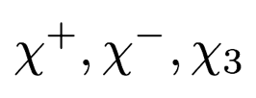
Electroweak Symmetry Breaking Mystery of something in the vacuum
The success of the SM is a success of gauge principle. We know that the transverse components of W and Z are gauge fields of the EW gauge symmetry.
Since the gauge symmetry forbids explicit mass terms for W and Z, it must be broken by something condensed in the vacuum which carries EW charges:
This “something” supplies 3 longitudinal modes of W and Z:
Since Left- and right-handed matter fermions carry different EW charges, explicit matter fermion mass terms are also forbidden by the EW gauge symmetry. Their masses have to be generated through their Yukawa interactions with some weak-charged vacuum.
In the SM, the same “something” mixes the left- and right-handed matter fermions, consequently generating masses and inducing flavor-mixings among generations.
In order to form the Yukawa interaction terms, we need a complex doublet scalar field. The SM identifies three real components of the doublet with the Goldstone modes that supply the longitudinal modes of W and Z.
We need one more to form a complex doublet, which is the physical Higgs boson.
This SM symmetry breaking sector is the simplest and the most economical, but there is no reason for it. The symmetry breaking sector (hereafter called the Higgs sector) might be more complex.
We don’t know whether the “something” is elementary or composite.
We knew it’s there in the vacuum with a vev of 246GeV. But other than that we did not know almost anything about the “something” until July 4, 2012.
: Goldstone modes

Slide 3
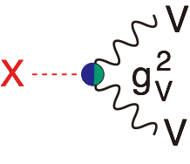
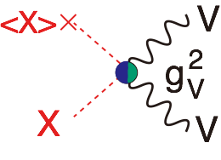
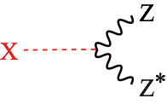
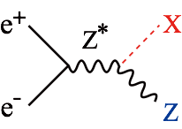
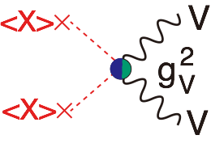
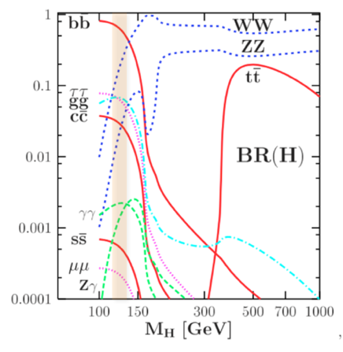
Since the July 4th, the world has changed!
The discovery of the ~125 GeV boson at LHC could be called a quantum jump.
X -> γγ means X is a boson and J ≠ 1 (Landau-Yang theorem).
We know that the 125GeV boson decays to ZZ* and WW*, indicating the existence of XVV couplings: (V=W/Z: gauge bosons). There is no gauge coupling like XVV. There are only XXVV or XXV, hence XVV is most probably from XXVV with one X replaced by its vacuum expectation value <X> ≠ 0, namely <X>XVV. Then there must be <X><X>VV, a mass term for V, meaning that X is at least part of the origin of the masses of V=W/Z. --> This is a great step forward but we need to know whether <X> saturates the SM vev = 246GeV.
X -> ZZ* means, X can be produced via e⁺e⁻ -> Z* -> ZX
By the same token, X -> WW* means, X can be produced via W fusion process: e⁺e⁻ -> ννX
We knew almost nothing about this “something” until July 4.
We now know there is indeed “something” which seems to be condensed in the vacuum. --> No lose theorem for a LC.
~125GeV is the best place for the LC, where variety of decay modes are accessible.
We need to check this ~125GeV boson in detail to see if it has indeed all the required properties of the something in the vacuum.
V=W/Z
Rotate and attach e⁺e⁻ to Z*

Slide 4
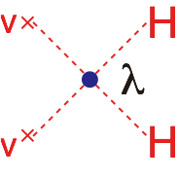
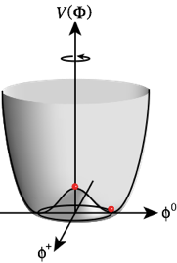
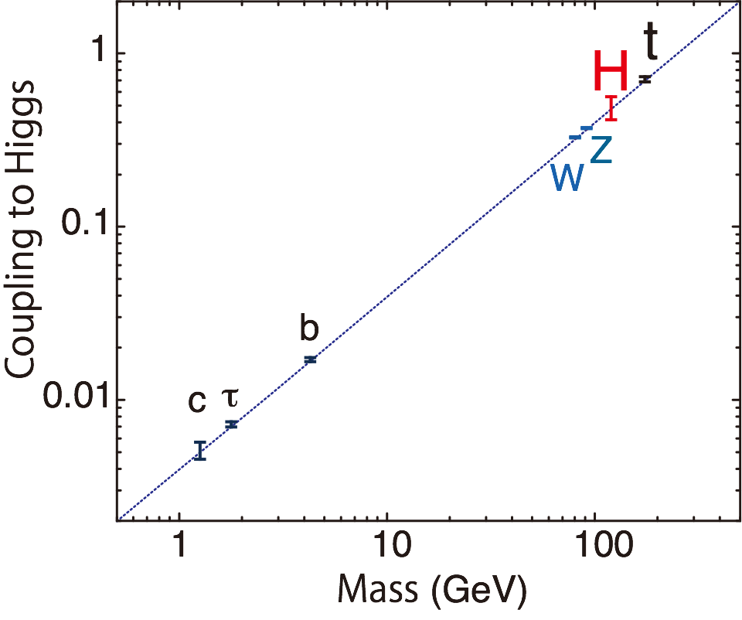
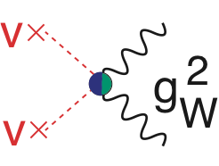
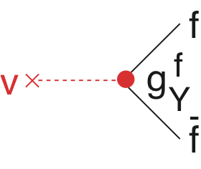
The Mass Coupling Relation
Uncover the secret of the Electroweak Symmetry Breaking
Higgs Force
Properties to measure are
mass, width, J^{PC}
Gauge quantum numbers (multiplet structure)
Yukawa couplings
Self-coupling
The key is to measure the mass-coupling relation
Gauge Force
If the 125GeV boson is the one to give masses to all the SM particles, coupling should be proportional to mass.
e+e- -> ZH
-> ZHH
-> TTH
γγ-> HH
Yukawa Force
Any deviation from the straight line signals BSM!
ACFA Report
The Higgs as a window to BSM physics!

Slide 5
Precision Higgs Studies
The Mission = Bottom-up reconstruction of the EWSB sector
Through the coupling measurements, determine the Electroweak Symmetry Breaking sector (bottom-up model-independent reconstruction of the Lagrangian for the Higgs and Yukawa sectors):
Multiplet structure:
Additional singlet?
Additional doublet?
Additional triplet?
Underlying dynamics :
Weakly interacting or strongly interacting? = elementary or composite ?
Relations to other problems :
DM
EW baryogenesis
neutrino mass
inflation?
The July 4 was the opening of a new era which will last probably 20 years or more, where a 500 GeV LC will / must play the central role.
Many models
discussed in the Higgs Session

Slide 6
Why 500 GeV? Three well known thresholds
ZH @ 250 GeV (~mZ+mH+20GeV)：
Higgs mass, width, J^{PC}
Gauge quantum numbers
Absolute measurement of HZZ coupling (recoil mass)
BR(h->VV,qq,ll,invisible) : V=W/Z(direct), g, γ (loop)
ttbar @ 340-350GeV (~2mt)：ZH meas. Is also possible
Threshold scan --> theoretically clean mt measurement --> indirect meas. of top Yukawa coupling
AFB, Top momentum measurements
Form factor measurements
vvH @ 350 - 500GeV：
HWW coupling -> total width --> absolute normalization of couplings
ZHH @ 500GeV (~mZ+2mH+170GeV)：
Prod. cross section attains its maximum at around 500GeV -> Higgs self-coupling
ttbarH @ 500GeV (~2mt+mH+30GeV)：
Prod. cross section becomes maximum at around 700GeV.
QCD threshold correction enhances the cross section -> top Yukawa measurable at 500GeV concurrently with the self-coupling
-> couplings to H (other than top)
γ γ → HH @ 350GeV possibility
We can complete the mass-coupling plot at ~500GeV!

Slide 7
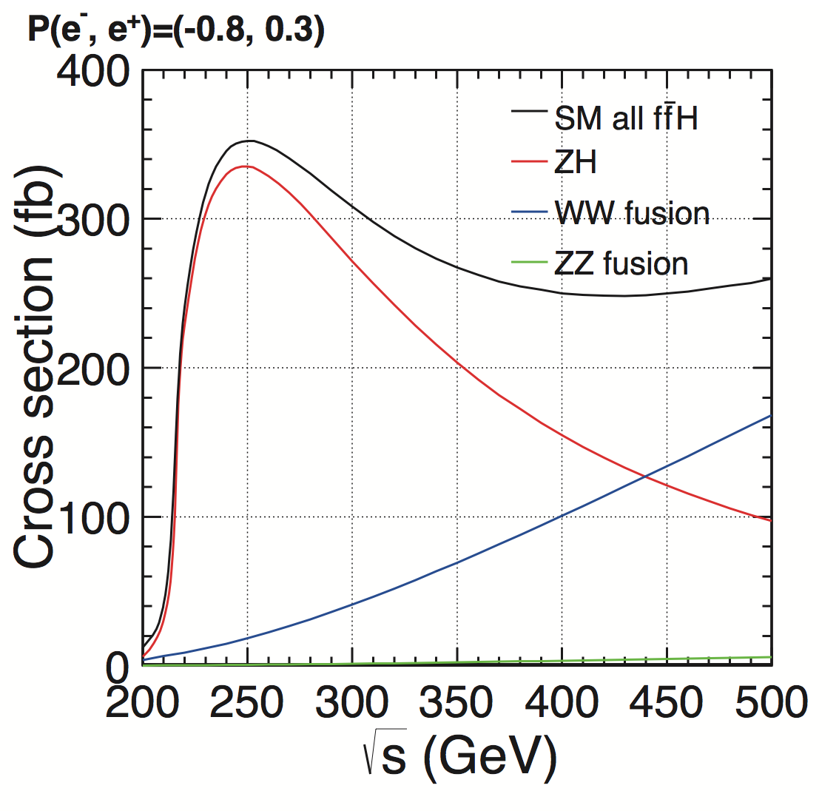
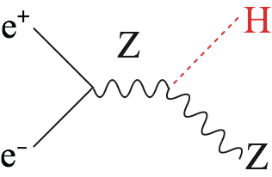
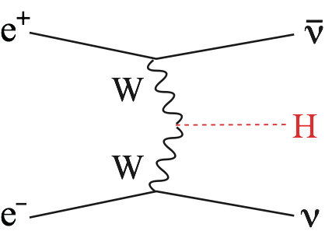
Two Main Processes Single Higgs Production
Production cross section
ZH dominates at 250 GeV (~90k ev: 250 fb⁻¹)
vvH takes over at 500 GeV (~130k ev: 500 fb⁻¹)
Possible to rediscover the Higgs in one day!

Slide 8
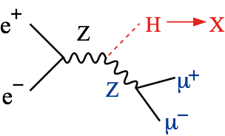
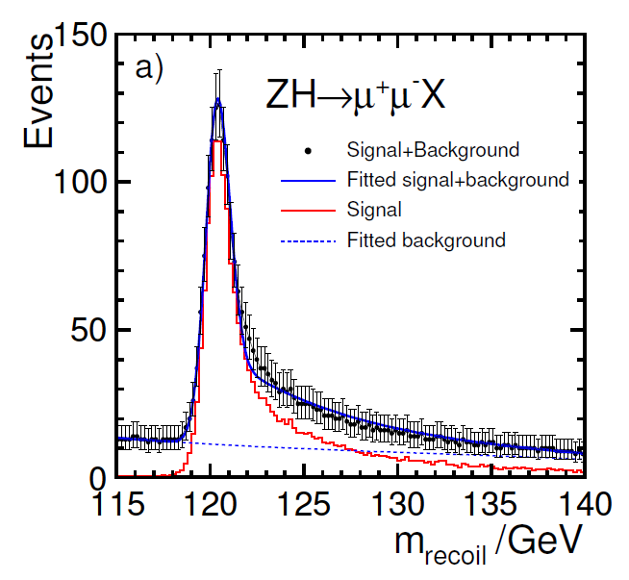
Recoil Mass Measurements The flagship measurement
Recoil Mass
Invisible decay detectable!
ILD LoI
Model-independent absolute measurement of the HZZ coupling

Slide 9
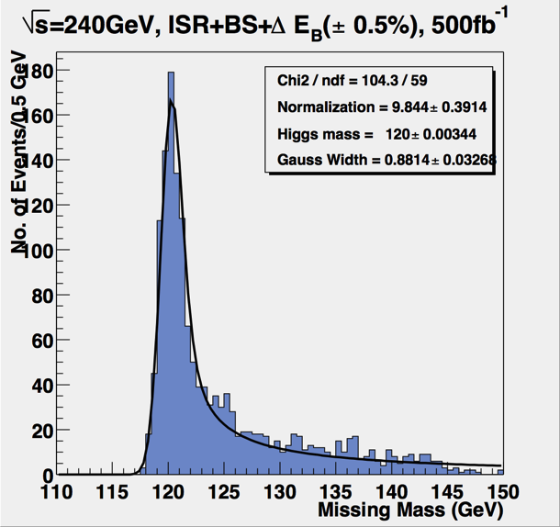
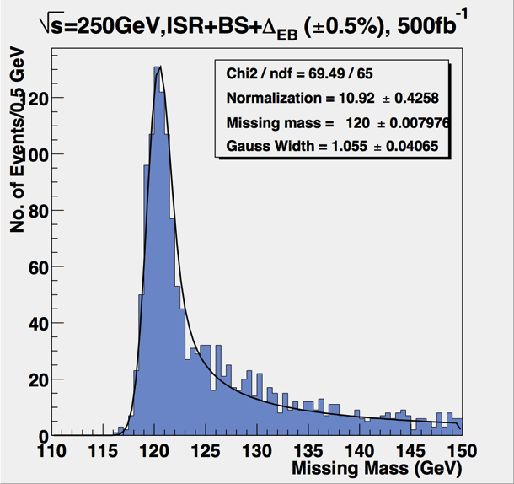
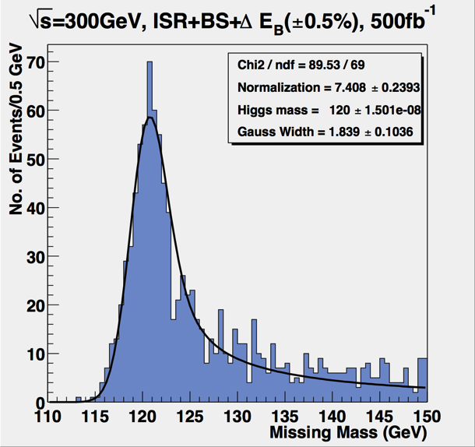
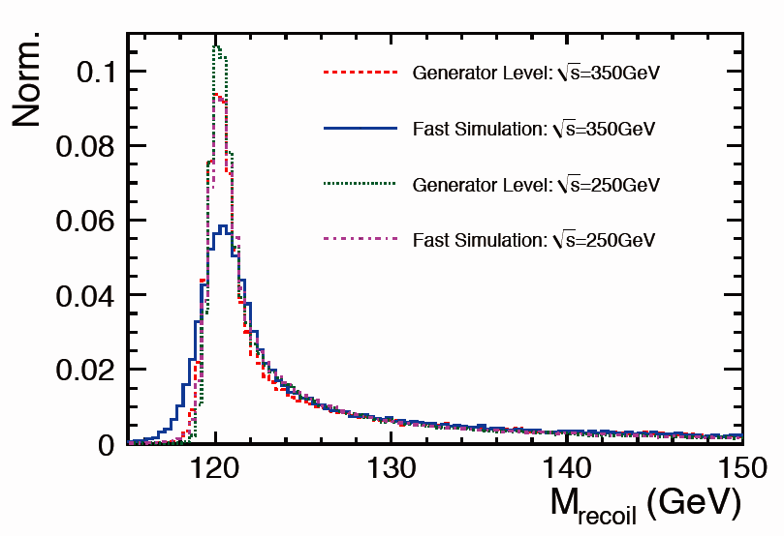
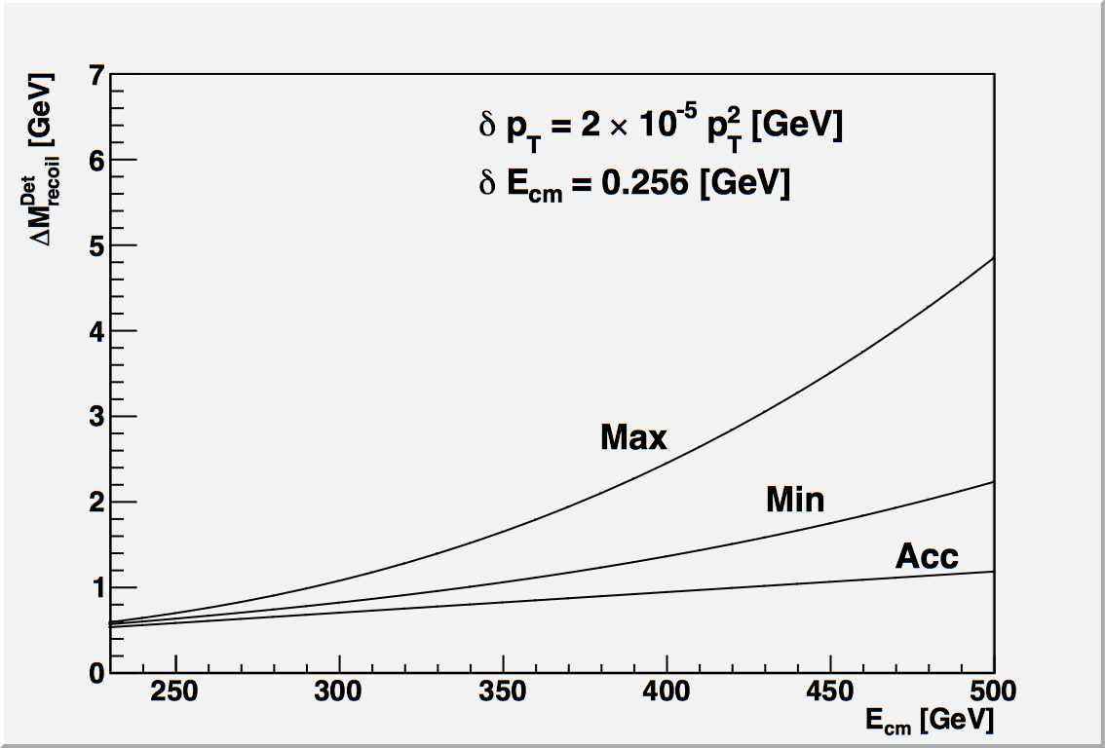
Recoil Mass Resolution
Estimation by simulation
Old ACFA Study
by Akiya Miyamoto
240GeV
250GeV
300GeV
Rough analytic estimate
ILD
Hengne Li
Degrades with energy

Slide 10
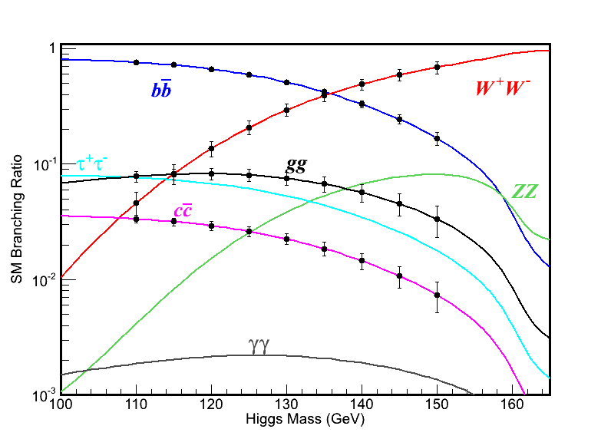
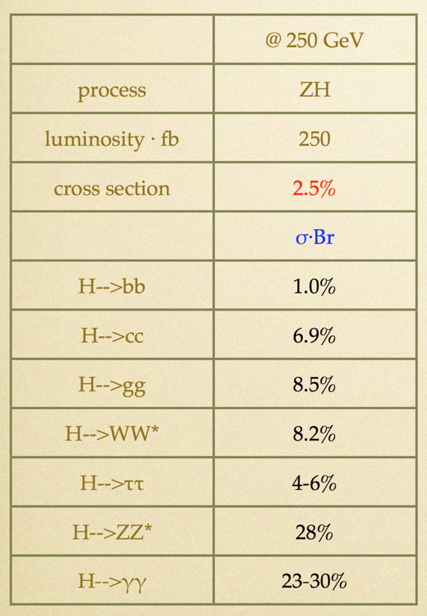
Branching Ratio Measurements for b, c, g, tau, WW*
preliminarily
ILD DBD Study (Ono)
Measurement accuracies extrapolated from Mh=120 GeV results (Final).
To extract BR from σxBR, however, we need σ from the recoil mass measurement. --> Δσ/σ=2.5% eventually limits the BR measurement. --> If we want to improve this, we need more data at 250GeV.
H. Ono’s talk

Slide 11
Total Width and Coupling Extraction One of the major advantages of the LC
To extract couplings from BRs, we need the total width:
To determine the total width, we need at least one partial width and corresponding BR:
In principle, we can use the A=Z, or W for which we can measure both the BRs and the couplings:
More advantageous but not easy at low E
BR=O(1%): precision limited by low stat. for H->ZZ* events
Jenny List’s talk

Slide 12
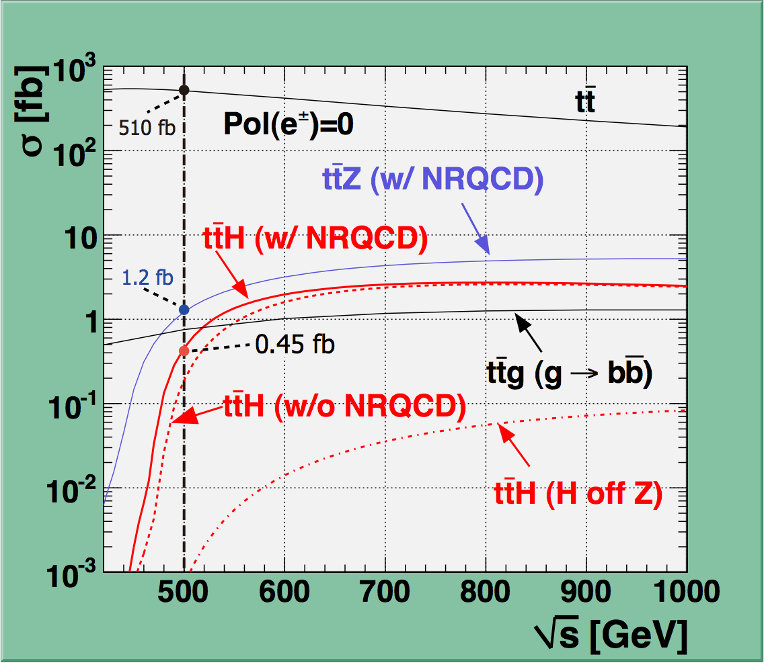
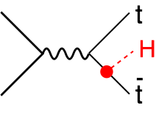
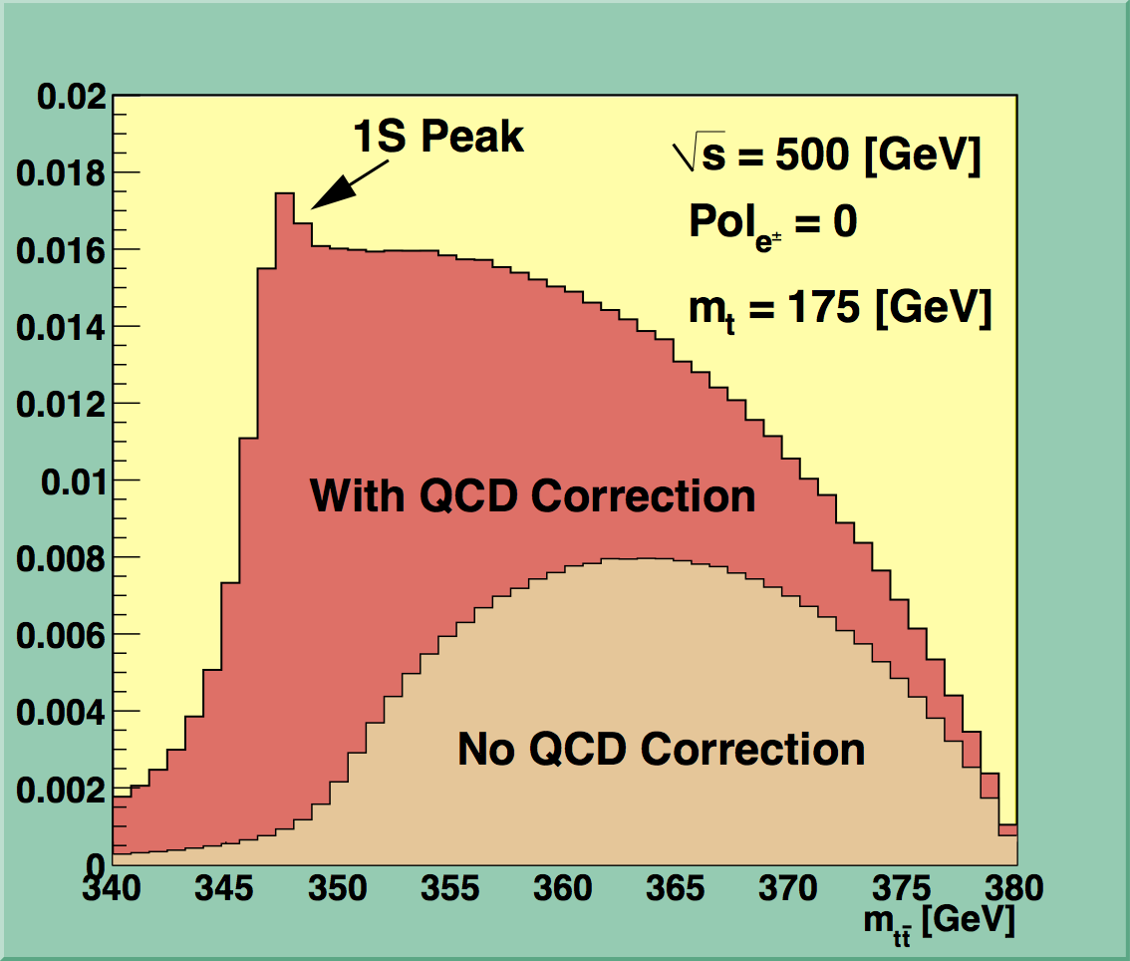
Top Yukawa Coupling The largest among matter fermions, but not yet observed
A factor of 2 enhancement from QCD bound-state effects
Cross section maximum at around Ecm = 800GeV
Philipp Roloff
Tony Price’s talk
Tony Price’s talk
Notice σ(500+20GeV)/σ(500GeV) ~ 2
Moving up a little bit helps significantly!

Slide 13
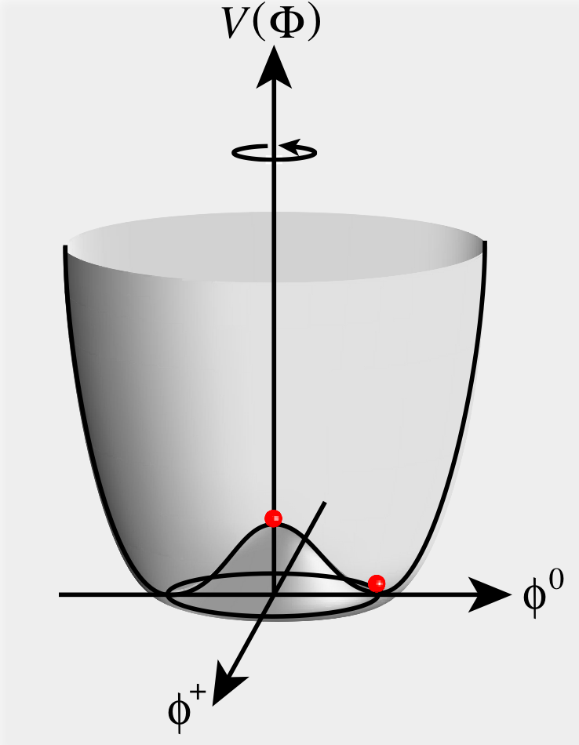
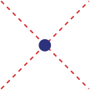
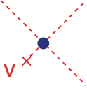
Higgs Self-coupling What force makes the Higgs condense in the vacuum?
In order to uncover the secret of electroweak symmetry breaking, we need to observe the force that makes the Higgs condense in the vacuum!
We need to measure the Higgs
self-coupling
= We need to measure the shape
of the Higgs potential

Slide 14
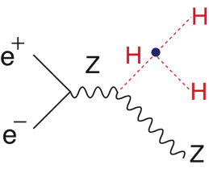
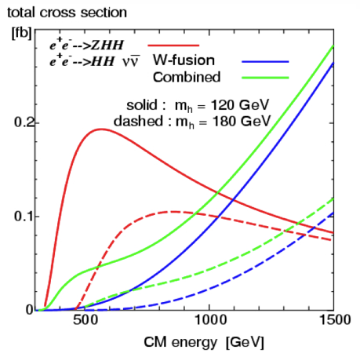
ILD (ACFA Higgs WG: J. Tian et al)
Pol.: (e+,e-)=(+0.3,-0.8)
mH=120GeV, 2ab^-1
Expected Precision with DBD tools and DBD samples
Junping Tian’s talk in ILD session

Slide 15
Width and BR Measurements at 500 GeV Addition of 500GeV data to 250GeV data
comes in as a powerful tool!
Mode | ΔBR/BR
bb | 2.0 (2.7)%
cc | 3.8 (7.3)%
gg | 4.4 (8.9)%
WW* | 3.5 (8.6)%
ILD DBD Study (Junping Tian)
preliminarily
The numbers in the parentheses are
as of

Slide 16
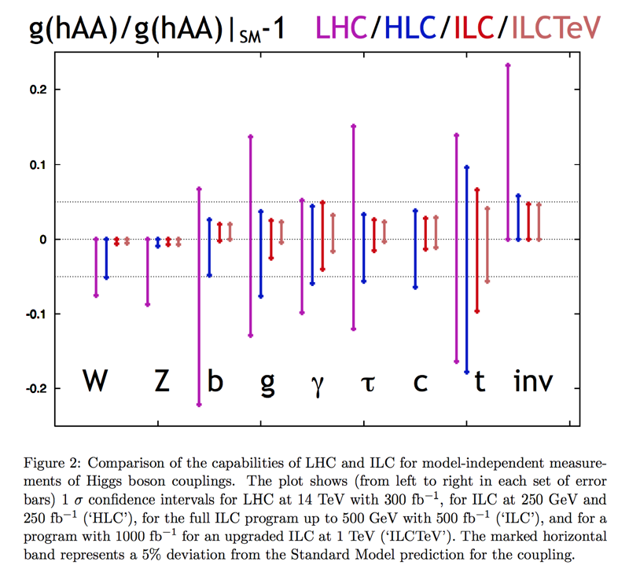
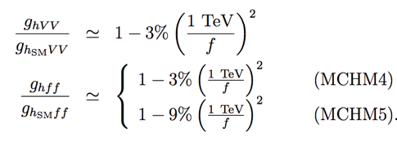
Why Precision? Expected precision and deviation
Assumed Luminosities
LHC = LHC14TeV: 300fb⁻¹
M.Peskin arXiv: hep-ph/1207.2516v1
HLC = ILC250: 250fb⁻¹
ILC = ILC500: 500fb⁻¹
ILCTeV = ILC1000: 1000fb⁻¹
Maximum deviation when nothing but the 125 GeV object would be found at LHC
R.S.Gupta, H.Rzehak, J.D.Wells
arXiv: 1206.3560v1
Mixing with singlet
Composite Higgs
SUSY
LC’s precision provides important information on the energy scale for BSM physics.
Different models predict different deviation patterns --> Fingerprinting!

Slide 17
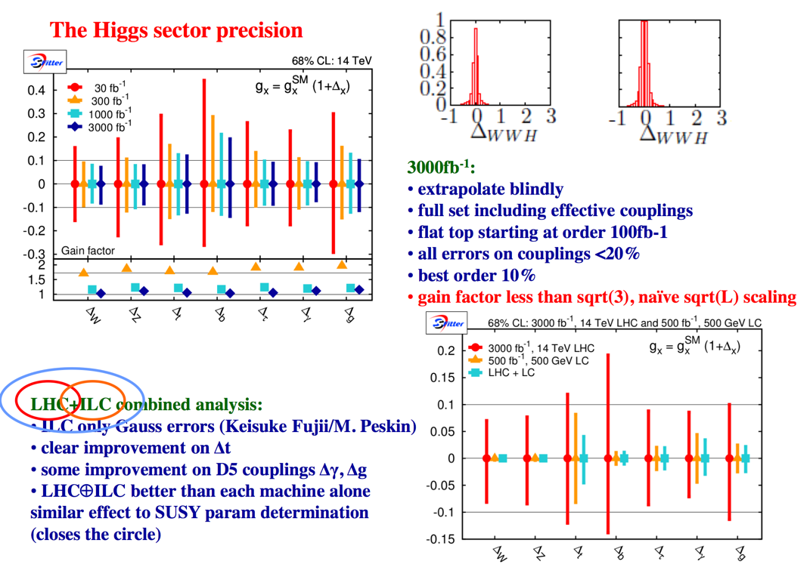
SFitter
Dirk Zerwas’s talk

Slide 18
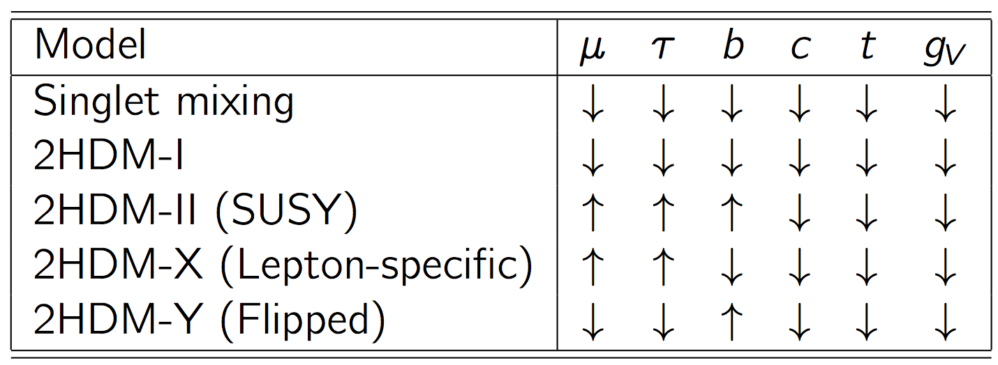
Fingerprinting Extended Higgs Sector Higgs as a window to BSM physics
Expected deviation pattern
Different models predict different deviation patterns --> Fingerprinting!
Singlet mixing reduces all the coupling uniformly, but 2HDM-I does not.

Slide 19
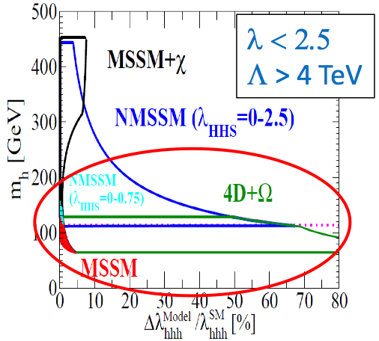
What if only the slef-coupling deviates from the SM?
Large deviation can be expected in models motivated by EW-baryogenesis scenarios.
Nevertheless, 20% or better relative precision seems necessary for the self-coupling measurement.
Kanemura, Shindou, Yagyu (2010)

Slide 20
Summary Our primary goal is to uncover the secret of EWSB
ZH @ 250 GeV (~mZ+mH+20GeV)：250fb^-1 to 500fb^-1
Higgs mass, width, J^{PC}
Gauge quantum number
Absolute meas. of HZZ coupling (recoil mass) --> limiting factor for BR precision (more data?)
BR(h->VV,qq,ll,invisible) : V=W/Z(direct), g,A(loop)
ttbar @ 340-350GeV (~2mt)：100-200fb^-1：ZH meas. Is also possible
Threshold scan --> theoretically clean mt
--> indirect measurement of top Yukawa coupling?
AFB, Top momentum measurements
Form factor measurements
vvH @ 350 - 500GeV：500fb^-1
HWW coupling -> total width to 6% --> absolute normalization of couplings
ZHH @ 500GeV (~mZ+2mH+170GeV)：2ab^-1
Prod. cross section attains its maximum at around 500GeV -> Higgs self-coupling to 40% (more data)
ttbarH @ 500GeV (~2mt+mH+30GeV)：1ab^-1
Prod. cross section becomes maximum at around 700~800 GeV.
QCD threshold correction enhances the cross section -> top Yukawa measurable to 10% at 500GeV concurrently with the self-coupling. Slight increase of Ecm significantly increases the cross section near the threshold.
-> coupling to H (other than top)
Self-coupling with γγ → HH @ 350GeV possibility?
We can complete the mass-coupling plot at ~500GeV!

Slide 21
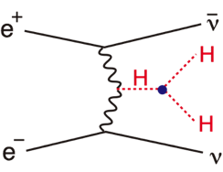
Higgs Physics at Higher Energy Self-coupling with WBF, top Yukawa at xsection max., other higgses, ...
vvH @ at >1TeV：2ab^-1 (pol e+, e-)=(+0.2,-0.8)
allows us to measure rare decays such as H -> mu+ mu-, ...
vvHH @ 1TeV or higher：2ab^-1 (pol e+, e-)=(+0.2,-0.8)
cross section increases with Ecm but the sensitivity might not, because of background diagrams.
Nevertheless,
or better is expected.
If possible, we want to see the running of the self-coupling (very very challenging).
ttbarH @ 1TeV：1ab^-1
Prod. cross section becomes maximum at around 700GeV.
CP mixing of Higgs can be unambiguously studied.
(Ref. CLIC, ILD DBD studies)
Obvious but most important advantage of higher energies in terms of Higgs physics is its higher mass reach to other Higgses expected in an extended Higgs sector and higher sensitivity to WLWL scattering to decide whether the Higgs sector is strongly interacting or not.
In any case we can improve the mass-coupling plot by including the data at 1TeV!

Slide 22
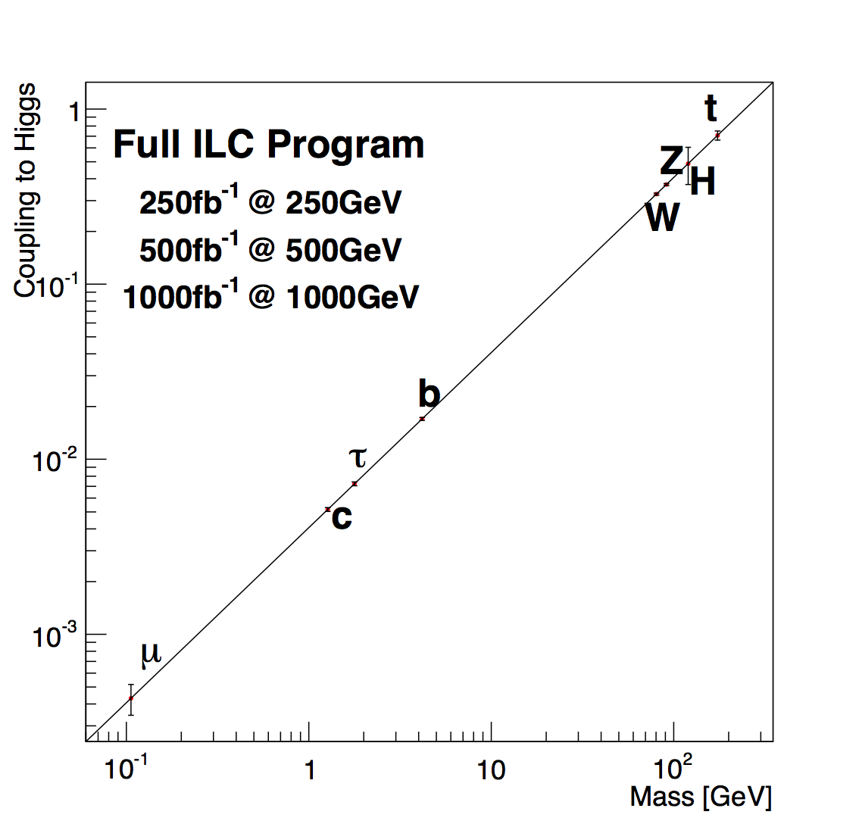
Mass Coupling Relation After Nominal Full ILC Program
Preliminary

Slide 23
Conclusions
The primary goal of the ILC 500 is to uncover the secret of the EW symmetry breaking. This will open up a window to BSM and set the energy scale for the E-frontier machine that follows LHC and ILC 500.
To achieve the primary goal we need self-contained precision Higgs studies to complete the mass-coupling plot
starting from e+e- -> ZH at Ecm = mZ+mH+20GeV,
then ttbar at around 350GeV,
and then ZHH and ttbarH at 500GeV.
The ILC to cover up to Ecm=500 GeV is absolutely necessary to carry out this mission (regardless of BSM scenarios) and we can do this with staging starting from Ecm at around 250GeV. We may need more data depending on the size of the deviation. Lumi-upgrade possibility should be always kept in our scope.
If we are lucky, some extra Higgs might be within our reach already at ILC 500. If not, we will need the energy scale information from the precision Higgs studies. Guided by the energy scale information, we will go hunt direct BSM signals, if necessary, with a new machine. Eventually we will need to measure WLWL scattering to decide if the Higgs sector is strongly interacting or not.

