Slide 1
Physics at ILC
Keisuke Fujii (KEK)
Nov. 27, 2015
MadGraph School 2015
Thanks to T. Tanabe
for many materials

Slide 2
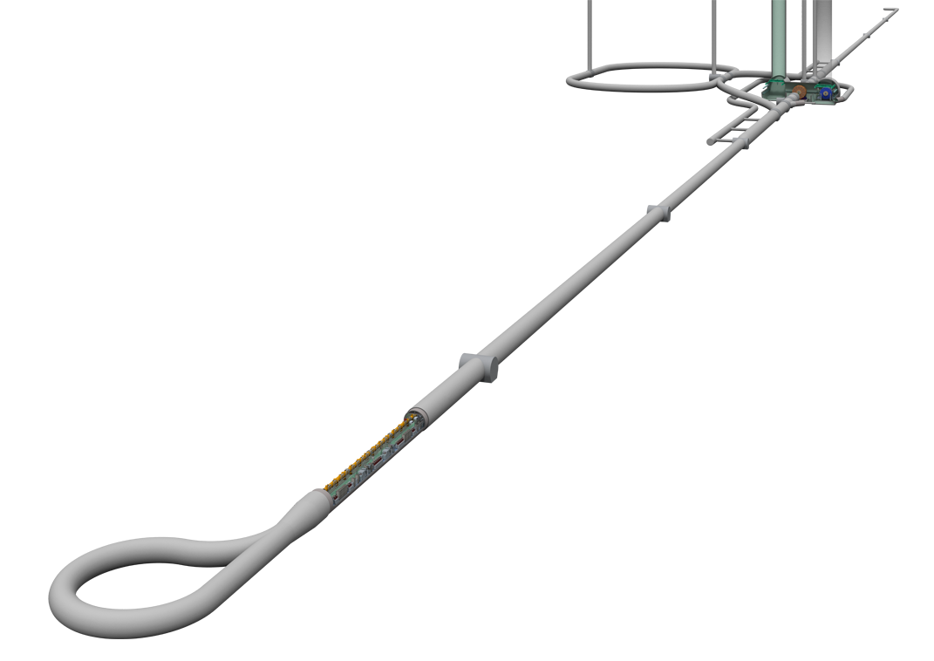
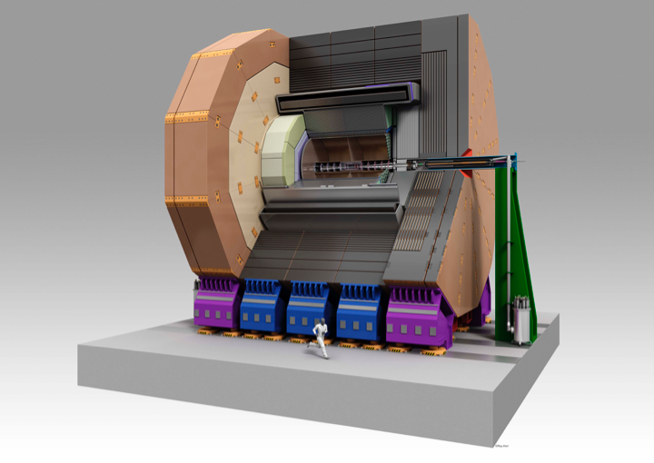
Bird’s Eye View of the ILC Accelerator
Damping Ring
Ultra-low emittance
normalized emittance＝37nm
Nano-beam collisions
Beam Delivery System
Detectors
ILD
High gradient
world highest gradient as with super-conducting cavities = 31.5 MV/m
beam cuurent = 5.8 mA
High resolution high granularity detector
e+, e- Main Linac
Tunnel Layout Plan for a Japanese Mountain Site
Energy : 250GeV + 250GeV
Length : 11km + 11km
# of DRFS Klystron: 7280 total
# of Cryomodules : 1680 total
# of Cavities : 14560 total
Cryomodules housing
Super Cond. Cavities
Technologies at hand!
Slide by H. Hayano

Slide 3
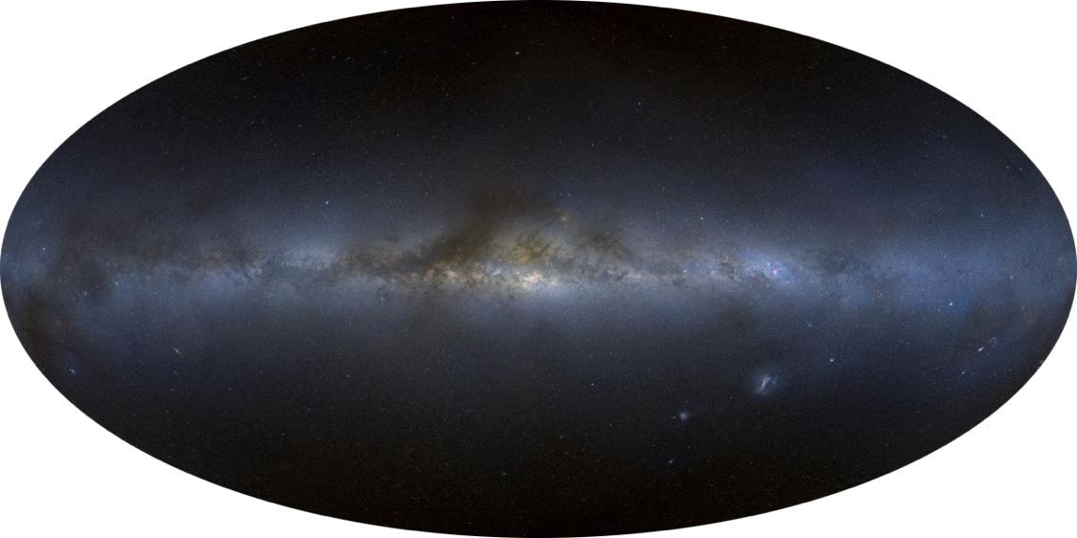
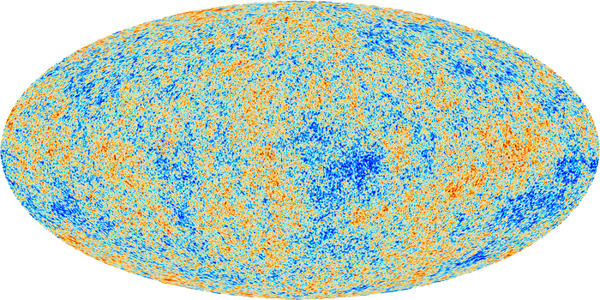
Towards ultimate unification
Gravity
Strong
Weak
EM
13.8 byr
380 kyr
Age of Universe
EW symmetry breaking
= phase transition
10⁻¹⁰ s
Electroweak Unification
Unification of
forces
ILC
Grand Desert?
10⁻³⁶ s
Unification of
matter
Grand Unification ?
Unification of
matter and force
10⁻⁴³ s
Quantum Gravity ?
Unification of
matter, force, and space-time

Slide 4
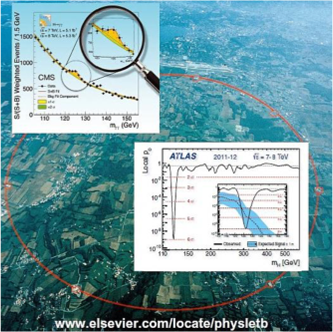
High Energy Physics = Endeavor to understand matter, force, and space time in a unified manner
Gravity
Strong
Weak
EM
Going back in time to the moment of creation when everything, including matter, force, and space-time, was unified.
13.8 byr
Our understanding as of today : Standard Model (SM)
Age of Universe
380 kyr
EW symmetry breaking
= Phase transition
10⁻¹⁰ s
Unification of forces
Gauge Symmetry = SU(3)xSU(2)xU(1)
Unification of matter
Grand Desert?
ILC
Electroweak unification
Matter field = quarks & leptons (3 gen.)
10⁻³⁶ s
Unification of matter and force
GUT?
10⁻⁴³ s
1995: Top found @ FNAL Tevatron →3 gen. of matter spectrum completed
Quantum Gravity?
Unification of
matter, force, and space-time
Force field = gauge field (γ,W/Z, g)
1983: W/Z found @ CERN SPPS
→gauge fields for (strong/weak/em) completed
July 4, 2012
Discovery of H125
at CERN LHC
Symmetry breaking field = Higgs field (H)
→ 2012: found @ LHC: Completion of SM
Go beyond SM
→ Mysteries left out (dark matter, baryon number,
neutrino mass/mixing, dark energy, ..)
→ Beginning of a new journey to the Planck scale: EW scale is right in the middle → still long way?
Why the EW scale so important?

Slide 5
Why is the EW scale so important ?

Slide 6
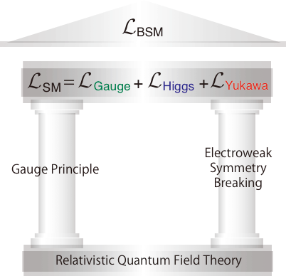
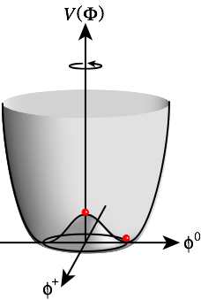
Why is the EW scale so important?
Mystery of something in the vacuum
2 Pillars of SM
Unknown
Vacuum filled with weak charge (evidence: H125)
Nature of the Higgs field, its multiplet structure, dynamics behind it, is all unknown!
Success of SM = success of gauge theory (left pillar)
Precisely tested!
The SM does not explain why the Higgs field developed a vacuum expectation value ( )! The answer forks depending on whether H125 is elementary or composite!
Why μ² < 0?

Slide 7
Electroweak Symmetry Breaking Mystery of something in the vacuum
The EW symmetry forbids masses of gauge bosons and matter fermions. In order to break it without breaking that of the Lagrangian, we need “something” condensed in the vacuum which carries weak charge: → We are living in a weakly charged vacuum!
The discovery of H(125) provided evidence that it is an excitation of (at least part of) this “something” in the vacuum and hence the correctness of this idea of the vacuum breaking the EW symmetry.
In the SM, a single complex doublet scalar field is responsible for both gauge boson and matter fermion masses. The SM EWSB sector is the simplest, but other than that there is no reason for it. The EWSB sector might be more complex. → We need to know the multiplet structure of the EWSB sector.
Moreover, the SM does not explain why the Higgs field developed a vacuum expectation value.
In other words the SM does not tell us:
Why μ² < 0?
V=W/Z

Slide 8
Why μ² < 0?
To answer this question
we need to go beyond the SM.

Slide 9
The Big Branching Point
Concerning the dynamics behind the EWSB.
Is it weakly interacting or strongly interacting? = Is the H(125) elementary or composite?
SUSY, which gives a raison d’être for a fundamental scalar fields, is the most attractive scenario for the 1st branch, where EW symmetry is broken radiatively. → The EWSB sector is weakly interacting. → H(125) is elementary and embedded in an extended multiplet structure (with at least 2 Higgs doublets). → Possible Grand Desert → Telescope for GUT scale physics
Composite Higgs Models, the 2nd branch, where a new QCD-like strong interaction makes a vacuum condensate. → The EWSB sector is strongly interacting. → H(125) is composite. → Jungle of new particles in TeV(+) scale

Slide 10
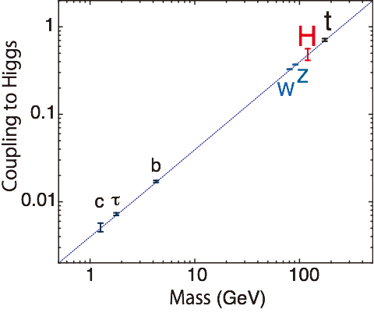
Elementary or Composite? How can ILC address this question?
If SUSY (elementary), → (At least) 2 Higgs doublets → extra degrees of freedom → Search for new particles - extra Higgs bosons: H, A, H± - uncolored SUSY particles: EWkinos, sleptons → Look for specific deviation patterns in - various Higgs couplings - gauge boson properties
If Composite, → Look for specific deviation patterns in - various Higgs couplings - Top (ttZ) couplings
Mass-Coupling Relation
Any deviation from the straight line signals BSM!
SM
Different models predict
different deviation patterns!
ACFA Report

Slide 11
Big Branching Point at the EW Scale
SUSY
EW symmetry was broken radiatively SUSY particles, extra Hs
Deviations in Higgs couplings
Grand Desert?
Clear sky to GUT Scale
GUT
?
H125 is elementary
Quantum Gravity
Ultimate Unification
Why
μ²<0 ?
ILC
Dark Matter
WIMP
decides the direction
H125 is Composite
?
Composite Higgs
New strong force makes a vacuum condensat
Deviations in Higgs and Top couplings
New particle jungle in TeV+ scale

Slide 12
The 3 major probes for BSM at ILC:
Higgs, Top, and
search for
New Particles

Slide 13
The 3 major tools to enable this endeavor
Well defined initial state and controllable Ecm
Clean environment: no QCD BG, only with calculable BG from EW processes
Beam polarization

Slide 14
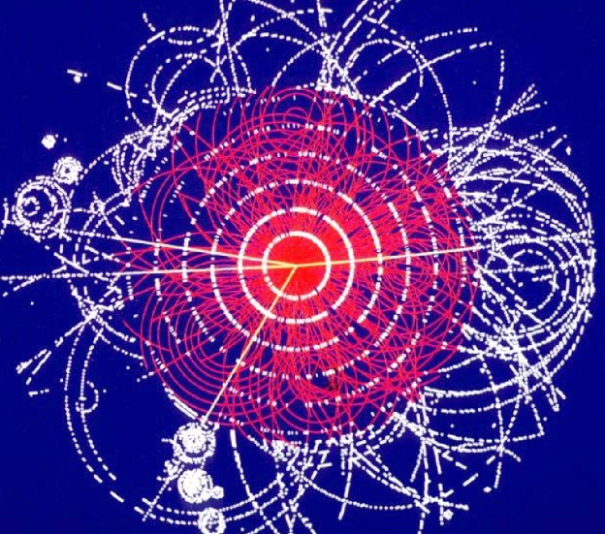
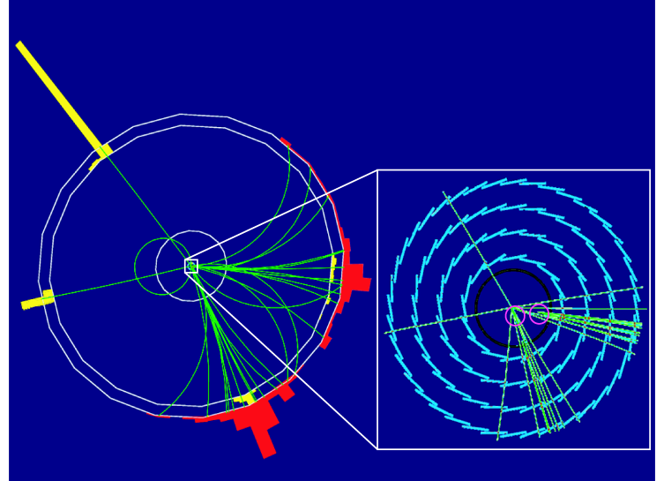
3 Powerful Tools
LHC: Collision of protons which are composite
ILC: Collision of e+e- which are elementary
p
p
e⁻
e⁺
1. Well-defined initial state
Ecm 7-14 TeV
Pileup
Initial state not very well defined
Ecm 0.25-1 TeV
Lab. frame = CM frame
Huge QCD BG
2. Clean environment w/o QCD BG
3. Polarized Beam
proton is composite ⇒ events are complicated but maximum reachable energy is high.!
clean and and able to detect everything produced!

Slide 15
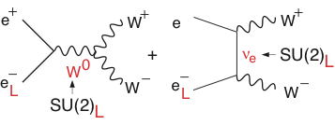
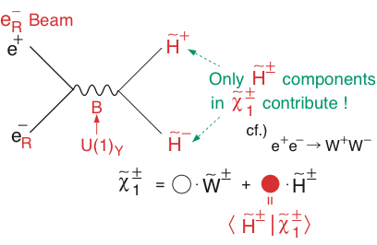
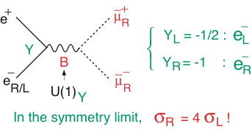
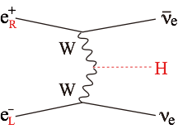
Power of Beam Polarization
W⁺W⁻ (Largest SM BG in SUSY searches)
BG Suppression
Chargino Pair
Slepton Pair
WW-fusion Higgs Prod.
Decomposition
 | ILC
Pol (e⁻) | -0.8
Pol (e⁺) | +0.3
(σ/σ0)vvH | 1.8x1.3=2.34
Signal Enhancement

Slide 16
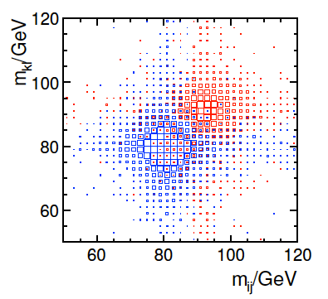
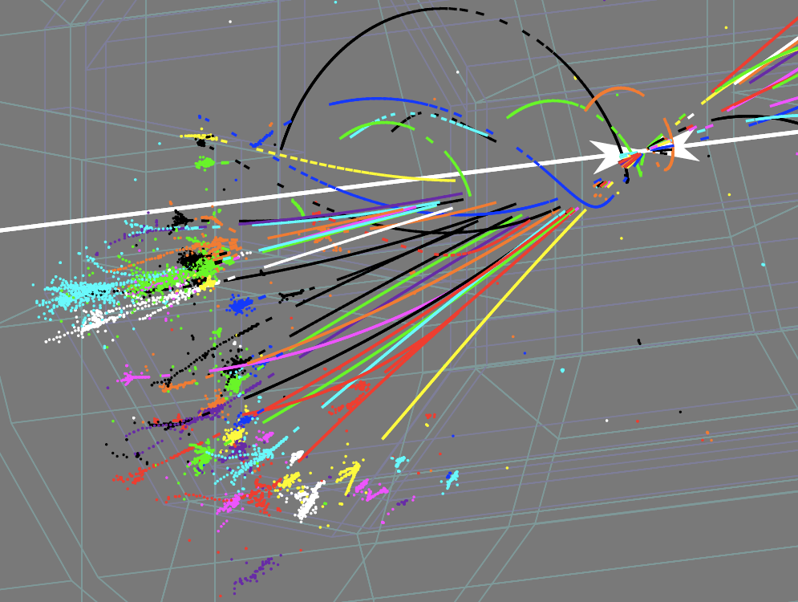
New Paradigm : View events as viewing a Feynman diagram
Reconstruct final states in terms of fundamental particles (quarks, leptons, gauge bosons, and Higgs bosons)
Identify W/Z/top/Higgs with their
jet invariant mass: M_{jets}
Z
W
Particle Flow Analysis
PFA is the key to achieve excellent jet invariant mass resolution comparable to the natural width of the weak boson:
PFA at ILC
1-to-1 track- cluster matching for exact Ech subtraction
Use tracker for charged particles, use CAL only for neutral particles, removing energy deposits by charged particles (Ech) in CAL by
1-to-1 track to CAL cluster matching
1-to-1 matching requires
High resolution tracking
High granularity calorimetry

Slide 17
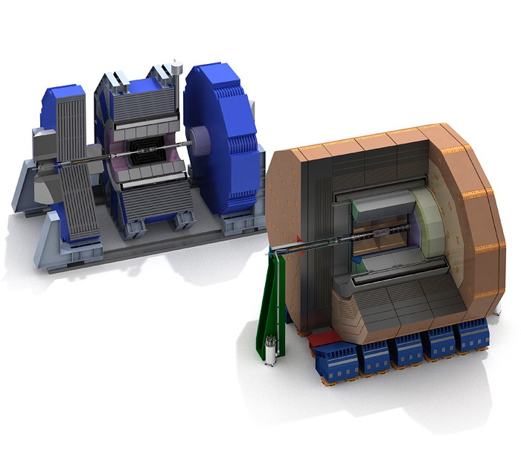
Detailed Baseline Design (TDR vol.4)
Large R with TPC tracker
LOI signatories: 32 countries, 151 institutions, ~700 members
Most members from Asia and Europe
B=3.5T, TPC + Si trackers
ECal: R=1.8m
arXiv: 1306.6329
ILD
SiD
High B with Si strip tracker
LOI signatories: 18 countries, 77 institutions, ~240 members
Mostly American
B=5T, Si only tracker
ECal：R=1.27m
Both detector concepts are optimized for
Particle Flow Analysis

Slide 18
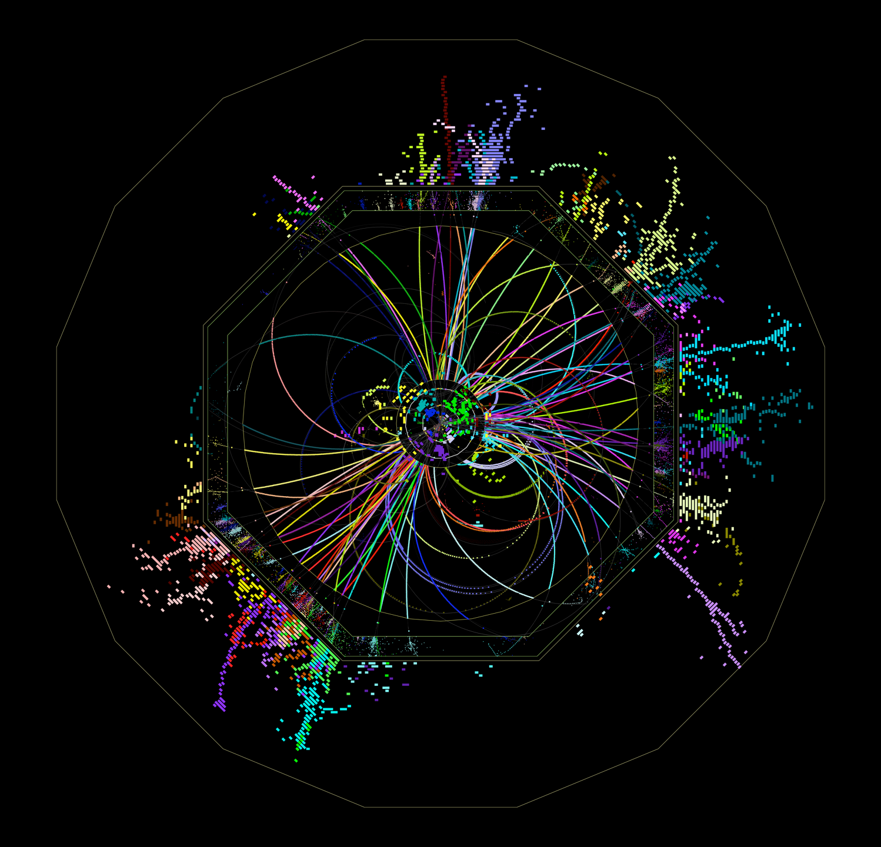
Features of ILC Detectors
HCAL
Compared with LHC detectors, ILC detectors have ~10 times better momentum resolution and 100~1000 times finer granularity.
This performance can be achieved only in the clean environment of the ILC, and cannot be achieved in the LHC environment.
ILD
HCAL
ECAL
TPC
VTX
tth @ 500 GeV

Slide 19
Higgs
14

Slide 20
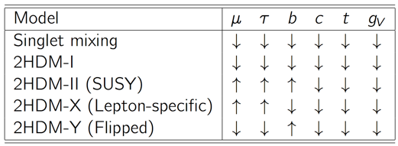
Our Mission = Bottom-up Model-Independent Reconstruction of the EWSB Sector through Precision Higgs Measurements
Multiplet structure :
Additional singlet? (φ + S) + …?
Additional doublet? (φ + φ’) + …?
Additional triplet? (φ + Δ) + …?
Underlying dynamics :
Why did the Higgs condense in the vacuum?
Weakly interacting or strongly interacting? = elementary or composite ?
Relations to other questions of HEP :
φ + S → (B-L) gauge, DM, …
φ + φ’ → Type I : mν from small vev, …
Type II : SUSY, DM, …
Type X: mν (rad.seesaw), …
φ + Δ → mν (Type II seesaw), …
λ > λSM → EW baryogenesis ?
λ↓0 → inflation ?
There are many possibilities!
Different models predict different deviation patterns --> Fingerprinting!
Mixing with singlet
Composite Higgs
SUSY
Expected deviations are small, typically a few % → We need a sub% precision!
We need a LC to cover Ecm= 250 to 500 GeV!

Slide 21
Our mission is to understand
Multiplet Structure &
Dynamics
of the EWSB sector,
and their relation to
Other Big Questions of High Energy Physics:
DM, baryogenesis, …

Slide 22
Our strategy is to fully exploit
LHC-ILC Synergies
in
direct searches/studies of
New Particles,
and
Precision measurements of H(125) Properties (couplings)

Slide 23
Deviation in Higgs Couplings
Mass-coupling relation
The size of the deviation depends on the new physics scale (Λ)!
Any deviation from the straight line signals BSM!
Decoupling Theorem: Λ↑ → SM
SM
example 1: Minimal SUSY (MSSM : tanβ=5, radiative correction factor ≈ 1)
Different models predict
different deviation patterns!
heavy Higgs mass
example 2: Minimal Composite Higgs Model
ACFA Report
composite scale
New physics at 1 TeV → deviation is at most ~10%
We need a %-level precision → LHC is not enough → ILC at 500 GeV

Slide 24
Why 500 GeV?

Slide 25
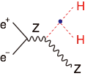
Higgs-related Physics at Ecm ≲ 500 GeV Three well know thresholds
ZH @ 250 GeV (~MZ+MH+20GeV)：
Higgs mass, width, J^{PC}
Gauge quantum numbers
Absolute measurement of HZZ coupling (recoil mass)
BR(h->VV,qq,ll,invisible) : V=W/Z(direct), g, γ (loop)
ttbar @ 340-350GeV (~2mt)：ZH meas. Is also possible
Threshold scan --> theoretically clean mt measurement: --> test stability of the SM vacuum --> indirect meas. of top Yukawa coupling
AFB, Top momentum measurements
Form factor measurements
vvH @ 350 - 500GeV：
HWW coupling -> total width --> absolute normalization of Higgs couplings
ZHH @ 500GeV (~MZ+2MH+170GeV)：
Prod. cross section attains its maximum at around 500GeV -> Higgs self-coupling
ttbarH @ 500GeV (~2mt+MH+30GeV)：
Prod. cross section becomes maximum at around 800GeV.
QCD threshold correction enhances the cross section -> top Yukawa measurable at 500GeV concurrently with the self-coupling
→Higgs couplings (other than top)
γ γ → HH @ 350GeV possibility
We can access all the relevant Higgs couplings
at ~500GeV for the mass-coupling plot!

Slide 26
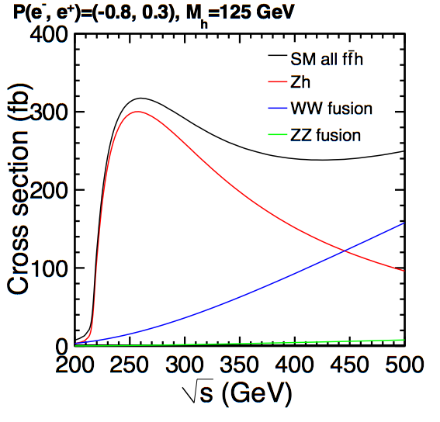
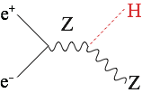
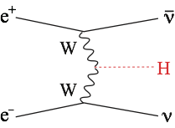
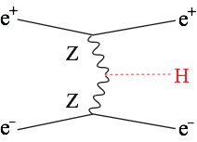
Main Production Processes Single Higgs Production
Production cross section
ZH dominates at 250 GeV (~80k ev: 250 fb⁻¹)
vvH takes over at 500 GeV (~125k ev: 500 fb⁻¹)
200k w/ TDR baseline, eventually >1M Higgs events!

Slide 27
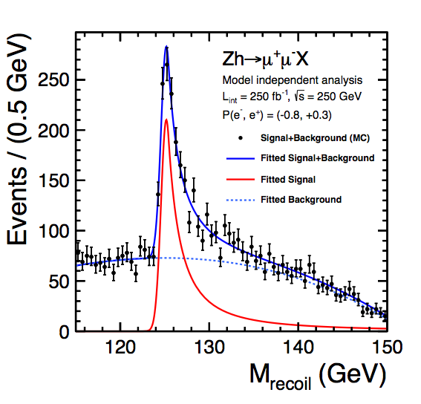
Recoil Mass Measurement: The Key to unlock the door to fully model-independent determinations of various BRs, Higgs couplings, and total widths
Recoil Mass
Invisible decay detectable!
Watanuki
scaled from mH=120 GeV
Model-independent absolute measurement of the σ(HZ) → HZZ coupling

Slide 28
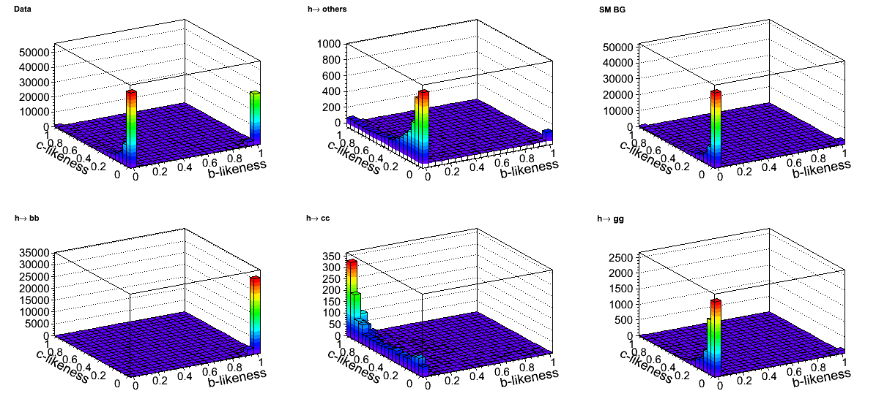
High Performance Flavor Tagging to directly access major couplings: bb, cc, ττ, gg, WW*
By template fitting, we can separate H →bb, cc, gg, others!
MC Data
H→Others
SM BG
scaled from mH=120 GeV
 | @250GeV
process | ZH
Int. Lumi. [fb⁻¹] | 250
Δσ/σ | 2.6%
decay mode | ΔσBr/σBr
H → bb | 1.2%
H → cc | 8.3%
H → gg | 7%
H → WW* | 6.4%
H → ττ | 4.2%
H→bb
H→cc
H→gg
What we measure
What we measure here is not BR itself but σxBR.
--> Δσ/σ=2.6% eventually limits the BR measurements. --> luminosity upgrade and/or longer running in a later stage.
DBD Physics Chap.
Clean environment and a high performance vertex detector are the two powerful weapons of the ILC to directly access all of the major couplings (great advantage of the ILC)

Slide 29
Total Width and Coupling Extraction One of the major advantages of the LC
To extract couplings from BRs, we need the total width:
To determine the total width, we need at least one partial width and corresponding BR:
In principle, we can use A=Z, or W for which we can measure both the BRs and the couplings:
BR=O(1%): precision limited by low stat. for H->ZZ* events
More advantageous but not easy at low E
C.F.Durig, Helmholtz Alliance 6th WS, Dec. 2012

Slide 30
Width and BR Measurements at 500 GeV Addition of 500GeV data to 250GeV data
Ecm [GeV] | independent measurements | relative error
250 |  | 2.6%
 |  | 1.2%
 |  | 8.3%
 |  | 7%
 |  | 6.4%
 |  | 4.2%
 |  | 10.5%
500 |  | 3%
 |  | 1.8%
 |  | 13%
 |  | 11%
 |  | 9.2%
 |  | 5.4%
 |  | 0.66%
 |  | 6.2%
 |  | 4.1%
 |  | 2.4%
comes in as a powerful tool!
Mode | ΔBR/BR
bb | 2.2 (2.9)%
cc | 5.1 (8.7)%
gg | 4.0 (7.5)%
WW* | 3.1 (6.9)%
τ τ | 3.7 (4.9)%
The numbers in the parentheses are
as of
ILD DBD Full Simulation Study
Notes:
ILC におけるヒッグス生成は、Higgs-strahlung 過程（ZH）と W fusion 過程（vvH）の二つ。前者は 250 GeV での主過程。後者は 500 GeV でZH を逆転する。クリーンで大量なヒッグスサンプルが大量（>~100k）に得られる。ヒッグスファクトリー実験。設計ルミノシティーでは、１日でヒッグスの再発見ができる。 Recoil mass 測定によるヒッグスの生成断面積測定は、ヒッグスの崩壊を見ることなく測れるので、断面積、よってZHH 結合の絶対測定が可能となる。たとえヒッグスが見えない粒子（ダークマター）に崩壊したとしても検出可能である。ヒッグスの崩壊の測定は、基本的に全て（断面積）x（崩壊分岐比）の測定なので（断面積）で割って初めて（崩壊分岐比）が得られる。よって最も基本的かつ大切な測定である。 TTH は、トップ湯川の測定。標準模型の物質粒子のうち圧倒的に重いトップの湯川結合測定は、物質粒子の質量生成機構の解明の鍵となる。TTH生成断面積は700GeVあたりで最大となるが、しきい値近くの 500 GeV でも、QCD によるしきい値補正の効果で断面積が倍増し、相対誤差で10% のトップ湯川結合定数測定が可能となる。
フルシミュレーション結果は、過去のファストシミュレーション結果と同等かあるいはそれ以上の精度を達成。唯一の例外はヒッグス自己結合。これについては改善努力中。

Slide 31
At ILC all but the σ measurement using recoil mass technique is σ×BR measurements.
Key Point
At LHC all the measurements are σ×BR measurements.
σ×BR
BR
g
coupling
WW-fusion is crucial for precision total width measurement
→ Ecm > 350GeV
The Key
σ
from recoil mass
ΓH
Total Width
Can detect even if Higgs decays invisibly!

Slide 32
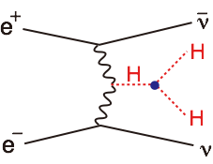
Higgs Physics at Higher Energy Self-coupling with WBF, top Yukawa at xsection max., other higgses, ...
vvH @ at >1TeV：> 1ab⁻¹ (pol e⁺, e⁻)=(+0.2,-0.8)
allows us to measure rare decays such as H -> μ⁺ μ⁻, ...
further improvements of coupling measurements
vvHH @ 1TeV or higher： 2ab⁻¹ (pol e⁺, e⁻)=(+0.2,-0.8)
cross section increases with Ecm, which compensates the dominance of the background diagrams at higher energies, thereby giving a better precision for the self-coupling.
If possible, we want to see the running of the self-coupling (very very challenging).
ttbarH @ 1TeV： 1ab⁻¹
Prod. cross section becomes maximum at around 800GeV.
CP mixing of Higgs can be unambiguously studied.
Obvious but most important advantage of higher energies in terms of Higgs physics is, however, its higher mass reach to other Higgs bosons expected in extended Higgs sectors and higher sensitivity to W_{L}WL scattering to decide whether the Higgs sector is strongly interacting or not.
In any case we can improve the mass-coupling plot by including the data at 1TeV!
Notes:
３つの良く知られた threshold がある。
まずは 250 GeV で ZH生成。ここでヒッグス質量や量子数、崩壊分岐比を測定。特に recoil mass measurement による HZZ 結合の絶対測定（LHC では不可能）が重要。
次に350 GeV のトップ対 threshold。ここではトップの質量の精密測定を始めとするトップに関する様々な測定に加えて、トップ湯川結合の間接測定の可能性がある。光子光子衝突によるヒッグスの自己結合測定の可能性もある。
次は500 GeV、ここでは W-fusion によるヒッグス生成でまず HWW 結合を精密測定。これは、ヒッグスの全巾に対する制限を与えることで、これまでの結合測定の全ての精度をいっきにおし上げる。そして、ttH によるトップ湯川結合測定と ZHH によるヒッグスの自己結合測定である。こうして、500 GeV ILC では、ヒッグスに対する質量と結合定数の関係のプロットを完結することができる。

Slide 33
Independent Higgs Measurements at ILC
Baseline (=TDR) ILC program
250 GeV: 250 fb⁻¹
500 GeV: 500 fb⁻¹
1 TeV: 1000 fb⁻¹
(MH = 125 GeV)
Ecm | 250 GeV |  | 500 GeV |  | 1 TeV
luminosity [fb⁻¹] | 250 |  | 500 |  | 1000
polarization (e⁻,e⁺) | (-0.8, +0.3) |  | (-0.8, +0.3) |  | (-0.8, +0.2)
process | ZH | vvH(fusion) | ZH | vvH(fusion) | vvH(fusion)
cross section | 2.6% | - | 3% | -
 | σ⋅Br | σ⋅Br | σ⋅Br | σ⋅Br | σ⋅Br
H→bb | 1.2% | 10.5% | 1.8% | 0.66% | 0.32%
H→cc | 8.3% |  | 13% | 6.2% | 3.1%
H→gg | 7% |  | 11% | 4.1% | 2.3%
H→WW* | 6.4% |  | 9.2% | 2.4% | 1.6%
Η→ττ | 3.2% |  | 5.4% | 9% | 3.1%
Η→ΖΖ* | 19% |  | 25% | 8.2% | 4.1%
Η→γγ | 34% |  | 34% | 19% | 7.4%
H→μμ | 72% | - | 88% | 72% | 31%
tth/H→bb | - |  | 28% (12%@550GeV) |  | 6.2%

Slide 34
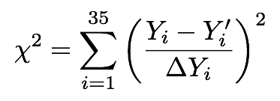
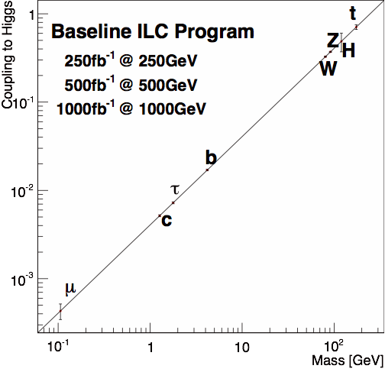
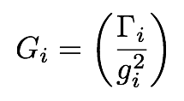
Model-independent Global Fit for Couplings
33 σxBR measurements (Yi) and σZH (Y34,35)
(TDR)
Systematic Errors
arXiv: 1310.0763
ILC’s precisions will eventually reach sub-% level!

Slide 35
Higgs Couplings
Model-independent coupling fit, impossible at LHC
H20 Scenario
arXiv: 1506.05992
Top Yukawa improves by going to 550 GeV
arXiv: 1506.07830
Better hγγ with LHC/ILC synergy
LHC can precisely measure
BR(h→γγ) / BR(h→ZZ*)
= (Kγ / KZ)²
Excellent vertex detectors for
b/c-tagging at ILC
Near threshold
→ a factor of 4
enhancement of σ_{tth} by going from 500GeV to 550 GeV
ILC can precisely measure KZ
→ 3%
All of major Higgs decay modes accessible at ILC with 250-500GeV!
500 GeV already excellent except for Kt , Kμ , and Kγ
~1% or better for most couplings!

Slide 36
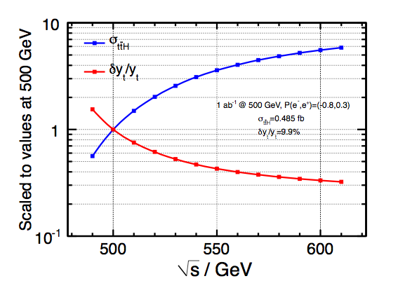
Top Yukawa coupling
x~4
x~2
Y. Sudo
Slight increase of Emax is very beneficial!

Slide 37
Model-dependent coupling fit (LHC-style 7-parameter fit)
H20 Scenario
ΣSM BR = 1
arXiv: 1506.05992
arXiv: 1506.07830
Possible to achieve precision far exceeding LHC!

Slide 38
Fingerprinting

Slide 39
Fingerprinting
H20 Scenario
arXiv: 1506.05992
arXiv: 1506.07830
Elementary v.s. Composite?
Supersymmetry
(MSSM)
Composite Higgs
(MCHM5)
Downward shift for all the couplings
Upward shift only in down-type fermions
ILC 250+500 LumiUP
Complementary to direct searches at LHC: Depending on parameters, ILC’s sensitivity far exceeds that of LHC!

Slide 40
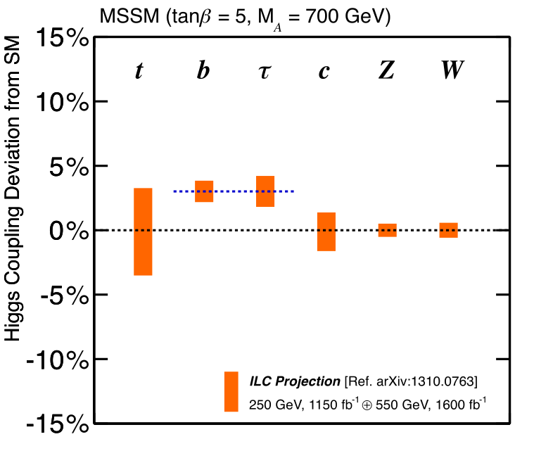
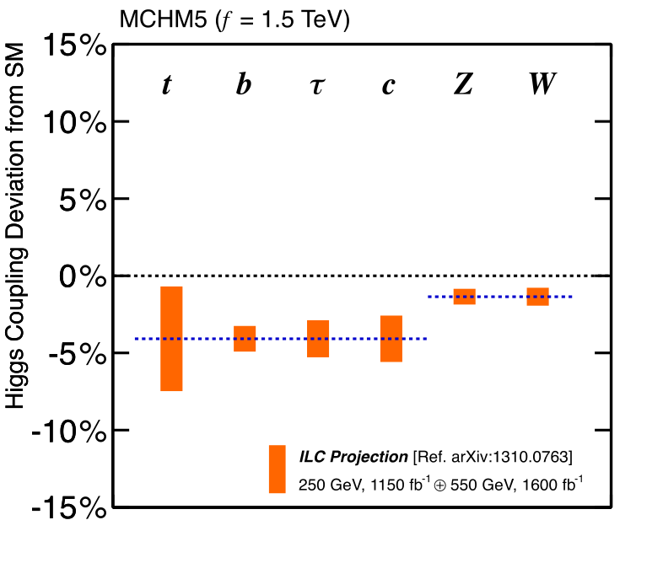
Fingerprinting
Elementary v.s. Composite
Supersymmetry
(MSSM)
Composite Higgs
(MCHM5)
ILC 250+550 LumiUP

Slide 41
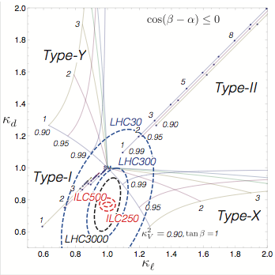
Fingerprinting
2HDM
Multiplet Structure
4 Possible Z2 Charge Assignments
that forbids tree-level Higgs-induced FCNC
(SUSY?)
KV² = sin(β-α)² =1 ⇔ SM
Kb
Given a deviation of the Higgs to Z coupling: ΔKv² = 1-Kv² = 0.01 we will be able to discriminate the 4 models!
Model-dependent
7-parameter fit
ILC: Baseline lumi.
(rad. seesaw?)
Kτ
ILC TDR
Snowmass ILC Higgs White Paper (arXiv: 1310.0763)
Kanemura et al (arXiv: 1406.3294)

Slide 42
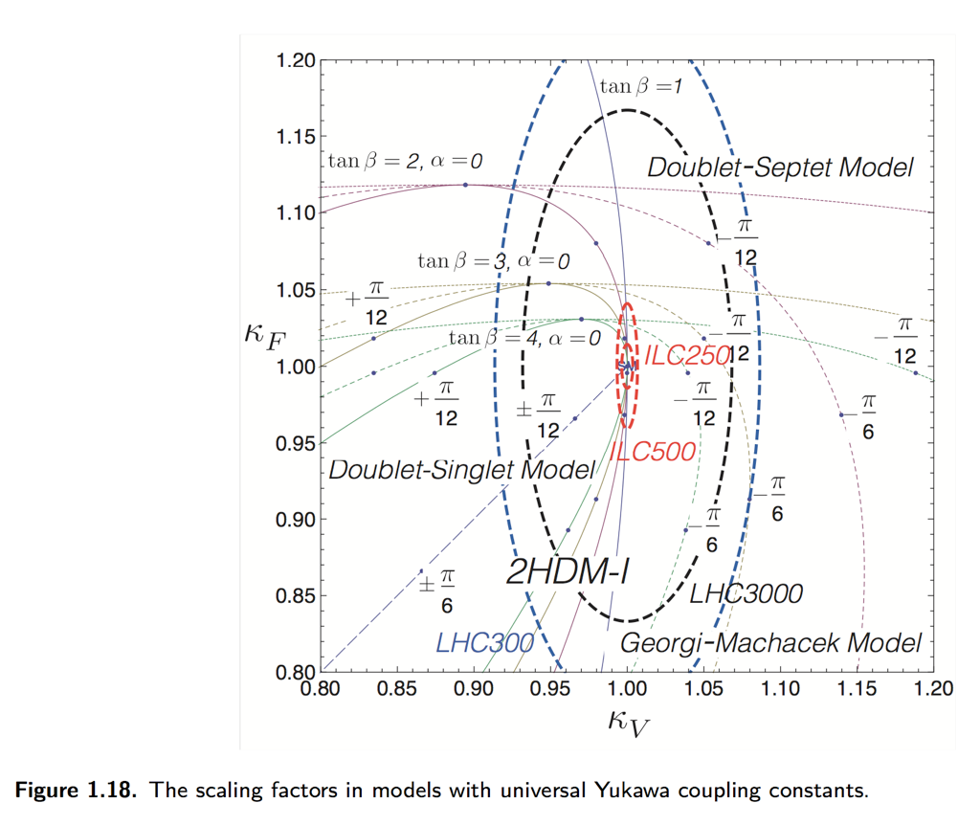
Multiplet Structure
Other ρ=1 possibilities
2+7
2+1
2+3
Snowmass ILC Higgs White Paper (arXiv: 1310.0763)
Kanemura et al (arXiv: 1406.3294)

Slide 43
arXiv 1502.03959

Slide 44
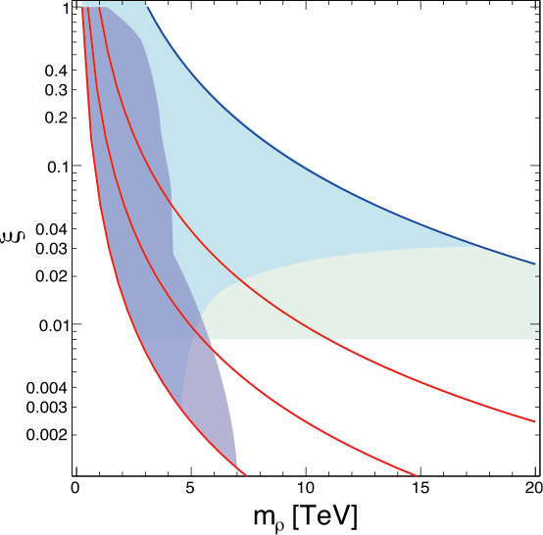
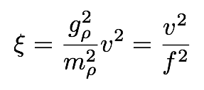
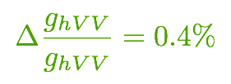
Composite Higgs: Reach
Complementary approaches to probe composite Higgs models
Direct search for heavy resonances at the LHC
Indirect search via Higgs couplings at the ILC
Comparison depends on the coupling strength (g*)
Direct Search
Based on Contino, et al, JHEP 1402 (2014) 006
Torre, Thamm, Wulzer 2014
Grojean @ LCWS 2014
a generic SO(5)/SO(4) CHM
Higgs Couplings
EWPT (T-parameter)
gρ=4π
HL-LHC14
ILC
ILC (250+500 LumiUP)
gρ=2
gρ=4
gρ=1

Slide 45
arXiv 1410.8413

Slide 46
Mode independence proved !
mW to 2 MeV
CPV in Higgs Sector
mA > 1 TeV

Slide 47
Higgs Self-coupling
EW phase transition:
1st order
or
2nd order?

Slide 48
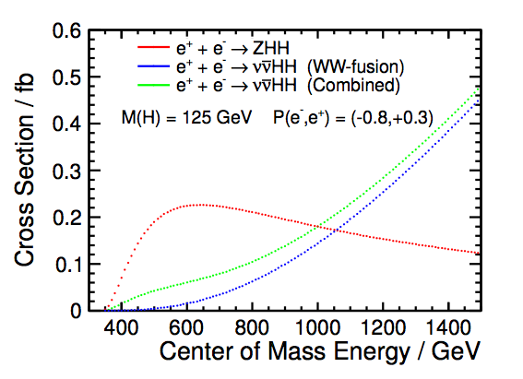
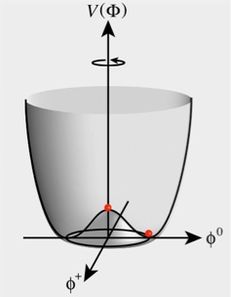
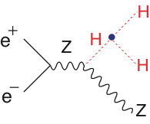
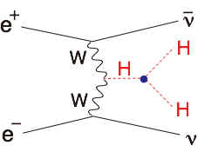
Higgs Self-Coupling
The Higgs 3-point self-coupling is at the heart of EWSB!
There are two ways to measure it at ILC
arXiv:1310.0763
Challenging even at ILC because of
Small cross section
Presence of irreducible BG diagrams
27% (H20)
Ongoing analysis improvements towards O(10)% measurement
Notes:
4点結合の足のひとつが真空期待値を得ることで3点結合になる → 真空凝縮の直接検証
宇宙の成り立ちと密接に関係 → 宇宙初期は対称性を保った状態、低温になる過程で相転移が起きてヒッグス・ポテンシャルは現在の形に

Slide 49
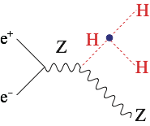
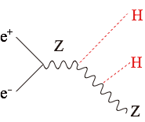
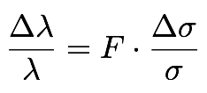
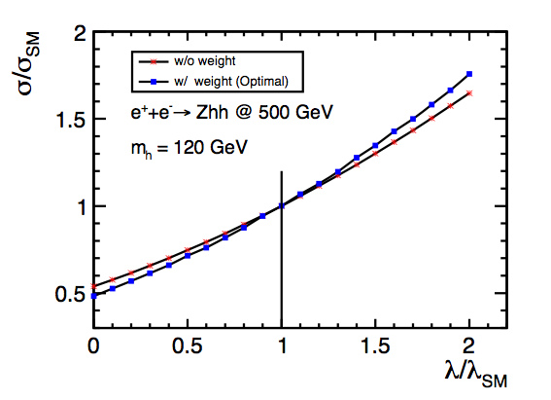
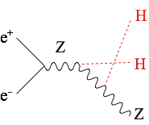
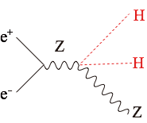
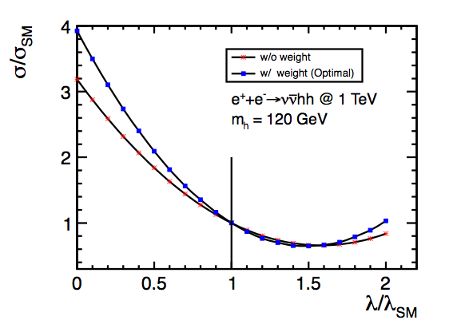
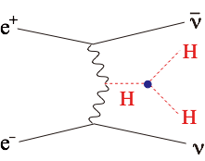
The Problem : BG diagrams dilute self-coupling contribution
Signal
diagram
Irreducible
BG diagrams
F=0.5 if no BG diagrams
+
+
+
Signal
diagram
Irreducible
BG diagrams
+
+
+
Junping Tian LC-REP-2013-003

Slide 50
Higgs Self-coupling

Slide 51
Electroweak Baryogenesis
Example:
Electroweak baryogenesis in a Two Higgs Doublet Model
Large deviations in Higgs self-coupling
→ 1st order EW phase
transition
→ Out of equilibrium
+ CPV in Higgs sector
→ EW baryogenesis possible
Region where EW baryogenesis is expected
1st order EWPT
Minimum value of Higgs self-coupling
Constructive interference between signal and BG diagrams:
→ if +100% deviation, then 14% precision expected on λ at 500GeV.
ILC can address the idea of baryogenesis occurring at the electroweak scale.
Senaha, Kanemura

Slide 52
Precision can be much better for large λ
ZHH-vvHH complimentary
Junping Tian @ ALCW2015

Slide 53
Top
14

Slide 54
Search for Anomalous tZZ Couplings
Top: Heaviest in SM→Must couples strongly to EW breaking sector (source of μ²<0)! → Specific deviation pattern expected in ttZ form factors depending on new physics.
→ Beam polarization essential to separate L- and R-couplings (Strength of ILC)
Deviation in ttZ coupling
of left-handed top quark
Phys.Rev.D73 (2006) 034016
ILC, √s = 500 GeV
Lumi = 500 fb⁻¹
Deviation in ttZ coupling
of right-handed top quark
Z
ILC is sensitive to MKK up to ~25TeV for typical RS scenarios (even up to ~80 TeV in extreme cases)!
Deviation expected for various new physics models (new physics scale ~1 TeV) arXiv:1505.06020

Slide 56
Complementarity

Slide 57
What if no deviation from the SM would be seen?

Slide 58
Stability of SM Vacuum
With the 125GeV Higgs boson, the SM vacuum seems to be at a subtle point of meta-stability!
Does λ really become negative below ΛPl?
or λ(ΛPl) = 0?
To answer this we need a precision mt measurement!
Top Pair Threshold
Theoretically very clean measurement of mt
ILC 3σ
ILC pins down the location !
arXiv:1205.6497, Degrassi et al.
arXiv:hep-ph/1502.01030: Quark mass relation to 4-loop order
arXiv:hep-ph/1506.06864: NNNLO QCD
arXiv:hep-ph/1506.06542: possibility of MSbar mass to 20MeV

Slide 59
Clarify the Range of Validity of SM Stability of SM Vacuum
V(φ)
Stable
Top Yukawa coupling drives the 4-point Higgs couplint (λ) to negative! The current values of mt and mh: Subtle point of meta-stability!
mt↑
λ goes to negative below ΛP? or λ(ΛPl) = 0 ?
φ
To anser this, we need precision mt measurement!
True vacuum?
Our vacuum
At LHC, theory error limits the precision to ~500MeV.
TTbar Threshold Scan ＠ILC
Theoretically very clean measurement of mt
ILC 3σ
ILC pinpoints the vacuum location
arXiv:1205.6497, Degrassi et al.
arXiv:hep-ph/1502.01030: Quark mass relation to 4-loop order
arXiv:hep-ph/1506.06864: NNNLO QCD
arXiv:hep-ph/1506.06542: possibility of MSbar mass to 20MeV

Slide 60
arXiv: 1502.01030: 4-loop mass relation
arXiv: 1506.06864: NNNLO QCD completed for S-wave threshold
arXiv: 1506.06542: MSbar mass to 20MeV (Kiyo ..)
arXiv: 1505.06020: Anomalous ttZ couplings

Slide 61
Direct Searches for
New Particles
14

Slide 62
ILC, too, is an energy frontier machine!
It will enter an uncharted region never explored by any e⁺e⁻ collider!

Slide 63
New Particle Searches
ILC, too, is an energy frontier machine!
→ It will enter an uncharted region for e⁺e⁻ colliders
Thanks to well-defined initial states, clean environment w/o QCD BG, and polarized beams ILC can cover blind spots of LHC
eg. : Searches for uncolored SUSY particles
LHC: difficult to search if ΔM(from LSP) < 20GeV
ILC: possible even if ΔM(from LSP) < 1GeV → LHC’s blind spots are ILC’s sweet spot!
example: Natural Radiative SUSY
Relatively light Higgsino-like chargino/LSP expected
→ Compressed mass spectrum
Power of beam polarization (decomposition of components)
→ M1, M2 → Test of GUT relation
→ Dark Matter Searches
M < m_{h}/2 → Invisible Higgs decay (to BR<1%)
M > Ecm/2 → Mono-photon search : model-independent, power of beam polarization
μ not far above 100GeV
typically Δm of 20 GeV or less → very difficult for LHC!

Slide 64
ILC, too, is an energy frontier machine!
→ It will enter an uncharted region for e⁺e⁻ colliders
Thanks to well-defined initial states, clean environment w/o QCD BG, and polarized beams ILC can cover blind spots of LHC
eg. : Searches for uncolored SUSY particles
LHC: difficult to search if ΔM(from LSP) < 20GeV
ILC: possible even if ΔM(from LSP) < 1GeV
→ LHC’s blind spots are ILC’s sweet spot!
example: Natural Radiative SUSY
Relatively light Higgsino-like chargino/LSP expected
→ Compressed mass spectrum
Power of beam polarization (decomposition of components)
→ M1, M2 → Test of GUT relation
→ Dark Matter Searches
M < mh/2 → Invisible Higgs decay (to BR<1%)
M > Ecm/2 → Mono-photon search : model-independent, power of beam polarization

Slide 65
What can ILC add to HL-LHC?

Slide 66
SUSY: LHC vs. ILC
“LHC has excluded MSSM up to high masses”
vs.
“LHC leaves out holes in MSSM parameter space”
“ILC can set model-indep. limits on SUSY particles”
vs.
“There is nothing interesting left within the reach of ILC”
These statements are all true to a certain extent…
The Big Picture:
SUSY is only complete with SUSY breaking implemented!
The answer depends on this SUSY breaking mechanism.
An example of connecting the “high mass reach of LHC” with “model-independent reach of ILC”:
Gluino @ LHC vs. Chargino/Neutralino @ ILC
assuming various gaugino mass relations (e.g. GMSB, AMSB) and LSP types (Bino, Wino, Higgsino)

Slide 67
Sensitivity to SUSY
[this comparison is for illustration only; specific channels should be looked at for actual comparisons]
Examples of direct SUSY searches
LHC: Gluino search
ILC: EWkino (Chargino/Neutralino) search
Compare using gaugino mass relations
LHC 8 TeV (heavy squarks)
LHC 300 fb⁻¹, √s=14 TeV
LHC 3000 fb⁻¹, √s=14 TeV
Preliminary
Bino LSP
(Gravity
mediation)
ILC 500 GeV
ILC 1 TeV
Wino LSP
(Anomaly
mediation)
(no relation between μ and M₃₎
Higgsino LSP
0
1
2
3
4
5
M₃ (TeV) ~ Gluino mass
[Assumptions: MSUGRA/GMSB relation M₁ : M₂ : M₃ = 1 : 2 : 6; AMSB relation M₁ : M₂ : M₃ = 3.3 : 1 : 10.5]

Slide 68
But, LHC can also search for direct EWkino production

Slide 69
SUSY EW @ HL-LHC
C₁N₂ → WN₁ZN₁
arXiv:1307.7292

Slide 70
Is it only a tiny corner in the parameter space
that will be left?
Is ILC a gleaner?

Slide 71
SUSY Electroweak Sector
Bino-like LSP
Wino-like LSP
Higgsino-like LSP
M1<<M2, μ
M2<<M1, μ
μ<<M2,M1
LSP/NLSP typically degenerate
(depends on mixing)

Slide 72
ΔM < 20GeV
difficult at LHC
Bino-like LSP
Wino-like LSP
Higgsino-like LSP
LHC’s blind spot is ILC’s sweet spot!
Natural Radiative SUSY: μ not far above 100GeV
typically Δm of 20 GeV or less → very difficult for LHC!

Slide 73
Higgsinos in Natural SUSY (ΔM<a few GeV)
ILC as a Higgsino Factory
ISR Tagging
soft
tracks,
photons
ISR photon
ISR Tagging
Only very soft particles in the final states → Require a hard ISR to kill huge two-photon BG!
2×Mχ
500fb-1 @ Ecm=500GeV
Pol (e+,e-) = (+0.3,-0.8) and (-0.3,+0.8)
Mχ1+Mχ2
EPJC (2013) 73:2660

Slide 74
Extracting M1 and M2
Hale Sert
ECFA LCWS 2013, DESY
Berggren et al. EPJC (2013) 73:2660
RNS: Baer et al.
arXiv: 1404.7510
ΔM=15GeV
100fb⁻¹@250GeV
In the radiatively driven natural SUSY (RNS) scenario as in arXiv: 1404.7510, ΔM~10GeV, we can determine M1 and M2 to a few % or better, allowing us to test GUT relation!

Slide 75
GUT Scale Physics

Slide 76
GUT Scale Physics
If we are lucky and the gluino is in LHC’s mass reach and the lighter chargino and the neutralinos are in ILC’s mass reach, we will be able to test the gaugino mass unification!
LHC: gluino discovery
→ mass determination
ILC: Higgsino-like EWkino discovery
→ M1, M2 via mixing between Higgsino and Bino/Wino
Chargino decomposition
Gaugino mass unification:
Higgsino-like LSP scenario
By Baer, List
LHC
ILC
ILC
Beam polarization is essential to
decompose the EWkinos to bino, wino, and higgsino and extract M1 and M2.

Slide 77
New benchmark study started!
Best fit indicates low mass uncolored SUSY
Another way to naturalness
LHC-ILC Synergy
Natural
even for M0=5TeV

Slide 78
Dark Matter

Slide 79
WIMP Dark Matter Search @ ILC
Weakly Interacting Massive Particle 探索
Decay of a new particle to Dark Matter (DM)
DM has a charged partner in many new physics models.
SUSY: The Lightest SUSY Particle (LSP) = DM → Its partner decays to a DM.
Events with missing Pt (example: light chargino: see the previous page)
Higgs Invisible Decay
Mono-photon Search
MDM < Mh /2
BR(H→invis.) < 0.4%
at 250 GeV, 1150 fb⁻¹
→ MDM reach ~ Ecm/2
Possible to access BRinv to 0.4%!
Possible to access DM to ~Ecm/2!

Slide 80
Slepton decays to DM with small mass differences
Study of stau pair production at the ILC
Observation of lighter and heavier stau states with decay to DM + hadronic tau
Benchmark point: m(LSP) = 98 GeV, m(stau1) = 108 GeV, m(stau2) = 195 GeV
Bechtle, Berggren, List, Schade, Stempel, arXiv:0908.0876, PRD82, 055016 (2010)
Signal
SM bkg
SUSY bkg
√s=500 GeV, Lumi=500 fb-1, P(e-,e+)=(+0.8,-0.3)
Stau1 mass ~0.1%, Stau2 mass ~3% → LSP mass ~1.7%

Slide 81
DM: Effective Operator Approach
Chaus, List et al.
Chaus, List et al.
LHC sensitivity: Mediator mass up to Λ~1.5 TeV for large DM mass
ILC sensitivity: Mediator mass up to Λ~3 TeV for DM mass up to ~√s/2
LHC-ILC synergy!

Slide 82
DM Relic Abundance
WMAP/Planck (68% CL)
ESA/Planck
Once a DM candidate is discovered, crucial to check the consistency with the measured DM relic abundance.
Mass and couplings measured
at ILC → DM relic density to compare with the CMB data
Suvi-Leena Lehtinen, LCWS 2015

Slide 83
Summary

Slide 84
The primary goal for the next decades is to uncover the secret of the EW symmetry breaking. The discovery of H(125) completed the SM particle spectrum and taught us how the EW symmetry was broken. However, it does not tell us why it was broken. Why μ² < 0? To answer this question we need to go beyond the SM.
There is a big branching point concerning the question: Is H(125) elementary or composite? There are two powerful probes in hand: H(125) itself and the top quark. Different models predict different deviation patterns in Higgs and top couplings. ILC will measure these couplings with unprecedented precision.
This will open up a window to BSM and fingerprint BSM models, otherwise will set the energy scale for the E-frontier machine that will follow LHC and ILC.
Cubic self-coupling measurement will decide whether the EWSB was strong 1st order phase transition or not. If it was, it will provide us the possibility of understanding baryogenesis at the EW scale.
The ILC is an ideal machine to answer these questions (regardless of BSM scenarios) and we can do this model-independently.
It is also very important to stress that ILC, too, is an energy frontier machine. It will access the energy region never explored with any lepton collider. It is not a tiny corner of the parameter space that will be left after LHC. There is a wide and interesting region for ILC to explore (eg. Natural SUSY).
Once a new particle is found at ILC, we can precisely determine its properties, making full use of polarized beams. In the case of natural radiative SUSY scenario, we might even probe GUT scale physics using RGE.
If there is a DM candidate within ILC’s reach, its measured mass and couplings can be used to calculate the DM relic density and will reveal the nature of the cosmic DM.
In this way, ILC will pave the way to BSM physics.

Slide 85
Backup

Slide 86
Higgs Hadronic Decays: Flavor Tagging
Z→qq, E_{CM}=91.2 GeV, ILD Full Simulation [Suehara, TT]
b mis-id
c mis-id
uds mis-id
uds mis-id
b-jet tagging
c-jet tagging
ILC detectors allow high performance b/c/g tagging
Precise measurement of BR(H→bb, cc, gg)

Slide 87
What observables limit the coupling precisions?
The 4 most important ones
Y1 : recoil mass
Y2 : WW-fusion h→bb
Y3 : higgsstrahlung h→bb
Y4 : WW-fusion h→WW*
Both ZH and ννH productions matter!
For more details, see J.Tian @ Tokusui Workshop 2013

Slide 88
Top Yukawa Coupling The largest among matter fermions, but not yet directly observed
H-> bb
A factor of 2 enhancement from QCD bound-state effects
Cross section maximum at around Ecm = 800GeV
Philipp Roloff, LCWS12
Tony Price, LCWS12
Tony Price, LCWS12
scaled from mH=120 GeV
DBD Full Simulation
Notice σ(500+20GeV)/σ(500GeV) ~ 2
Moving up a little bit helps significantly!

Slide 89
Expected Coupling Precision as a Function of Ecm
Sensitivity Factor
F=0.5 if no BG diagrams there
BG diagrams dominate at high Ecm
propagator suppression
⇒ F grows quickly with Ecm !
Coupling Precision
ZHH :
optimal Ecm ~ 500 GeV
though the cross section maximum is at around Ecm = 600 GeV
vvHH :
Precision slowly improves with Ecm
ILD DBD Study (Junping Tian)

Slide 90
Expected Coupling Precision as a Function of Ecm
2ab⁻¹
everywhere
2ab⁻¹
everywhere
L∝Ecm
L∝Ecm
2ab⁻¹ at 1 TeV
2ab⁻¹ at 1 TeV
ILD DBD Study (Junping Tian)

Slide 91
Top

Slide 92
Top Quark
The heaviest in the SM particles
Γt ≈ 1.4 GeV for mt = 175 GeV
Because of this large width, the top and the anti-top pair created at r=0 decay before entering the non-perturbative QCD regime.
Γt acts as an infrared cutoff
Reliable cross section calculation from first principle (perturbative QCD) as first shown by Fadin-Khoze!
The first chance to measure momentum space wave function of a (remnant of) quarkonium state.

Slide 93
Top Quark
Threshold Region
At threshold both the top quark and the anti-top quark are slow and stay close to each other, allowing multiple exchange of Coulombic gluons.
⇒ Leading contribution
The threshold correction factor (bound-state effect) denoted by Γ satisfies the Bethe-Salpeter equation which reduces to Schroedinger’s equation:
in the non-relativistic limit. The operator G is related to Γ through
for vector part
for axial vector part

Slide 94
Top Quark
Threshold Region
How to access G experimentally
ptop = pbW = p3jets
momentum space wave fun.
wave function at origin

Slide 95
Top at Threshold
Threshold Scan
M.Stahlhofen Top Phys WS 2012
Theory improving!
~10% effect
Expected accuracies
Threshold scan alone
F.Simon Top Phys WS 2012
+ AFB & Top Momentum
arXiv:hep-ph/0601112v2
arXiv:hep-ph/1502.01030: Quark mass relation to 4-loop order -> <50MeV

Slide 96
Reducing Theoretical Ambiguities
9% effect on the X-section
Normalization ambiguity due to the QCD enhancement has been an obstacle to do this measurement
Yuichiro Kiyo
@ LCWS10
Use of the RG improved potential can significantly improve the situation!
Still preliminary but prospect is bright!

Slide 97
Top Quark
Open Top Region
Key points
Γt ≈ 1.4 GeV for mt = 175 GeV
The top decays before forming a top hadron.
Top spin is measurable by angular analysis of decay products.
+ Polarized beams are available at ILC

Slide 98
Other Probes

Slide 99
Z’

Slide 100
Z’ : Heavy Neutral Gauge Bosons
New gauge forces imply existence of heavy gauge bosons (Z’)
Complementary approaches LHC/ILC
LHC: Direct searches for Z’ (mass determination)
ILC: Indirect searches via interference effects (coupling measurements and model discrimination) – beam polarizations improve reach and discrimination power
Z’
Z’ = 2 TeV
hep-ph/0511335
Models with Z’ boson
arXiv:0912.2806 [hep-ph]
Z’ mass (TeV)
Z’ mass (TeV)

Slide 101
Two-Fermion Processes
Z’ Search / Study
Observables: dσ(P-,P+)/d cosθ
(f=e, μ, τ, c, b)
Example: Sequential SM-like Z’
arXiv: 0912.2806
500fb⁻¹@ 500GeV
1000fb⁻¹@1000GeV
95%CL distinction

Slide 102
Two-Fermion Processes
Z’ Search / Study
arXiv:0912.2806 [hep-ph]
hep-ph/0511335
Z’(2TeV)
1ab^-1 @ 500 GeV
ILC’s Model ID capability is expected to exceed that of LHC even if we cannot hit the Z’ pole.
Beam polarization is essential to sort out various possibilities.

Slide 103
Two-Fermion Processes
Compositeness
S. Riemann, LC-TH-2001-007
Beam polarization is essential to sort out various possibilities.

Slide 104
More Extra Slides

Slide 105
Running Scenario
See arXiv: 1506.07830

Slide 106
Recommended

Slide 108
Self-coupling reaches <30%
for SM case.
<15% if lamda=2xSM
Most couplings reach <1%

