Slide 1
Current Status
of
ILC Project
Keisuke Fujii, KEK
May 9, 2015

Slide 2
MEXT’s ILC Review

Slide 3
May 27, 2013: MEXT → SCJ
The Research Promotion Bureau of the Ministry of Education, Culture, Sports, Science, and Technology (MEXT) requested Science Council of Japan (SCJ) for deliberation of the ILC project from academic point of view.
Sep.30, 2013: SCJ → MEXT
SCJ submitted a recommendation regarding ILC to MEXT.
http://www.scj.go.jp/ja/info/kohyo/pdf/Report%20on%20ILC_Exective%20Summary.pdf
Excerpt from the SCJ recommendation
blue and red lines by KF
Oct., 2013: Japanese HEP community
Japanese HEP community filed a petition for the Japanese government to invite the ILC to Japan. → ILC became a project officially recognized by the government.
May 8, 2014: MEXT
An Academic Experts Committee including external members under MEXT’s ILC TF started the official review process! → Report due by the end of JFY2015.

Slide 4
MEXT’s ILC Review
MEXT’s ILCTask Force
Established in May 2014
Academic Experts Committee (2014-5-1→2016-3-31: extensible if needed)
Total project cost (including construction, operation, upgrade, and decommissioning) and its international sharing
Strategy for particle physics research at ILC taking into account other related projects, and possible additional cost
Necessary human resources in construction, and operation periods, including leaders
Domestic organization and management
Social influence of ILC
Budgetary framework which will not conflict with other important projects/policies
Research Contract on External Impact
Particle and Nuclear Physics WG
Review ILC physics case, taking into account other HEP projects
TDR Validation WG
Evaluate ILC TDR from technical point of view (mostly on accelerator)
Nomura Research Inst.
Established in June 2014
Established in June 2014

Slide 5
Special Committee on ILC Project
Experts from various fields (Chair: Prof. S. Hirano, a former president of Nagoya Univ.)
Meetings in May 8, 2014, November 11, 2014, and April 21, 2015
Particle and Nuclear Physics Working Group
Revisiting scientific merit
Members from particle and nuclear and related fields (Chair, Prof. T. Kajita, ICRR)
8 open meetings since June 2014
A status report was submitted to the 2nd meeting of Special Committee
A report to be submitted to the 3rd meeting
TDR Validation Working Group
Evaluation of TDR and cost estimates
Members mostly from accelerator experts (Chair, Dr. H. Yokomizo, CROSS)
6 meetings mostly closed ones since June 2014
A status report was submitted to the 2nd meeting of Special Committee
A report to be submitted to the 3rd meeting
Y.Okada ALCW2015

Slide 6
Progress of the Review Process
June 24, 2014: MEXT: 1st meeting of Particle and Nuclear Physics WG
WG organizational matter; overview of particle physics: status of SM and physics beyond it; overview of ILC project with emphasis on ILC physics case; schedule as follows:
July 29, 2014: MEXT: 2nd meeting of Particle and Nuclear Physics WG
Review European strategy and P5 report, and discuss ILC in the context of these projects
August 27, 2014: MEXT: 3rd meeting of Particle and Nuclear Physics WG
Review cosmic ray physics and astronomy in relation to ILC
September 22, 2014: MEXT: 4th meeting of Particle and Nuclear Physics WG
Review flavor physics and neutrino physics in relation to ILC, LHC-ILC relation
October 21, 2014: MEXT: 5th meeting of Particle and Nuclear Physics WG
Summarize the discussions so far for the Experts Committee Mtg on Nov.14
January 8, 2015: MEXT: 6th meeting of Particle and Nuclear Physics WG
Discuss items pointed out at the 2nd Experts Committee Mtg + SSC
February 17, 2015: MEXT: 7th meeting of Particle and Nuclear Physics WG
Sort out ILC physics case, whether it is matching the investment or not
March 30, 2015: MEXT: 8th meeting of Particle and Nuclear Physics WG
Summarize the discussions for the Expoerts Committee Mtg on April 21

Slide 7
June 30, 2014: MEXT: 1st meeting of TDR Validation WG
WG organizational matter; overview of ILC TDR; overview of ILC cost estimate; schedule, etc. Mostly about ILC accelerator.
July 28, 2014: MEXT: 2nd meeting of TDR Validation WG
Review SCRF system, main linacs, RF power sources
September 8, 2014: MEXT: 3rd meeting of TDR Validation WG
Review SCRF cost, etc. (continued from July 28 mtg) and CFS.
November 4, 2014: MEXT: 4th meeting of TDR Validation WG
Review the total ILC project cost (incl. project management) and summarize the discussions so far for the Experts Committee Mtg on Nov.14
November 14 2014: MEXT: 2nd meeting of the Academic Experts Committee
Discussions based on progress reports from the two working groups
January 26, 2015: MEXT: 5th meeting of TDR Validation WG
Review e-/e+ sources, DR, BDS + detectors and discuss manpower issues
March 2, 2015: MEXT: 6th meeting of TDR Validation WG
Summarize the discussions for the 3rd Experts Committee Mtg on April 21
April 21 2015: MEXT: 3rd meeting of the Academic Experts Committee
Discussions based on progress reports from the two working groups
→ 2 more meetings by the end of June for interim summary

Slide 8
Report from
MEXT Particle & Nuclear Physics WG
Presented by WG Chair, Prof. T.Kajita
at the 3nd Academic Experts Committee Mtg.
Unofficial Translation: official version available only in Japanese

Slide 9
Progress Report to
the Academic Experts Committee Regarding
The International Linear Collider (ILC)
(The Particle and Nuclear Physics Working Group)
Unofficial Translation

Slide 10
Report from the particle and nuclear physics WG
Report to the Academic Experts Committee Regarding
The International Linear Collider (ILC)
The Particle and Nuclear Physics Working Group: Outline
1. Scientific Case (Future Perspectives of Particle Physics (HEP field) and the ILC’s Role)
History and current status of elementary particle physics Elementary particle physics is a field of science to study internal structures of matter and fundamental forces that act therein.
• Elementary particle physics has been making a great progress along with advances of particle accelerators, in recent years, with that of colliding accelerators in particular.
• By the end of the 20th century the correctness of the standard model of particle physics had turned out to be quite solid.
• In 2012, the last missing particle of the standard model at that time, the Higgs boson that gives masses to elementary particles, was discovered.
• On the other hand, through the compelling evidence of the existence of dark matter and various theoretical studies, it has also been widely recognized that the standard model would not be the ultimate theory.
• The mainstream of particle physics is now shifting to the quest for physics beyond the standard model including the dark matter, etc.
The International Linear Collider (ILC) is a facility to do experiments and searches concerning the following items:
Full elucidation of the Higgs mechanism by means of precision studies of the Higgs boson and the top quark, thereby searching for physics beyond the standard model.
Searches for new particles such as supersymmetric particles and their detailed studies once found.
Others (such as dark matter and extra dimensions)
There are significant scientific meanings as targets of future elementary particle physics to study the items listed above.
2. Cost (Excerpt from the TDR validation WG report)
Total cost for the construction of the accelerator facility: about 1.1 x 10¹² JYen (including labor)
Construction cost of the accelerator itself: 9,907 x 10⁸ JYen (items described in TDR)
Detector-related cost: 1,005 x 10⁸ JYen (items described in TDR)
Annual running cost: 491 x 10⁸ JYen (items described in TDR)
The cost is to be internationally shared.

Slide 11
3. Past examples of construction costs in accelerator facility implementations
Examples in Japan
Even the largest accelerator facility so far built in Japan (The High Intensity Proton Accelerator Facility (J-PARC)) was about 1,500 x 10⁸ JYen.
Examples overseas
The world largest accelerator: the Large Hadron Collider (LHC) at CERN (accelerator implementation: about 5,000 x 10⁸ JYen + existing facilities and tunnels + cost for labor)
The LHC has been built by CERN, which is an international organization (with additional contributions from Japan, the US, Russia, etc.)
There was a prospect for the Higgs discovery at the time of the construction start based on the experimental data available by that time and the standard model assumption. However, the discovery could have been made by some other experiment before the LHC.
4. Experiments that ILC will be able to carry out as described in the TDR
The ILC will enable the following:
Searches for physics beyond the standard model through precision measurements of the Higgs boson and the top quark.
Searches for supersymmetric (SUSY) particles (Note that the LHC after its energy-upgrade will also search for strongly interacting SUSY particles (mainly in 2015~2017)).
Searches for dark matter particles and extra dimensions, etc.

Slide 12
5. View points for judging if the scientific case is matching the investment or not
The optimal strategic prospects for research should be clarified based on the results of searches for strongly interacting SUSY particles, etc. from the LHC experiments at the collision energy of 13TeV (TeV=10¹² electron volts*) (the 13TeV LHC), which starts in 2015.
In order to carry out the research program according to the optimal strategic prospects, it is necessary to reassess the appropriateness of the performance described in the ILC TDR.
Since the ILC is an international project that requires the enormous cost, significant international cost sharing should be prerequisite, considering the budgetary situation in Japan
Considering the scale of the necessary investment for the ILC project, it is important to get understanding and cooperation from communities of other fields of science.
In case timely decision should not be made concerning the ILC project implementation, the project might lose its international appeal. It is hence important to formulate a system so as not to delay the decision.
6. Scenarios at the ILC based on anticipated achievements at the 13TeV LHC
In the case of discovery of a new particle (which appears to be consistent with SUSY):
Strategy: Using the ILC, elucidate new physics phenomena behind the new particle through precision measurements of the Higgs boson, etc. If the ILC energy is sufficient, discovery of some other new particles linked to the LHC discovery is anticipated.
In the case of observation (or discovery) of events hinting at a new phenomenon (dark matter, etc.) other than the above:
Strategy: Scrutinize the new phenomenon discovered at the LHC.
In the case of no discovery of any new particle or phenomenon at the 13TeV LHC:
Strategy: Search for physics beyond the standard model through precision measurements of the Higgs boson, etc. Search also for new particles that are difficult to find at the LHC. Investigate in detail possible reason for the non-discovery at the LHC and examine whether energy upgrade would be necessary in the future or not.

Slide 13
Report from
MEXT TDR Validation WG
and
Nomura Research Inst.
Presented by WG Chair, Prof. H.Yokomizo
at the 3nd Academic Experts Committee Mtg.
Unofficial Translation: official version available only in Japanese

Slide 14
Highlights from the TDR Verification WG report
1. ILC Cost Estimate Summary in TDR
List the TDR cost including manpower in yen
List possible cost items not included in TDR
2. Technical Issues and Cost Risks in TDR
Risks in the cost estimates remaining
Technical reality/feasibility
Human resource for construction, operation, and management
3. Points to be considered for judging to host the project or not
International Cooperation
Agreement for safety and legal regulation
Others needed to:
Consider available budget limitation in our country.
Watch the various constraints in each country
Maximize to reflect the R&D progress toward improvement of the accelerator performance.
Y.Okada ALCW2015

Slide 15
Report on technological and economical impacts of ILC projects and
status in the particle and nuclear physics researches
Nomura research Institute
Interviews to governments, research institutions and accelerator related companies in Japan and world.
Estimate of economical impacts
( x2.12; using experience at CERN )
Y.Okada ALCW2015

Slide 16
Plan from now on
4th and 5th meetings are planned in June 2015
Set up a working group investigating manpower issues
Research contract to investigate technical feasibility and R&D status
Y.Okada ALCW2015

Slide 17
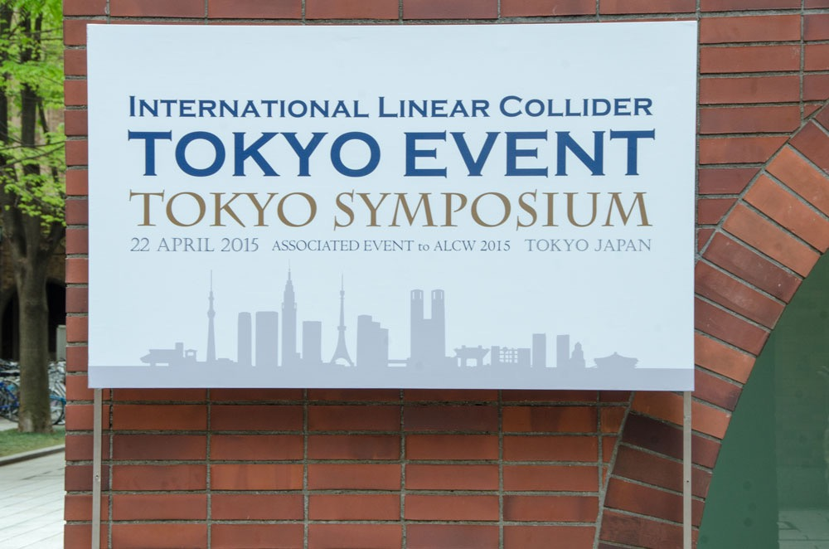
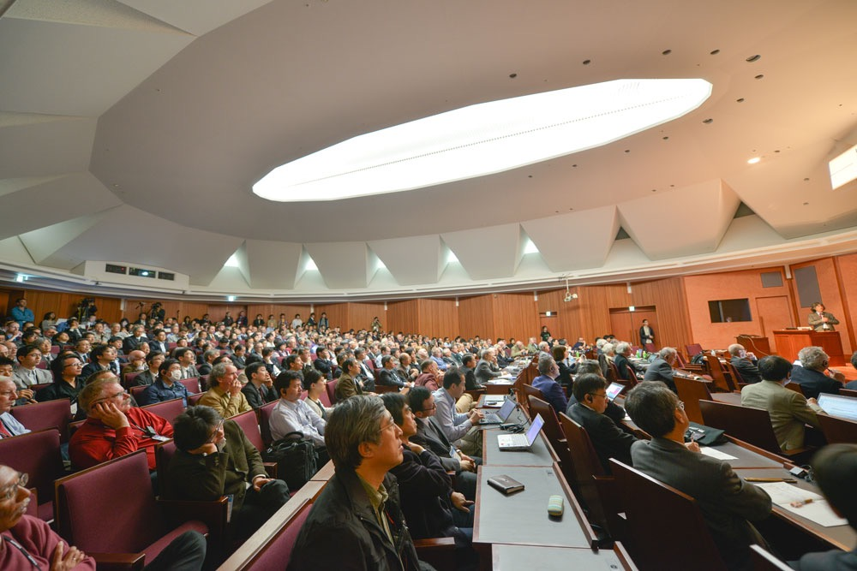
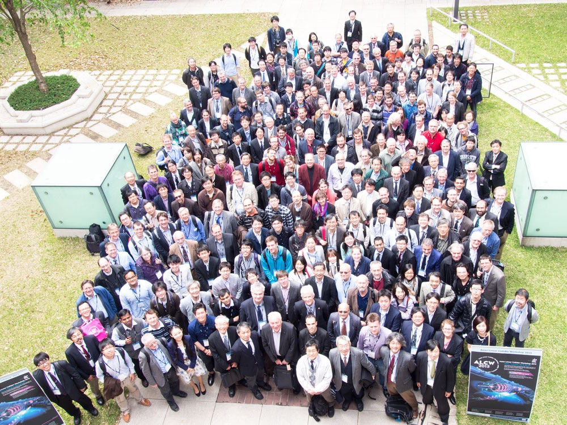
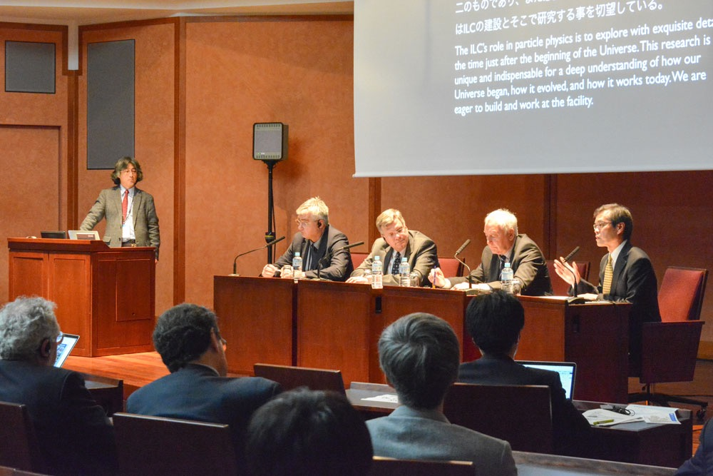
ALCW2015

Slide 18
T.Mori ALCW2015

Slide 19
Statement on “Towards the realisation of the International Linear Collider”
22 April 2015, Tokyo
At the ILC Tokyo Symposium, held on 22 April 2015 at the Ito International Hall, Tokyo, Japan, the Linear Collider Collaboration (LCC) and the participants around the world at the Asian Linear Collider Workshop (ALCW) 2015 decided to issue a statement confirming their conviction of the scientific justification for a prompt realisation of the International Linear Collider (ILC).
. 1) The ILC’s role in particle physics is to explore with exquisite detail the time just after the beginning of the Universe. This research is unique and indispensable for a deep understanding of how our Universe began, how it evolved, and how it works today. We are eager to build and work at the facility.
. 2) The technical feasibility of the ILC has been demonstrated in the Technical Design Report. The ILC is ready to be built following the completion of an engineering-design phase. The project is now in a phase where governmental involvement should lead to a decision to realize the project. In this context we express our appreciation of the ongoing project assessment being undertaken by the Japanese government.
. 3) The ILC is one of the largest scientific projects ever proposed, on a similar scale to requires the establishment of an international framework for sharing the cost and expertise among countries. We therefore intend to facilitate discussions between governments and funding authorities to achieve this goal as soon as possible.
Lyn Evans Director of the LCC, on behalf of the LCC and scientists at the ALCW 2015.

Slide 20
Government-to-Government
Talks
See Satoru’s talk
at ALCW2015

Slide 21
S.Yamashita ALCW2015

Slide 22
Running Scenario
See Jim Brau’s talk
at ALCW2015

Slide 23
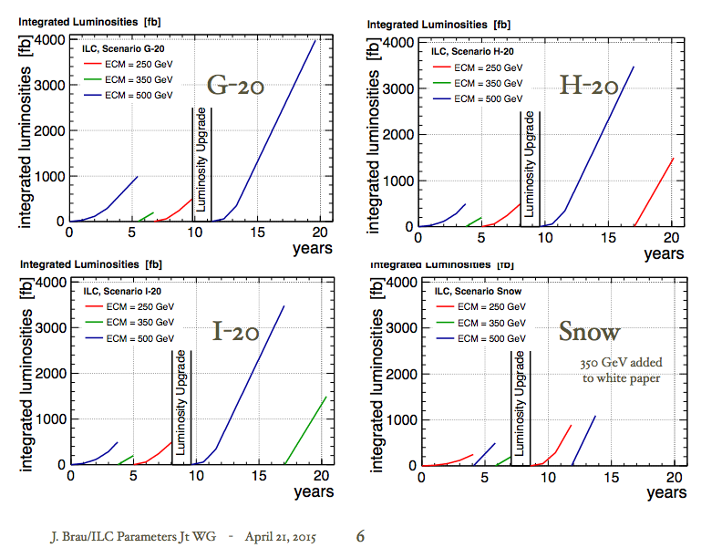
Recommended

Slide 25
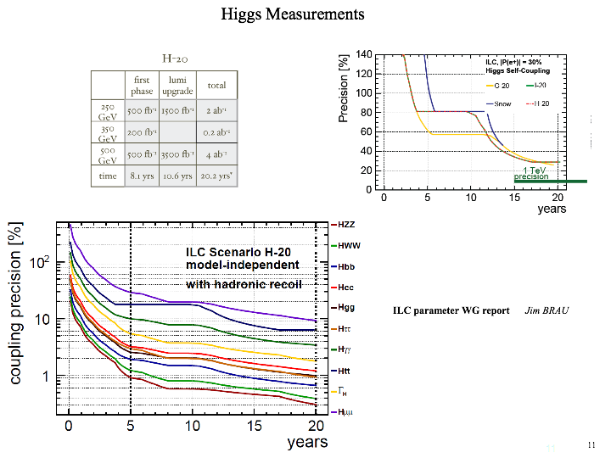
Self-coupling reaches <30%
for SM case.
<15% if lamda=2xSM
Most couplings reach <1%

Slide 27
ZHH-vvHH complimentary

Slide 28
4-loop mass formula
Simultaneous extraction of all form factors!

Slide 29
Summary

Slide 30
Reports from the both WGs well received by the Experts Committee.
But we still need to convey the ILC physics case (big picture) in a language intelligible to the general public.
We need to show that there are enough number of interested and capable people to realize the ILC. → video message!
We need to facilitate discussions between governments and funding authorities to achieve this goal as soon as possible.

