Slide 1
ILC Physics
Overview
Keisuke Fujii (KEK)
March 13, 2015
Thanks to T. Tanabe
for many materials

Slide 2
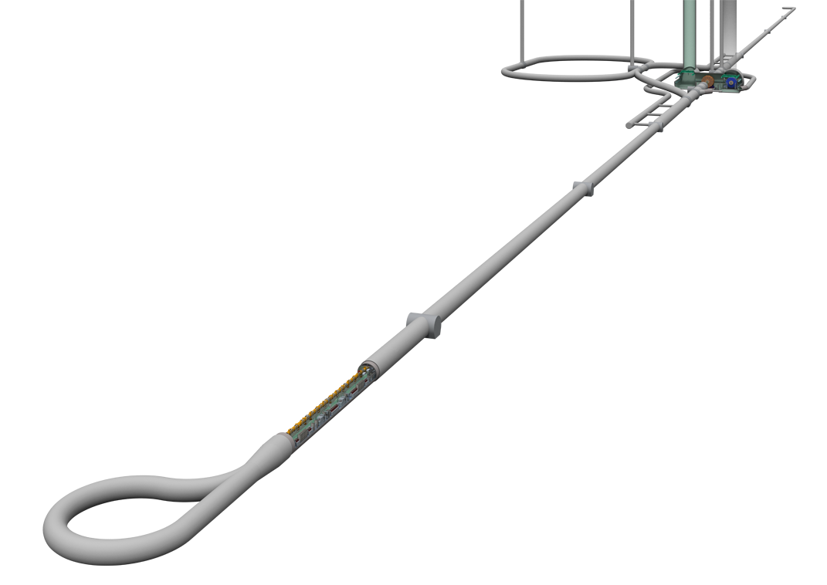
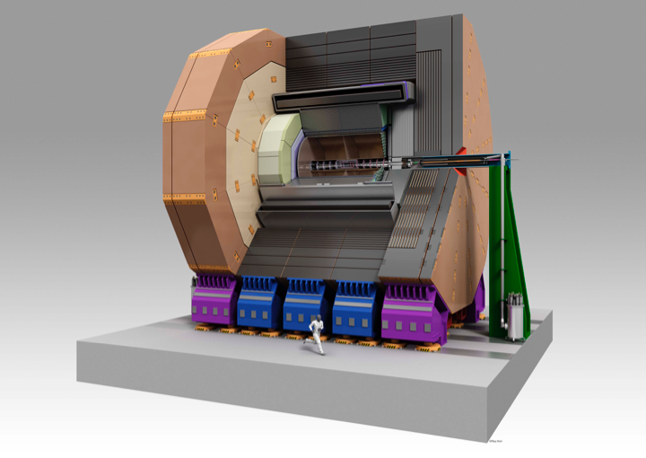
Bird’s Eye View of the ILC Accelerator
Damping Ring
Ultra-low emittance
normalized emittance＝37nm
Nano-beam collisions
Beam Delivery System
Detectors
ILD
High gradient
world highest gradient as with super-conducting cavities = 31.5 MV/m
beam cuurent = 5.8 mA
High resolution high granularity detector
e+, e- Main Linac
Tunnel Layout Plan for a Japanese Mountain Site
Energy : 250GeV + 250GeV
Length : 11km + 11km
# of DRFS Klystron: 7280 total
# of Cryomodules : 1680 total
# of Cavities : 14560 total
Cryomodules housing
Super Cond. Cavities
Slide by H. Hayano

Slide 3
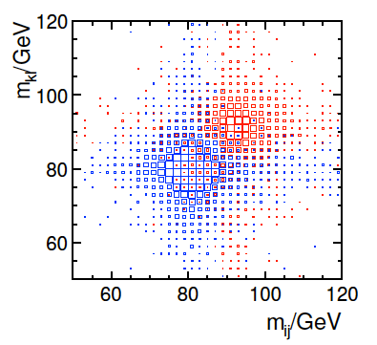
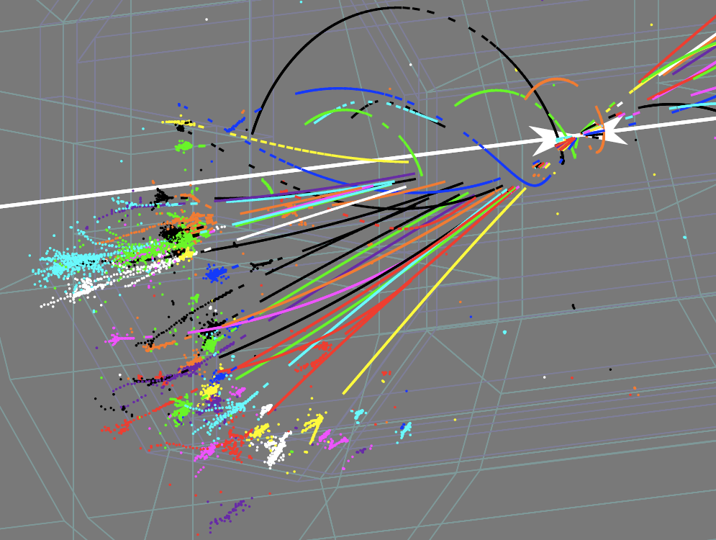
New Paradigm : View events as viewing a Feynman diagram
Reconstruct final states in terms of fundamental particles (quarks, leptons, gauge bosons, and Higgs bosons)
Identify W/Z/top/Higgs with their
jet invariant mass: M_{jets}
Z
W
Particle Flow Analysis
PFA is the key to achieve excellent jet invariant mass resolution comparable to the natural width of the weak boson:
PFA at ILC
1-to-1 track- cluster matching for exact Ech subtraction
Use tracker for charged particles, use CAL only for neutral particles, removing energy deposits by charged particles (Ech) in CAL by
1-to-1 track to CAL cluster matching
1-to-1 matching requires
High resolution tracking
High granularity calorimetry

Slide 4
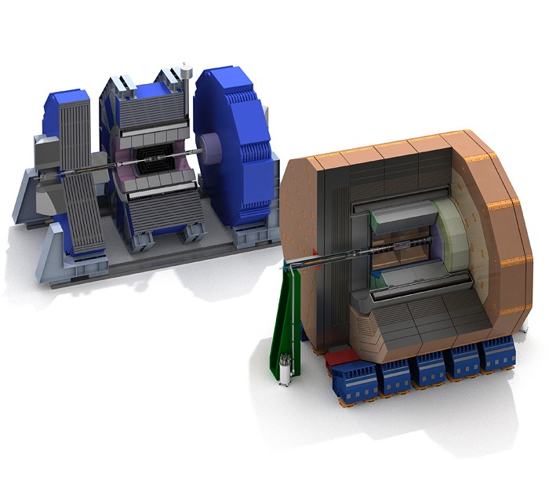
Detailed Baseline Design (TDR vol.4)
Large R with TPC tracker
32 countries, 151 institutions, ~700 members
Most members from Asia and Europe
B=3.5T, TPC + Si trackers
ECal: R=1.8m
arXiv: 1306.6329
ILD
SiD
High B with Si strip tracker
18 countries, 77 institutions, ~240 members
Mostly American
B=5T, Si only tracker
ECal：R=1.27m
Both detector concepts are optimized for Particle Flow Analysis

Slide 5
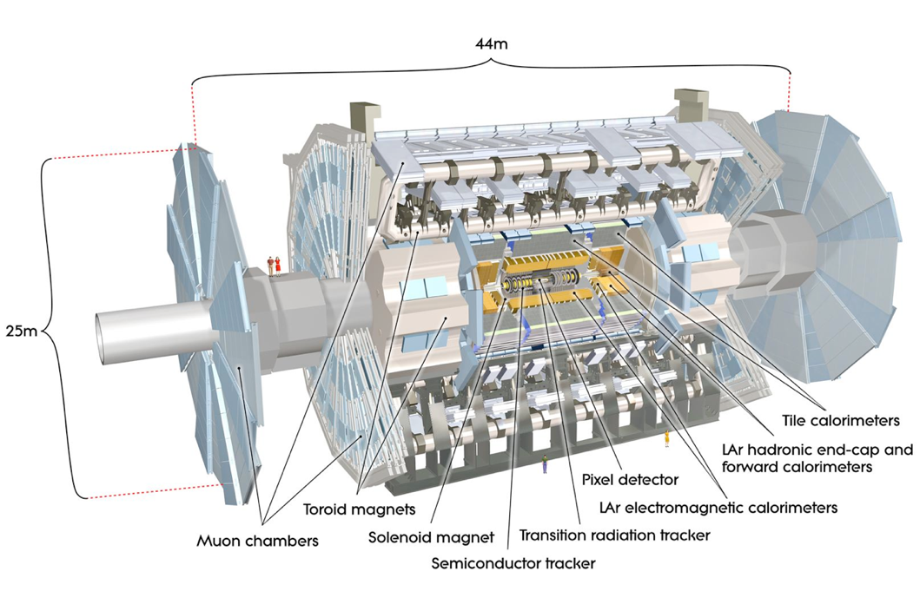
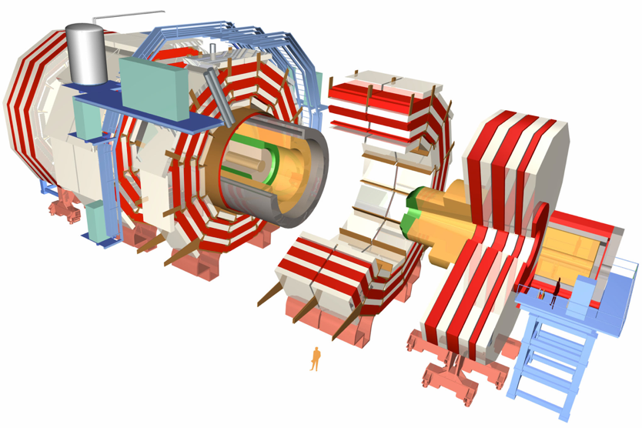
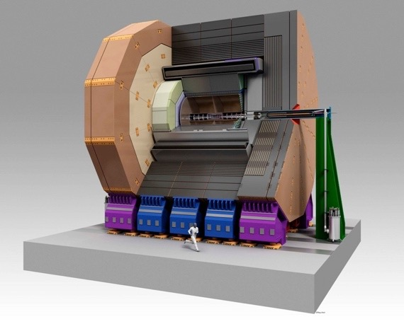
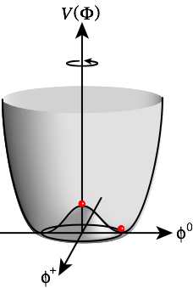
Comparison
LHC vs ILC
Size
LHC : current state of the art
Use the cleanest modes to beat the huge QCD BG.
Moral
ATLAS
Energy Frontier Collider Detectors
spearhead state-of-the-art detector technologies
ILC : next generation
e.g.) ILD
CMS
Use the dominant (jet) modes to take advantage of clean environment
LHC : Higgs Discovery
Search for New Physics
Granularity
ILC : Precision Higgs Study
Search for New Physics
Tracker
Resolution
>100 x more granular
10 x higher resolution
10 x less material budget

Slide 6
ILD
HCAL
ECAL
TPC
tth @ 500 GeV

Slide 7
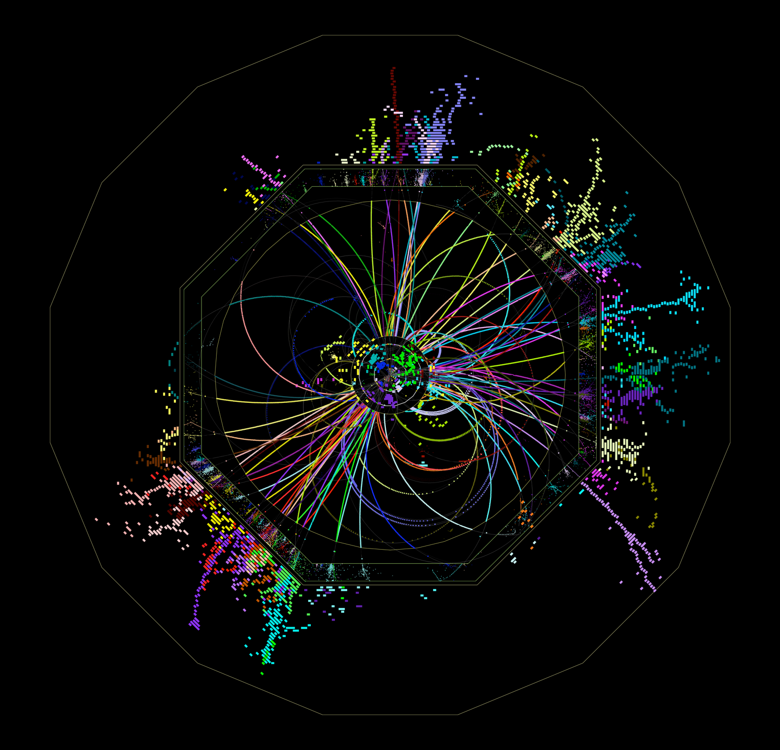
Features of ILC Detectors
HCAL
Compared with LHC detectors, ILC detectors have ~10 times better momentum resolution and 100~1000 times finer granularity.
This performance can be achieved only in the clean environment of the ILC, and cannot be achieved in the LHC environment.
The cost of ILC detectors is similar to or less than that of the LHC detectors.
ILD
HCAL
ECAL
TPC
VTX
tth @ 500 GeV

Slide 8
Physics at ILC

Slide 9
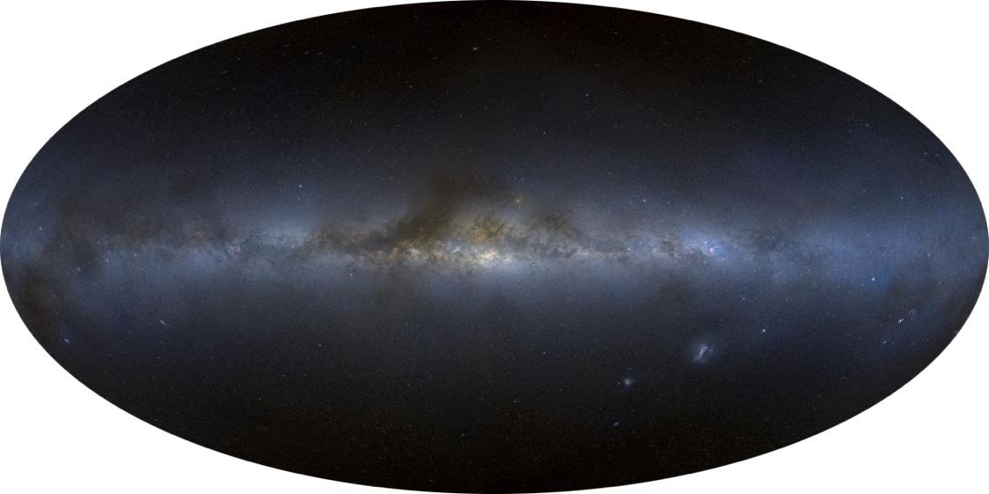
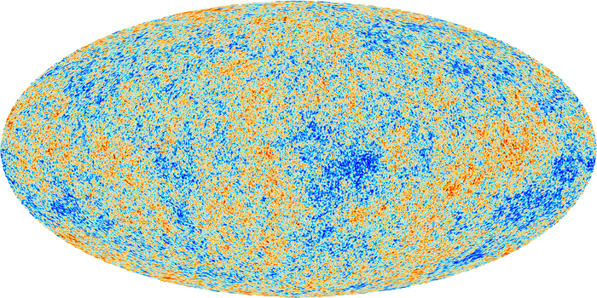
Towards ultimate unification
Gravity
Strong
Weak
EM
13.8 byr
380 kyr
Age of Universe
EW symmetry breaking
= phase transition
10⁻¹⁰ s
Electroweak Unification
Unification of
forces
ILC
Grand Desert?
10⁻³⁶ s
Unification of
matter
Grand Unification ?
Unification of
matter and force
10⁻⁴³ s
Quantum Gravity ?
Unification of
matter, force, and space-time

Slide 10
Why is the EW scale so important ?

Slide 11
Electroweak Symmetry Breaking Mystery of something in the vacuum
The EW symmetry forbids masses of gauge bosons and matter fermions. In order to break it without breaking that of the Lagrangian, we need “something” condensed in the vacuum which carries weak charge: → We are living in a weakly charged vacuum!
The discovery of H(125) provided evidence that it is an excitation of (at least part of) this “something” in the vacuum and hence the correctness of this idea of the vacuum breaking the EW symmetry.
In the SM, a single complex doublet scalar field is responsible for both gauge boson and matter fermion masses. The SM EWSB sector is the simplest, but other than that there is no reason for it. The EWSB sector might be more complex. → We need to know the multiplet structure of the EWSB sector.
Moreover, the SM does not explain why the Higgs field developed a vacuum expectation value.
In other words the SM does not answer the question:
Why μ² < 0?
V=W/Z

Slide 12
Why μ² < 0?
To answer this question
we need to go beyond the SM.

Slide 13
The Big Branching Point
Concerning the dynamics behind the EWSB.
Is it weakly interacting or strongly interacting? = Is the H(125) elementary or composite?
SUSY, which gives a raison d’être for a fundamental scalar fields, is the most attractive scenario for the 1st branch, where EW symmetry is broken radiatively. → The EWSB sector is weakly interacting. → H(125) is elementary and embedded in an extended multiplet structure (there must be at least 2 Higgs doublets). → Possible Grand Desert → Telescope for GUT scale physics
Composite Higgs Models, the 2nd branch, where a new QCD-like strong interaction makes a vacuum condensate. → The EWSB sector is strongly interacting. → H(125) is composite. → Jungle of new particles in TeV(+) scale

Slide 14
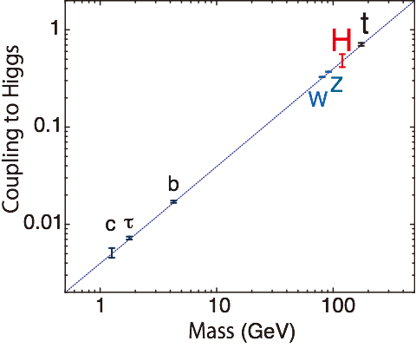
Elementary or Composite? How can ILC address this question?
If SUSY (elementary), → (At least) 2 Higgs doublets → extra degrees of freedom → Search for new particles - extra Higgs bosons: H, A, H± - uncolored SUSY particles: EWkinos, sleptons → Look for specific deviation patterns in - various Higgs couplings - gauge boson properties
If Composite, → Look for specific deviation patterns in - various Higgs couplings - Top (ttZ) couplings
Mass-Coupling Relation
Any deviation from the straight line signals BSM!
SM
Different models predict
different deviation patterns!
ACFA Report

Slide 15
The 3 major probes for BSM at ILC:
Higgs, Top, and
search for
New Particles

Slide 16
The 3 major tools to enable this endeavor
Well defined initial state and controllable Ecm
Clean environment: no QCD BG, only with calculable BG from EW processes
Beam polarization

Slide 17
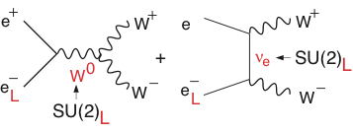
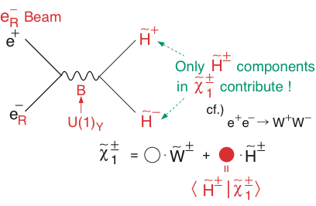
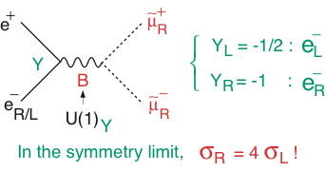
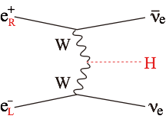
Power of Beam Polarization
W⁺W⁻ (Largest SM BG in SUSY searches)
BG Suppression
Chargino Pair
Slepton Pair
WW-fusion Higgs Prod.
Decomposition
 | ILC
Pol (e⁻) | -0.8
Pol (e⁺) | +0.3
(σ/σ0)vvH | 1.8x1.3=2.34
Signal Enhancement

Slide 18
Higgs Physics at ILC

Slide 19
Our mission is to understand
Multiplet Structure &
Dynamics
of the EWSB sector,
and their relation to
Other Big Questions of High Energy Physics:
DM, baryogenesis, …
→ Bottom up Reconstruction of BSM Lagrangian

Slide 20
Our mission is to understand
Multiplet Structure &
Dynamics
of the EWSB sector,
and their relation to
Other Big Questions of High Energy Physics:
DM, baryogenesis, …

Slide 21
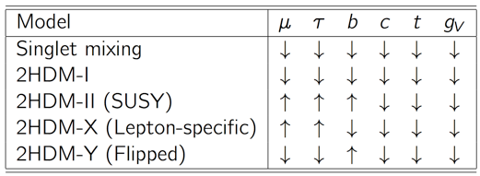
Our Mission = Bottom-up Model-Independent Reconstruction of the EWSB Sector through Precision Higgs Measurements
Multiplet structure :
Additional singlet? (φ + S) + …?
Additional doublet? (φ + φ’) + …?
Additional triplet? (φ + Δ) + …?
Underlying dynamics :
Why did the Higgs condense in the vacuum?
Weakly interacting or strongly interacting? = elementary or composite ?
Relations to other questions of HEP :
φ + S → (B-L) gauge, DM, …
φ + φ’ → Type I : mν from small vev, …
Type II : SUSY, DM, …
Type X: mν (rad.seesaw), …
φ + Δ → mν (Type II seesaw), …
λ > λSM → EW baryogenesis ?
λ↓0 → inflation ?
There are many possibilities!
Different models predict different deviation patterns --> Fingerprinting!
Mixing with singlet
Composite Higgs
SUSY
Expected deviations are small, typically a few % → We need a sub% precision!
We need a LC to cover Ecm= 250 to 500 GeV!

Slide 22
Our strategy is to fully exploit
LHC-ILC Synergies
in
direct searches/studies of
New Particles,
and
Precision measurements of H(125) Properties (coupling)

Slide 23
Our strategy is to fully exploit
LHC-ILC Synergies
in
direct searches/studies of
New Particles,
and
Precision measurements of H(125) Properties (coupling)

Slide 24
Why 500 GeV?

Slide 25
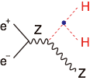
Higgs-related Physics at Ecm ≲ 500 GeV Three well know thresholds
ZH @ 250 GeV (~MZ+MH+20GeV)：
Higgs mass, width, J^{PC}
Gauge quantum numbers
Absolute measurement of HZZ coupling (recoil mass)
BR(h->VV,qq,ll,invisible) : V=W/Z(direct), g, γ (loop)
ttbar @ 340-350GeV (~2mt)：ZH meas. Is also possible
Threshold scan --> theoretically clean mt measurement: --> test stability of the SM vacuum --> indirect meas. of top Yukawa coupling
AFB, Top momentum measurements
Form factor measurements
vvH @ 350 - 500GeV：
HWW coupling -> total width --> absolute normalization of Higgs couplings
ZHH @ 500GeV (~MZ+2MH+170GeV)：
Prod. cross section attains its maximum at around 500GeV -> Higgs self-coupling
ttbarH @ 500GeV (~2mt+MH+30GeV)：
Prod. cross section becomes maximum at around 800GeV.
QCD threshold correction enhances the cross section -> top Yukawa measurable at 500GeV concurrently with the self-coupling
→Higgs couplings (other than top)
γ γ → HH @ 350GeV possibility
We can access all the relevant Higgs couplings
at ~500GeV for the mass-coupling plot!

Slide 26
Deviation in Higgs Couplings
The size of the deviation depends on
the scale of new physics.
mass
Decoupling Theorem: Λ↑ → SM
m_{A}
Example 1: MSSM (tanβ=5, radiative correction factor ≈ 1)
heavy Higgs mass
Example 2: Minimal Composite Higgs Model
m_{h}
composite scale
New physics at 1 TeV gives only a few percent deviation.
We need a %-level precision to see such a deviation → ILC

Slide 27
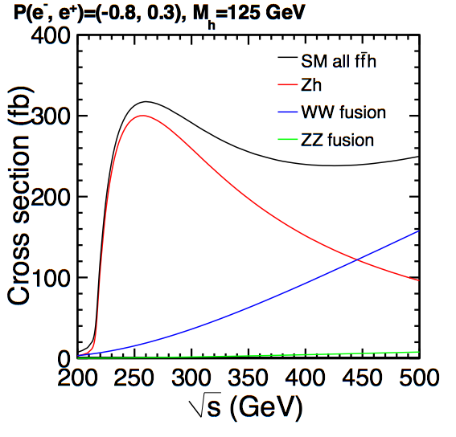
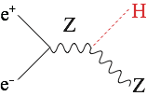
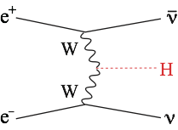
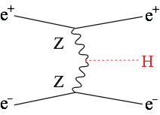
Main Production Processes Single Higgs Production
Production cross section
ZH dominates at 250 GeV (~80k ev: 250 fb⁻¹)
vvH takes over at 500 GeV (~125k ev: 500 fb⁻¹)
Possible to rediscover the Higgs in one day!

Slide 28
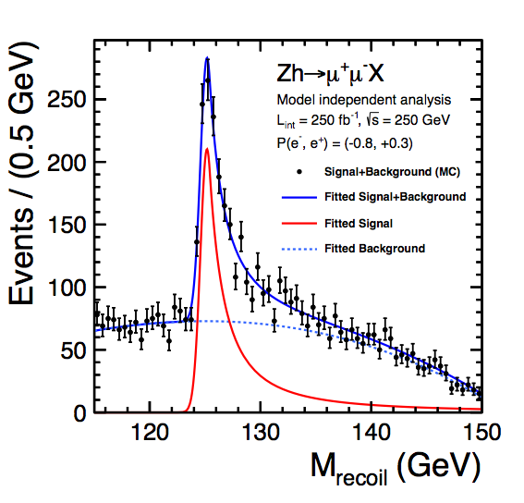
Recoil Mass Measurement: The Key to unlock the door to fully model-independent determinations of various BRs, Higgs couplings, and total widths
Recoil Mass
Invisible decay detectable!
Watanuki
scaled from mH=120 GeV
Model-independent absolute measurement of the σ(HZ) → HZZ coupling

Slide 29
Total Width and Coupling Extraction One of the major advantages of the LC
To extract couplings from BRs, we need the total width:
To determine the total width, we need at least one partial width and corresponding BR:
In principle, we can use A=Z, or W for which we can measure both the BRs and the couplings:
BR=O(1%): precision limited by low stat. for H->ZZ* events
More advantageous but not easy at low E
C.F.Durig, Helmholtz Alliance 6th WS, Dec. 2012

Slide 30
At ILC all but the σ measurement using recoil mass technique is σ×BR measurements.
Key Point
At LHC all the measurements are σ×BR measurements.
σ×BR
BR
g
coupling
WW-fusion is crucial for precision total width measurement
→ Ecm > 350GeV
The Key
σ
from recoil mass
ΓH
total width
Z→qq is also usable.

Slide 31
Independent Higgs Measurements at ILC
Baseline (=TDR) ILC program
250 GeV: 250 fb⁻¹
500 GeV: 500 fb⁻¹
1 TeV: 1000 fb⁻¹
(MH = 125 GeV)
Ecm | 250 GeV |  | 500 GeV |  | 1 TeV
luminosity [fb⁻¹] | 250 |  | 500 |  | 1000
polarization (e⁻,e⁺) | (-0.8, +0.3) |  | (-0.8, +0.3) |  | (-0.8, +0.2)
process | ZH | vvH(fusion) | ZH | vvH(fusion) | vvH(fusion)
cross section | 2.6% | - | 3% | -
 | σ⋅Br | σ⋅Br | σ⋅Br | σ⋅Br | σ⋅Br
H→bb | 1.2% | 10.5% | 1.8% | 0.66% | 0.32%
H→cc | 8.3% |  | 13% | 6.2% | 3.1%
H→gg | 7% |  | 11% | 4.1% | 2.3%
H→WW* | 6.4% |  | 9.2% | 2.4% | 1.6%
Η→ττ | 4.2% |  | 5.4% | 9% | 3.1%
Η→ΖΖ* | 18% |  | 25% | 8.2% | 4.1%
Η→γγ | 34% |  | 34% | 19% | 7.4%
H→μμ | 100% | - | - | - | 31%
tth/H→bb | - |  | 14% (6.1%@550GeV) |  | 3.1%

Slide 32
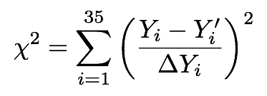
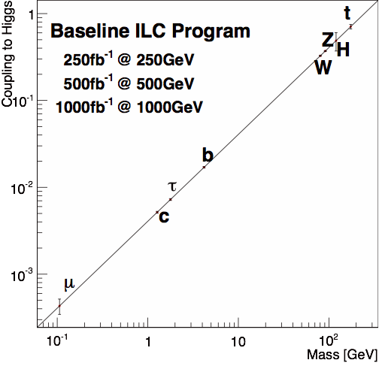
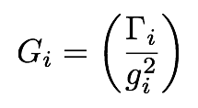
Model-independent Global Fit for Couplings
33 σxBR measurements (Yi) and σZH (Y34,35)
Systematic Errors
arXiv: 1310.0763
ILC’s precisions will eventually reach sub-% level!

Slide 33
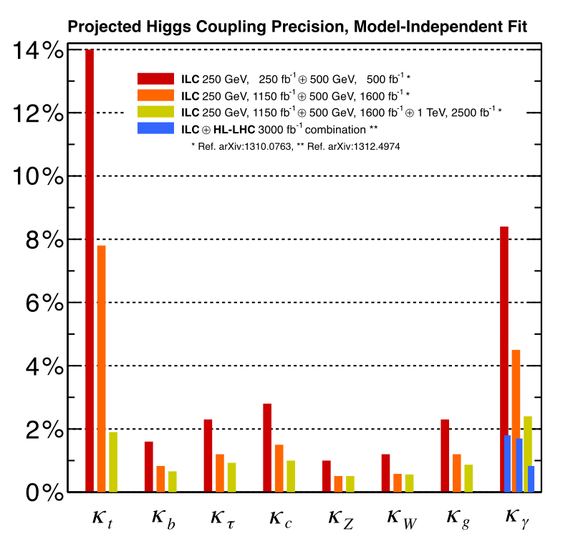
Higgs Couplings
Model-independent coupling determination, impossible at LHC
Excellent vertex detectors for
b/c-tagging at ILC
All of major Higgs decay modes accessible at ILC!
500 GeV already excellent except for Kt and Kγ

Slide 34
Higgs Couplings
Model-independent coupling determination, impossible at LHC
Excellent vertex detectors for
b/c-tagging at ILC
All of major Higgs decay modes accessible at ILC!
500 GeV already excellent except for Kt and Kγ

Slide 35
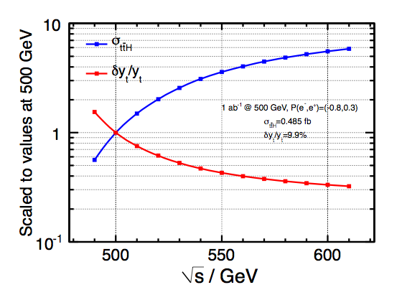
Top Yukawa coupling
x~4
x~2
Y. Sudo
Slight increase of Emax is very beneficial!

Slide 36
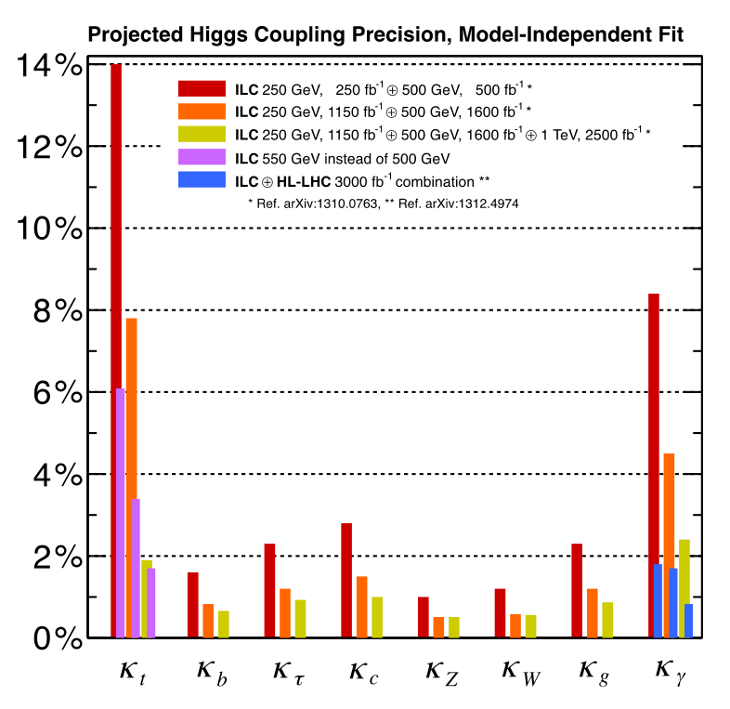
Higgs Couplings
Model-independent coupling determination, impossible at LHC
Top Yukawa improves by going to 550 GeV
Near threshold
→ a factor of 4
enhancement of σ_{tth} by going from 500GeV to 550 GeV
LHC can precisely measure
BR(h→γγ) / BR(h→ZZ*)
= (Kγ / KZ)²
ILC can precisely measure KZ
Better hγγ with LHC/ILC synergy
~1% or better precision for most couplings!

Slide 37
Higgs Couplings
Model-independent coupling determination, impossible at LHC
Top Yukawa improves by going to 550 GeV
All of major Higgs decay modes accessible at ILC!
LHC can precisely measure
BR(h→γγ) / BR(h→ZZ*)
= (Kγ / KZ)²
Near threshold
→ a factor of 4
enhancement of σ_{tth} by going from 500GeV to 550 GeV
Excellent vertex detectors for
b/c-tagging at ILC
ILC can precisely measure KZ
Better hγγ with LHC/ILC synergy
500 GeV already excellent except for Kt and Kγ
~1% or better precision for most couplings!

Slide 38
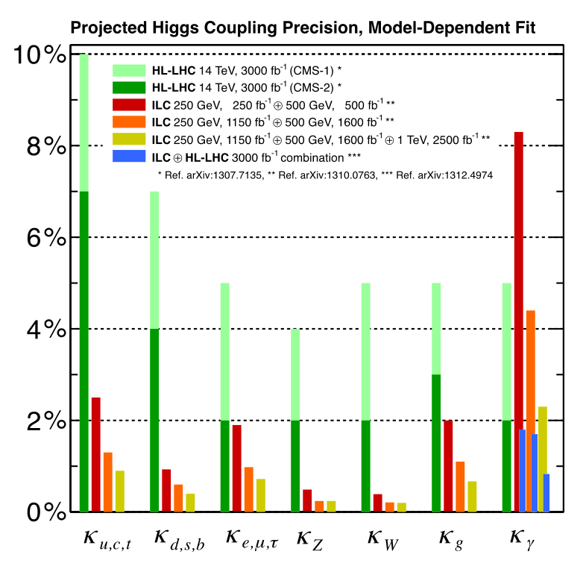
LHC-style 7-parameter fit
ΣSM BR = 1

Slide 39
Fingerprinting

Slide 40
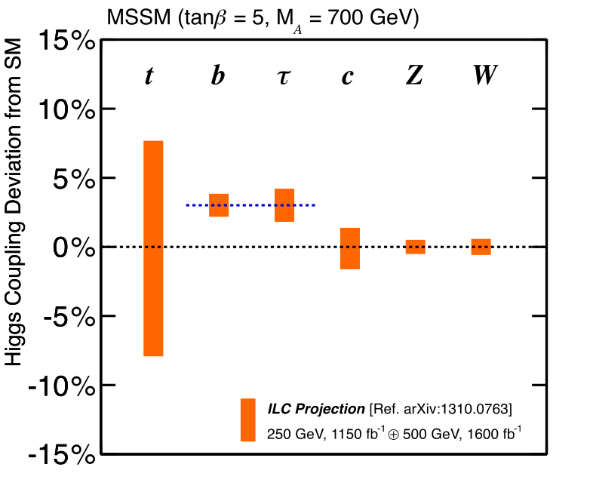
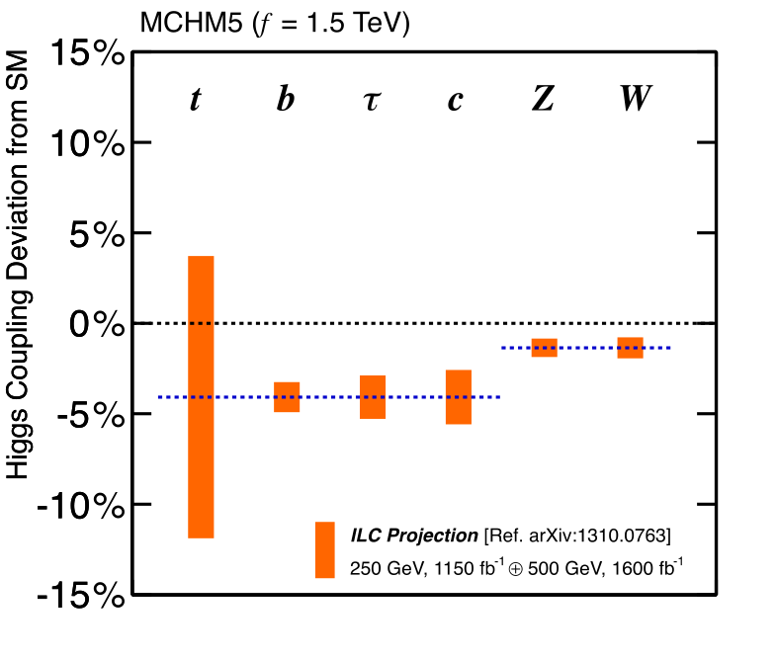
Fingerprinting
Elementary v.s. Composite
Supersymmetry
(MSSM)
Composite Higgs
(MCHM5)
ILC 250+500 LumiUP

Slide 41
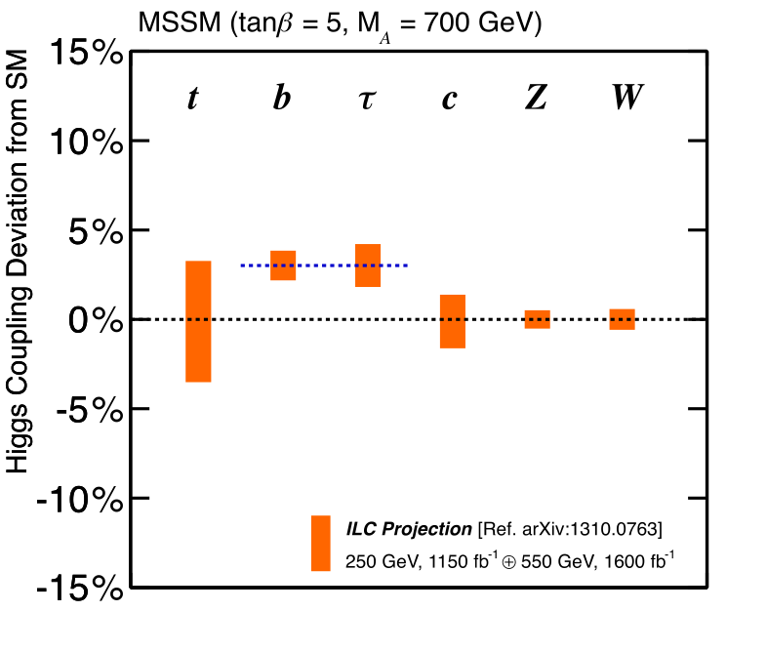
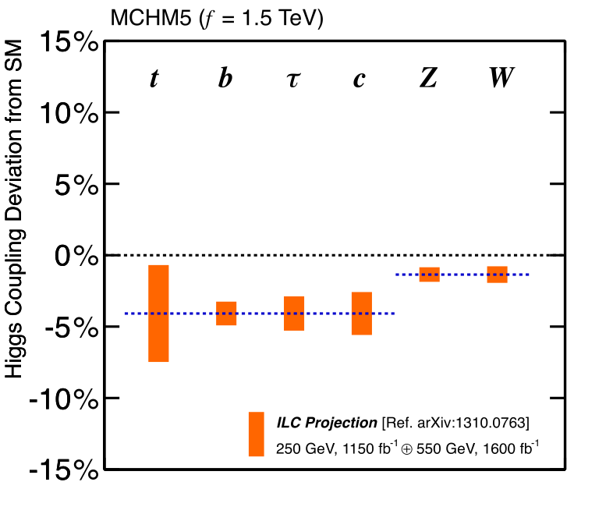
Fingerprinting
Elementary v.s. Composite
Supersymmetry
(MSSM)
Composite Higgs
(MCHM5)
ILC 250+550 LumiUP

Slide 42
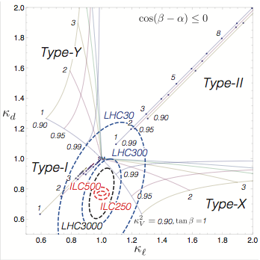
Fingerprinting
2HDM
Multiplet Structure
4 Possible Z2 Charge Assignments
that forbids tree-level Higgs-induced FCNC
(SUSY?)
KV² = sin(β-α)² =1 ⇔ SM
Kb
Given a deviation of the Higgs to Z coupling: ΔKv² = 1-Kv² = 0.01 we will be able to discriminate the 4 models!
Model-dependent
7-parameter fit
ILC: Baseline lumi.
(rad. seesaw?)
Kτ
ILC TDR
Snowmass ILC Higgs White Paper (arXiv: 1310.0763)
Kanemura et al (arXiv: 1406.3294)

Slide 43
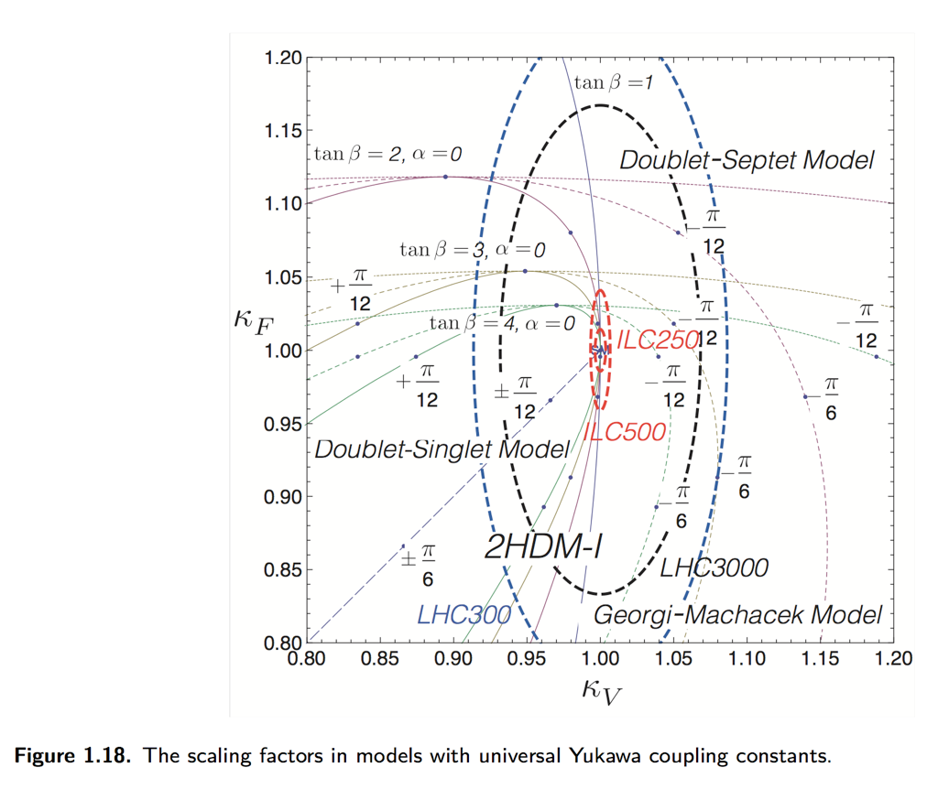
Multiplet Structure
Other ρ=1 possibilities
2+7
2+1
2+3
Snowmass ILC Higgs White Paper (arXiv: 1310.0763)
Kanemura et al (arXiv: 1406.3294)

Slide 44
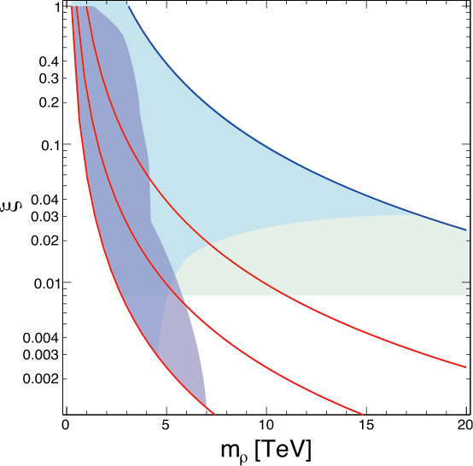
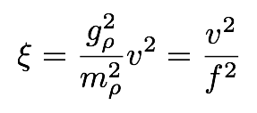
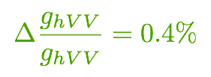
Composite Higgs: Reach
Complementary approaches to probe composite Higgs models
Direct search for heavy resonances at the LHC
Indirect search via Higgs couplings at the ILC
Comparison depends on the coupling strength (g*)
Direct Search
Based on Contino, et al, JHEP 1402 (2014) 006
Torre, Thamm, Wulzer 2014
Grojean @ LCWS 2014
a generic SO(5)/SO(4) CHM
Higgs Couplings
EWPT (T-parameter)
gρ=4π
HL-LHC14
ILC
ILC (250+500 LumiUP)
gρ=2
gρ=4
gρ=1

Slide 45
EW Phase Transition
1st order
or
2nd order ?

Slide 46
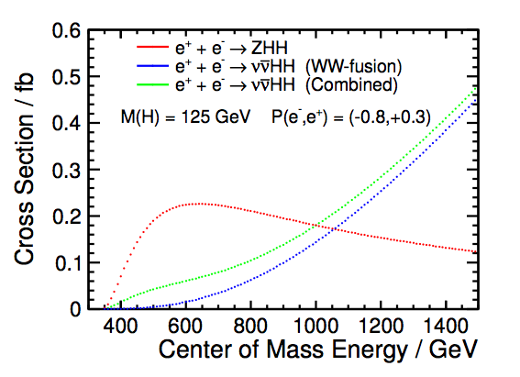
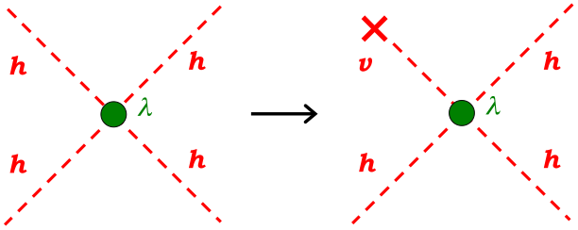
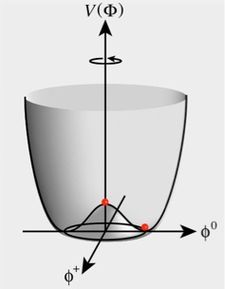
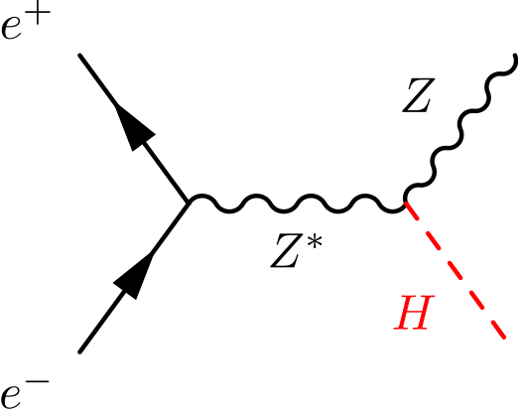
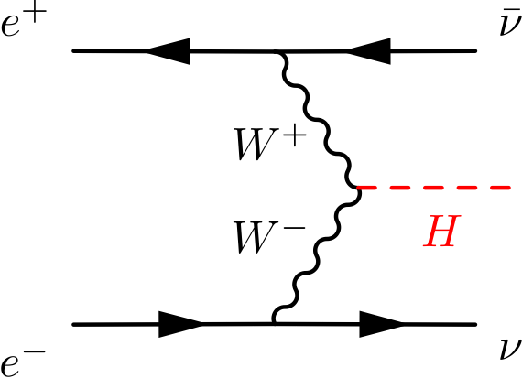
Higgs Self-Coupling
hhh coupling =
consequence of vacuum condensation
Challenging measurement because of:
Small cross section (Zhh 0.2 fb at 500 GeV)
Many jets in the final state
Presence of irreducible BG diagrams
H
arXiv:1310.0763
H
H
H
Ongoing analysis improvements towards O(10)% measurement
See J.Tian’s Poster
Notes:
4点結合の足のひとつが真空期待値を得ることで3点結合になる → 真空凝縮の直接検証
宇宙の成り立ちと密接に関係 → 宇宙初期は対称性を保った状態、低温になる過程で相転移が起きてヒッグス・ポテンシャルは現在の形に

Slide 47
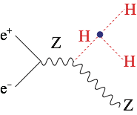
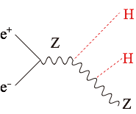
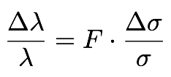
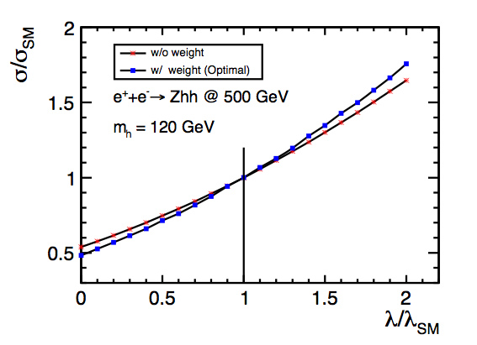
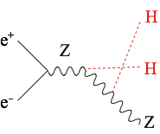
The Problem : BG diagrams dilute self-coupling contribution
Signal
diagram
Irreducible
BG diagrams
F=0.5 if no BG diagrams
+
+
+
Signal
diagram
Irreducible
BG diagrams
+
+
+
Junping Tian LC-REP-2013-003

Slide 48
Electroweak Baryogenesis
Example:
Electroweak baryogenesis in a Two Higgs Doublet Model
Large deviations in Higgs self-coupling
→ 1st order EW phase
transition
→ Out of equilibrium
+ CPV in Higgs sector
→ EW baryogenesis possible
Region where EW baryogenesis is expected
1st order EWPT
Minimum value of Higgs self-coupling
ILC can test the idea of baryogenesis occurring at the electroweak scale.
Senaha, Kanemura

Slide 49
Summary

Slide 50
The primary goal for the next decades is to uncover the secret of the EW symmetry breaking. The discovery of H(125) completed the SM particle spectrum and taught us how the EW symmetry was broken. However, it does not tell us why it was broken. Why μ² < 0? To answer this question we need to go beyond the SM.
There is a big branching point concerning the question: Is H(125) elementary or composite? There are two powerful probes in hand: H(125) itself and the top quark. Different models predict different deviation patterns in Higgs and top couplings. ILC will measure these couplings with unprecedented precision.
This will open up a window to BSM and fingerprint BSM models, otherwise will set the energy scale for the E-frontier machine that will follow LHC and ILC.
Cubic self-coupling measurement will decide whether the EWSB was strong 1st order phase transition or not. If it was, it will provide us the possibility of understanding baryogenesis at the EW scale.
The ILC is an ideal machine to address these questions (regardless of BSM scenarios) and we can do this model-independently.

Slide 51
Last but Not Least
In this talk I have been focusing on the case where H(125) alone would be the probe for BSM physics, but there is a good chance for LHC Run 2 to bring us more.
It is also very important to stress that ILC, too, is an energy frontier machine. It will access the energy region never explored with any lepton collider. It is not a tiny corner of the parameter space that will be left after LHC. There is a wide and interesting region for ILC to explore. Example: Natural Radiative SUSY Naturalness prefers μ not far above 100GeV but colored sparticles can be heavy enough to escape LHC detection
light chargino/neutralinos will be higgsino-dominant and nearly mass degenerate
typically Δm of 20 GeV or less → very difficult for LHC!
Once a new particle is found at ILC, we can precisely determine its properties, making full use of polarized beams. In the case of natural radiative SUSY scenario, we might even probe GUT scale physics using RGE.
If there is a DM candidate within ILC’s reach, its measured mass and couplings can be used to calculate the DM relic density and will reveal the nature of the cosmic DM.
In this way, ILC will pave the way to BSM physics.
Baer, List
LHC: gluino
ILC:EWkinos

Slide 52
Top Physics at ILC

Slide 53
Impact of BSM on Top Sector
In composite Higgs models, it is often said that the top quark is partially composite, resulting in form factors in ttZ couplings, which can be measured at ILC. Beam polarization is essential to distinguish the left- and right-handed couplings.
Deviation in ttZ coupling
of left-handed top quark
ILC, √s = 500 GeV
Lumi = 500 fb⁻¹
20%
with the power of beam polarization
Deviation in ttZ coupling
of right-handed top quark
10%
RS with SU(2)_{R}×SU(2)_{L}×U(1)_{X}
SM / SUSY
−80%
−60%
−40%
−20%
20%
40%
60%
80%
RS warped with Hosotani mechanism
AdS₅ with Custodial O(3)
−10%
Composite Higgs with SO(5)/SO(4)
Little Higgs
5D Emergent
−20%
RS with Custodial SU(2)
Composite Top
HL-LHC 3000 fb⁻¹ (approx.) 68%CL
Based on Baur, Juste, Orr, Rainwater, PRD71, 054013 (2005)
Deviations for different models for new physics scale at ~1 TeV.
Based on F. Richard, arXiv:1403.2893

Slide 55
SM up to ΛPlanck?
What if the Higgs properties would turn out to be just like those of the SM Higgs boson, to the ILC precision, and that no BSM signal found?
We would need to question then the range of validity of the SM.
How far can the SM go?

Slide 56
Stability of SM Vacuum
With the 125GeV Higgs boson, the SM vacuum seems to be at a subtle point of meta-stability!
Does λ really become negative below ΛPl?
or λ(ΛPl) = 0?
To answer this we need a precision mt measurement!
Top Pair Threshold
Theoretically very clean measurement of mt
ILC 3σ
arXiv:1205.6497, Degrassi et al.
ILC pins down the location !
arXiv:hep-ph/1502.01030: Quark mass relation to 4-loop order -> <50MeV

Slide 57
Searches for direct production of SUSY / DM at the ILC

Slide 58
What can ILC add to HL-LHC?

Slide 59
SUSY: LHC vs. ILC
“LHC has excluded MSSM up to high masses”
vs.
“LHC leaves out holes in MSSM parameter space”
“ILC can set model-indep. limits on SUSY particles”
vs.
“There is nothing interesting left within the reach of ILC”
These statements are all true to a certain extent…
The Big Picture:
SUSY is only complete with SUSY breaking implemented!
The answer depends on this SUSY breaking mechanism.
An example of connecting the “high mass reach of LHC” with “model-independent reach of ILC”:
Gluino @ LHC vs. Chargino/Neutralino @ ILC
assuming various gaugino mass relations (e.g. GMSB, AMSB) and LSP types (Bino, Wino, Higgsino)

Slide 60
Sensitivity to SUSY
[this comparison is for illustration only; specific channels should be looked at for actual comparisons]
Examples of direct SUSY searches
LHC: Gluino search
ILC: EWkino (Chargino/Neutralino) search
Compare using gaugino mass relations
LHC 8 TeV (heavy squarks)
LHC 300 fb⁻¹, √s=14 TeV
LHC 3000 fb⁻¹, √s=14 TeV
Preliminary
Bino LSP
(Gravity
mediation)
ILC 500 GeV
ILC 1 TeV
Wino LSP
(Anomaly
mediation)
(no relation between μ and M₃₎
Higgsino LSP
0
1
2
3
4
5
M₃ (TeV) ~ Gluino mass
[Assumptions: MSUGRA/GMSB relation M₁ : M₂ : M₃ = 1 : 2 : 6; AMSB relation M₁ : M₂ : M₃ = 3.3 : 1 : 10.5]

Slide 61
But, LHC can also search for direct EWkino production

Slide 62
SUSY EW Production
For LHC:
Decays:
For ILC:
Higgs!

Slide 63
SUSY EW @ LHC
Mass
(LSP)
Sensitive to particular mass spectra

Slide 64
SUSY EW @ LHC
Mass
(LSP)
100% assumed, but not generally true due to neutralino mixing

Slide 65
SUSY EW @ HL-LHC
C₁N₂ → WN₁ZN₁
arXiv:1307.7292

Slide 66
Is it only a tiny corner in the parameter space
that will be left?
Is ILC a gleaner?

Slide 67
SUSY Electroweak Sector
Bino-like LSP
Wino-like LSP
Higgsino-like LSP
M1<<M2, μ
M2<<M1, μ
μ<<M2,M1
LSP/NLSP typically degenerate
(depends on mixing)

Slide 68
Natural Radiative SUSY: μ not far above 100GeV
typically Δm of 20 GeV or less → very difficult for LHC!

Slide 69
Higgsinos in Natural SUSY (ΔM<a few GeV)
ILC as a Higgsino Factory
ISR Tagging
soft
tracks,
photons
ISR photon
ISR Tagging
Only very soft particles in the final states → Require a hard ISR to kill huge two-photon BG!
2×Mχ
500fb-1 @ Ecm=500GeV
Pol (e+,e-) = (+0.3,-0.8) and (-0.3,+0.8)
2×Mχ
EPJC (2013) 73:2660

Slide 70
Extracting M1 and M2
Hale Sert
ECFA LCWS 2013, DESY
Berggren et al. EPJC (2013) 73:2660
RNS: Baer et al.
arXiv: 1404.7510
ΔM=15GeV
100fb⁻¹@250GeV
In the radiatively driven natural SUSY (RNS) scenario as in arXiv: 1404.7510, ΔM~10GeV, we can determine M1 and M2 to a few % or better, allowing us to test GUT relation!

Slide 71
GUT Scale Physics

Slide 72
Test gaugino mass unification
Chargino/Neutralino @ ILC → probe M₁-M₂ gaugino mass relation
Gluino @ LHC → test of gaugino mass relation by ILC-LHC complementarity
Gives a prediction of the gluino mass scale
Discrimination of SUSY spontaneous symmetry breaking scenarios
Gaugino mass unification:
Higgsino-like LSP scenario
By Baer, List
LHC
LHC: gluino discovery
→ mass determination
ILC: Higgsino discovery
→ M1, M2 via mixing between Higgsino and Bino/Wino
ILC
ILC

Slide 73
Dark Matter

Slide 74
WIMP Dark Matter @ ILC
WIMP searches at colliders are complementary to direct/indirect searches.
Examples at the ILC:
Higgs Invisible Decay
Mono-photon Search
MDM < Mh /2
BR(H→invis.) < 0.4%
at 250 GeV, 1150 fb⁻¹
→ MDM reach ~ Ecm/2
In many models, DM has a charged partner as in higgsino DM case of SUSY.
SUSY-specific signatures (decays to DM)
light Higgsino, light stau, etc.

Slide 75
Dark Matter Search
LHC 14 TeV, 3000 fb-1, Jets+MET analysis only
pMSSM Neutralino DM expected exclusion
LC:
Mono photon search
may use mono-jet
Cahill-Rowley, Hewett, Ismail, Rizzo [arXiv:1307.8444]
Beam polarization to kill ννγ
Hermeticity to θ<O(10mrad)
Veto low angle μ and hadrons as well as e/γ
photon
Loopholes of HL-LHC → Hunting ground of ILC

Slide 76
DM: Effective Operator Approach
Chaus, List et al.
Chaus, List et al.
LHC sensitivity: Mediator mass up to Λ~1.5 TeV for large DM mass
ILC sensitivity: Mediator mass up to Λ~3 TeV for DM mass up to ~√s/2

Slide 77
DM Relic Abundance
WMAP/Planck (68% CL)
ESA/Planck
Once a DM candidate is discovered, crucial to check the consistency with the measured DM relic abundance.
Mass and couplings measured
at ILC → DM relic density
Baltz, Battaglia, Peskin, Wizansky
PRD74 (2006) 103521, arXiv:hep-ph/0602187
*This particular benchmark point is excluded. Update is in progress.

Slide 78
Summary

Slide 79
The primary goal for the next decades is to uncover the secret of the EW symmetry breaking. The discovery of H(125) completed the SM particle spectrum and taught us how the EW symmetry was broken. However, it does not tell us why it was broken. Why μ² < 0? To answer this question we need to go beyond the SM.
There is a big branching point concerning the question: Is H(125) elementary or composite? There are two powerful probes in hand: H(125) itself and the top quark. Different models predict different deviation patterns in Higgs and top couplings. ILC will measure these couplings with unprecedented precision.
This will open up a window to BSM and fingerprint BSM models, otherwise will set the energy scale for the E-frontier machine that will follow LHC and ILC.
Cubic self-coupling measurement will decide whether the EWSB was strong 1st order phase transition or not. If it was, it will provide us the possibility of understanding baryogenesis at the EW scale.
The ILC is an ideal machine to answer these questions (regardless of BSM scenarios) and we can do this model-independently.
It is also very important to stress that ILC, too, is an energy frontier machine. It will access the energy region never explored with any lepton collider. It is not a tiny corner of the parameter space that will be left after LHC. There is a wide and interesting region for ILC to explore.
Once a new particle is found at ILC, we can precisely determine its properties, making full use of polarized beams. In the case of natural radiative SUSY scenario, we might even probe GUT scale physics using RGE.
If there is a DM candidate within ILC’s reach, its measured mass and couplings can be used to calculate the DM relic density and will reveal the nature of the cosmic DM.
In this way, ILC will pave the way to BSM physics.

Slide 80
Please attend ALCW 2015
The Asia region
Linear Collider Workshop
April 20 ~ April 24
April 20-21: at KEK
LC Physics (mostly theory) sessions
April 22: at Univ. of Tokyo
Scientific and Political
Plenary Sessions
April 23: at KEK
latest results on ILC capabilities
WS home:
http://www-conf.kek.jp/alcw2015
Registration:
http://www-conf.kek.jp/alcw2015/registration.html
Early registration deadline: March 22
Tokyo Event:
http://aaa-sentan.org/tokyo_event2015/en/index.html
Please send your talk proposal by March 31 to physics session conveners:
Keisuke Fujii: keisuke.fujii@kek.jp
Christophe Grojean: christophe.Grojean@cern.ch
Michael Peskin: mailto:mpeskin@slac.stanford.edu

Slide 81
Additional Slides

Slide 82
Physics and
Experiments

Slide 83
Cross Sections
_{LHC}
Typically,
_{Tevatron}
e⁺e⁻ cross sections
σ (fb)
LEP
ILC
1 TeV
Number of events
for L=500 fb⁻¹
√s (GeV)

Slide 84
Higgs Hadronic Decays: Flavor Tagging
Z→qq, E_{CM}=91.2 GeV, ILD Full Simulation [Suehara, TT]
b mis-id
c mis-id
uds mis-id
uds mis-id
b-jet tagging
c-jet tagging
ILC detectors allow high performance b/c/g tagging
Precise measurement of BR(H→bb, cc, gg)

Slide 85
Higgs

Slide 86
Our Mission = Bottom-up Model-Independent Reconstruction of the EWSB Sector through Precision Higgs Measurements
Multiplet structure :
Additional singlet? (φ + S) + …?
Additional doublet? (φ + φ’) + …?
Additional triplet? (φ + Δ) + …?
Underlying dynamics :
Why did the Higgs condense in the vacuum?
Weakly interacting or strongly interacting? = elementary or composite ?
Relations to other questions of HEP :
φ + S → (B-L) gauge, DM, …
φ + φ’ → Type I : mν from small vev, …
Type II : SUSY, DM, …
Type X: mν (rad.seesaw), …
φ + Δ → mν (Type II seesaw), …
λ > λSM → EW baryogenesis ?
λ↓0 → inflation ?
There are many possibilities!
Different models predict different deviation patterns --> Fingerprinting!
Mixing with singlet
Composite Higgs
SUSY
Expected deviations are small, typically a few % → We need a sub% precision!
We need a LC to cover Ecm= 250 to 500 GeV!

Slide 87
Recoil Mass Resolution
Estimation by simulation
Old ACFA Study
by Akiya Miyamoto
240GeV
250GeV
300GeV
Resolution does matter if you want to do this at higher energy!
Rough analytic estimate
ILD
Hengne Li

Slide 88
High Performance Flavor Tagging : The Key to directly access major couplings: bb, cc, ττ, gg, WW*
By template fitting, we can separate H →bb, cc, gg, others!
MC Data
H→Others
SM BG
scaled from mH=120 GeV
 | @250GeV
process | ZH
Int. Lumi. [fb⁻¹] | 250
Δσ/σ | 2.6%
decay mode | ΔσBr/σBr
H → bb | 1.2%
H → cc | 8.3%
H → gg | 7%
H → WW* | 6.4%
H → ττ | 4.2%
H→bb
H→cc
H→gg
What we measure
What we measure here is not BR itself but σxBR.
--> Δσ/σ=2.6% eventually limits the BR measurements. --> luminosity upgrade and/or longer running in a later stage.
DBD Physics Chap.
Clean environment and a high performance vertex detector are the two powerful weapons of the LC to directly access all of the major couplings (great advantage of the LC)

Slide 89
Total Width and Coupling Extraction One of the major advantages of the LC
To extract couplings from BRs, we need the total width:
To determine the total width, we need at least one partial width and corresponding BR:
In principle, we can use A=Z, or W for which we can measure both the BRs and the couplings:
BR=O(1%): precision limited by low stat. for H->ZZ* events
More advantageous but not easy at low E
C.F.Durig, Helmholtz Alliance 6th WS, Dec. 2012

Slide 90
What observables limit the coupling precisions?
The 4 most important ones
Y1 : recoil mass
Y2 : WW-fusion h→bb
Y3 : higgsstrahlung h→bb
Y4 : WW-fusion h→WW*
Both ZH and ννH productions matter!
For more details, see J.Tian @ Tokusui Workshop 2013

Slide 91
Model-independent Global Fit for Couplings
Luminosity Upgraded LC
250 GeV: 250 fb⁻¹
500 GeV: 500 fb⁻¹
1 TeV: 1000 fb⁻¹
250 GeV: 1150 fb⁻¹
500 GeV: 1600 fb⁻¹
1 TeV: 2500 fb⁻¹
(MH = 125 GeV)
P(e-,e+)=(-0.8,+0.3) @ 250, 500 GeV
P(e-,e+)=(-0.8,+0.2) @ 1 TeV
coupling | 250 GeV | 250 GeV + 500 GeV | 250 GeV + 500 GeV + 1 TeV
HZZ | 0.6% | 0.5% | 0.5%
HWW | 2.3% | 0.6% | 0.6%
Hbb | 2.5% | 0.8% | 0.7%
Hcc | 3.2% | 1.5% | 1%
Hgg | 3% | 1.2% | 0.93%
Hττ | 2.7% | 1.2% | 0.9%
Hγγ | 8.2% | 4.5% | 2.4%
Ημμ | 42% | 42% | 10%
Γ0 | 5.4% | 2.5% | 2.3%
Htt | - | 7.8% | 1.9%
HHH | - | 46%(*) | 13%(*)
*) With H->WW* (preliminary), if we include expected improvements in jet clustering, it would become 10%!

Slide 92
Top Yukawa Coupling The largest among matter fermions, but not yet directly observed
H-> bb
A factor of 2 enhancement from QCD bound-state effects
Cross section maximum at around Ecm = 800GeV
Philipp Roloff, LCWS12
Tony Price, LCWS12
Tony Price, LCWS12
scaled from mH=120 GeV
DBD Full Simulation
Notice σ(500+20GeV)/σ(500GeV) ~ 2
Moving up a little bit helps significantly!

Slide 93
Non-decoupling Corrections
19-parameter pMSSM
HL-ILC500
HL-LHC
Neutralino LSP
Cahill-Rowley, Hewett, Ismail, Rizzo (arXiv: 1407.702)
There might be an O(1) deviation even after HL-LHC due to large sbottom mixing through non-decoupling (mostly gluino) loop effects

Slide 94
Multiplet Structure
Other ρ=1 possibilities
2+7
2+1
2+3
Snowmass ILC Higgs White Paper (arXiv: 1310.0763)
Kanemura et al (arXiv: 1406.3294)

Slide 95
MSSM Heavy Higgs Bosons
Exclusions of pMSSM points via Higgs couplings (combining hγγ, hττ, hbb)
Cahill-Rowley, Hewett, Ismail, Rizzo, arXiv:1407.7021 [hep-ph]
HL-LHC 3000 fb-1
ILC (1150 fb⁻¹@250 GeV & 1600 fb⁻¹@500 GeV)
tanβ
tanβ
Heavy Higgs mass
Heavy Higgs mass
Precision Higgs coupling measurements sensitive probe for heavy Higgs bosons
mA ~ 2 TeV reach for any tanβ at the ILC

Slide 96
SUSY

Slide 97
Slepton decays to DM with small mass differences
Study of stau pair production at the ILC
Observation of lighter and heavier stau states with decay to DM + hadronic tau
Benchmark point: m(LSP) = 98 GeV, m(stau1) = 108 GeV, m(stau2) = 195 GeV
Bechtle, Berggren, List, Schade, Stempel, arXiv:0908.0876, PRD82, 055016 (2010)
Signal
SM bkg
SUSY bkg
√s=500 GeV, Lumi=500 fb-1, P(e-,e+)=(+0.8,-0.3)
Stau1 mass ~0.1%, Stau2 mass ~3% → LSP mass ~1.7%

Slide 98
SUSY Precision Measurements
jets
soft
tracks,
photons
jets
γ_{ISR}
Berggren, Bruemmer, List, Moortgat-Pick, Robens, Rolbiecki, Sert, EPJ C73 (2013) 2660 [arXiv:1307.3566]
Suehara, List, arXiv:0906.5508
Mass determination via kinematic edges
Large mass differences between
chargino/neutralino; decays to jets.
O(1)% mass precision
Small mass differences between chargino/neutralino; ISR photon tag.
O(1)% mass precision

Slide 99
pMSSM Scan
arXiv:1407.4130
LHC constraint + no over-closing the universe

Slide 101
Top

Slide 102
Top Quark
Threshold Region
How to access G experimentally
ptop = pbW = p3jets
momentum space wave fun.
wave function at origin

Slide 103
Top at Threshold
Threshold Scan
M.Stahlhofen Top Phys WS 2012
Theory improving!
~10% effect
Expected accuracies
Threshold scan alone
F.Simon Top Phys WS 2012
+ AFB & Top Momentum
arXiv:hep-ph/0601112v2
arXiv:hep-ph/1502.01030: Quark mass relation to 4-loop order -> <50MeV

Slide 104
Reducing Theoretical Ambiguities
9% effect on the X-section
Normalization ambiguity due to the QCD enhancement has been an obstacle to do this measurement
Yuichiro Kiyo
@ LCWS10
Use of the RG improved potential can significantly improve the situation!
Still preliminary but prospect is bright!

Slide 105
Top Quark
Open Top Region
Key points
Γt ≈ 1.4 GeV for mt = 175 GeV
The top decays before forming a top hadron.
Top spin is measurable by angular analysis of decay products.
+ Polarized beams are available at ILC

Slide 106
Other Probes

Slide 107
Z’

Slide 108
Z’ : Heavy Neutral Gauge Bosons
New gauge forces imply existence of heavy gauge bosons (Z’)
Complementary approaches LHC/ILC
LHC: Direct searches for Z’ (mass determination)
ILC: Indirect searches via interference effects (coupling measurements and model discrimination) – beam polarizations improve reach and discrimination power
Z’
Z’ = 2 TeV
hep-ph/0511335
Models with Z’ boson
arXiv:0912.2806 [hep-ph]
Z’ mass (TeV)
Z’ mass (TeV)

Slide 109
Two-Fermion Processes
Z’ Search / Study
Observables: dσ(P-,P+)/d cosθ
(f=e, μ, τ, c, b)
Example: Sequential SM-like Z’
arXiv: 0912.2806
500fb⁻¹@ 500GeV
1000fb⁻¹@1000GeV
95%CL distinction

Slide 110
Two-Fermion Processes
Z’ Search / Study
arXiv:0912.2806 [hep-ph]
hep-ph/0511335
Z’(2TeV)
1ab^-1 @ 500 GeV
ILC’s Model ID capability is expected to exceed that of LHC even if we cannot hit the Z’ pole.
Beam polarization is essential to sort out various possibilities.

Slide 111
Two-Fermion Processes
Compositeness
S. Riemann, LC-TH-2001-007
Beam polarization is essential to sort out various possibilities.

Slide 112
HL-ILC ?

Slide 113
ILC Stages and Upgrades
x4 upgrade
@250GeV
Snowmass ILC Higgs White Paper (arXiv: 1310.0763)
Blue: upgrade described in TDR
The current ILC design is rather conservative!

Slide 114
Scalability (short-term)
Luminosity can be enhanced by increasing the number of bunches and the collision rate.
ILC TDR
Higgs Whitepaper for Snowmass (arXiv:1310.0763)
 |  |  | Baseline |  |  |  | Luminosity Upgrade
CM Energy | GeV |  | 250 | 500 | 1000 |  | 250 | 250 | 500
Luminosity | 10³⁴ cm⁻² s⁻¹ |  | 0.75 | 1.8 | 4.9 |  | 1.5 | 3.0 | 3.6
Collision rate | Hz |  | 5 | 5 | 4 |  | 5 | 10 | 5
Number of bunches | Hz |  | 1312 | 1312 | 2450 |  | 2625 | 2625 | 2625
Avg. total beam power | MW |  | 5.9 | 10.5 | 27.2 |  | 11.8 | 21.0 | 21.0
AC power | MW |  | 122 | 163 | 300 |  | 161 | 204 | 204
Relative cost |  |  | 69% | 100% | 166% |  | 74% | 106% | 106%
in a tunnel for 500 GeV ILC
Luminosity upgrade available at a relatively small footprint;
→ the way to go if additional funds become available

Slide 115
Power Consumption
Breakdown of estimated AC power (ILC TDR, Vol.3II; Unit in MW)
161 MW for a 500 GeV ILC (baseline)
Modest power consumption (cf. circular colliders)

Slide 116
TDR

Slide 117
HL-ILC

Slide 123
All Scenarios assume a single E-upgrade to ~500GeV:
The optimal scenario starting from 250 GeV is C-500, which spends the largest fraction of its lifetime operating at the highest possible energy. This scenario optimizes the possibility of discoveries of new physics while making the earliest measurements of the important Higgs properties.
A significant improvement in the earliest physics reach can be achieved if the first phase of the collider is at 350 GeV, rather than 250 GeV. This would optimize the Higgs measurements as well as open up measurements of the top mass and electroweak couplings.
The physics impact of the ILC is significantly improved if the maximum energy of the ∼500 GeV ILC is stretched to ∼550 GeV where the top Yukawa precision is more than a factor of two times better than at 500 GeV.
Future investigations should include the following:
The reduction in physics which would result if the assumed 30% position polarization were reduced to zero (effect of no e+ polarization).
The importance of the Z-pole calibration referred to in Section 7
The capability of ILC detectors to operate with 10 Hertz collisions.

