Slide 1
Development of Readout ASIC for FPCCD Vertex Detector
01 October 2009
Kennosuke.Itagaki
Tohoku University

Slide 2
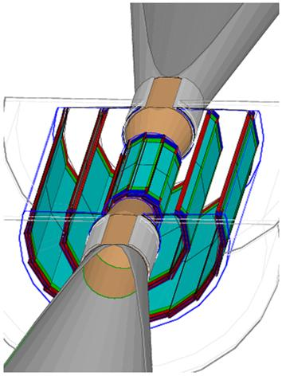
FPCCD Vertex Detector
Large amounts of e⁺・e⁻ pair background is generated at beam collision.
For low pixel occupancy, we develop Vertex Detector adopt fine pixel CCD sensor.
FPCCD Vertex Detector
Fine Pixel CCD
Pixel size ： 5μm × 5μm
Epitaxial layer thickness：15μm
20,000 ×128 pix/ch
# of channels ~ 6,000ch
Double layers ： CCDs are attached on two sides of the ladders.
Readout ASIC for FPCCD is developed.
e⁺
e⁻
^{γ}
e⁻
e⁺
e⁺
^{γ}
e⁻
120mm

Slide 3
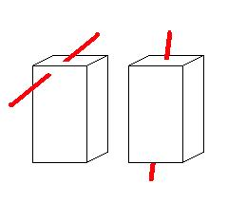
Requirements to readout ASIC
Power consumption < 6 mW/ch
Setting in a cryostat
Total power consumption < 100W
Readout rate > 10 Mpix/sec
Read out in the inter-train time
20,000 ×128 pix / 200 ms
Noise level < 30 electrons
Signal becomes small for particles
penetrating with large angle.
Readout ASIC was designed to satisfy these requirement.
~1ms
~200ms
pixel
Signal is small

Slide 4
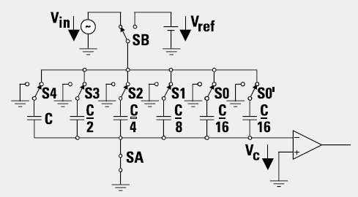
Solution of Requirements
Power consumption < 6 mW/ch
ADC is the main power consumption source.
For suppressing power consumption at ADC, charge sharing ADC is used.
Signal is converted by comparing
the reference voltage with a capacitor.
Power consumption of ADC < 10μW/ch
Readout rate > 10 Mpix/sec
It is difficult to operate charge sharing ADC with high-speed
Two 5MHzADC are used alternatively.
10Mpix/sec
Estimated noise level < 30e

Slide 5
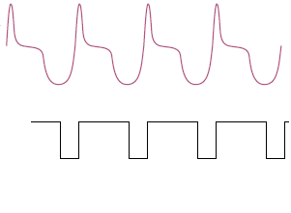
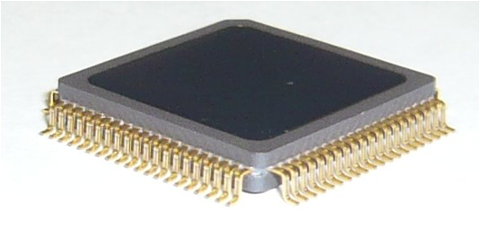
Test sample of readout ASIC
sampling
Design of prototype ASIC
Amplifier
Low pass filter (LPF)
Correlated double sampling (CDS)‏
sample backward and forward of pixel data
output voltage difference at sampling points
Charge sharing ADC×2
Serial output
Test sample
0.35μm TSMC process
Chip size ： 2.85 mm × 2.85 mm
# of channels : 8
Package : QFP-80 pin
CCD output
CDS output
ADC
CCD
AMP
LPF
CDS
output
ADC
package
14mm
14mm
The performance of a test sample was checked

Slide 6
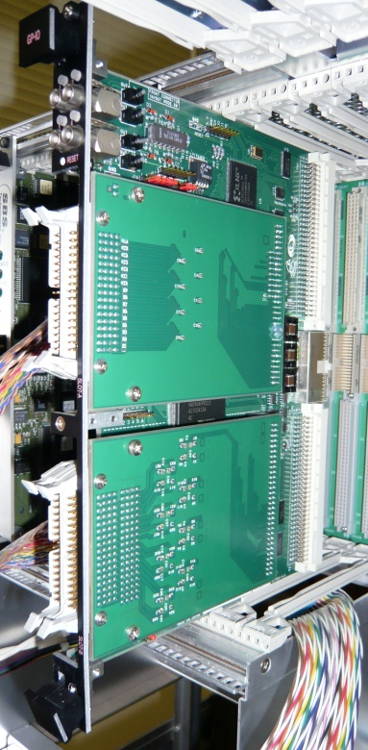
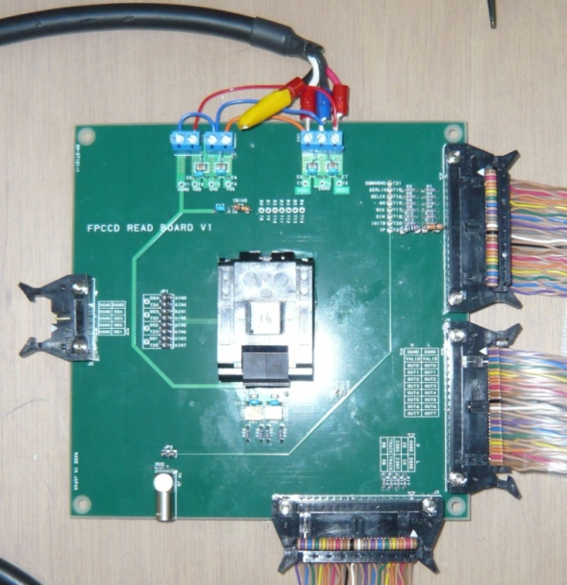
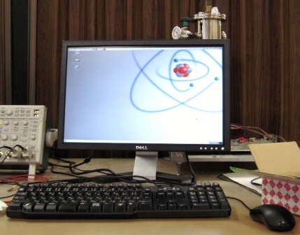
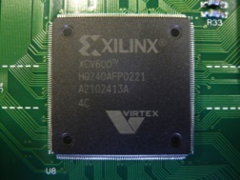
Test bench
Data acquisition and circuit control are done by a VME module.
GNV-250 module
The control logic was implemented into FPGA.
The test job and parameter setting are controlled by PC.
ADC output is stored on FIFO embedded in FPGA, and sent to PC.
Test board
GNV-250
PC
Parameter setting
control
Data
Data
ASIC
Operation signal
FPGA
Test pulse

Slide 7
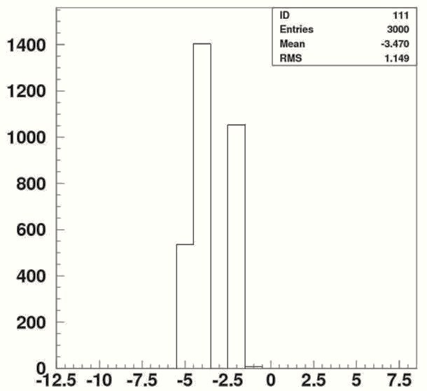
Pedestal distribution
Pedestal distribution was checked
Conversion rate ~1.5 Mpix/sec
Pedestal distribution
Some ADC counts are not output.
The reason was investigated.
Next slide
Noise level
RMS = 1.1
Equivalent noise charge at sensor input ⇒ ~45e (Requirement:30e)
Temperature dependency was checked.
After the next slide
ADC count

Slide 8
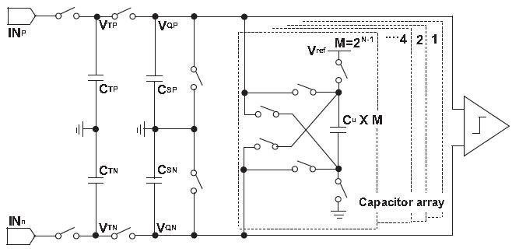
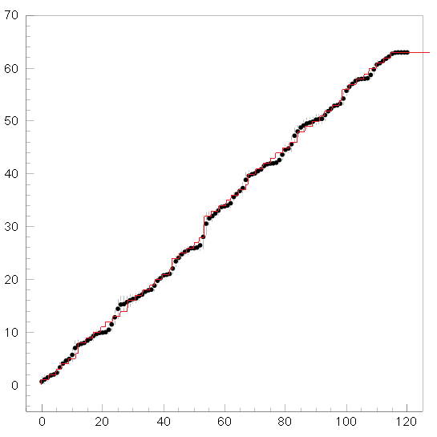
Problem of ADC design
ADC output was simulated by MATLAB.
Simulation result of enlarged capacity of ADC capacitor is consistent with measurement.
Charge sharing ADC
Test chip measurement and simulation
ADC count
● : measurement
: Simulation
of enlarged capacity
The floating capacitance at the switching circuit in the ADC unbalanced the ADC capacitor ratio.
The switching circuit was designed again.
Input voltage(mV)

Slide 9
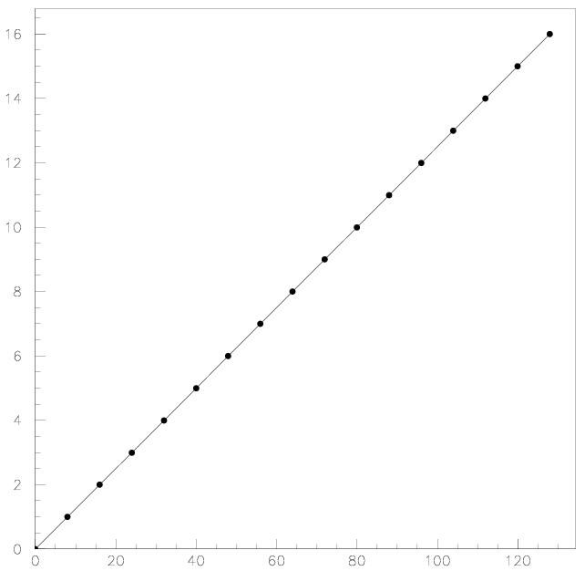
New circuit
ADC output was checked by simulation with new switching circuit.
New circuit has no problem, and is adopted to the next sample.
Test chip measurement and simulation
New circuit simulation
ADC count
ADC count
● : measurement
redesign
: Simulation
for enlarged capacity
Input voltage(mV)
Input voltage(mV)

Slide 10
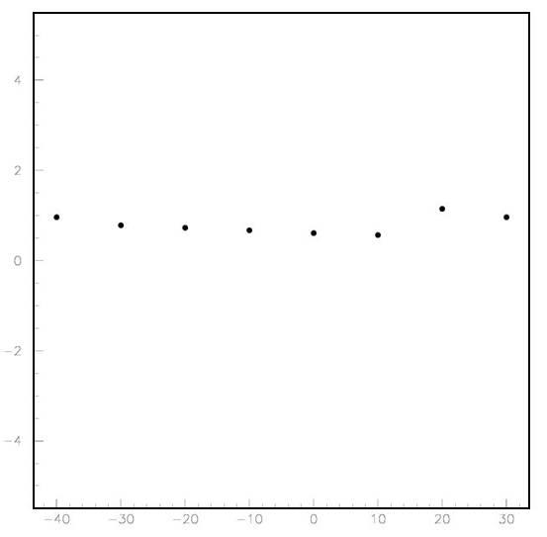
Temperature dependency of Pedestal
The pedestal distribution was measured for various temperature.
The main fluctuation of RMS comes from effect of the missing ADC counts.
The temperature dependency is smaller than the RMS fluctuation.
The temperature dependency will be studied with the next sample.
4
RMS（ADC count）
0.6
0
-4
-40
-20
0
20
temperature（℃）

Slide 11
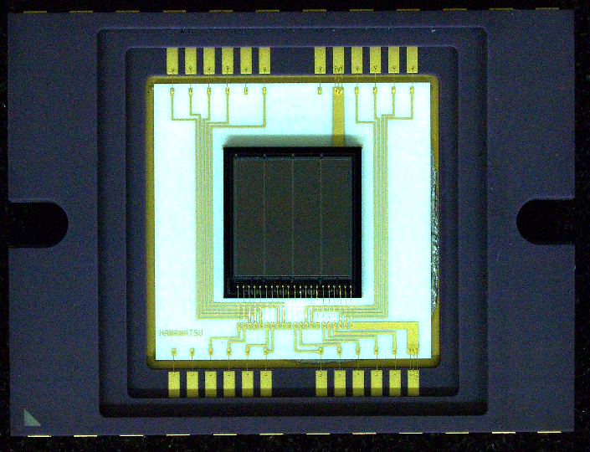
Fine Pixel CCD sample
Test sample to establish technology
Pixel size：12μm × 12μm
Epitaxial layer thickness：15μm
# of readout channels：4ch
512 × 128 pix/ch
128pix
512pix
FPCCD and readout ASIC were connected.
The control logic for CCD was also implemented on FPGA.
GNV-250
data
data
ASIC
FPCCD
data
FPGA
PC
control
control

Slide 12
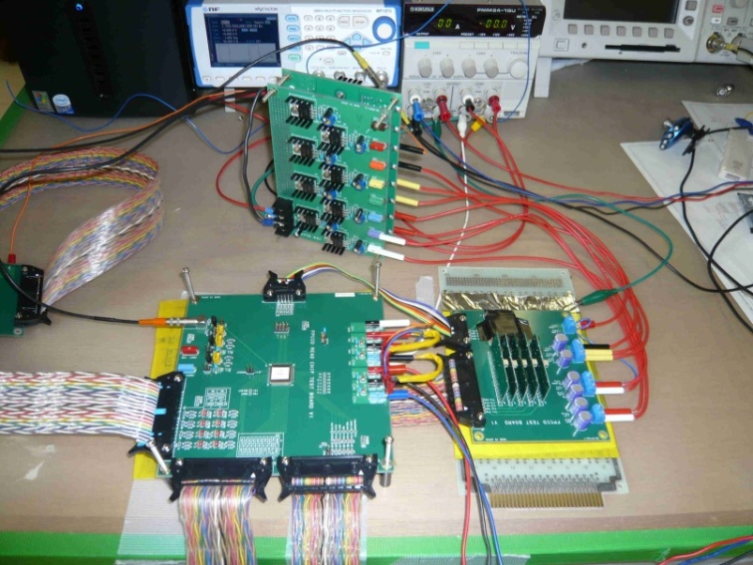
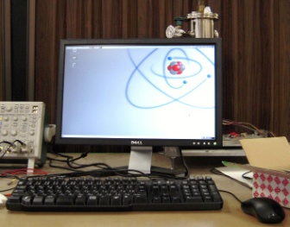
FPCCD readout
GNV-250
PC
Parameter setting
Control
CCD
ASIC
Operation signal
Data
Data
512×128 pix/ch × 4ch
⇒ ~260,000pix
slow（~10kbps）
Speed transmission of VME module to PC is slow.
ADC output is temporarily stored in FIFO.
By limit of FPGA capacity, all the data cannot be stored.
ADC data were converted to 1bit.
Threshold : 30

Slide 13
FPCCD reaction for light
Response of FPCCD to the light was checked.
1channel(512×128 pixel)
Response of FPCCD to the light emission can be observed.
The image will be read as the next step.
Black ： do not react
White ： react
Light shielding
No shielding

Slide 14
Summary
We developed FPCCD vertex detector
Requirement for readout ASIC
Power consumption < 6mW/ch
Readout rate > 10Mpix/sec
Noise level < 30e
Pedestal check for readout ASIC sample
Noise level ～ 45e
Some ADC count are not output.
switching circuit was designed again.
Temperature dependency of ASIC cannot be observed because of missing ADC.
examined next sample
FPCCD sample readout
By limit of FPGA capacity, all pixel cannot read out.
ADC data were converted 1bit.
Readout ASIC can read out FPCCD data
Next step is readout image
Readout board can read out all pixel is developed and tested.

Slide 16
Buck up

Slide 17
Power consumption of LVDS
Differential voltage : 350mV
Resistor : 100Ω
Power consumption : (350mV)² / 100Ω = 1.2mW
Below 6mV

